Slide 1
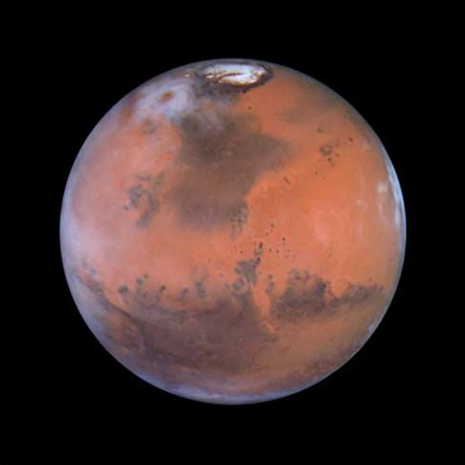
Water on Mars

Slide 2
Mars is full of cool surface features
Lets look at some!
(all images credit: Mike Sussman)

Slide 3
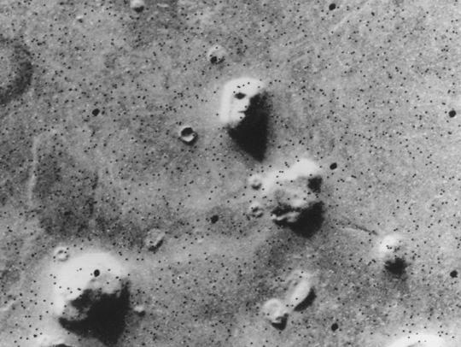
The famous “Face on Mars”

Slide 4
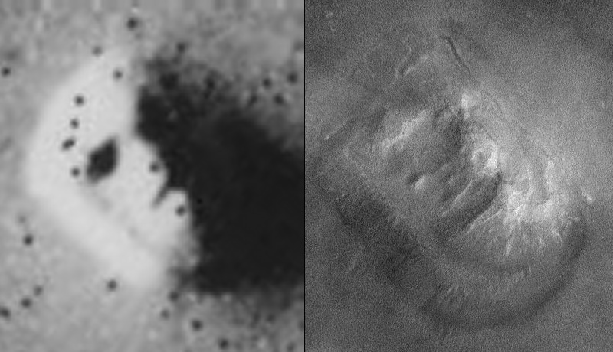
Now don’t get all excited…

Slide 5
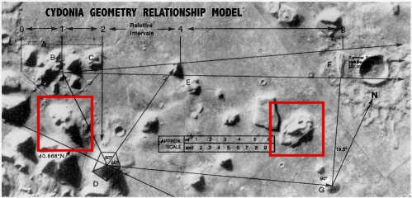
How Come We Missed These?

Slide 6
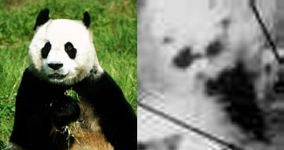
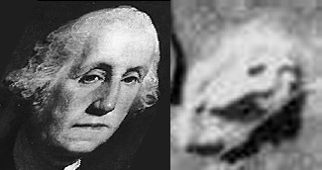
Look harder!
The Panda!
George Washington Screaming!

Slide 7
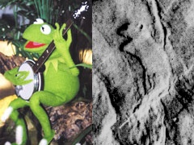
Kermit the Frog!

Slide 8
Surface Water Flow Features
Geological features suggest that at some point water must have flowed on the surface of Mars
Why? Look like water features on Earth!
Characterized by…
  Dendritic vs. Anastomosing Drainage
  Fast Formation vs. Slow Formation

Slide 9
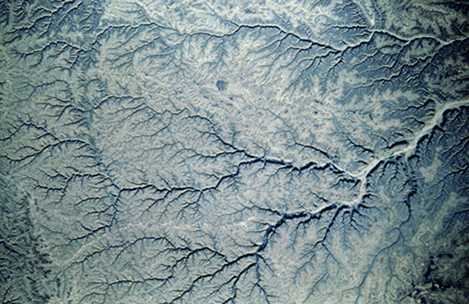
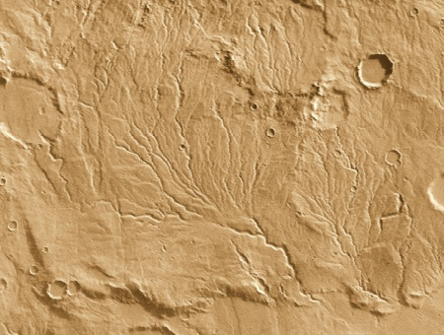
Dendritic Patterns
River in Yemen
Dry Riverbed on Mars

Slide 10
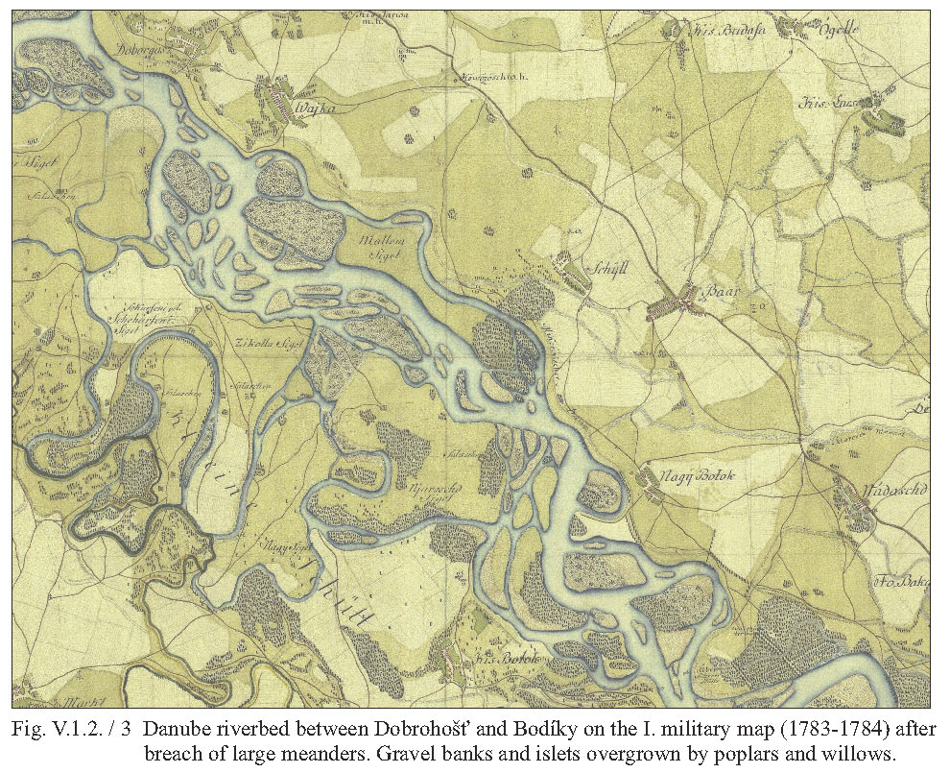
Anastomosing:
Branching and then Reconnecting

Slide 11
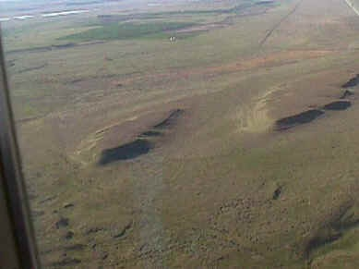
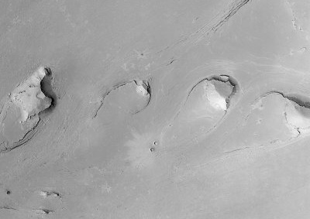
Islands in Anastomized Streams

Slide 12
Fast vs. Slow Formation
Anastomosing drainage usually the result of a flood event
Dendritic drainage usually caused by erosion over time
So… Which forms more “quickly”
Note that there is some wriggle room in geomorphology… It does what it wants.

Slide 13
What Are We Doing Today?
Characterizing some features on Mars
Figuring out how much water must have flowed to create features using a lil’ guesstimation
Figuring out how old features are (CRATER COUNTING!)

