Slide 1
First, a few orders of business…

Slide 2
Experiment #6:
The Orbit of Mercury

Slide 3
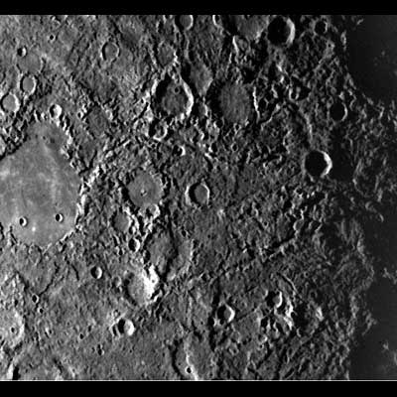
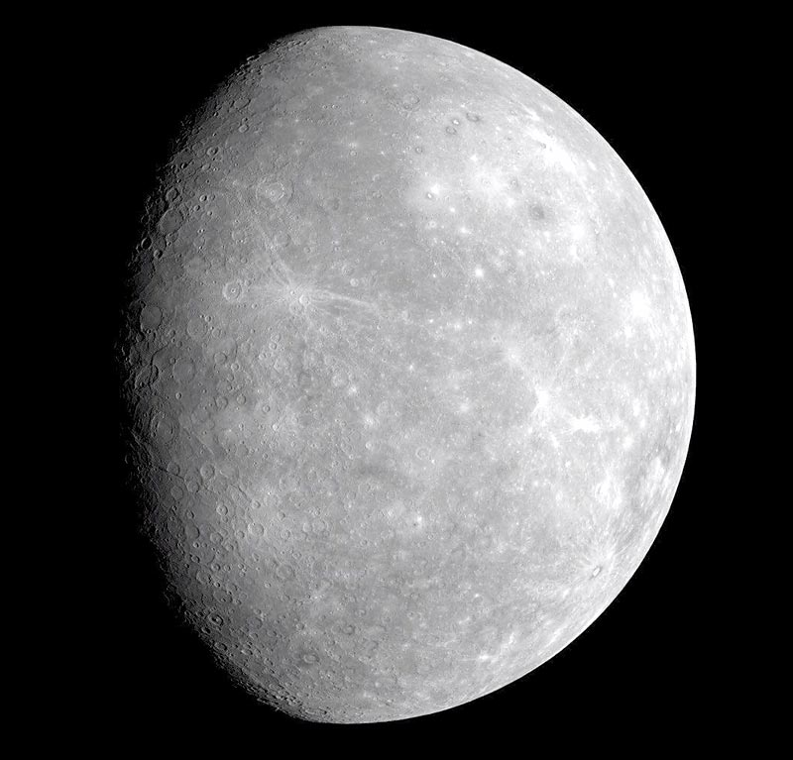
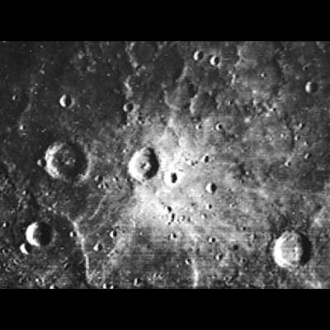
“A Dead, Inert World”

Slide 4
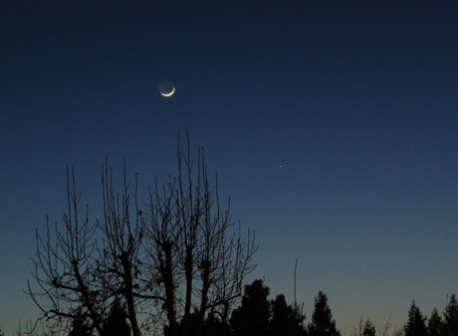
Greatest Eastern and Western Elongations
Times when Mercury has greatest angular separation from the Sun in the sky
Rises/sets ~2 hours before/after the Sun, so we can actually see Mercury!

Slide 5
Why Do We Care?
Can’t generally tell where interior planets are hanging out… There is a contrast problem!
Where do you think those numbers in your textbook came from?
Let’s figure out the orbit of Mercury!!

Slide 6
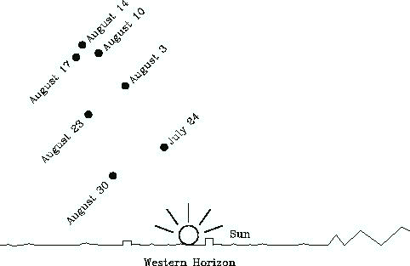
What This Looks Like in the Sky

Slide 7
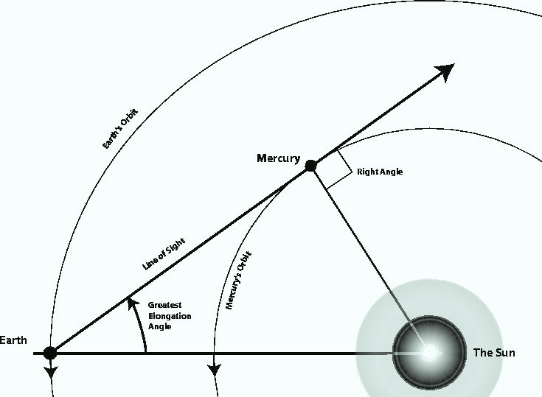
What This Looks Like to God

Slide 8
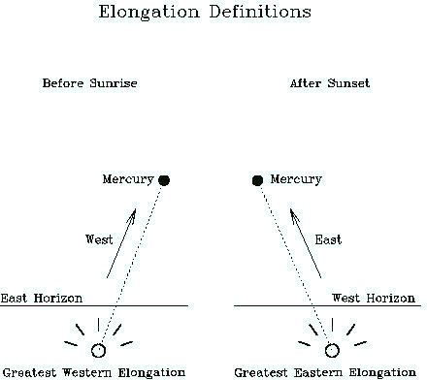
Western Elongation: to the RIGHT of the Sun
Eastern Elongation: to the LEFT of the Sun

Slide 9
On To Business…
You will plot table 6.1 on the Elongations of Mercury, thus tracing its orbit
Remember Earth moved around Sun (about 1 degree per day) while these measurements were taken, so swing your protractor around to match this rotation
Hint: Label your points

Slide 10
Ways to lose all 28 points for the plot
Turning in a sloppy plot, including:
  Drawing Lines Using pen instead of pencil
  Not drawing straight lines
Getting the points we plot together wrong
Confusing eastern and western elongations

