Slide 1
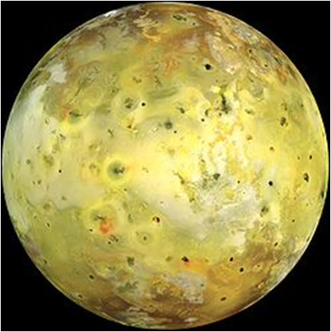
Heat Loss from Io

Slide 2
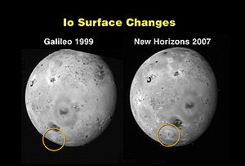
What’s an Io?
Io is one of Jupiter’s largest moons
Most volcanically active body in the solar system
Reshapes itself at least every 8 years =>

Slide 3
What’s a Blackbody?
Technically, refers to light in a thermodynamic equilibrium (???) but for us:
Anything governed by the following laws:
Let’s look at a picture…

Slide 4
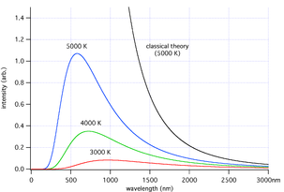
A Blackbody Curve

Slide 5
WTH does this have to do with Io?
The surface of Io can be modeled as a blackbody!
We can use those laws to figure out how hot this moon 598 392 000 kilometers away is!
Our goal for today: determine the temperature of different regions of Io using blackbody laws

