Slide 1
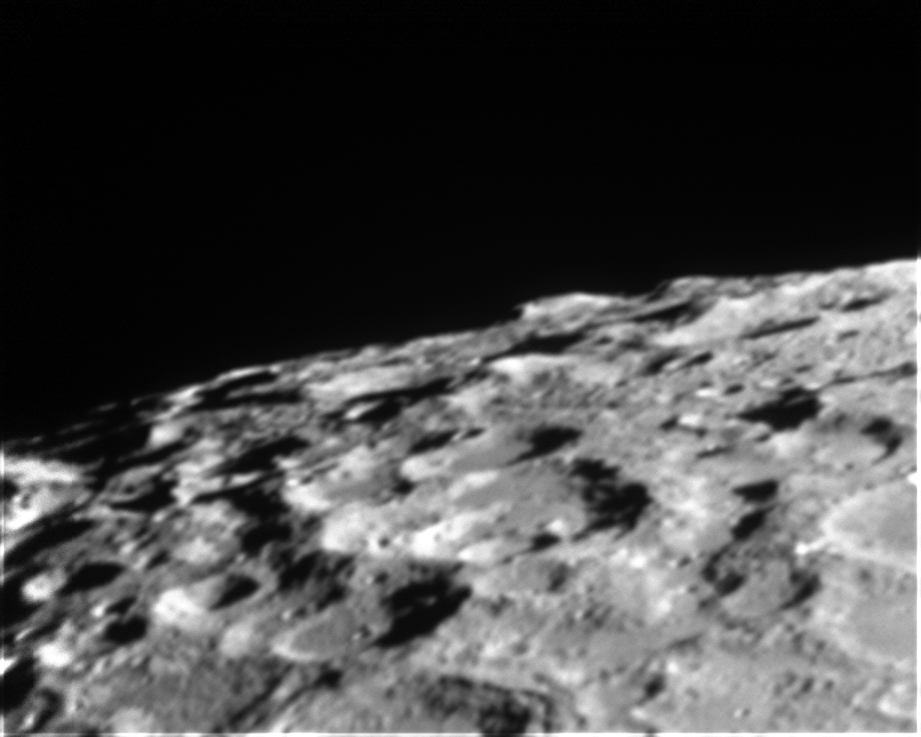
Experiment 11:
The Surface of The Moon

Slide 2
Why Does the Moon Look that Way?
First, a meteor impacts lunar surface.
This displaces part of the Moon’s surface, pushing it up higher than the rest
Other material spreads away from edge: rays
Sometimes, molten rock falls back in to center of crater creating an isolated mountain or central peak
Maria: special consideration…

Slide 3
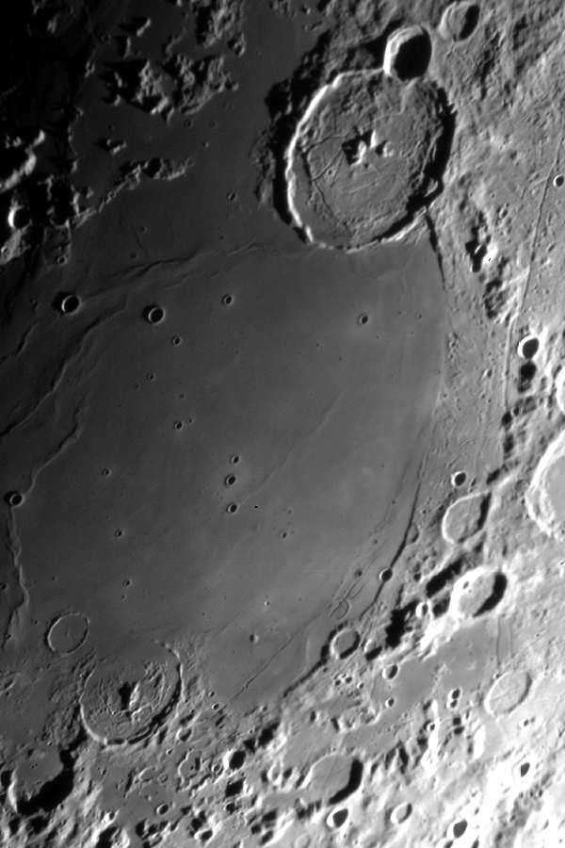
Maria
If it’s a particularly big meteor, the impact cracks open the Moon’s crust
Lunar magma! It seeps out through cracks and fills in crater, creating a smooth, dark sea.

Slide 4
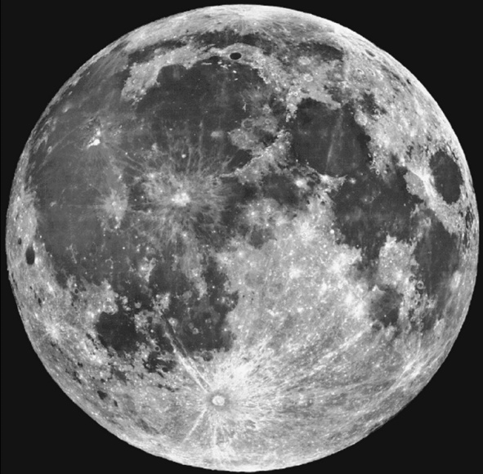
Name the Features

Slide 5
So How Old is This Stuff?
No erosion on moon…
Assuming a constant rate of meteor impact, the more craters a thing has, the older it is

Slide 6


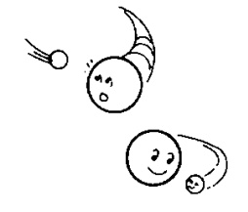
How Did the Moon Form?
Some Theories…
Theories of Moon formation.
SISTER THEORY
Moon formed right alongside Earth
FISSION THEORY
Earth was spinning so fast, Moon spun off
CAPTURE THEORY
Earth gravitationally captured a passing asteroid

Slide 7
Giant Impact Theory
A large body smashed into Earth! BAM!
Resulting impact melted surface of Earth and sent material flying into space
Most of this stuff was from crust and mantle
This stuff eventually coalesced into the Moon
WHY DO SCIENTISTS BELIEVE THIS?
CHEMICAL COMPOSITION OF MOON!

