Slide 1
Building a comet

Slide 2
What’s a Comet Made of?
“dirty snowball” model
Composed of :
  Ices: water, CO₂ and others
  Gases: water, CO_{2,} CO, O₂ and some simple organics
  Tiny dust particles (organic and inorganic)

Slide 3
Components of a Comet
Gas or Ion Tail
Dust Tail
Coma
Nucleus
THE SUN!

Slide 4
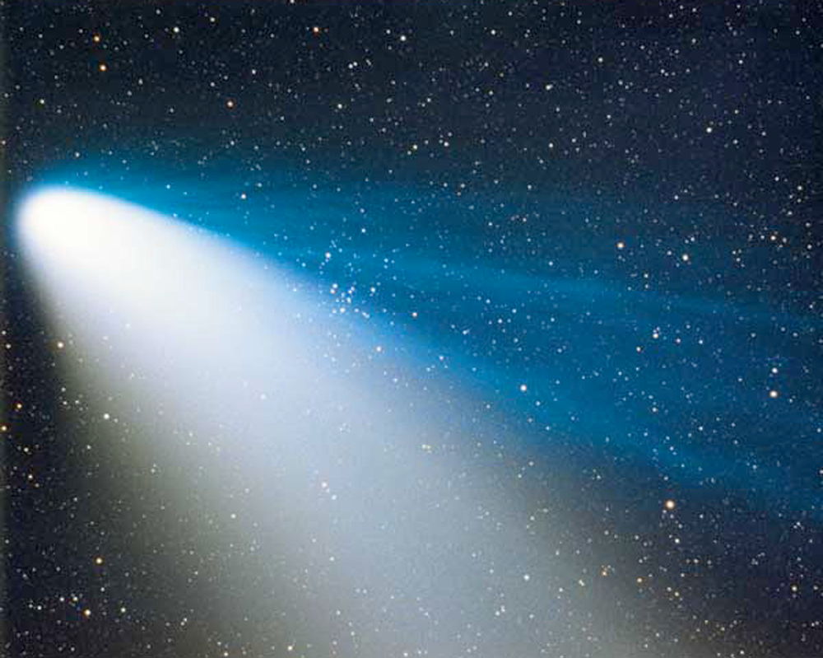

Slide 5
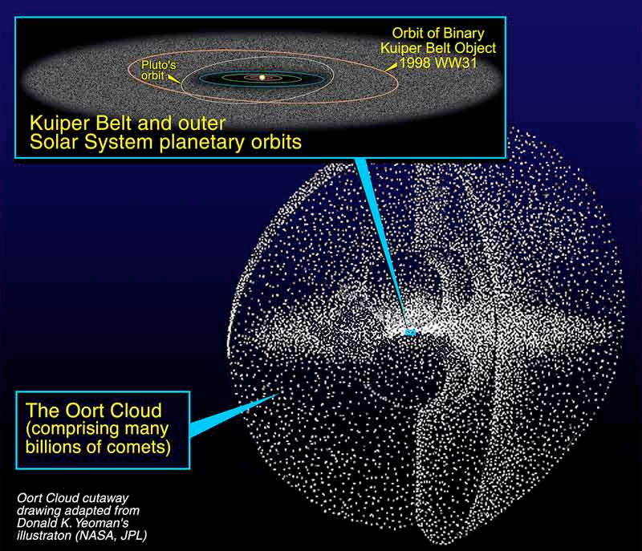
Where do Comets Come from?

Slide 6
All Comets Go to Heaven
Comets don’t last forever…
The ice on short range comets eventually melts away
Long range comets may leave solar system altogether
Either may slam into a larger body (internal strength…)

Slide 7

When a “dirty snowball” slams into something
pwnt

