Slide 1
ASTR 535 : Observational Techniques
Fall 2021 : class sessions

Slide 2
8/18
Intro

Slide 3
Topics 8/23
Questions
properties of light and quantities astronomers measure
  Basic quantities
  Electromagnetic spectrum
magnitudes

Slide 4
Discussion: flux, surface brightness, and luminosity
Describe these qualitatively
What are the dimensions?
Which quantities are relevant for what astronomical objects?
How do they depend on distance?

Slide 5
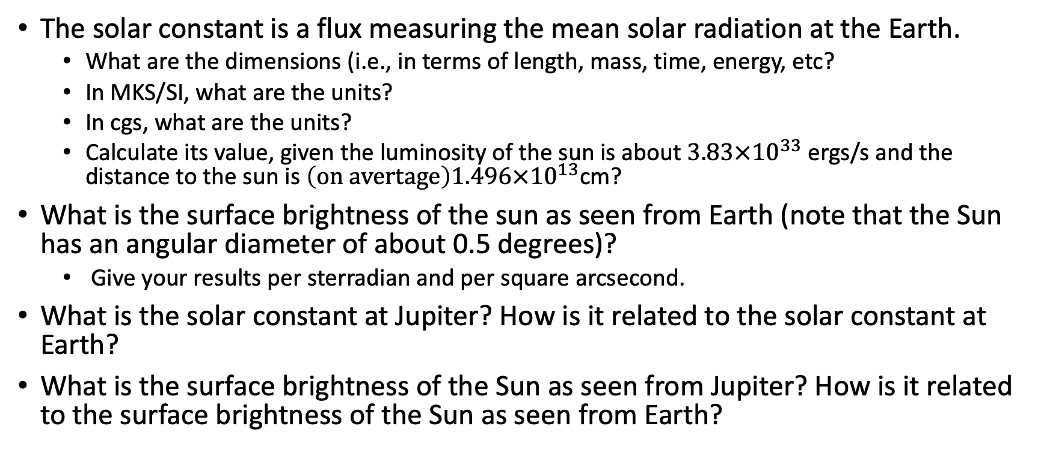
Problem : solar flux and surface brightness
The solar constant is a flux measuring the mean solar radiation at the Earth.
  What are the dimensions (i.e., in terms of length, mass, time, energy, etc?
  In MKS/SI, what are the units?
  In cgs, what are the units?
  Calculate its value, given the luminosity of the sun is about $3.83×{10}^{33}$ ergs/s and the distance to the sun is $\left(on avertage\right)1.496×{10}^{13}$cm?
What is the surface brightness of the sun as seen from Earth (note that the Sun has an angular diameter of about 0.5 degrees)?
  Give your results per sterradian and per square arcsecond.
What is the solar constant at Jupiter? How is it related to the solar constant at Earth?
What is the surface brightness of the Sun as seen from Jupiter? How is it related to the surface brightness of the Sun as seen from Earth?

Slide 6
Light and the electromagnetic spectrum
What are different types of light?
By what quantities are they characterized?
How are these quantities related?

Slide 7

Problem : monochromatic flux
The monochromatic flux of Vega at 5500 A is $F_{λ}$=3.63x${10}^{−9 }$ergs/cm^2/s/A
Calculate the monochromatic flux $F_{ν}$ in units of ergs/cm^2/s/Hz?

Slide 8
Discussion: magnitudes
Why use magnitudes?
How are magnitudes defined?
How does this apply to the relative brightnesses of two objects?
What is the relative brightness of two objects, m1=2,m2=9.5?
What is the relative brightness of two objects,m1=12, m2=19.5?
What is the magnitude difference between two objects that differ in brightness by a factor of a million?
What does the ratio of two magnitudes indicate?
What mathematical operations might you expect to use with magnitudes and which ones not)?
What quantities do apparent and absolute magnitude correspond do (flux, surface brightness, or luminosity?)

Slide 9
Problem : binary stars
A binary star system consists of two stars of equal brightness. If the magnitude of one star is m, what is the combined magnitude of the two stars, i.e., if they were observed as an unresolved system?
Roughly half of the stars in our Galaxy are in binary systems. What effect do you think this has on a HR diagram of a star cluster?
Imagine you are observing a binary star system, but where the stars are so close together that you see them as a single object. If the two stars have magnitudes of 17 and 18 individually, what is the combined observed magnitude?
Write a (short!) software function that takes as input the apparent magnitude of each of two stars, and computes and returns the apparent magnitude of the two stars combined.

Slide 10
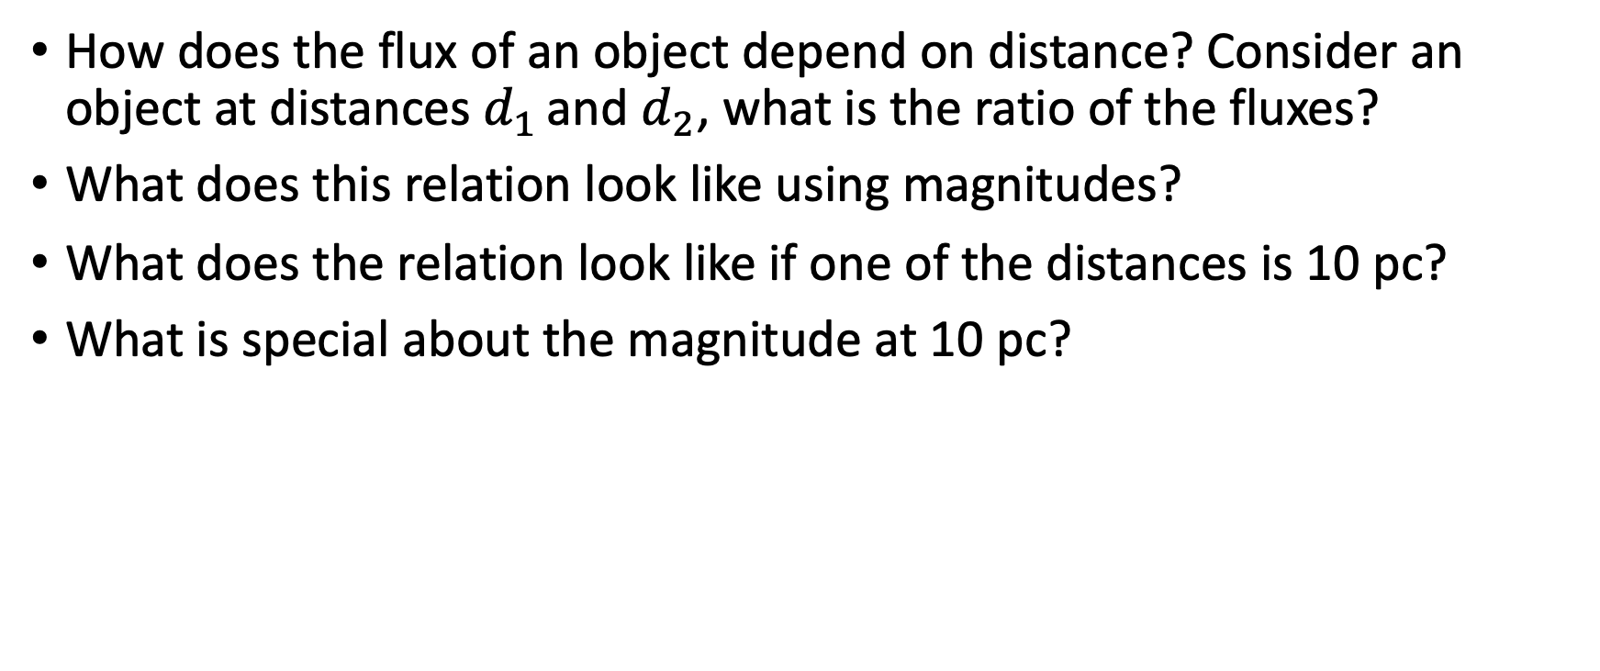
Problem: flux and distance
How does the flux of an object depend on distance? Consider an object at distances $d_{1 }$and $d_{2}$, what is the ratio of the fluxes?
What does this relation look like using magnitudes?
What does the relation look like if one of the distances is 10 pc?
What is special about the magnitude at 10 pc?

Slide 11
Topics 8/25
Questions on problems and/or lecture videos
Magnitude systems
Magnitude-flux conversion
colors

Slide 12
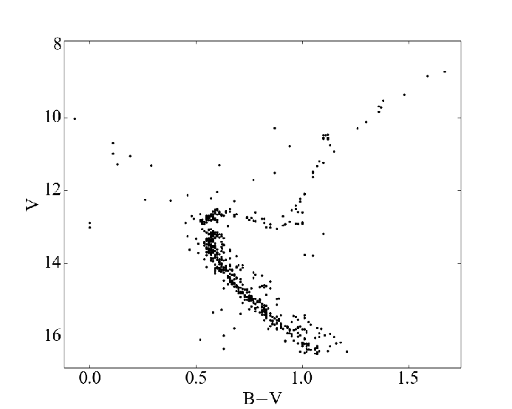
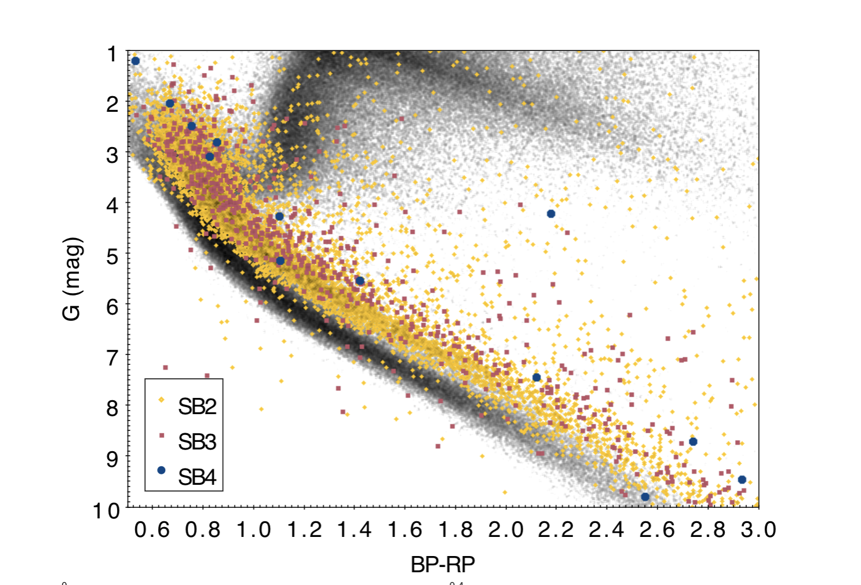
Binaries and the HR diagram
M67
GAIA with APOGEE SB2s
Geller et al 2015
Kounkel et al 2021

Slide 13
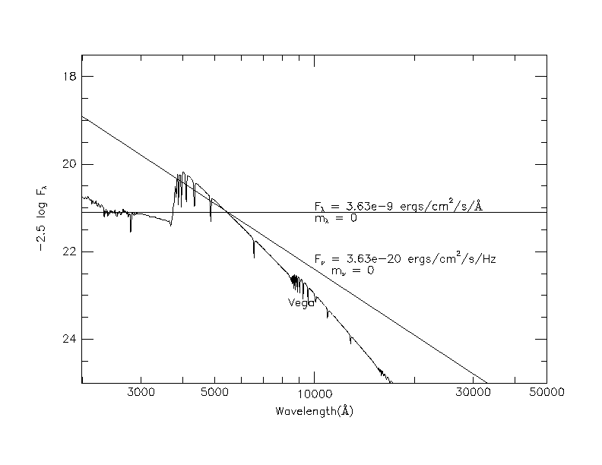
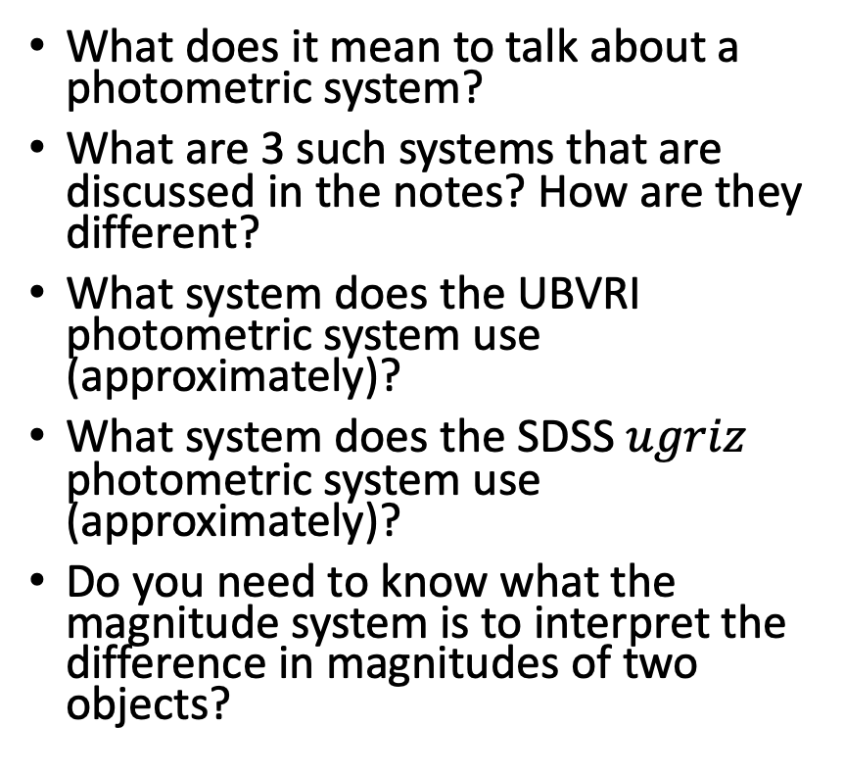
Discussion: magnitude systems
What does it mean to talk about a photometric system?
What are 3 such systems that are discussed in the notes? How are they different?
What system does the UBVRI photometric system use (approximately)?
What system does the SDSS $ugriz$ photometric system use (approximately)?
Do you need to know what the magnitude system is to interpret the difference in magnitudes of two objects?

Slide 14
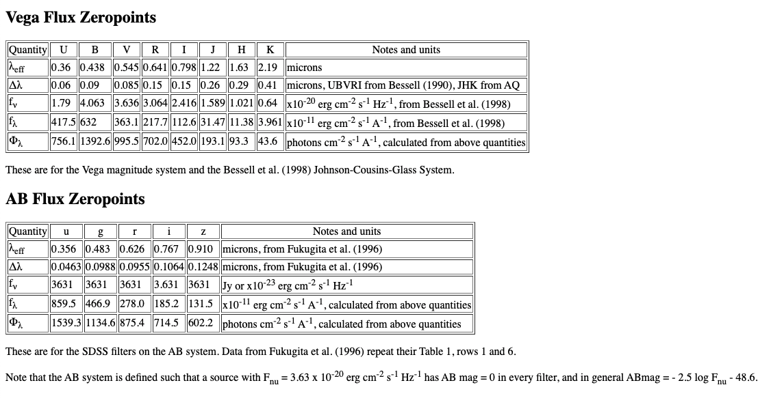
From magnitudes to fluxes
Astrophysics computes fluxes, so to compare to observed magnitudes, need to convert one way or another
  If astrophysics computes a spectrum, straightforward to derive magnitude
  Going from magnitude to flux can be done, but note subtlety depending on SED
    Table with fluxes corresponding to 0 magnitude
    Note subtlety depending on spectral energy distribution (SED), e.g. WISE
How would you calculate the apparent V magnitude of the Sun? The absolute magnitude?

Slide 15
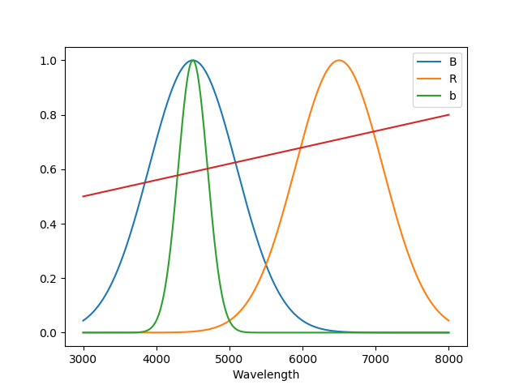
Discussion: colors
Colors expressed in magnitudes: what do B-V=0, g-r = 0 imply?
  Do we need to know what the photometric system is to interpret colors, i.e., differences of magnitudes at two wavelengths?
Narrowband vs broadband:
For the adjacent figure, let’s say you do photometry of the star with the red SED through the B(shown in blue) and R (shown in orange) filters, and you find that star has a B-R=1.0
You also make a measurement using the b (shown in green) filter, which uses the same photometric system zeropoint. What approximate value do you expect for b-R?

Slide 16
Questions: STMAG and ABNU systems
STMAG monochromatic magnitudes are defined as 𝑚_{𝑆𝑇𝑀𝐴𝐺}=−2.5log𝐹_{𝜆}−21.1, for 𝐹_{𝜆} in ergs/cm²/s/A
ABNU monochromatic magnitudes are defined as: 𝑚_{𝐴𝐵}=−2.5log𝐹_{𝜈}−48.6 for 𝐹_{𝜈} in ergs/cm²/s/Hz
1. Given that these systems are approximately normalized to the flux of Vega at 5500 A (3.63x10⁻⁹ ergs/cm²/s/A), where do the constants (-21.1 and -48.6) come from?
2. Derive a relation between STMAG and ABNU mag, i.e., the difference between monochromatic magnitudes in the two systems as a function of wavelength. Be careful about units.

Slide 17
Questions: magnitude –flux conversion
1. Using the effective wavelengths and Vega flux zeropoints from Bessell et al (1998), e.g. as tabulated at http://www.astronomy.ohio-state.edu/~martini/usefuldata.html, write a software function that will take as input an array of observed UBVRI magnitudes and return three arrays, giving the effective wavelength, and 𝐹_{𝜈} and 𝐹_{𝜆} of the object at the effective wavelengths of the UBVRI filters.
2. A star has the following apparent magnitudes in the UBVRI system. Use your routine to complete the following table and to plot the derived spectral energy distribution (SED). Remembering (or looking up) Wien's law, estimate the effective temperature of this star!
Bandpass | Magnitude | F_{𝜈} | F_{𝜆} | 𝜆_{eff}
U | 16.74
B | 16.86
V | 16.17
R | 15.72
I | 15.28

Slide 18
Topics 8/30
How are things going?
Wed lecture videos
APO trip
Questions on problems and/or lecture videos
Count equation
Photometry: zeropoints and transformation coefficients

Slide 19
Observed fluxes and the signal (count) equation
How is what we observe related to what objects emit?
The “signal (count) equation”
  What are the terms?
  How well do we know them?
Can we use the signal equation to measure accurate fluxes?
What can we use it for?

Slide 20

Signal equation
$S= Tt ∫Fλ\frac{λ}{hc}aλmλiλfλdλ dλ$
We can define the observed photon flux, S’:
S’ = $∫Fλ\frac{λ}{hc}aλmλiλfλdλ dλ$
S = S’ T t
What are the units of S? S’? S’T?

Slide 21
Signal equation
What is the photon flux from Vega at 5500 A?
F_{𝜆} = 3.63e-9 ergs/cm²/s/Å
Using a spectrograph which gives 1 A/pixel on a 1m (diameter) telescope, you count 10000 photons/A at 5500 A in a 1000 s exposure for a star with V=10. What is the throughput of the system?

Slide 22
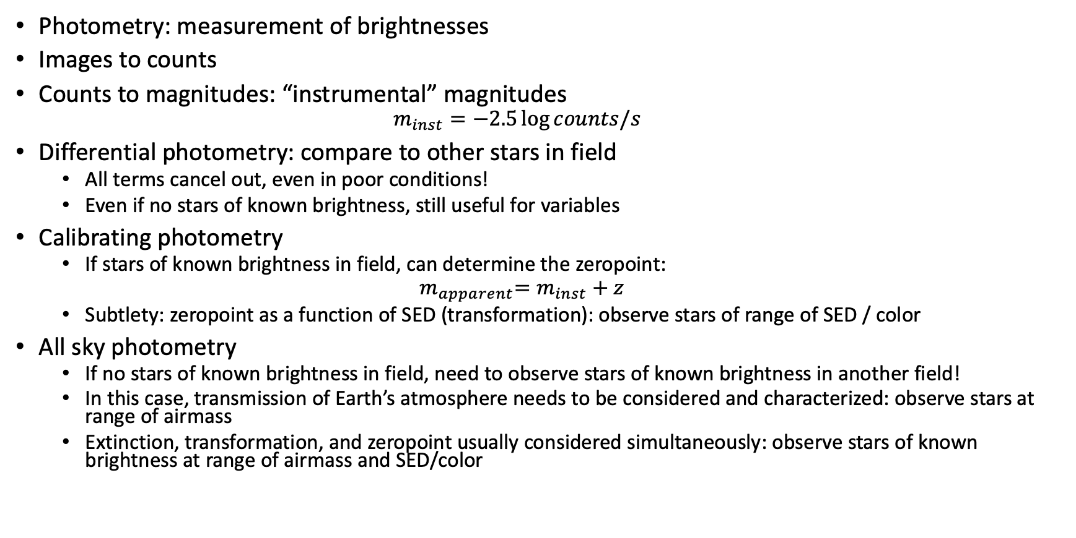
Calibrating observations of brightness
Photometry: measurement of brightnesses
Images to counts
Counts to magnitudes: “instrumental” magnitudes
  $$m_{inst}=−2.5\log{counts/s}$$
Differential photometry: compare to other stars in field
  All terms cancel out, even in poor conditions!
  Even if no stars of known brightness, still useful for variables
Calibrating photometry
  If stars of known brightness in field, can determine the zeropoint:
  $${ m}_{apparent}=m_{inst}+z$$
  Subtlety: zeropoint as a function of SED (transformation): observe stars of range of SED / color
All sky photometry
  If no stars of known brightness in field, need to observe stars of known brightness in another field!
  In this case, transmission of Earth’s atmosphere needs to be considered and characterized: observe stars at range of airmass
  Extinction, transformation, and zeropoint usually considered simultaneously: observe stars of known brightness at range of airmass and SED/color

Slide 23
Zeropoint
Two telescope systems have zeropoints of 22 and 24, respectively. Which one would you prefer to use?

Slide 24
Photon flux and the signal equation
The monochromatic flux of Vega at 5500 A is 𝐹_{𝜆}=3.63x10⁻⁹ ergs/cm²/s/A.
1. What is the monochromatic photon flux (photons/cm²/s/A) from Vega at 5500 A?
2. a. Estimate the number of photons/second you would receive for a star with a flat 𝐹_{𝜆} spectrum with V=20 using the TMO 0.6m (diameter) telescope, assuming that the atmosphere transmits 80% of the light, and that the combined detection efficiency of the telescope and detector is 50 percent, independent of wavelength. You can assume that the V bandpass is rectangular with a central wavelength of 5500 A, a full width of 850 A, with an in-band transmission of 80 percent.
b. Given your derived count rate, what is the zeropoint (Z) for the V bandpass for the 0.6m?

Slide 25
Photometric transformations
You observe three stars in the V filter. Two of them have known magnitudes and colors, while the third is unknown.
Star | V | B-V | V exposure time (s) | V total counts | B exposure time | B total counts
A | 16 | 0 | 10 | 10000 | 20 | 6000
B | 17 | 1 | 10 | 4000 | 20 | 1000
C | ? | ? | 10 | 2600 | 20 | 700
1. What are the zeropoint and transformation coefficients for the B and V filters? (Note that you can do polynomial fits using numpy.polyfit() )
2. What are the B and V magnitudes of star C? (Note that you can do linear algebra with numpy.linalg() , e.g., numpy.linalg.solve() .)

Slide 26
Examples: photometric data
Start a browser
Go to Canvas home page, click on Photometry link
Download Jupyter notebook phot_fill.ipynb
Start it:
jupyter notebook phot_fill.ipynb (--browser=firefox)
Work through the cells one at a time, making sure you understand everything that is happening in the cell. Execute a cell using Shift-Enter
Ask questions!
Some cells require you to add input!

Slide 27
Exposure time calculator: part one
Let’s design a modular program to apply the count equation
Given a magnitude and unnormalized SED, or input spectrum and a telescope/instrument, return estimate of observed photons, either as a function of wavelength (spectrograph) or number(s) for given filter(s) (imager)
What functions do we need?
  Function to return f(lambda) given input mag, spectrum
  Function to return collecting area given observatory/telescope
  function to return telescope transmission: tel(lambda), combine with previous?
  Function to return atmos(lambda) given observatory
  Function to return inst(lambda) given instrument
  Function to return filt(lambda) given instrument/filter(s)
  Function to return det(lambda) given instrument
  Function to integrate
How would we test this?

Slide 28
Other points
Photon fluxes
Converting UBVRI magnitudes to fluxes and vice versa
SDSS and asinh magnitudes

Slide 29
Topics 9/1
APO trip : 10/29-10/31, rough schedule
Questions
Probability distribution functions
Application to observational uncertainties
Exposure time calculator: signal equation

Slide 30
Probability distribution functions
What is a PDF, esp in the context of observational techniques?
  What are some statistics that are often used to characterize a PDF?
Population statistic vs sample statistics
  Robustness and efficiency

Slide 31
Poisson distribution
What is it a function of? What is the analytical form?
What does it look like?
What is the mean?
Standard deviation?
What is the application in observational techniques?

Slide 32
Poisson statistics
You collect 10000 photons with an instrument on the 3.5m. What’s the uncertainty (standard deviation)?
You collect 10000 photons with an instrument on the 0.6m. What’s the uncertainty (standard deviation)?
You collect 100000 photons with an instrument. What’s the uncertainty? Is the better or worse than the 10000 photon case?
What fractional uncertainties (uncertainty / signal) do these correspond to?
You collect 100 photons/second with some instrument. How long to you have to expose to reach the same fractional uncertainty as the first two above?

Slide 33
Gaussian (normal) distribution
What does it look like?
What is the mean?
What is the standard deviation?
What is the application in observational techniques?

Slide 34
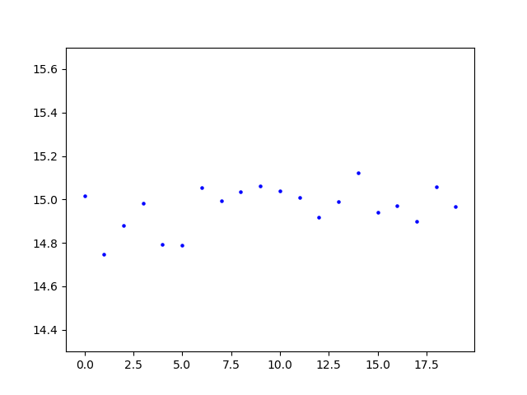
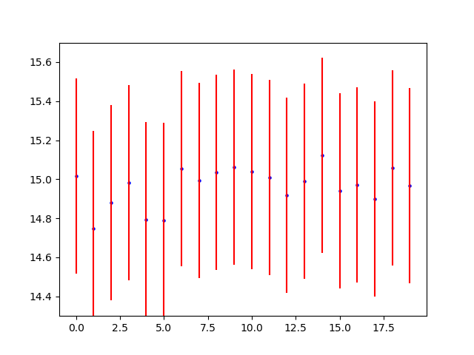
Importance of uncertainties: applications
Exposure time calculation
Probability of single measurements
  Gaussian: error function and typical values
Probability of a series of measurements
  Chi^2 and reduced chi^2

Slide 35
Exposure time calculator
Given information about source (magnitude and SED) and observational setup (telescope, instrument, etc.), how long do you have to observe to achieve a desired fractional uncertainty?
  What photon flux does the source produce?
  How long to achieve desired fractional uncertainty? Depends not only on source photon flux, but also on:
    Sky flux
    Instrumental noise
Start with first piece: what photon flux does the source produce?
  Spectroscopic and photometric applications

Slide 36
Examples
Class problem notebook
https://github.com/APOExposureTimeCalculator/APOExptime) (compiles many data files relevant for APO)

Slide 37
Topics 9/8
APO trip (Monday class)
Week of 9/20
Exposure time calculator
Reading
Questions
Noise equation
Propagation of uncertainties

Slide 38
Noise equation
Without looking it up, what is the ”noise equation” that allows you to calculate the S/N of some data?

Slide 39
Astronomical measurements
Uncertainty, noise, fractional uncertainty, and S/N
Standard noise sources
  Source
  Background : note area term, and importance of dark skies AND good image quality
  Readout noise
Noise equation, assuming perfect background subtraction
What is typical area over which we need to integrate source (and background)?
Where do we encounter different limiting cases?
  Broad band imaging (optical and near-IR), narrow-band imaging, spectroscopy
Limiting cases
  Signal-limited, background-limited, readout noise-limited
  Behavior with signal, exposure time and telescope aperture

Slide 40
Error propagation
Without looking it up, what is the general equation for error propagation?

Slide 41
Problems: noise equation
You observe a bright source that produces 1000 photons in a ten second exposure, with negligible sky background. What is the fractional uncertainty and the S/N of your observation?
You observe a faint source that produces 1000 photons in a ten minute exposure and, in that same time, the sky produces 500 photons that is measured in addition to the object.
  How many total photons (sky+background)? What will the uncertainty on that total be?
  If you assume that you can subtract the sky perfectly (usually you can come close), then the only effect that the background has is in the increased noise. What will be the expected signal to noise of your measurement of the source?

Slide 42
Problems
3. If you are looking at faint, background-limited, stars, how much fainter can you see (i.e., measure at the same S/N) if you have 0.3 arcsec instead of 1.0 arcsec images? Express your answer in magnitudes.
4. Say you have a system that has a photometric zeropoint of 23.5 in the bandpass where you plan to make observations, and you are observing at a site with 1 arcsec seeing, a background of 21 magnitudes per square arcsec with a detector with readout noise corresponding to 5 electrons/pixel, and a plate scale of 0.5 arcsec/pixel.
  a. How long do you need to expose to get a S/N of 100 for a 15th magnitude object?
  b. How long do you need to expose to get a S/N of 50 for a 22nd magnitude object?

Slide 43
Problems: error propagation
1. Using the error propagation formula, derive the expression for the uncertainty in the sample mean, <x> = ∑ x_{i} / N, for the case where the uncertainty on every x_{i} is the same, and given by 𝜎.
2. You observe a source that has a measured photon rate, on average, of 10 photons per second, and take a series of 10 second exposures.
a. how many counts will you observe on average?
b. what will be expected standard deviation if you make a series of measurements?
c. what is the signal-to-noise of each observation?
d. If you average together 10 of the 10s exposures, what is the expected error on this average?
3. You take a single observation and count 1000 photons
a. what is the expected uncertainty?
b. what is the expected uncertainty (in magnitudes) if you convert the counts into an instrumental magnitude?
4. If you observe a source in the B passband and count 500 photons and observe it in the V passband and count 1000 photons. You can assume no background in either measurement.
a. What is the expected uncertainty in the flux ratio, F(B)/F(V)?
b. What is the expected uncertainty in the color difference (in instrumental magnitudes), b-v?

Slide 44
Topics 9/13
Next week
Exposure time calculator
Questions
Averaging and splitting
Random and systematic uncertainties
Digital photometry

Slide 45
Splitting and averaging measurements
1. You make 3 identical observations of the same star.
a. How does the uncertainty on the average compare to the uncertainty on an individual observation?
b. Let's say you observe 90, 100, and 110 photons on three identical exposures. What is the mean and its uncertainty?
c. Let's say you take 3 exposure of different exposure times and get: 90 photons in 1 second, 1000 photons in 10 seconds, 11000 photons in 100 seconds. How would you combine these to get the best estimate of the photon rate (photons / sec)? What value do you get?
2. Let's say you observe a star and count 500 photons total in an aperture of diameter 2 arcseconds, in a 10 second exposure. From a different region, you measure 100 photons per square arcsecond coming from the sky. Let' s say readout noise is negligible.
a. What is the S/N of the measurement?
b. Let's say you need to make the measurement to a fractional accuracy of 1 percent. How long do you need to expose?
c. Let's say you are working with a telescope/instrument/detector that gives pixels that correspond to 0.5 arcseconds on a side. If the readout noise is 10 photons/pixel, what is a minimum exposure time to ensure that readout noise is not a significant noise source?
3. Let's say you observe a star at 5 different locations in a given instrument/detector, and measure 1050, 1000, 1080, 920, 950 photons in the different measurements.
a. What is the mean and its estimated uncertainty?
b. Should you be concerned about anything? Why or why not?

Slide 46
Exposure time calculator II
Continue working on your exposure time calculator software by adding routines to calculate the S/N given an exposure time and one to calculate the exposure time given a desired S/N. Start by just including Poisson noise from the signal. Make sure to check your results!
Continue by generalizing your instrument routine to return a pixel size (arcsec/pixel) and readout noise for an input instrument name (or, if you haven't generalized to that yet, from supplied pixel scale and readout noise). Include readout noise in your routines to calculate S/N and exposure time; to get the appropriate number of pixels for the readout noise term, you'll have to input the aperture radius (e.g the seeing FWHM) to use for a given observation.
Make sure you to validate your results and document this validation!

Slide 47
Topics 9/15
Monday schedule : 7:30pm via Zoom
Propagation of uncertainties
Exposure time calculator
Question
Time systems
Coordinate systems
Observability

Slide 48
Observability
Predict the RA crossing the meridian at midnight for the first of every month. Try the command skycalendar (on the cluster, unless you download it yourself for your laptop) – give yourself a wide terminal window first – to see how well you did.
What time is it now? What is the sidereal time? What coordinates would it be most optimal to observe right now?
When are the dark (no moon above horizon) first half nights in fourth quarter 2021?
APO schedules the 3.5m in half-night blocks (A and B), split at midnight (or 1am during daylight savings). What are the best half-nights in the next year (month and half night, e.g., Oct A, March B, etc.) to request to observe:
  Virgo cluster of galaxies (note central galaxy is M87, look up the coordinates)
  Galactic center (galactic coordinates are .... ask if you don't know!). You can use command skycoor (or Python or IDL tools) to convert galactic to equatorial (skycoor with no arguments gives syntax).
  Jupiter (look up its position using JPL HORIZONS)
Run skycalc (choose observatory A for APO, ? gives list of command help, look at r, d, y, and h commands). For the galactic center, what is the maximum amount of time it can be observed at an airmass of less than 2.5? How about the Virgo cluster? Why are these different?
Run jskycalc. Play with all of the buttons! What planets will be visible fall 2021, and at what times of night? Note that you can load files with a list of coordinates, and you can make airmass observability charts for them
Look up the catalog Globular Clusters in the Milky Way in VizieR and download it (make sure to get all of the rows).
  Plot the locations in an Aitoff projection (note matplotlib keyword projection='aitoff') of equatorial coordinates. Can you detect Galactic structure?
  What clusters would be possible to observe during our October (A halves) run?
  Convert coordinates to galactic coordinates (see astropy.coordinates) and plot in an Aitoff projection.

Slide 49
9/20
No class, did TMO observing session

Slide 50
Topics 9/22
Summing and averaging measurements
Exposure time calculator
TMO
Midterm
Questions
Telescope use and planning
Digital images and image display

Slide 51
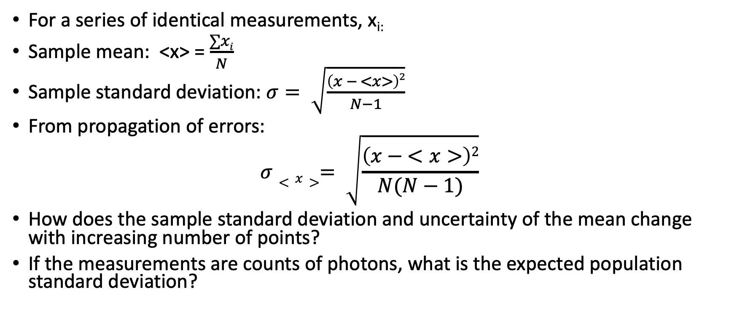
Summing and averaging
For a series of identical measurements, x_{i:}
Sample mean: <x> = $\frac{∑xi}{N}$
Sample standard deviation: $σ= \sqrt{\frac{\left(x − <x>\right)2}{N−1}}$
From propagation of errors:
$$σ<x>= \sqrt{\frac{\left(x − <x>\right)2}{N(N−1)}}$$
How does the sample standard deviation and uncertainty of the mean change with increasing number of points?
If the measurements are counts of photons, what is the expected population standard deviation?

Slide 52
TMO observing planning
The initial TMO observing project will be:
Determine the instrumental zeropoints for TMO for the 5 Sloan filters (SU, SG, SR, SI, SZ)
Estimate the combined throughput of telescope, optics, and detector for each filter
Outline the specific procedures you will need to take to accomplish these tasks as well as any external data that you will need.

Slide 53
Topics 9/27
Midterm
TMO
Questions
Digital imaging: file formats
Digital imaging: gain and readout noise
Digital imaging: basic data reduction

Slide 54
Image display demos
SAOimage ds9
ximtool
ginga
pyvista
  On cluster :
    module load pyvista
  On laptop:
    git clone https://github.com/holtzmanjon/pyvista
    cd pyvista
    python setup.py install

Slide 55
Exercises
We will be looking at some images taken at APO with various instruments. Generally, data taken at astronomical observatories are numbered sequentially with some index number that is embedded in the file name. Sometimes, files have "descriptive" names about their contents, other times they may just identify the date of the observations. The standard format for astronomical images is the FITS format, for which the standard file extension is .fits or .fit.
The images we will be looking at can all be found under /home/apo/a535 from machines on the cluster. If you want to transfer them to your laptop, see http://astronomy.nmsu.edu/holtz/a535/data

Slide 56
Exercises
The first set of images is taken with the old 3.5m imaging instrument, SPICAM. Open the image spicam/UT061215/SN17135_r.0103.fits,e.g.
ds9 /home/apo/a535/spicam/UT061215/SN17135_r.0103.fits (or use some other image display package)
  Look at the pan window. What portion of the image is being shown in the main display window? Note how you can pan around in the image using the pan window, using the mouse in the main window , or using the scroll bars.
  Set zoom factor to see the entire image. Why do you see a vertical white line in the main image but not in the pan window?
  Play around with changing the zoom values (ds9: zoom button or menu). At different zoom values, go into the main window and use the cursor to move around by single pixels at a time, and note the pixel numbers being displayed in the X and Y panels, as well as the pixel data values in the Value panel.
What do you see in the image?
  Move the cursor around in the main image and note the data values. Are changes in the data values reflected in the brightnesses that you see on the screen?
  Redisplay the image using the different selections in the Scale menu (or scale button, but the menu has more options) , from 100% down to 50%. Explain how and why the image appearance changes as you change this selection. If you don't understand what is changing and why, ask.
  Using your knowledge of the data values, try setting the display parameters manually using the Low and High panels (Scale Parameters from Scale menu), and understand how and why the appearance changes as you change these values.
  Try different color maps using the Color menu. If you don't understand what is changing and why, ask.
  Try using different intensity maps using the different mapping in the Scale menu. If you don't understand what is changing and why, ask.
What is in the image?
  Using zoom and color adjustments as need, try to describe all of the different types of objects you see in the frame.
  What are the data values in the background? What are reasonable display settings to use to see what is going on in the background?
  What are the data values in the brightest objects in the frame? What are reasonable display settings to use to see what is going on with these? For example, if you want to see how extended the objects are (note there may be different regimes!). How "big" are the stars?

Slide 57
Exercises
Look at the g and i band images of the same object (SN17135_g.0101.fits and SN17135_i.0105.fits). Compare and contrast with the r band image.
Look through several of the other images in the same directory, making sure to include some of then SA... images, bias images, flat images, and focus images. Practice determining good display settings to use for all of the images. Notice as much detail as you can about the images and ask if you don't know what something is.

Slide 58
Exercises
Determine the bias level for an image using the overscan region
Using two identical flat field images, try to solve for the gain
Using two bias images, try to solve for the readout noise

Slide 59
Exercises
Look at some images taken with other instruments, e.g.:
  APO3.5m + ARCTIC (optical imager): /home/apo/a535/arctic/UT160327/160327.0050.fits : what are you seeing here? Object? Background?
  APO3.5m + DIS (optical long-slit spectrograph, two channels): /home/apo/a535/dis/UT130113/130113.0025r.fits : what are you seeing here? vertical lines? small ``specs"? central horizontal band? blobs?
  APO3.5m + ARCES (optical echelle spectrograph): /home/apo/a535/arces/UT130623/130623.0021.fits : what are you seeing here?
  APO3.5m + TRIPLESPEC (near-IR slit spectrograph, multi-order): /home/apo/a535/tspec/UT170718/c.0001.fits: what are you seeing here?
  APO3.5m + NICFPS (near-IR imager): /home/apo/a535/nicfps/UT160327/160327.0020.fits (and 0040) : what are you seeing here?
  SDSS +APOGEE (SDSS multi-fiber near-IR spectrograph): /home/apo/a535/apogee/ap2D-b-03040015.fits : what are you seeing here? Note that this file is an example of a multi-extension FITS file, i.e., there are several images included in the file: a flux image, an uncertainty array, and a mask array. Try to look at the second extension and understand the values in it.

Slide 60
Topic 9/29
Questions
Effects of the Earth’s atmosphere
Atmospheric (and other “background”) emission

Slide 61
Topics 10/4
Questions
Atmospheric absorption
Atmospheric refraction

Slide 62
Topics 10/6
TeamMates feedback
Midterm
Class on Monday 10/11
APO observing 10/29-31 housing and vaccination
TMO observing week of 10/11
TMO analysis week of 10/19
Questions
Atmospheric seeing

Slide 63
Seeing
1. Seeing causes the observed shape of a star to roughly be a (2D) Gaussian. For a star that has a (2D) Gaussian profile, calculate the radii at which 50%, 95%, and 98% of the total light is enclosed as a function of the FWHM of the star.
2. Given your calculations, what is a reasonable choice for an aperture radius to choose to count a significant fraction of the total light from a star? If the seeing (FWHM) varies by 10-20% from exposure to exposure, what radius might be required to ensure that the fraction of the total flux from exposure to exposure varies by less than 1%?

Slide 64
Topics 10/11
Class feedback
APO observing: housing reservations and vaccination cards
Midterm
TMO observing
Questions
Basic optics
Multisurface systems

Slide 65
Questions
What does V=10 mean? By itself, does it tell you how many photons you will collect?
What does doing photometry to a precision of a millimag mean?

Slide 66
Problem
Exercise: the TMO 24” telescope is a f/5 system. The current detector has a pixel size of 3.76 microns. What angle in the sky would one pixel subtend?
  Do you think this is a good pixel scale and why or why not?

Slide 67
Topics 10/13
APO observing: housing reservations and vaccination cards
Questions : midterm/reading
Telescope technology
Aberrations
TMO observing procedures

Slide 68
TMO project observing resources
For photometric zeropoints, want stars with known magnitudes
  If we wanted to get more subtle, would include stars with a range of colors to see if there are color-dependent zeropoints, i.e. transformation terms
  If we wanted to account for atmospheric extinction, we’d need to get, or assume, extinction coefficient
Traditionally, e.g., UBVRI used fields with relatively bright (V~-10-12) standard stars, e.g. Landolt fields http://articles.adsabs.harvard.edu//full/1992AJ....104..340L/0000340.000.html
  Note Selected Areas
For SDSS, the actual photometric system is defined by the SDSS observations themselves
  These are saturated for bright stars!
  A u’g’r’I’z’ system was set up which is close, but not identical to SDSS. These used the same Landolt fields, Smith et al 2002, see table 7. It will suffice for our use!
  For finding charts, see Landolt paper
    Smaller fields: http://james.as.arizona.edu/~psmith/61inch/ATLAS/tableA.html
  Choose fields based on LST at observation time
  What do you expect for exposure times?
For throughput, want spectrophotometric standard, e.g. from http://www.eso.org/sci/observing/tools/standards/spectra.html

Slide 69
TMO observing modes
See astronomy.nmsu.edu:8000/tmo-wiki, esp TMO Users guide HowTo
Get a VNC client to connect to desktop
Alternatively/additionally, go to http://tmo.nmsu.edu for web based control
Alternatively, use robotic scheduler (not for this project)

Slide 70
TMO observing
General observing procedure:
  Connect to TMO desktop by VNC to tmo.nmsu.edu or to web interface (tmo.nmsu.edu)
  Open dome
  Focus
  Slew to star(s)
  Take exposures
  Optionally (?), take calibration frames: darks (match exposure times) and (probably not) twilight flats
Data will be automatically synced to astronomy.nmsu.edu
  In the morning, link in /home/tmo/YYYYMMDD (also accessible via web http://astronomy.nmsu.edu/tmo/YYYYMMDD
  More quickly, in /home/tmo/Observations/YYYY-MM-DD if taken directly with MaximDL

Slide 71
TMO analysis

Slide 72
Topics 10/18
Class plans
Questions?
Aberration compensation
Diffraction
Case study: HST
TMO scheduling and observing procedures

Slide 73
Two mirror telescopes
TMO is a Newtonian f/5 telescope with a parabolic primary mirror. What do you expect images to look like on and off axis?
The ARC 3.5m is a Ritchey Chretien f/10 telescope. What do you expect images to look like on and off axis?
Sketch the beams (a cone) coming into the focal plane for both TMO and the ARC 3.5m.
What are the relative plate scales of the two telescopes, without calculating the plate scale of either?

Slide 74
Topics 10/20
TMO feedback/tips? Analysis plans
Questions?
Instruments
Focal plane reimagers
Problem: diffraction limited imagig
Intro to APO observing projects

Slide 75
Diffraction limited imaging
Betelgeuse has a diameter of about 4 AU and is located at a distance of about 200 pc. How big a telescope would be required to marginally resolve the surface of Betelgeuse using the Rayleigh criterion (1.22 𝜆/D), assuming you could achieve diffraction limited images (e.g., with adaptive optics), both in the optical and in the near-IR?

Slide 76
Focal reducer
Imagine you have a detector that has pixels that are 24 microns on a side. You want to design a camera to match this detector to the ARC 3.5m telescope, which produces an f/10 beam in the telescope focal plane.
  What is the pixel scale in the telescope focal plane?
  What would be a desired pixel scale to match your detector, under the assumption that APO is a seeing limited site, with best seeing about 0.8 arcsec?
  Sketch a design for a reimaging camera that would achieve your pixel scale, showing the rays coming into the focal plane, the reimaging optics, and the rays coming to the reimaged focal plane, with approximately correct beam sizes.

Slide 77
10/25
Questions
Filters
Fabry-Perot interferometer
APO trip planning
  Logistics
  Science programs
  software

Slide 78
10/27
APO logistics: travel, temperature, food…
TUI
APO hardware/software setup
  Images on disk / images to laptop
  Obs3 machine : nmsuobserver account
  software
Observation planning
  schedule
  Coordinate files to obs3
  Exposure sequences
  Finding charts
Observation log preparation

Slide 79
TUI : web page https://www.apo.nmsu.edu/35m_operations/TUI/
Connecting
Basic windows:
  Status
  Users
  Message
  Slew
  Focal plane, sky, etc.
Instrument windows
  Instrument configuration
Exposure windows
  Note file naming
Acquisition and guiding
  Imagers
  Spectrographs
Calibration
  Calibration lamps
  Calibration scripts
Saving images to your computer

Slide 80
11/1
No class, returning from APO

Slide 81
11/3
APO debrief
Monday class
Questions
Dispersive spectrographs
Astronomical spectrographs
Dispersing elements
Working with data

Slide 82
Spectrograph resolution
Imagine you want to make a measurement of the H𝜖 and Ca H lines in a spectrum of a star. H𝜖 has a rest wavelength of 3970 A, Ca H of 3968.5 A.
a. What resolving power (R) is required to resolve these two lines?
b. Imagine you are observing this star with DIS with the grating which has 400 lines/mm and you find you have a resolution of about 4 angstroms with a 1 arcsecond slit. What slit width would you need to go to to resolve these two lines? Would the use of this slit width cause any significant trouble, and if so, what?
c. What slit width would you need if you used the 1200 lines/mm grating?

Slide 83
Inspection of images
We are going to want to do some data inspection and reduction beyond SaoimageDS9, e.g., by working with images directly in a Python environment
You can read FITS images with:
from astropy.io import fits
variable=fits.open(name)
This will give you an HDUList object in variable: you can access headers and data of first HDU using variable[0].header and variable[0].data. If you are only interested in the data, you could
variable = fits.open(name)[0].data
Alternatively, you may wish to get acquainted with the pyvista package that we will be using

Slide 84
Pyvista installation and file reading
On cluster:
  module load pyvista
  conda activate py3
On your laptop:
  Python (conda or pip) install astropy, ccdproc, photutils, holtz-tools
  git clone https://github.com/holtzmanjon/pyvista.git
  Put the pyvista python directory in your PYTHONPATH. Depending on your shell:
  setenv PYTHONPATH pathtopyvista/python (csh/tcsh)
  export PYTHONPATH= pathtopyvista/python (bash)
Reading images:
  from pyvista import imred
  r = imred.Reducer(‘KOSMOS’,dir=inputdirectory)
  im = r.rd(id)
  where id can be the image number in inputdirectory, or a file name: if no / is included, will read from inputdirectory
This will give you a CCDData object in im, which has attributes im.data, im.uncertainty and im.mask (note that uncertainty depends on gain and readout noise being correctly set in the Reducer!)

Slide 85
KOSMOS resolution
Last weekend, I obtained some calibration lamp (line lamps) exposures with KOSMOS with both the 1.18 and 2.1 arcsec slit.
1. How do you expect that these will differ in appearance, if at all?
2. Load two images from /home/holtz/raw/apo/oct21/ (via web at astronomy.nmsu.edu/holtz/Q4NM01 :
  Q4NM01/UT211031/kosmos/Ne.0010.fits
  Q4NM01/UT211031/kosmos/Ne.0014.fits
Choose a line and measure the FWHM in each of the two frames, and discuss your results.

Slide 86
11/8
Review session (ARC BoG meeting)

Slide 87
Review questions
Here are a set of questions that I would like you to be able to answer without having to refer to notes, etc. It would perhaps be useful both for you and for me to recognize how you are progressing towards this goal.
You can go through these questions however you would like. One possible suggestion: for each question, take 30 seconds for each person to consider the question individually, then take a minute or two to communicate as a group, then a minute or two to communicate with the whole class. For each question, you could note at which level (individual, group, class), if any, you feel confident that you can provide a good answer.
I strongly suggest that you do NOT look at your notes, at least until you have tried to formulate an answer and discussed it with others.
Light
1. If two objects differ in brightness by 4 magnitudes, what is the flux ratio between the two?
2.If an object has g-r=1.0, what does it imply about the shape of the underlying spectrum, being as quantifiable as possible.
3. What does the zeropoint of an instrument tell you, qualitatively and quantitatively?
Uncertainties
4. What are the three main sources of uncertainty in measuring flux?
5. How do you calculate the S/N of a measurement in a single pixel given the number of detected photons?
6. How does the gain (as astronomers use the term) relate the number of detected photons to the number of counts, i.e. how is it defined?
7. How do you calculate the S/N of a measurement given the number of counts in a single pixel?
8. If you average 3 measurements that each have equal uncertainty 𝜎σ, what is the uncertainty on the average?
9. What is the formula for propagation of uncorrelated uncertainties?

Slide 88
Observing
10. What is the quantitative relation between hour angle, local sidereal time, and right ascension?
11. Higher right ascension corresponds to what direction in the sky?
12. Higher declination corresponds to what direction in the sky?
Effects of the atmosphere
13. Sketch an atmospheric emission spectrum from 3000 A to 2.5 microns, for both moonless and full moon conditions.
14. Why are infrared observations generally scheduled during bright time?
15. Sketch an atmospheric absorption curve from 3000 A to 2.5 microns.
16. What does an extinction coefficient of -0.3 mean?
17. What does the amount of atmospheric refraction depend on? What is the amplitude of refraction?
18. What is differential refraction? Why is it important to understand for spectroscopy?
Optics/telescopes
19. How is the plate scale related to the diameter of the telescope and the focal ratio coming into the instrument focal plane?
20. What determines the size of a stellar image? What are typical image sizes for ground-based and space-based telescopes?
Instruments
21. Sketch a schematic of a dispersive spectrograph.
22. What does the dispersion of a spectrograph mean? What in the spectrograph determines it?
23. What does the resolution of a spectrograph mean? What in the spectrograph determines it?

Slide 89
11/10
Questions/discussion
  Additional spectrograph items
  Detectors
Data reduction : combining frames, bias frames, dark frames

Slide 90
Combining calibration frames
Considerations
  S/N
  Pixel outliers
  Frame outliers
Methods
  mean
  median
  sigma reject

Slide 91
pyvista tools
Documentation notation:
  Italics mean you can substitute whatever name or image identifier you want or is appropriate
  [] means optional keyword
Image display: the TV tool
  from pyvista import tv
  Instantiate a display tool, e.g. t=tv.TV()
  Display an image into that tool: t.tv(im)
Image reduction: the Reducer tool
  from pyvista import imred
  Instantiate a reducer, e.g. red= imred.Reducer(inst,dir=inputdir)
  red_im=red.rd(id) : reads image specified by id (number or name)
  red_im=red.reduce(id,[display=t]) : read and reduces, with steps given by keywords: w/o additional keywords, just bias subtracts. With display keyword, shows steps in display tool
  bias=red.mkbias(idlist,[display=t]) : combines frames from idlist to make superbias
  dark=red.mkdark(idlist,[bias=bias,display=t]) : combines frames from idlist to make superdark
  flat=red.mkflat(idlist,[bias=bias,dark=dark,display=t]) : combines frames from idlist to make superflat
  red_im= red.reduce(id,[bias=bias,dark=dark,flat=flat,display=t])

Slide 92
APO data
Data frames under /home/apo/UT… or http://astronomy.nmsu.edu/holtz/a535/apo/UT...
Create combined bias frames for
  ARCES (UT211030/echelle 14-18, 47-50)
  KOSMOS (UT211030/kosmos 23-32)
  ARCTIC (UT191020/ARCTIC 1-21)
  Inspecting both the final frames and also the difference between the individual input frames and the final combined frame
For each instrument, do you think subtracting a combined bias frame is warranted? Why or why not?
Create combined dark frames for
  ARCTIC

Slide 93
11/15
Questions/discussion
  Digitization
  Basic data reduction
TMO data reduction
Basic stellar aperture photometry
World coordinate systems

Slide 94
Basic World Coordinate System (WCS)
In general the FITS world coordinate system (WCS) of an image is defined by keywords in the FITS header.
The basic idea is that each axis of the image has the following keywords assocated with it:
Allows for full linear coordinate transformation (shift, rotation, shear)
  CTYPEi Type of coordinate on Axis i, 8 characters(The FITS WCS standard defined 25 different projections which are specified by the CTYPE keyword.) d
  CRPIXi Reference pixel on Axis i
  CRVALi Value of World Coordinate at Axis i at reference point (CRPIXi)
  CDi_j A Matrix of partial derivatives of the World Coordinates with respect to the pixel coordinates.
Old style allowed for shift and rotation
  CDELTi coordinate increment on Axis i
  CROTAi rotation parameter for each Axis i
Newer extensions allow for nonlinear transformations, e.g. SIP coefficients

Slide 95
WCS projections
Most common is tangent projection
  RA__TAN = CD1_1*(x-CRPIX1) + CD1_2*(y-CRPIX2) + CRVAL1
  DEC__TAN = CD2_1*(x-CRPIX1) + CD2_2*(y-CRPIX2) + CRVAL2
WCS also allows for other projections (important for larger areas)

Slide 96
Getting WCS for an image
Telescopes will generally put approximate WCS in images, but this may or may not be good enough to locate objects precisely
Tools for WCS
  wcstools
  astrometry.net

Slide 97
11/17
Questions/discussion
  Optical detectors
  Near-IR detectors
Observing and reducing near-IR data
TMO data analysis: WCS, photometric transformations

Slide 98
Near-IR observing
What are some differences between working in the optical and working in the near-IR?

Slide 99
Near-IR data
In the near-IR H band, the sky brightness might by something around 13.5 magnitudes / square arcsec
If you observe a star with H=13.5 and make a 1% error in determining the background level, by how much will you make an error in your measurement of the star brightness?
If you observe a star with H=18.5 and make a 1% error in determining the background level, by how much will you make an error in your measurement of the star brightness?
How do we typically measure the background level?

Slide 100
11/29
Discussion/questions
  Data reduction
TMO data reduction and analysis
Final
Spectroscopic data reduction
  Extraction
  Wavelength calibration

Slide 101
Photometric transformations
r = r_{inst} + k_{r}X + t_{r}(g-r) + Z_{r}
What values do you expect for k_{r}, t_{r}, and Z_{r,} for TMO, if the SDSS r filter transmission curve is a good match to the true SDSS r filter, has a central wavelength of 6200 A and an effective width of 1000 Angstroms?

Slide 102
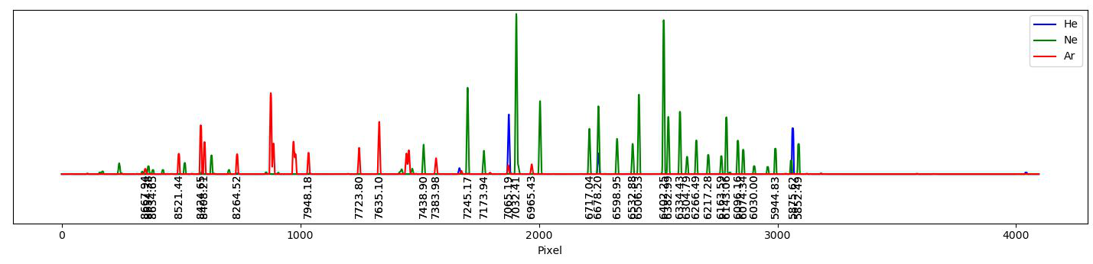
Spectroscopic data reduction
Images 15, 16, and 17 from UT211030 are He, Ne, and Ar lamp exposures with KOSMOS
Based on these frames, what is the approximate dispersion of KOSMOS?
What is the approximate resolution, both 𝛿𝜆 and R?

Slide 103
12/1
Discussion/questions
  Spectroscopic data reduction
Final
  Time
  Questions
Spectroscopic data reduction demonstration
  KOSMOS
  ARCES

