Slide 1
ASTR 535
Observational Techniques
Data Reduction

Slide 2
Learning objectives
Be familiar with the multiple possible steps in basic data reduction
Understand the importance of good calibration frames
Know what the different steps are, and whether the corrections are additive or multiplicative
Recognize that reduction steps might have subtleties

Slide 3
Basic processing
Potential steps
  Overscan subtraction: remove offset bias
  Bias subtraction: remove fixed pattern noise
  Linearity correction (IR detectors): correct for detector nonlinearities
  Dark subtraction: remove dark current
  Shutter shading correction: correct for variable exposure time across image
  Flat fielding: remove sensitivity variation across FOV
  Scattered light: remove scattered light
  Fringe subtraction: remove fringe pattern
Not all steps are necessary in all cases!

Slide 4
Calibration data
Key issue: calibration data are applied to ALL science data, so any uncertainty in calibration data propagates to ALL science data!
  Want calibration data to have significant higher S/N than desired for any science data
High S/N usually obtained by combining multiple individual frames
  How many frames to take is determined by desired/required S/N
  Combination of multiple frames also allows rejection of outliers (e.g., cosmic rays, stars in twilight flats, etc.)
  Median is robust way to combine, but not optimal way (i.e. highest S/N)
    Noise of median ∽1.25 * noise of mean.
While it is important to keep random uncertainties in calibration data low, be aware that systematic uncertainties may be the largest challenge!
Frequency of taking calibration data
  On what time scale do things change?
  Balance of time taking science data vs taking calibration data
    If calibration data can be taken without sacrificing science time, do it!
  Importance of checking calibration products
    Caution with frequent, but automated, calibration product construction

Slide 5
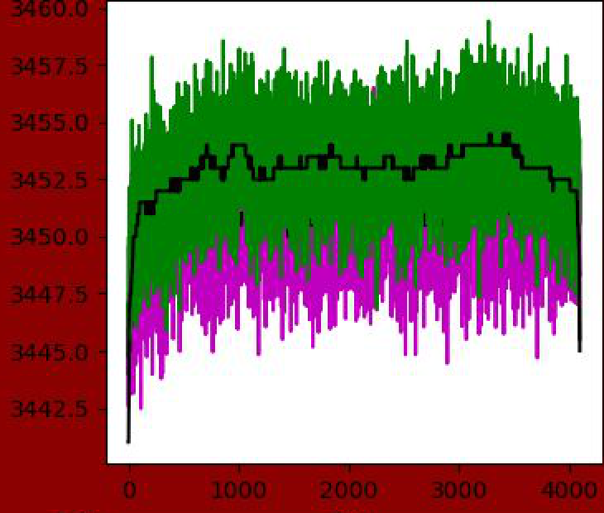
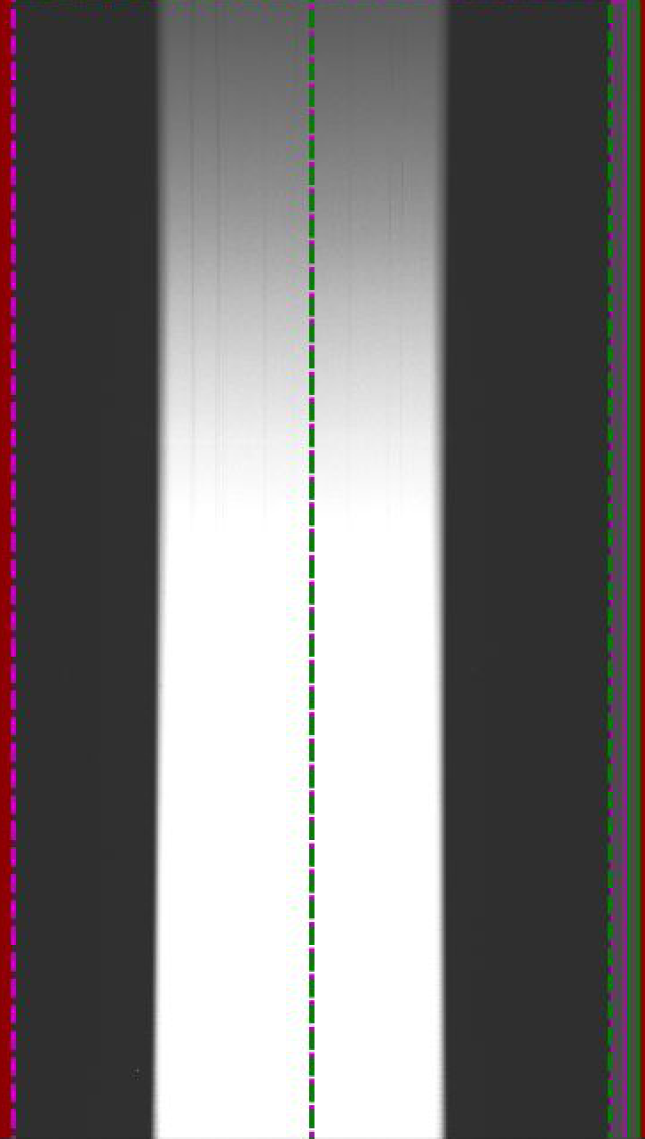
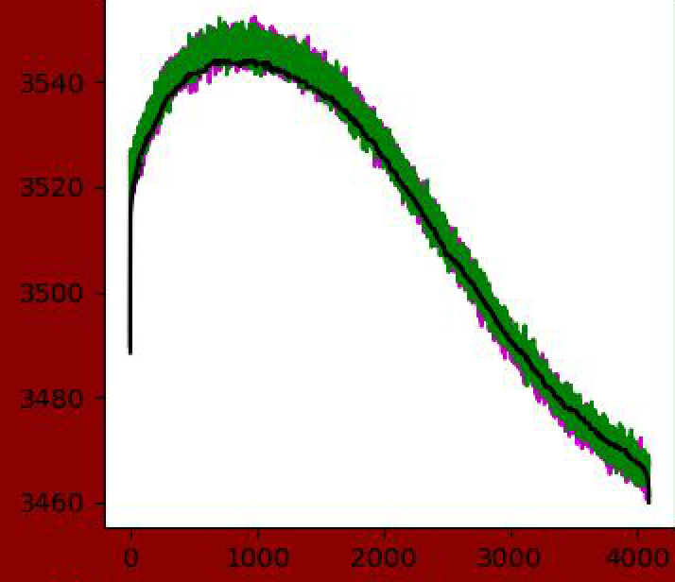
Overscan subtraction
remove offset bias level
  Bias level can vary from frame to frame or even within frame
Additive correction
Methodology
  Need to have overscan region
  Algorithms:
    Average value in overscan region
    Row-dependent value
      Smoothed
      Beware of bias “jumps”
    If row-dependence is repeatable, could use bias frame
    Beware of “leakage” from data

Slide 6
Bias subtraction
Bias subtraction: remove fixed pattern noise
Additive correction
Only relevant if there is fixed pattern!
  Check multiple sets of bias frames
If used, make sure to have enough bias frames so that introduced noise is negligible

Slide 7
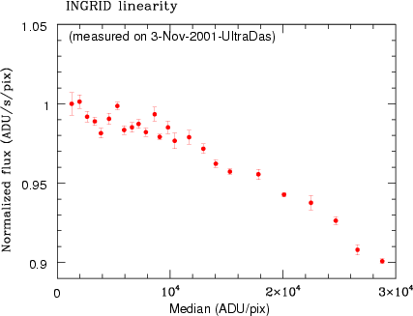
Linearity correction
Accounts for small nonlinearities in detector, i.e. QE that is a function of count level
Multiplicative correction
Generally, avoided for CCDs: work in linear regime, so know what this is when observing!
Often needed for IR detectors
  Methodology
    Take series of frames with constant light source (sometimes hard!) at different exposure levels, determine count rate as function of exposure level and determine correction
  Can minimize amplitude of correction by trying to get all frames at a similar exposure level

Slide 8
Dark subtraction
Remove dark current
Additive correction
Construct dark current correction by averaging multiple dark frames
Only apply if dark current is statistically significant
Beware of introducing noise, since dark frames may be harder to take
Dark current may not be linear, so beware of scaling dark frames
  May want dark frames at each exposure time used
If most pixels have negligible dark, consider correction only for pixels with significant dark current

Slide 9
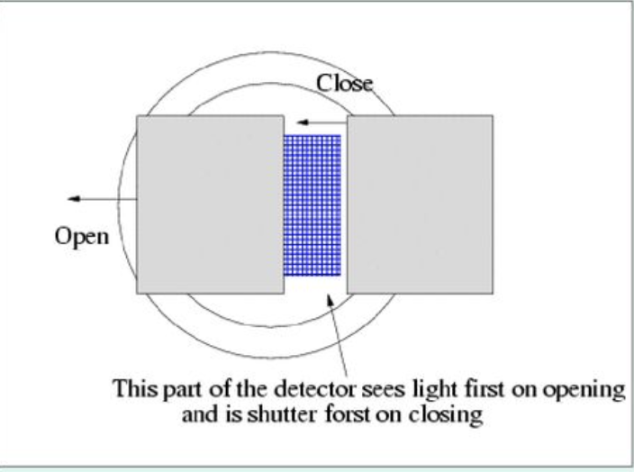
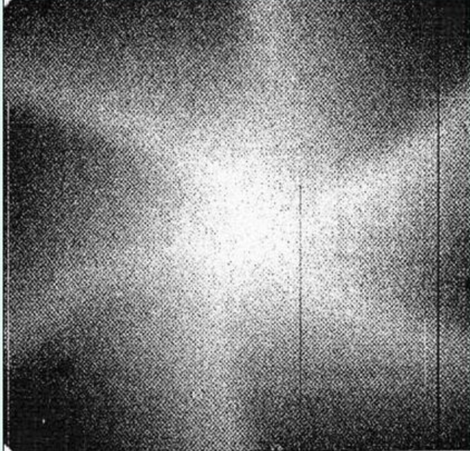
Shutter shading correction
Some shutters may illuminate some regions of the detector for longer than others
Multiplicative correction
Most relevant for short exposures
Depends on shutter type
  Iris shutter will have shutter shading
  Sliding shutter may not
Methodology
  Compare flat field of short exposure to that of long exposure, determine correction as a function of exposure time and location
  May want to avoid short exposure times!

Slide 10
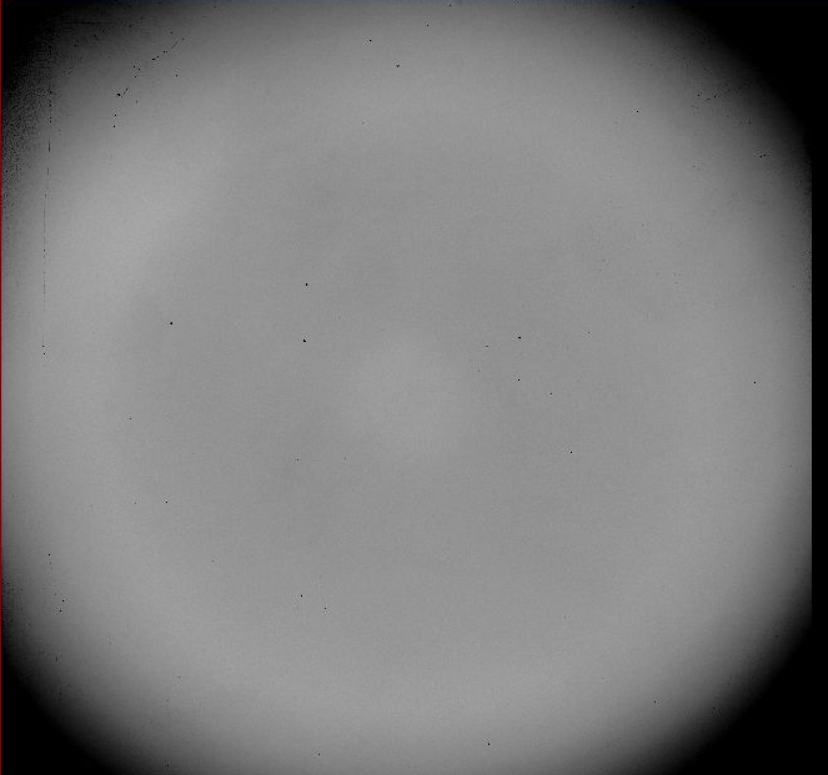
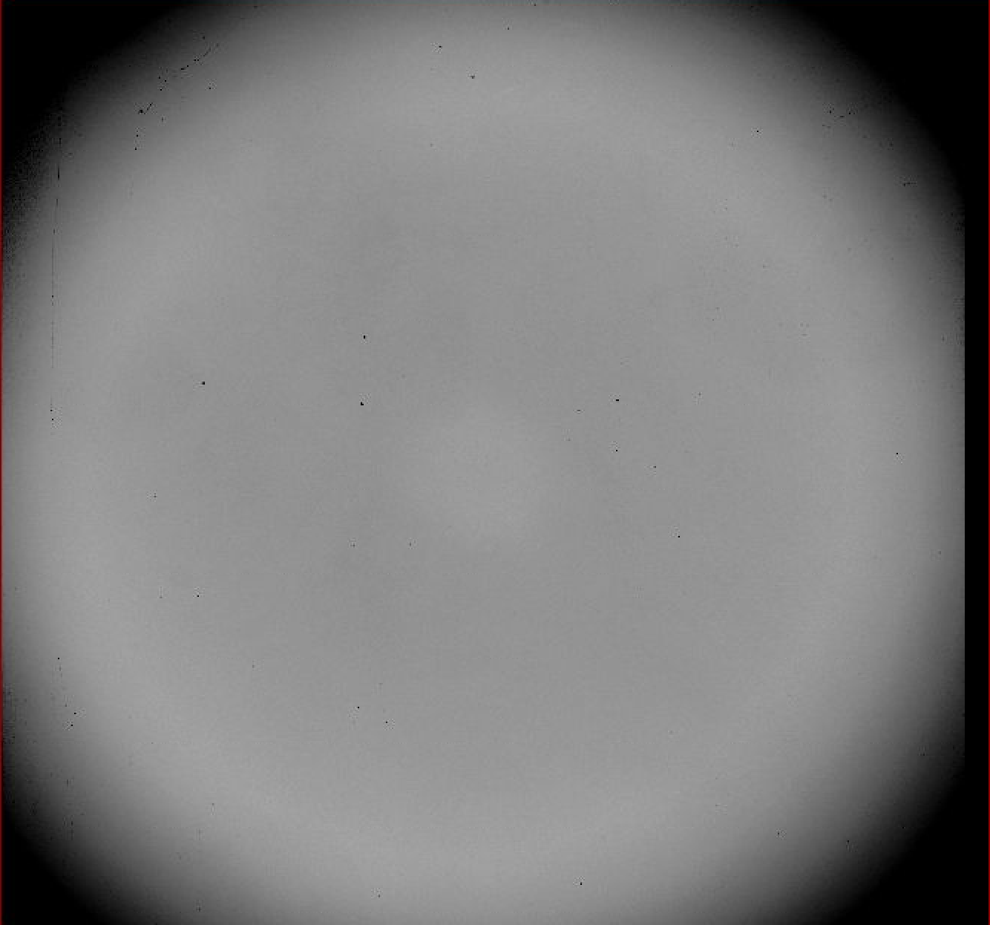
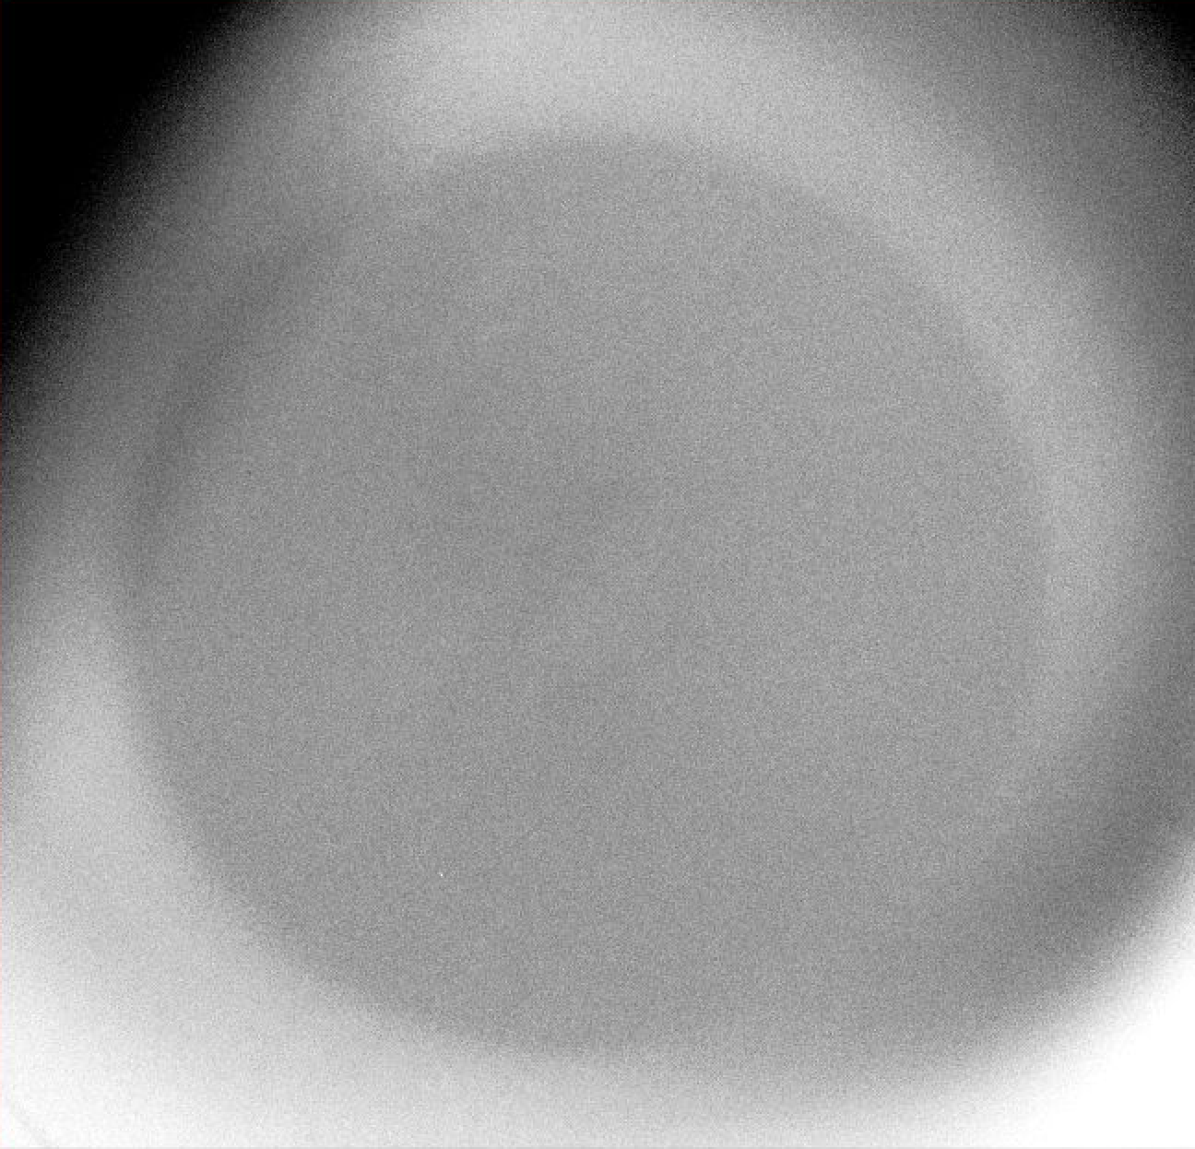
Flat fielding
sky
dome
Flat fielding: remove sensitivity variation across FOV
  Arises from combination of illumination variations, pixel sensitivity variations, etc.
Multiplicative correction
Methodology
  Observe something that is spatially flat, e.g., dome, twilight sky
  Challenge: nothing is totally spatially flat!
Impact
  If flat is incorrect, measured fluxes will be off by at least fractional error in flat
  If sky is significant, measured fluxes can be off by much more!
Sky/dome : .95-1.05 stretch

Slide 11
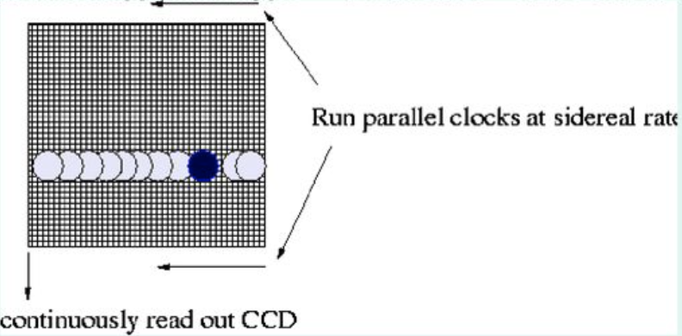
Flat fielding
Validation
  Does the measured brightness of an object change with location?
Mitigation
  Dither images to get sky at same pixel location: almost always done in near-IR observing since the sky is so bright
  Observe objects on multiple pixels : drift scanning (e.g., SDSS imaging survey)

Slide 12
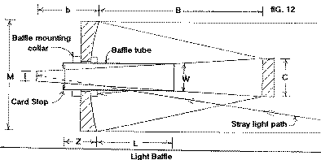
Scattered light
Scattered light refers to light that reaches the detector through an “alternative” path, i.e. not through the anticipated optical path
  Example: seeing the mirror covers directly from the focal plane at APO
  Example: Moon and TMO
Additive correction, but challenging
Scattered light in flat fields can have a particularly bad impact!
Note also ”ghosts” and reflections
Mitigation:
  Baffles in optical design (not always so easy, without restricting field of view!
Optical ghosts
Electronic ghost

Slide 13
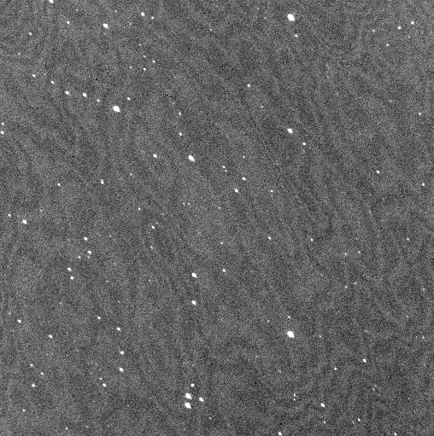
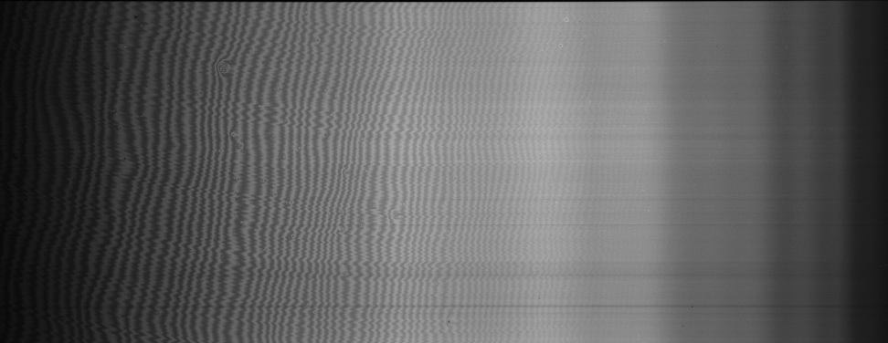
Fringe subtraction
Fringes from monochromtic light interference from “reflection” of back of detector
  Generally seen at longer wavelengths
Additive correction
Amplitude may vary depending on monochromatic flux contribution, e.g., with Moon vs without
Mitigation
  Offset pointings
  Solve for fringing pattern and scale to exposure

Slide 14
IR data reduction
Acquisition and analysis of near-IR has some differences because of the relative brightness of the sky and because of different detectors
Multiple readouts, e.g. doubly-correlated sampling, Fowler sampling, up-the-ramp sampling, should remove need for bias subtraction, but some IR arrays are still tricky
  No overscan, but some arrays do include “reference pixels” to track bias variations
Calibration frames, e.g. flats, may include some thermal emission: may need to take “lights-on”, “lights-off” flat fields to remove
Stringent needs for accurate sky subtraction usually require dithering of exposures and subtraction of sky from same pixels as object, taking care to account for variability of sky
  additive corrections not applied if subtracting sky frames!

Slide 16
Demonstration
Overscan subtraction
  See DIS, ARCES, ARCTIC
Bias creation subtraction
  See DIS, ARCES, ARCTIC: is bias subtraction warranted?
Flat field creation and application
  See DIS, ARCTIC
  Twilight vs dome
  TSPEC
  ARCES

Slide 17
ASTR 535
Observational Techniques
Spectroscopic Data Reduction

Slide 18
Learning objectives
Understand the basics of spectroscopic data reduction
Know what tracing and extraction is, and how they are performed
Know what wavelength calibration is and how it is performed
Learn about telluric absorption removal, some sky subtraction issues and techniques, and flux calibration

Slide 19
Spectral data reduction
Basic data reduction
Tracing and extraction: locate spectra and sum spatially
Wavelength calibration: associate wavelength with pixel
Telluric absorption correction: remove telluric absorption from spectra
Flux calibration: get relative fluxes

Slide 20
Basic data reduction
Basic data reduction of spectrograph data similar to that of imaging, with some possible differences
Flat fielding: in wavelength direction, source is not spectrally flat
  Often, the spectral signature is removed so that the spectrum of the flat source (usually red) is not inversely imprinted on the spectra of the objects
Scattered light: in cross-dispersed spectrographs (e.g., echelle) there is often light between the orders that needs to be subtracted out
Exposures are generally longer, so cosmic rays and perhaps dark current may be more prevalent

Slide 21
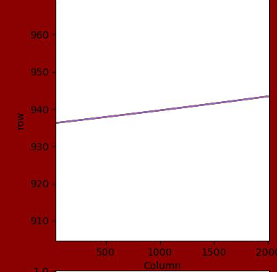
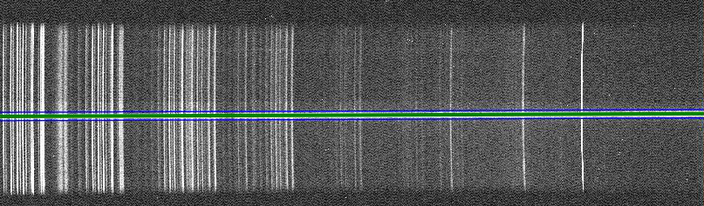
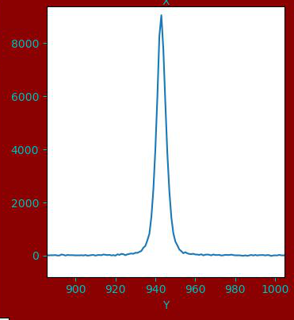
Tracing
Location of spectra of point source generally does not lie directly along rows or columns; often not even a straight line
Tracing technique and issues
  Find centroid, i.e. row as a function of column (or vice versa for vertical spectra)
  May be challenging for faint sources / emission line sources, so might use shape from brighter source, but allow for shift along slit, since object may not be in identical slit position
  Note differential refraction effect: if slit is perpendicular to parallactic angle, won’t have light loss as a function of wavelength, but will have shift of trace as a function of wavelength → different traces for different objects

Slide 22

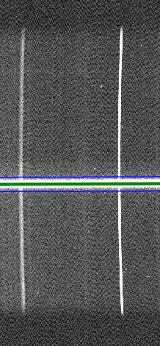
Extraction
Extraction: take 2D flux distribution and make 1D spectrum by summing along the slit
  aperture extraction: direct sum within some distance of trace
  Optimal extraction maximizes S/N by fitting profile along slit rather than direct sum
    Optimal extraction is analogous to PSF fitting photometry in images
sky subtraction : choose sky region along slit farther from object
    Beware of line curvature,
    esp. for subtraction of sky lines

Slide 23
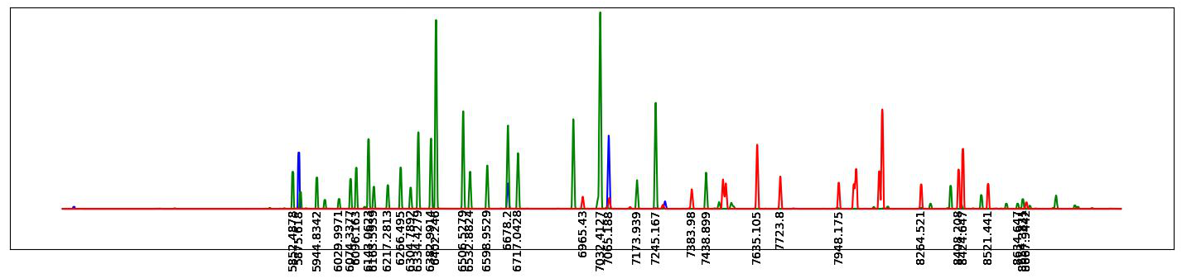
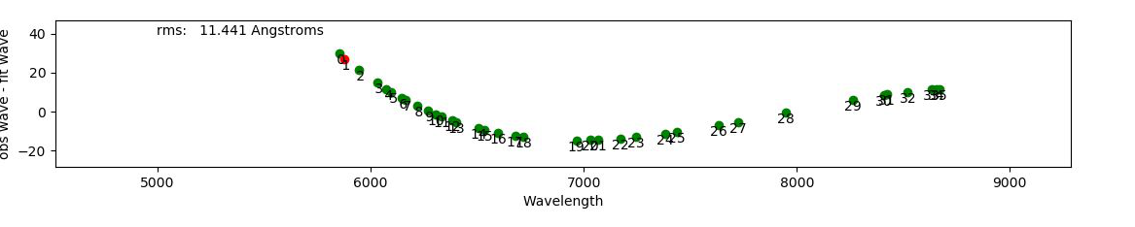
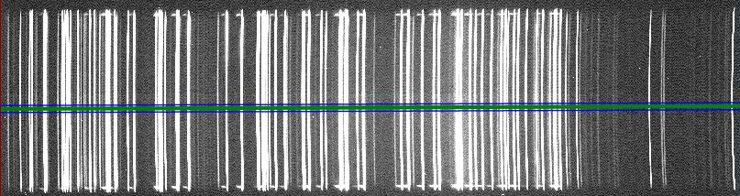
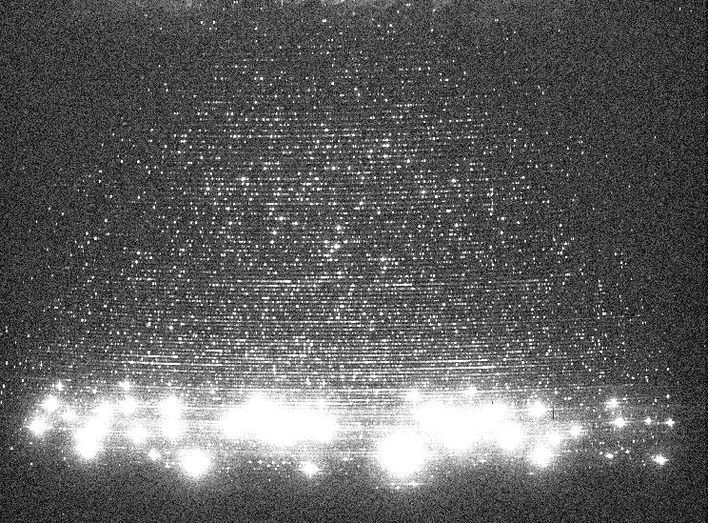
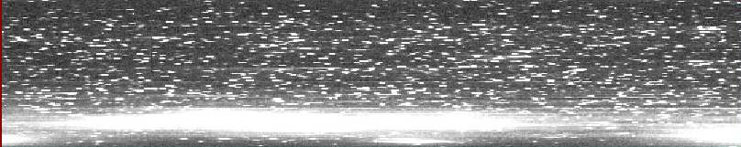
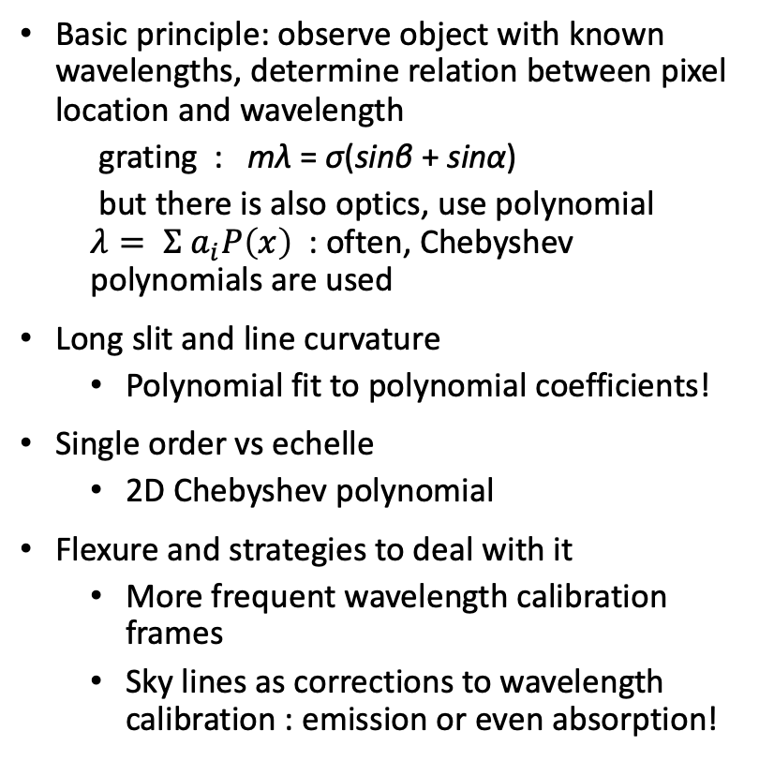
Wavelength calibration
Basic principle: observe object with known wavelengths, determine relation between pixel location and wavelength
  grating : mλ = σ(sinβ + sinα)
  but there is also optics, use polynomial $λ= Σ a_{i}P\left(x\right)$ : often, Chebyshev polynomials are used
Long slit and line curvature
  Polynomial fit to polynomial coefficients!
Single order vs echelle
  2D Chebyshev polynomial
Flexure and strategies to deal with it
  More frequent wavelength calibration frames
  Sky lines as corrections to wavelength calibration : emission or even absorption!

Slide 24
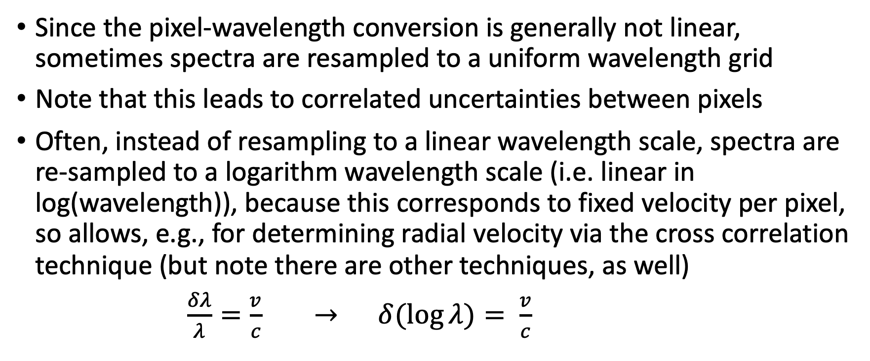
Wavelength resampling
Since the pixel-wavelength conversion is generally not linear, sometimes spectra are resampled to a uniform wavelength grid
Note that this leads to correlated uncertainties between pixels
Often, instead of resampling to a linear wavelength scale, spectra are re-sampled to a logarithm wavelength scale (i.e. linear in log(wavelength)), because this corresponds to fixed velocity per pixel, so allows, e.g., for determining radial velocity via the cross correlation technique (but note there are other techniques, as well)
$\frac{δλ}{λ}=\frac{v}{c} → δ(\log{λ)= \frac{v}{c}}$

Slide 25
Telluric absorption correction
Atmosphere has some absorption features, especially as one goes to the near-IR
Empirical removal: observe object with “featureless” spectrum (e.g. a hot star), and use it to divide out telluric absorption
  Absorption is a function of airmass and time, so need nearby object
  No star is totally featureless, so may need to divide out stellar model spectrum before correction
Model removal: use a sky model absorption spectrum, fit free parameters to absorption features in
  See, e.g. ESO Molecfit

Slide 26
Sky subtraction
If sky comes from different location in slit (either from long slit or perhaps from sky fibers in a fiber fed spectrograph), might not be able to directly subtract because of variations in wavelength scale
Interpolate sky spectrum, but may be challenging if lines are marginally sampled
Model sky spectrum, e.g. by fitting sky model (e.g., ESO SKYCORR)

Slide 27
Flux calibration
Corrects for non-uniform wavelength response of system (telescope, detector, etc.) to allow for relative flux measurements as a function of wavelength
May not be necessary, depending on science
  Equivalent widths and line positions don’t require fluxing
Usually only relative flux calibration, because of variable slit losses
recall differential refraction effect: if slit not aligned with parallactic angle, can get differential slit losses with wavelength

Slide 29
Demonstration
Tracing
  DIS, TSPEC, ARCES
Extraction
Wavelength calibration
Fluxing

