Slide 1
ASTR 535
Observational Techniques
Fall 2023
Optics / Telescopes

Slide 2
10/24
APO debrief
Questions
Optics
  Basic principles
  Vocabulary
  Multi-surface systems
Plate scale
(Data reduction thoughts)

Slide 3
Plate scale
Canvas assignment: plate scale and optimum pixel size

Slide 4
10/26

Slide 5
10/31

Slide 6
11/02
Discussion/questions/quiz
Instruments
  General principles
  Field flattener
  Focal plane reducers

Slide 7
Imaging data reduction
Calibration frames
  Flats
  Biases
World coordinate system
  Relates pixel position to sky position
  Simple transformation
  More complex transformation
  Plate solving
    astrometry.net

Slide 8
World coordinate system keywords
Simple transformations: CRVALN, CDELTN, CRPIXN
Full linear transformations: CDN_1, CDN_2
Standard imaging polynomials: nonlinear transformations

Slide 9
Basic optics
Why use optics?
Basic laws of refraction and reflection
  n sin i = n’ sin i’ (refraction)
  i = -i’ (reflection)
Images and objects
  real and virtual images
Terminology
  Optical axis
  Rays: chief, paraxial, marginal
  Field angle
  Geometric optics vs diffraction/physical optics
Paraxial regime
  Consider rays near the chief ray
  Angles are small
  No aberrations
  Optical surface specified fully by radius of curvature -- surface approximated by a sphere
  Can still consider objects at non-zero field angle

Slide 10
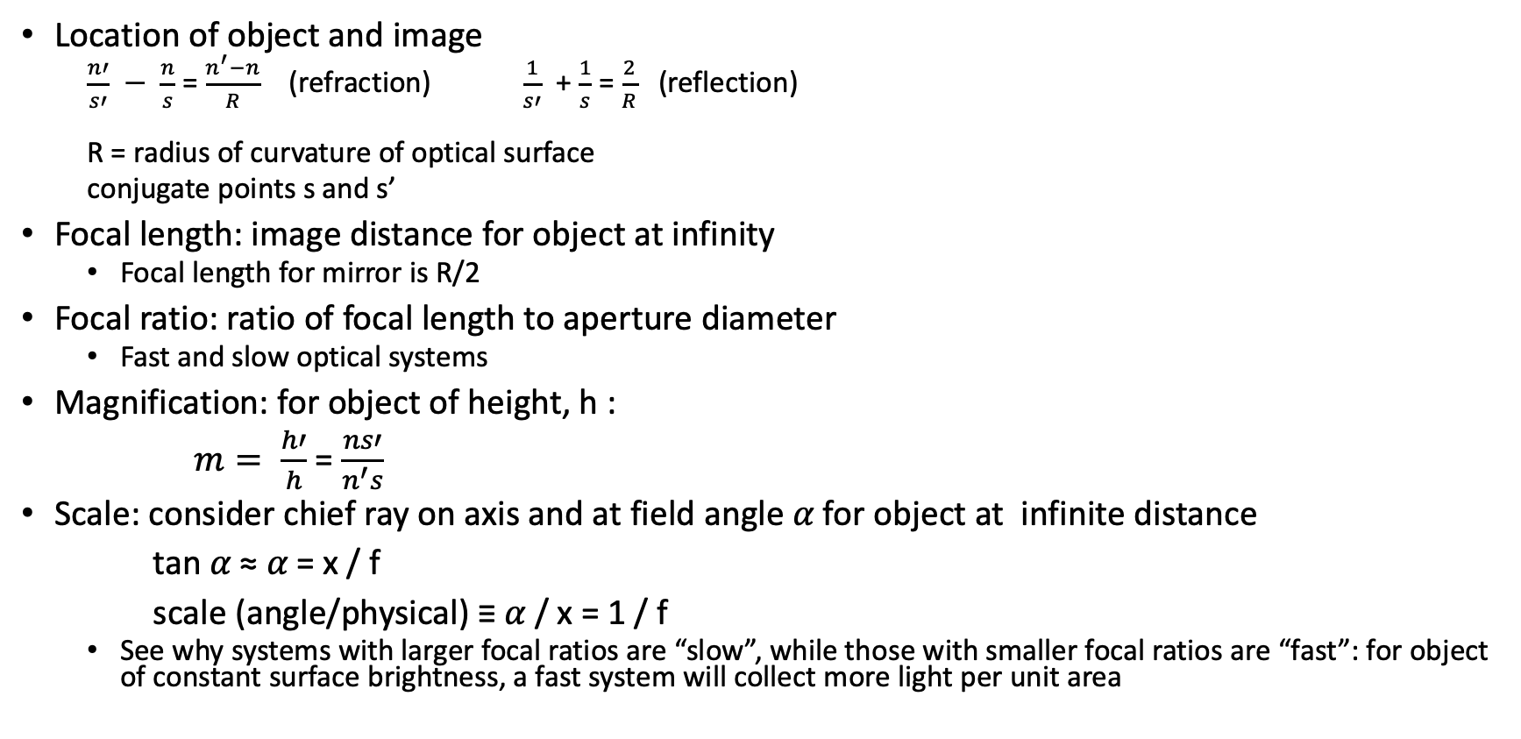
First order optics
Location of object and image
  $\frac{n′}{s′} − \frac{n}{s}$ = $\frac{n^{′}−n}{R}$ (refraction) $\frac{1}{s′}$ + $\frac{1}{s}$ = $\frac{2}{R}$ (reflection)
  R = radius of curvature of optical surface
  conjugate points s and s’
Focal length: image distance for object at infinity
  Focal length for mirror is R/2
Focal ratio: ratio of focal length to aperture diameter
  Fast and slow optical systems
Magnification: for object of height, h :
$m= \frac{h′}{h}$ = $\frac{ns′}{n^{′}s}$
Scale: consider chief ray on axis and at field angle 𝛼 for object at infinite distance
tan 𝛼 ≈ 𝛼 = x / f
scale (angle/physical) ≡ 𝛼 / x = 1 / f
  See why systems with larger focal ratios are “slow”, while those with smaller focal ratios are “fast”: for object of constant surface brightness, a fast system will collect more light per unit area

Slide 11
Problem
Exercise: the APO 3.5m telescope is a f/10 system. A typical CCD might have 15 micron pixels. What angle in the sky would one pixel subtend?
  Do you think this is a good pixel scale and why or why not?

Slide 12
Multi surface systems
Basic principle: each successive surface takes image of preceding surface as its object, and makes an image of it
Examples:
  lens
    Thin lens formula
    Plane parallel plate
  Two mirror telescopes families
    Newtonian: flat secondary
    Cassegrain: convex secondary
    Gregorian: concave secondary

Slide 13
Basic equations of 2-mirror telescopes
User/science: primary diameter, scale, back focal distance
Design: primary diameter, radii of curvature, separation of mirrors
  Primary mirror radius of curvature limited by cost/technology
Basic parameters:
  Magnification of secondary (m), ratio of radii of curvatures of primary and secondary (rho), back focal distance (beta), and separation of primary and secondary (as given by ratio of marginal ray heights, k)
  See notes
Effective focal length = f(primary) * m
  Often calculated from primary diameter and effective focal ratio

Slide 14
Problem: telescope design
Someone gives you an 8m f/1.5 concave mirror
Design a telescope!
  What is the primary mirror scale?
  What image scale might you want?
  What magnification is required?
  What is the primary focal length?
  What back focal distance?
  What mirror separation?

Slide 15
Secondary mirror movement and the focal plane
Focusing a telescope
Adjusting the scale

Slide 16
Pupils and stops
Stops: things that limit something
  Aperture stop
  Field stop
Pupils: location where light from all field angles fills the same aperture
  entrance pupil
  exit pupil

Slide 17
Aberrations: surface shapes for perfect images
Fermat’s principle
  Light travels path such that small variations in path doesn’t change light travel time
Applications
  Concave mirror, object at infinity
    Application: primary mirror of telescope
  Concave mirror, object at finite distance
    Application: secondary mirror of Gregorian telescope
  Convex mirror, object at finite distance
    Application: secondary mirror of Cassegrain telescope
  Convex mirror, object at infinity
These shapes are families of surfaces: parameters within a family related to object and image distances
  Conic sections and conic constants

Slide 18
Aberrations
Aberrations will be present if:
  Surface shape is non-optimal per Fermat’s principle
  Off-axis objects! (since only sphere is the same when seen off axis)
Characterizing aberrations
  Ray description
    Transverse and angular aberrations
  Wavefront/surface description
    Deviation from spherical wavefront
  These are related
    Ray aberrations are first derivative of wavefront aberrations

Slide 19
Classical (third order) aberrations
Spherical aberration
  Terminology:
    transverse spherical (TSA), angular spherical (ASA)
    Paraxial, marginal, diffraction, circle of least confusion focal points
General description of aberrations
Astigmatism
Coma
Field curvature
Distortion

Slide 20
Aberration compensation
With multiple surfaces, gain ability to remove/minimize abererations
Classical Cassegrain: removes spherical aberration
Aplanatic telescopes: removes spherical and coma
  Aplanatic Cassegrain: Ritchey-Chretien
  Aplanatic Gregorian

Slide 21
Sources of aberration
Design
  Optical design: ray tracing and optimization
Imperfect construction
mechanical support
Chromatic aberration (lenses)
Seeing …

Slide 22
Physical (diffraction) optics
Scale where diffraction becomes important: one wavelength across aperture
Calculation of diffraction image
  Optical transfer function (OTF) and point spread function (PSF)
  OTF consists of pupil function and phase in the pupil
Circular aperture, no aberrations
  Clear aperture: Airy pattern
  Aperture with central obscuration+spiders
Circular aperture with aberrations
  Zernike polynomials
Application: HST optical aberrations

Slide 23
Adaptive optics
What is it? Adaptive vs active optics
  timescales
Basic components
  Wavefront sensor
  control system
  Wavefront corrector
Wavefront sensor
  Shack-Hartmann sensor
Wavefront correctors
  Deformable mirrors / number of actuators

Slide 24
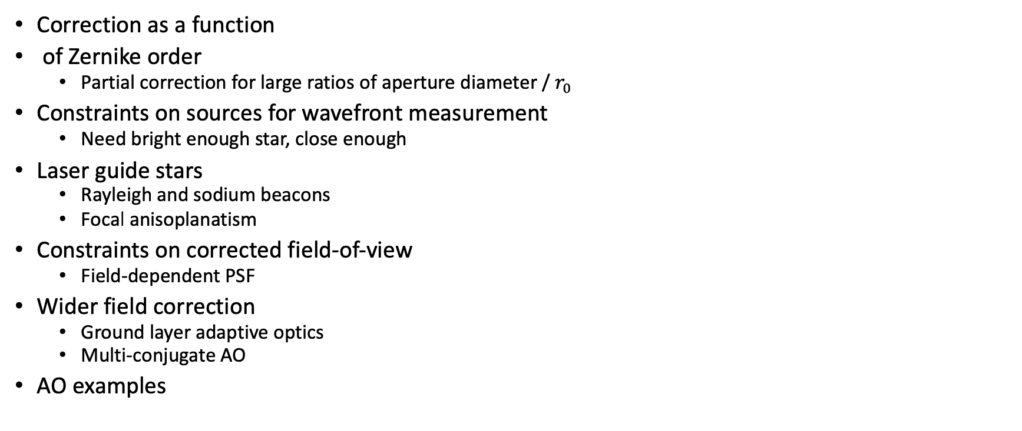
AO wavefront correction, limitations, and overcoming them
Correction as a function
of Zernike order
  Partial correction for large ratios of aperture diameter / $r_{0}$
Constraints on sources for wavefront measurement
  Need bright enough star, close enough
Laser guide stars
  Rayleigh and sodium beacons
  Focal anisoplanatism
Constraints on corrected field-of-view
  Field-dependent PSF
Wider field correction
  Ground layer adaptive optics
  Multi-conjugate AO
AO examples

Slide 25
Telescopes
Large telescopes
  Large mirror construction
    Borosilocate honeycomb
    Thin mirrors
    Segmented mirrors
  Large telescopes in the world
Mirror coatings
Telescope mounts
  Equatorial
  alt-az
    Need for derotator
  Pointing and pointing models
    Typical pointing accuracy
  guiding

Slide 26
Instruments
General considerations
  Location of optics: near focal plane vs near pupil
  Throughput : transmission and reflection
  Refractive vs reflective optics
    achromats

Slide 27
Instrument examples
Field flatteners
Focal plane reimagers
  Why?
Pupil reimagers
  Field lens
  Motivations
    Adaptive optics
    Minimize size of optics, e.g. https://www.rp-photonics.com/field_lenses.html
    Coronagraphs
    IR instruments and cold pupil stops

Slide 28
Filters
classification by width
  Broad-band
  Medium-band
  Narrow band
Classification by type
  Colored glass
  Interference filters: partially reflecting parallel surfaces
    mλ = 2nd cosθ
    Dependences on angle of incidence: implication for filter location and bandpass variation in different optical systems
    Note also antireflection coatings

Slide 29
Imaging spectroscopy: Fabry-Perot interferometer
the etalon: a tunable interference filter
Location of etalon in collimated beam
  Implication: different bandpass at different field angle
Fabry-Perot data cubes

Slide 30
Dispersing spectrographs
Basic design
  Focal plan reimager, with a dispersing element
  Dispersing elements:
    Diffraction grating
    Prism
Basic spectrograph user characteristics
  dispersion
    Angular dispersion (angle per wavelength, e.g. radians/A) : dispersing element
    Linear dispersion (distance per wavelength e.g. mm/A) : dispersing element + camera lens
    Inverse linear dispersion (wavelength per distance, e.g. A/mm or A/pixel)
  resolution
  throughput

Slide 31
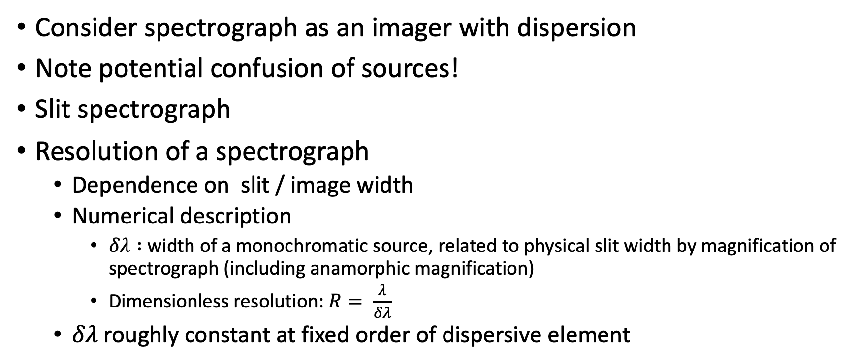
Spectrographs
Consider spectrograph as an imager with dispersion
Note potential confusion of sources!
Slit spectrograph
Resolution of a spectrograph
  Dependence on slit / image width
  Numerical description
    $δλ :$ width of a monochromatic source, related to physical slit width by magnification of spectrograph (including anamorphic magnification)
    Dimensionless resolution: $R= \frac{λ}{δλ}$
  $δλ$ roughly constant at fixed order of dispersive element

Slide 33
Astronomical spectrographs
Slitless spectroscopy
  E.g. grism
  Implication for sky background
Long-slit spectroscopy
multiobject spectroscopy with slitlets
Image slicers:
Fiber spectrographs
Integral field spectrograph

Slide 34
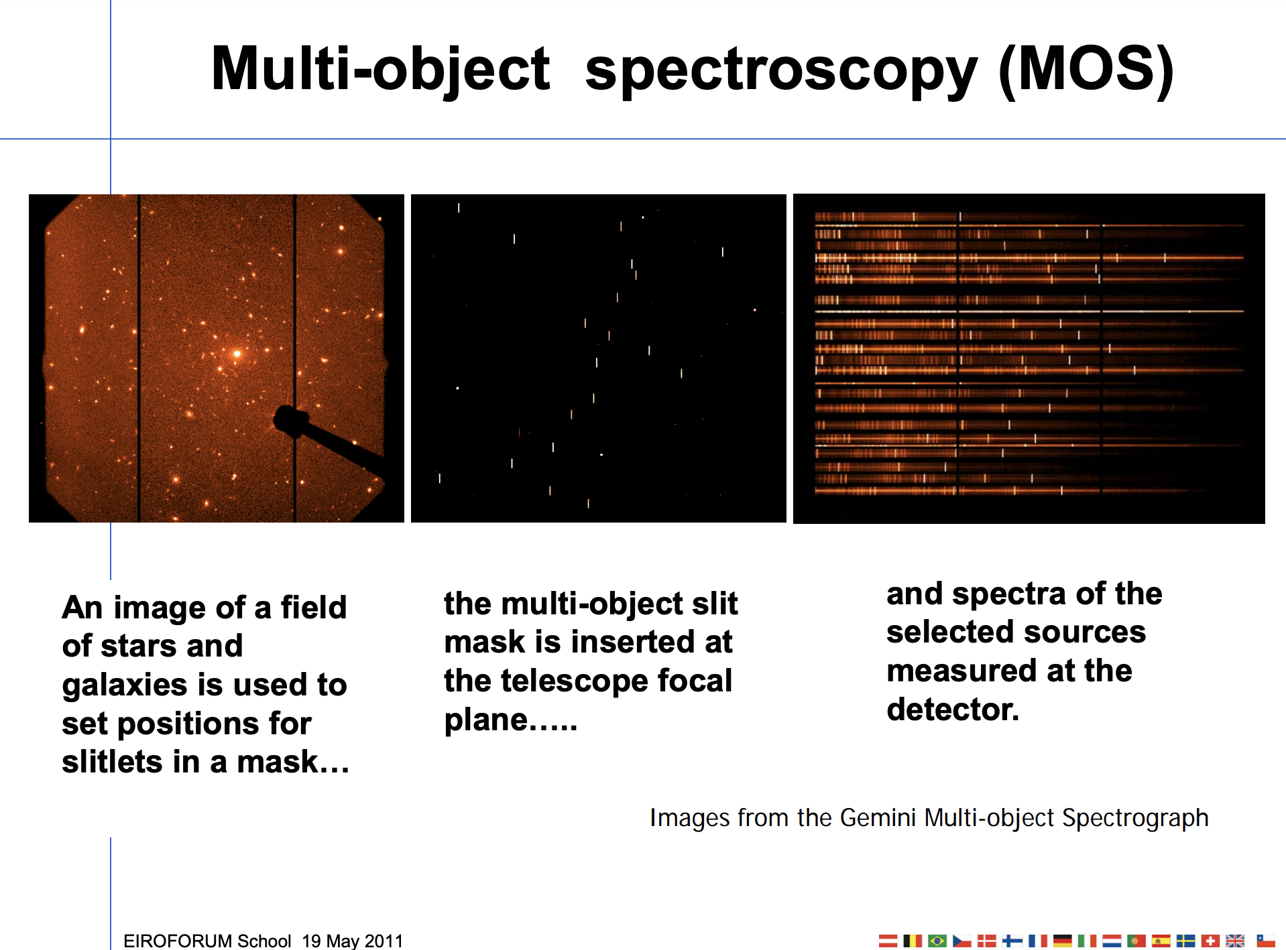

Slide 35
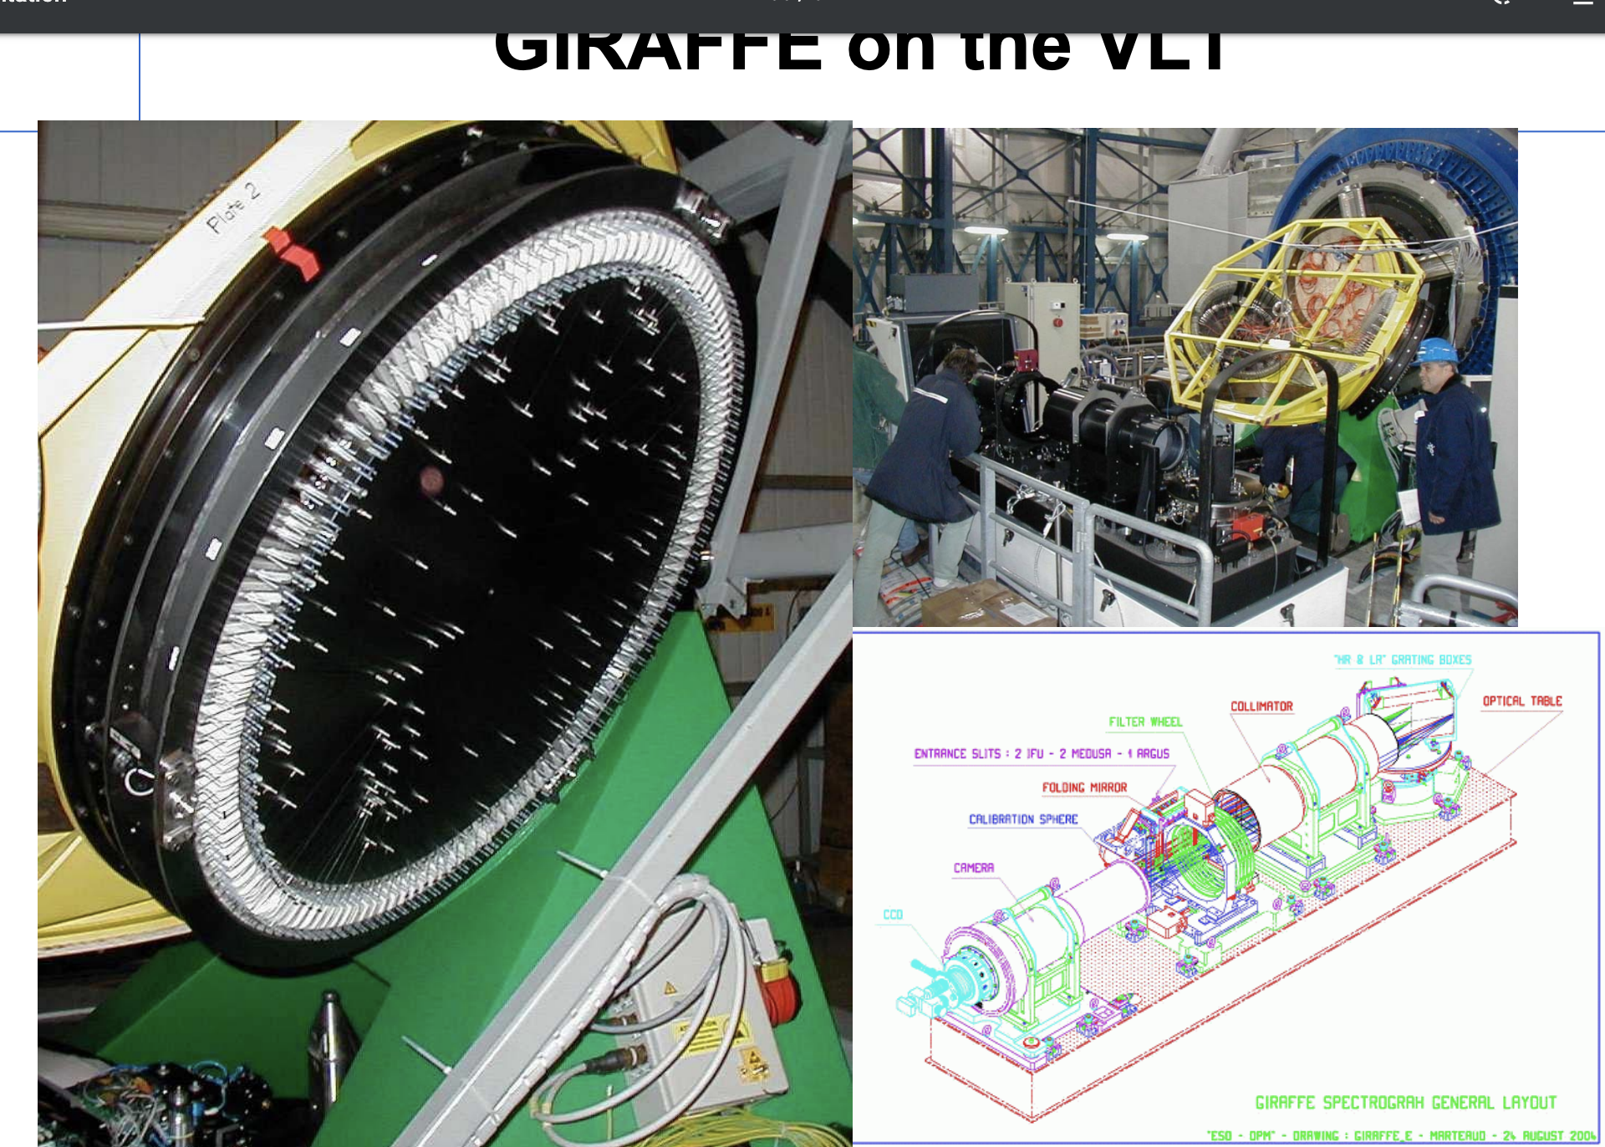

Slide 36
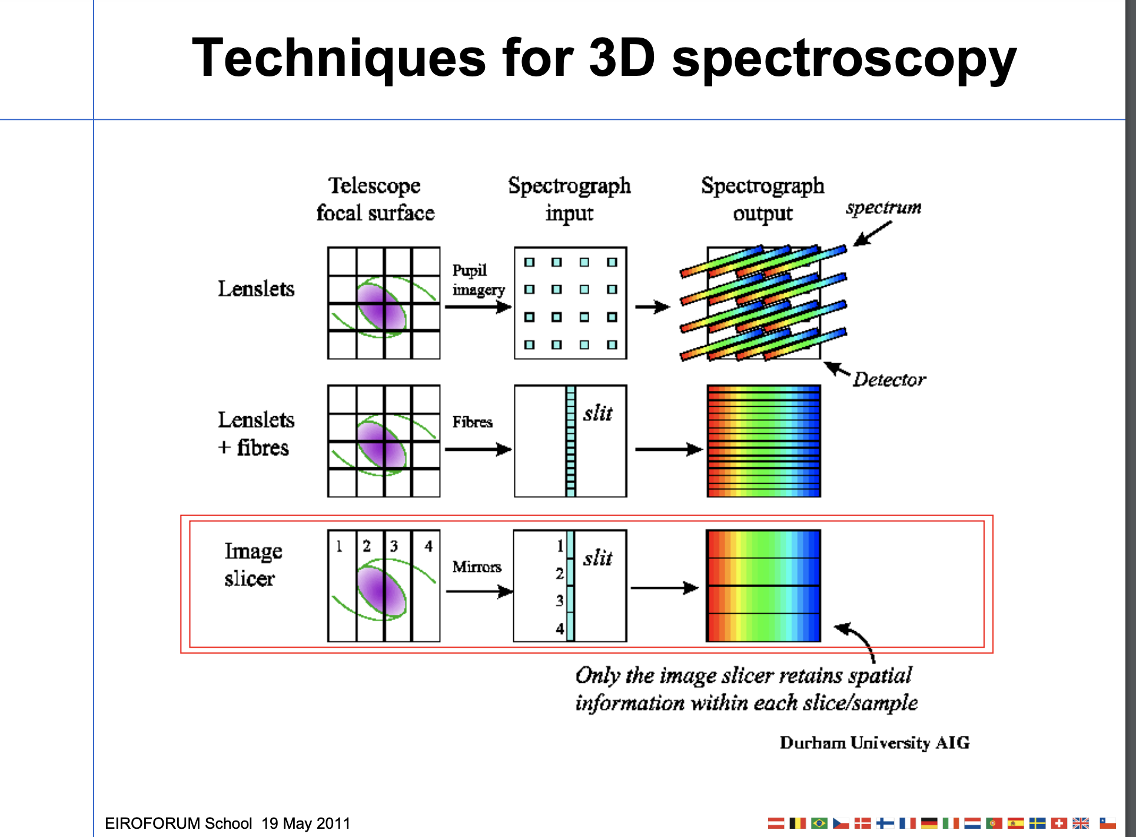

Slide 37
Dispersing elements
Prisms
Diffraction gratings: multi-slit interference (note this is not spectrograph slit!)
  Grating equation
    mλ = σ(sinβ + sinα)
  Orders and order overlap
  Echelle spectroscopy
  Anamorphic magnification
  Grating throughput/efficiency and grating blaze
    Volume phase holographic (VPH) gratings

Slide 38
Detectors
Basic types:
  Photographic
  Photon counter: photons make “events”
    Photomultipliers
    Photon counting arrays
  Photon collector: photons generate photoelectrons
    Photoelectric effect
    Different materials: Si, HgCdTe, InSb, PtSi

Slide 39
Detector characteristics
Quantum efficiency
Size / resolution elements
Discovery efficiency : size * QE
Dark current
Linearity
Full well

Slide 40
More detector characteristics
Others
  Defects
  Modulation transfer function (note fringing)
  Readout speed
  Saturation behavior
  Hysteresis
  reciprocity

Slide 41
Digitization
A/D converters: bits and output range
Gain/amplification
  Implication for noise calculations
Dynamic range
Determining gain and readout noise

Slide 42
CCDs
Readout method
Charge transfer
  CTE
  Deferred charge
QE
  Front side vs back side thinned

Slide 43
CMOS detectors
Readout method

Slide 44
IR detectors
Readout method: multiplexer
Non-destructive readout
Reset (kTC) noise
Readout noise
Readout modes
  Doubly correlated sampling
  Fowler sampling
  Up the ramp sampling

Slide 45
UV detectors
Because of low background, photon counting devices are often preferred

