Slide 1
ASTR 535
Observational Techniques
Optics / Telescopes
Basic optics

Slide 2
Learning Objectives
Understand basic optics: refraction and reflection
Understand basic terminology: objects and images (real and virtual), rays
Understand what the paraxial regime means and the equations that govern paraxial (first-order) optics
Understand terminology: focal ratio, magnification, and scale
Know how to compute the plate scale for a telescope

Slide 3
Optics and astronomy
As astronomers study light, optics are a critical tool
Especially true given that most objects are very faint, so need to collect light over large area and attempt to direct it all to the same place

Slide 4
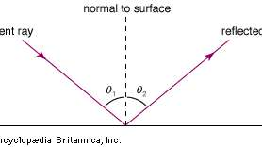
Refraction and reflection
Can redirect light using mirrors (reflection) or lenses (refraction)
Reflection:
  law of reflection: i = - i’
  where angles are measured relative to surface normal
Refraction:
  Snell’s law: n sin i = n'sin i’
  where angles are measured relative to surface normal, and n and n’ are the indices of refraction

Slide 5
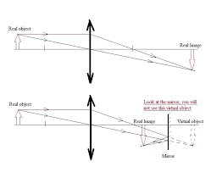
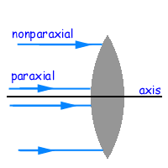
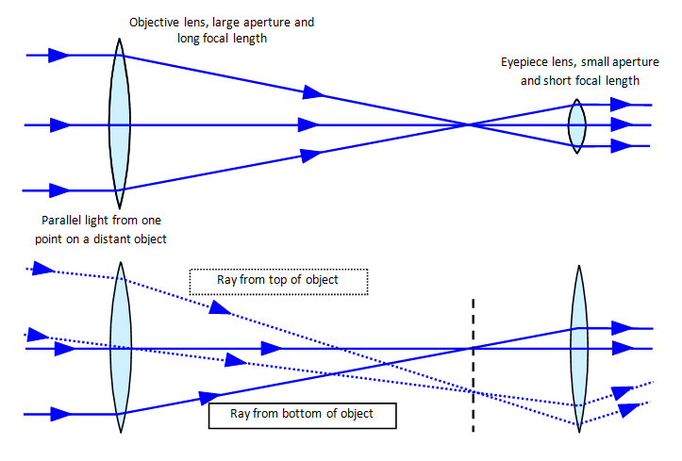
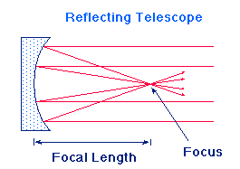
Basic optics terms
Images and objects
  Real and virtual
Basic terminology
  Optical axis
  Rays: chief ray, paraxial rays, marginal rays
  Field angle
Geometric optics vs diffraction/physical optics
Field angle

Slide 6
Paraxial regime
Consider rays near the chief ray
Angles are small
No aberrations: all rays focus at the same place
Optical surface specified fully by radius of curvature – surface can be approximated by a sphere
Can still consider objects at non-zero field angle

Slide 7
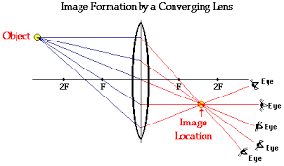
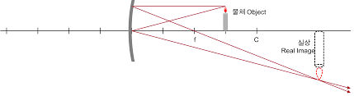
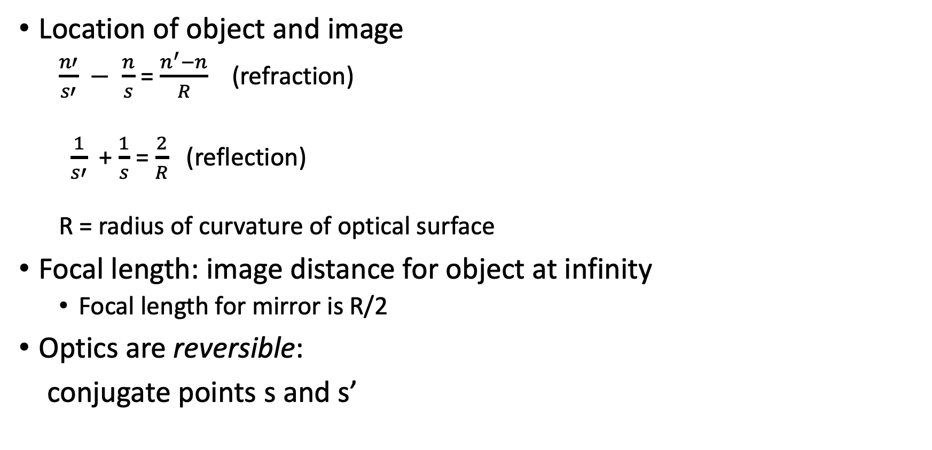
First order optics
s’
Location of object and image
  $\frac{n′}{s′} − \frac{n}{s}$ = $\frac{n^{′}−n}{R}$ (refraction)
  $\frac{1}{s′}$ + $\frac{1}{s}$ = $\frac{2}{R}$ (reflection)
  R = radius of curvature of optical surface
Focal length: image distance for object at infinity
  Focal length for mirror is R/2
Optics are reversible:
conjugate points s and s’
s
s’
s

Slide 8
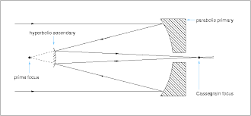
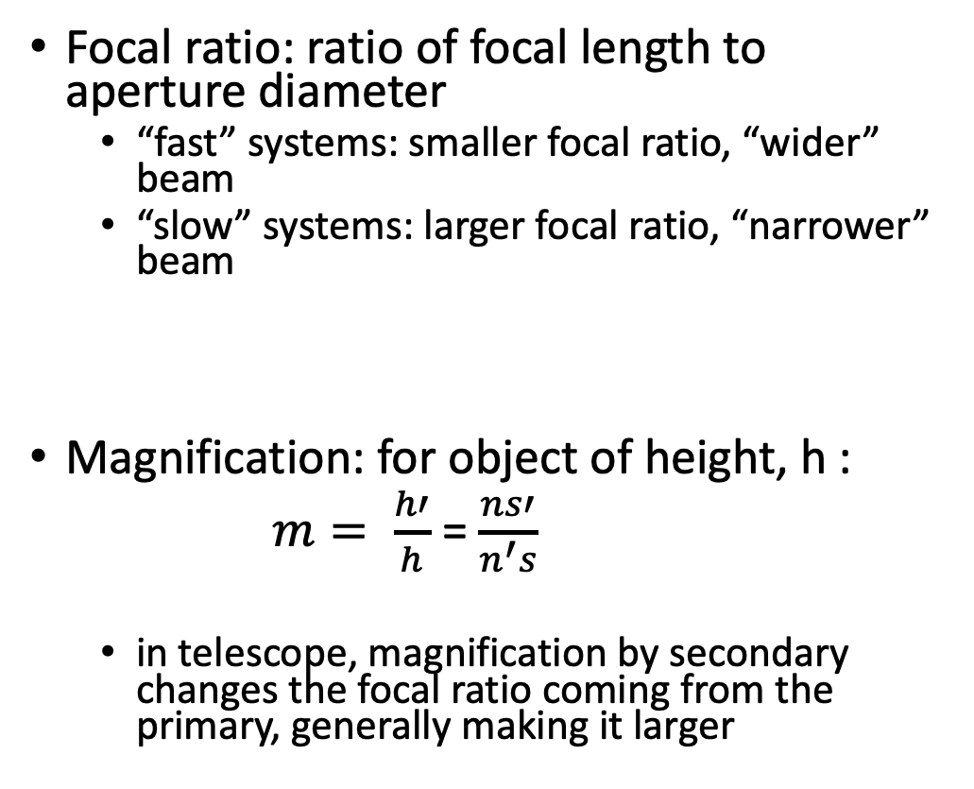
Focal ratio and magnification
Focal ratio: ratio of focal length to aperture diameter
  “fast” systems: smaller focal ratio, “wider” beam
  “slow” systems: larger focal ratio, “narrower” beam
Magnification: for object of height, h :
$m= \frac{h′}{h}$ = $\frac{ns′}{n^{′}s}$
  in telescope, magnification by secondary changes the focal ratio coming from the primary, generally making it larger

Slide 9
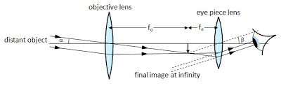
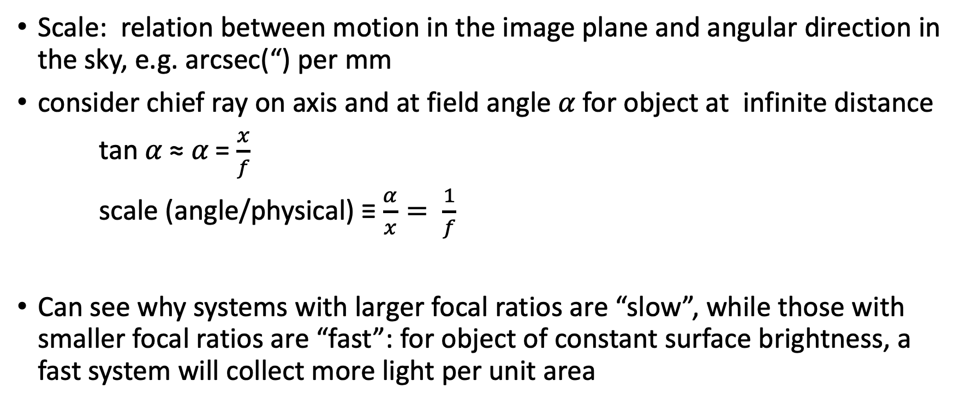
Telescope scale
Scale: relation between motion in the image plane and angular direction in the sky, e.g. arcsec(“) per mm
consider chief ray on axis and at field angle 𝛼 for object at infinite distance
tan 𝛼 ≈ 𝛼 = $\frac{x}{f}$
scale (angle/physical) ≡ $\frac{α}{x}= \frac{1}{f}$
Can see why systems with larger focal ratios are “slow”, while those with smaller focal ratios are “fast”: for object of constant surface brightness, a fast system will collect more light per unit area
cx
x

Slide 11
ASTR 535
Observational Techniques
Optics / Telescopes
Multisurface systems

Slide 12
Learning Objectives
Understand the basic principles of how multi-surface optical systems work and how they are often described by “equivalent” single surface systems
Understand the basic families of two-mirror telescopes and how each family has different configurations that provide different performance
Understand how focus is achieved at a telescope
Understand basic terminology of stops and pupils

Slide 13
Multi surface systems
Most optical systems will have more than one optical element
Basic principle of calculation: each successive surface takes image of preceding surface as its object, and makes an image of it
For multi-surface systems, can define ”effective” parameters, i.e., parameters of an “equivalent” single element system
  for example, the effective focal length
  The single element system is “equivalent” only to first-order

Slide 14
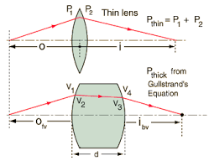
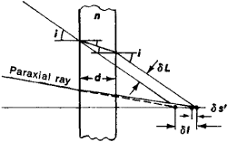
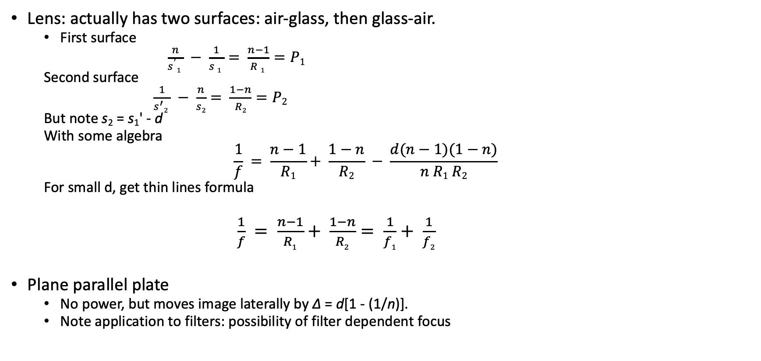
Example: lenses
Lens: actually has two surfaces: air-glass, then glass-air.
  First surface
  $\frac{n}{s^{′}1 } − \frac{1}{s 1 }= \frac{n−1}{R 1 }=P1$
  Second surface
  $\frac{1}{s^{′}2 } − \frac{n}{s2}= \frac{1−n}{R2}=P2$
  But note s₂ = s₁' - d
  With some algebra
  $$\frac{1}{f} = \frac{n−1}{R1}+ \frac{1−n}{R2} − \frac{d(n−1)(1−n)}{n R1 R2}$$
  For small d, get thin lines formula
$\frac{1}{f} = \frac{n−1}{R1}+ \frac{1−n}{R2}= \frac{1}{f1}+ \frac{1}{f2}$
Plane parallel plate
  No power, but moves image laterally by Δ = d[1 - (1/n)].
  Note application to filters: possibility of filter dependent focus

Slide 15
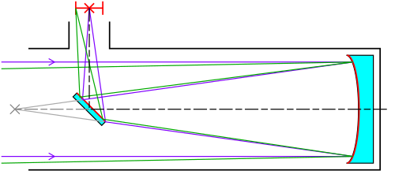
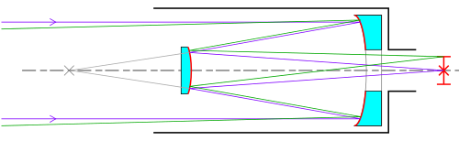
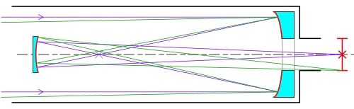
Example: two mirror telescopes
Newtonian
Two mirror telescope families
  Newtonian: flat secondary
  Cassegrain: convex secondary
  Gregorian: concave secondary
Within each family, there are many configurations, with different radii of curvatures of mirrors and mirror separations, leading to different magnifications, focal ratios, effective focal lengths, etc.
Cassegrain
Gregorian

Slide 16
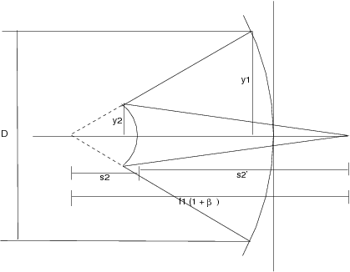
Basic design of 2-mirror telescopes
User/science: primary diameter, scale, back focal distance
Adjustable design parameters: primary diameter, radii of curvature, separation of mirrors
  Primary mirror radius of curvature limited by cost/technology
Effective focal length = f_{primary} m
  Often calculated from primary diameter and effective focal ratio
  Effective focal length determines scale

Slide 17
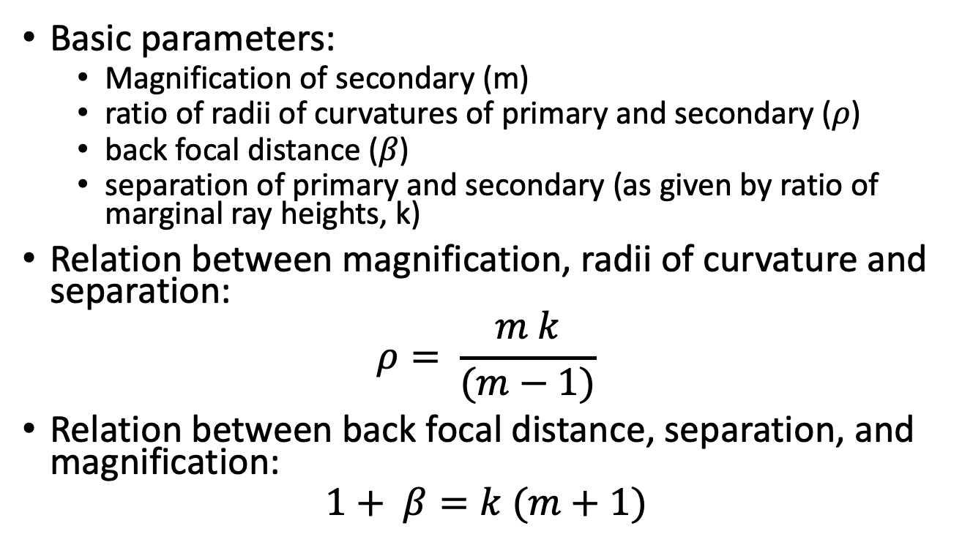
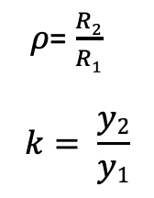
Basic equations of two mirror telescopes
Basic parameters:
  Magnification of secondary (m)
  ratio of radii of curvatures of primary and secondary (𝜌)
  back focal distance (𝛽)
  separation of primary and secondary (as given by ratio of marginal ray heights, k)
Relation between magnification, radii of curvature and separation:
$$ρ= \frac{m k}{(m−1)}$$
Relation between back focal distance, separation, and magnification:
$$1+ β=k (m+1)$$
𝜌= $\frac{R2}{R1}$
$$k= \frac{y2}{y1}$$

Slide 18
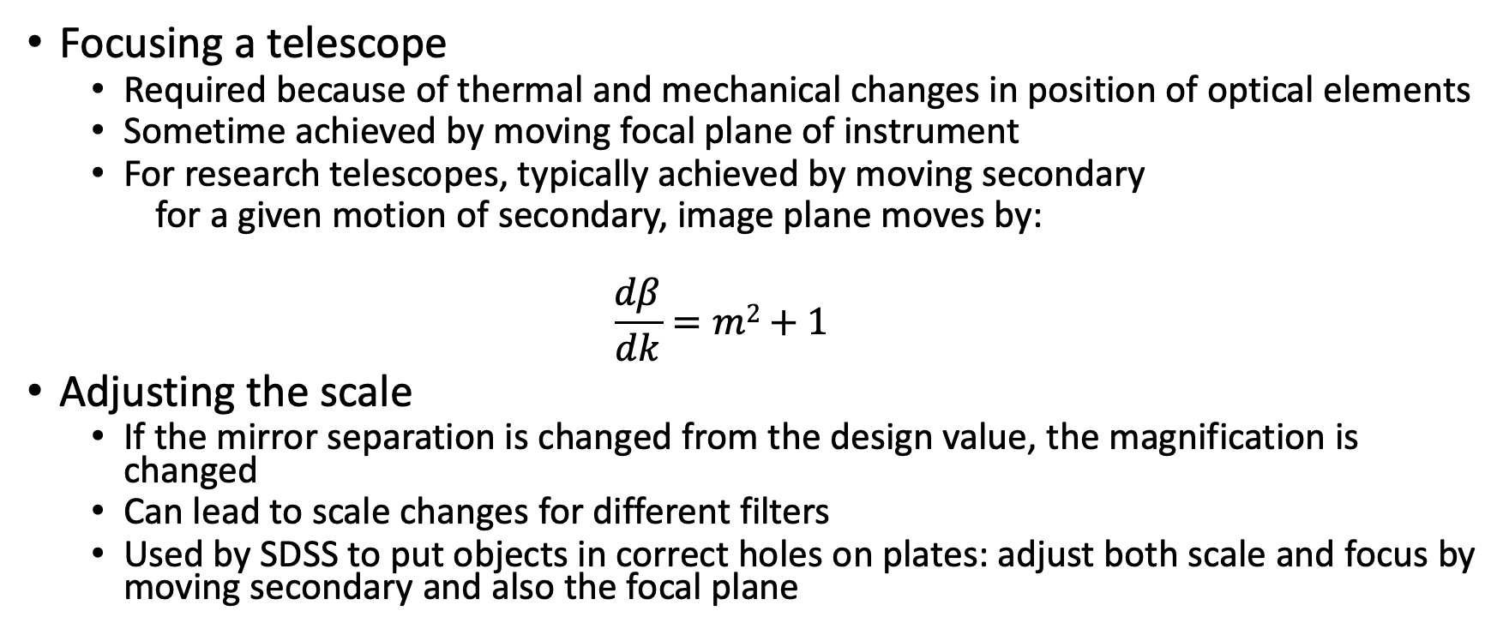
Secondary mirror movement and the focal plane
Focusing a telescope
  Required because of thermal and mechanical changes in position of optical elements
  Sometime achieved by moving focal plane of instrument
  For research telescopes, typically achieved by moving secondary
  for a given motion of secondary, image plane moves by:
  $$\frac{dβ}{dk}=m2+1$$
Adjusting the scale
  If the mirror separation is changed from the design value, the magnification is changed
  Can lead to scale changes for different filters
  Used by SDSS to put objects in correct holes on plates: adjust both scale and focus by moving secondary and also the focal plane

Slide 19
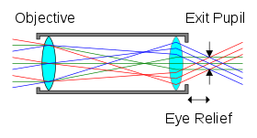
Pupils and stops
Stops: locations that limit something
  Aperture stop: location the limits the amount of light passing through an optical system
    For telescopes, almost always the primary mirror
  Field stop : location that limits the field-of-view of an optical system
    For telescopes, usually the detector, but could also be the secondary or some optical element in the system
Pupils: location where light from all field angles fills the same footprint
  entrance pupil: first pupil
  exit pupil: last pupil
  Each pupil is an image of the previous one
  Pupils are important for multiple reasons

Slide 21
Problem: telescope design
Someone gives you an 8m f/1.5 concave mirror
Design a telescope!
  What is the primary mirror scale?
  What image scale might you want?
  What magnification is required?
  What is the primary focal length?
  What back focal distance?
  What mirror separation?

Slide 23
ASTR 535
Observational Techniques
Optics / Telescopes
Telescope technologies

Slide 24
Learning Objectives
Learn about some large mirror technologies and be aware of the world’s largest telescope
Learn about different mirror coatings
Understand the difference between equatorial and alt-az mounts, and understand the field rotation that occurs in the latter
Learn a bit about telescope pointing and guiding

Slide 25
Telescope mirrors
LBT
Refractors vs reflectors
Large mirror construction
  Challenges: gravity, thermal
  Solutions:
  Borosilocate honeycomb
  Thin mirrors
  Segmented mirrors
SALT
TMT and ELT concept
GTC
VLT

Slide 26
Large telescopes of the world
World’s largest telescopes
Extremely large telescopes of the (near?) future

Slide 27
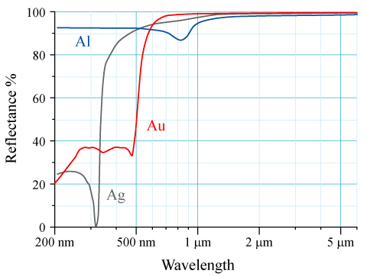
Mirror coatings
Reflectivity of mirrors comes from very thin metallic coating
  Aluminum (Al) is typical
  Silver and gold have slightly higher near-IR reflectivity, but lower in blue
Mirrors periodically need to be recoated due to degradation of coating
  Affects some telescope closure criteria, e.g. humidity and dust

Slide 28
Telescope mounts and pointing
Telescope mounts
  Equatorial
    Focal plane aligned with NSEW
  alt-az
    Focal plane aligned with zenith/horizon
    Need for derotator
Pointing and pointing models
  Typical pointing accuracy : few arcseconds
  Guiding

Slide 30
ASTR 535
Observational Techniques
Optics / Telescopes
Aberrations

Slide 31
Learning Objectives
Understand Fermat’s principle, and know what optical shapes produce unaberrated images for different situations.
Know the terminology: conic constant
Understand the basic concepts of aberration.
Know what the five third-order aberrations are: spherical, astigmatism, coma, field curvature, and distortion and have a basic idea about how the affect image quality or location

Slide 32
Aberrations: surface shapes for perfect images
Fermat’s principle
  Light travels path such that small variations in path doesn’t change light travel time. Alternatively, light travels such that the optical path length (OPL) is unchanged to first order for small change in path
  OPL = ∫ c dt = ∫ (c/v) v dt = ∫ n ds
  Implies the laws of refraction and reflection
  Consistent with wave theory
Implication for unaberrated images: if we want light from all location in the aperture to arrive at the same location, they must all have the same optical path length
  Implication for the surface shape depends on situation, i.e. where the object is located relative to the aperture

Slide 33
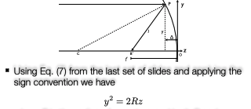
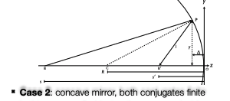
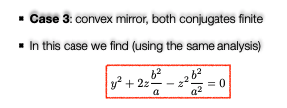
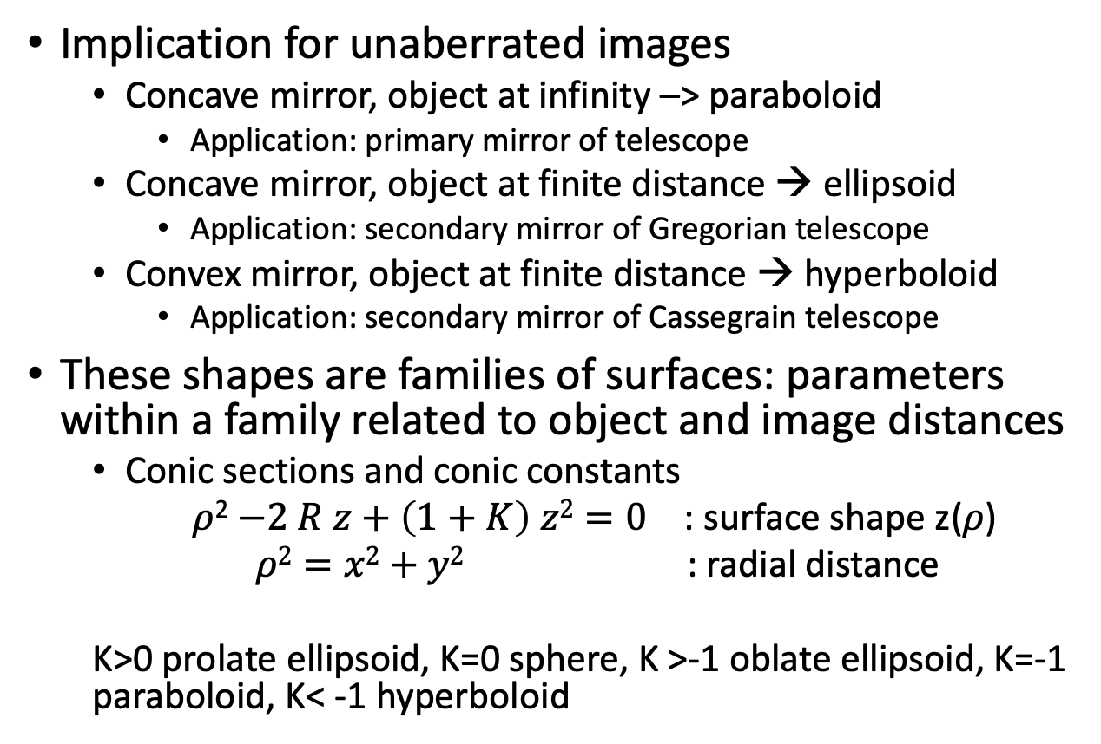
Fermat’s principle and shapes for unaberrated images
Implication for unaberrated images
  Concave mirror, object at infinity –> paraboloid
    Application: primary mirror of telescope
  Concave mirror, object at finite distance → ellipsoid
    Application: secondary mirror of Gregorian telescope
  Convex mirror, object at finite distance → hyperboloid
    Application: secondary mirror of Cassegrain telescope
These shapes are families of surfaces: parameters within a family related to object and image distances
  Conic sections and conic constants
  $ρ$²$−2 R z+\left(1+K\right) z2=0$ : surface shape z(𝜌)
  $ρ2=x2+y2$ : radial distance
  K>0 prolate ellipsoid, K=0 sphere, K >-1 oblate ellipsoid, K=-1 paraboloid, K< -1 hyperboloid

Slide 34
Aberrations
Aberrations will be present if:
  Surface shape is non-optimal per Fermat’s principle
  Off-axis objects! (since only sphere is the same when seen off axis)

Slide 35
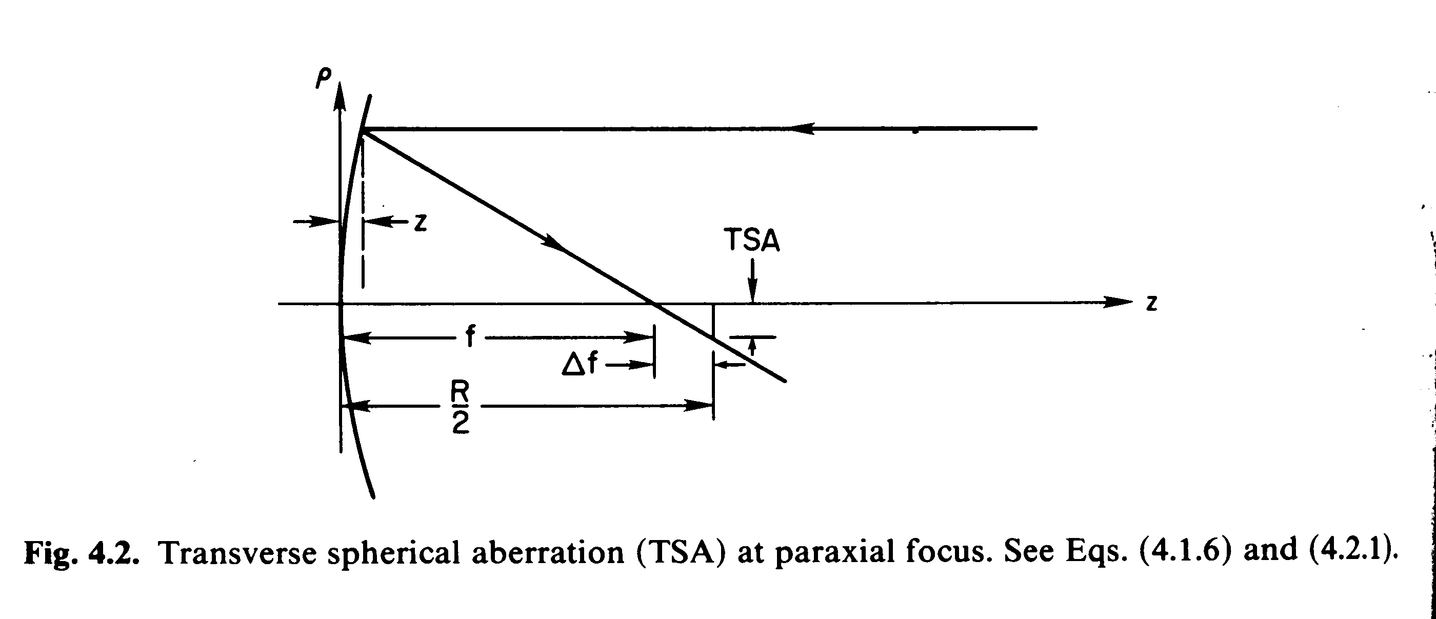
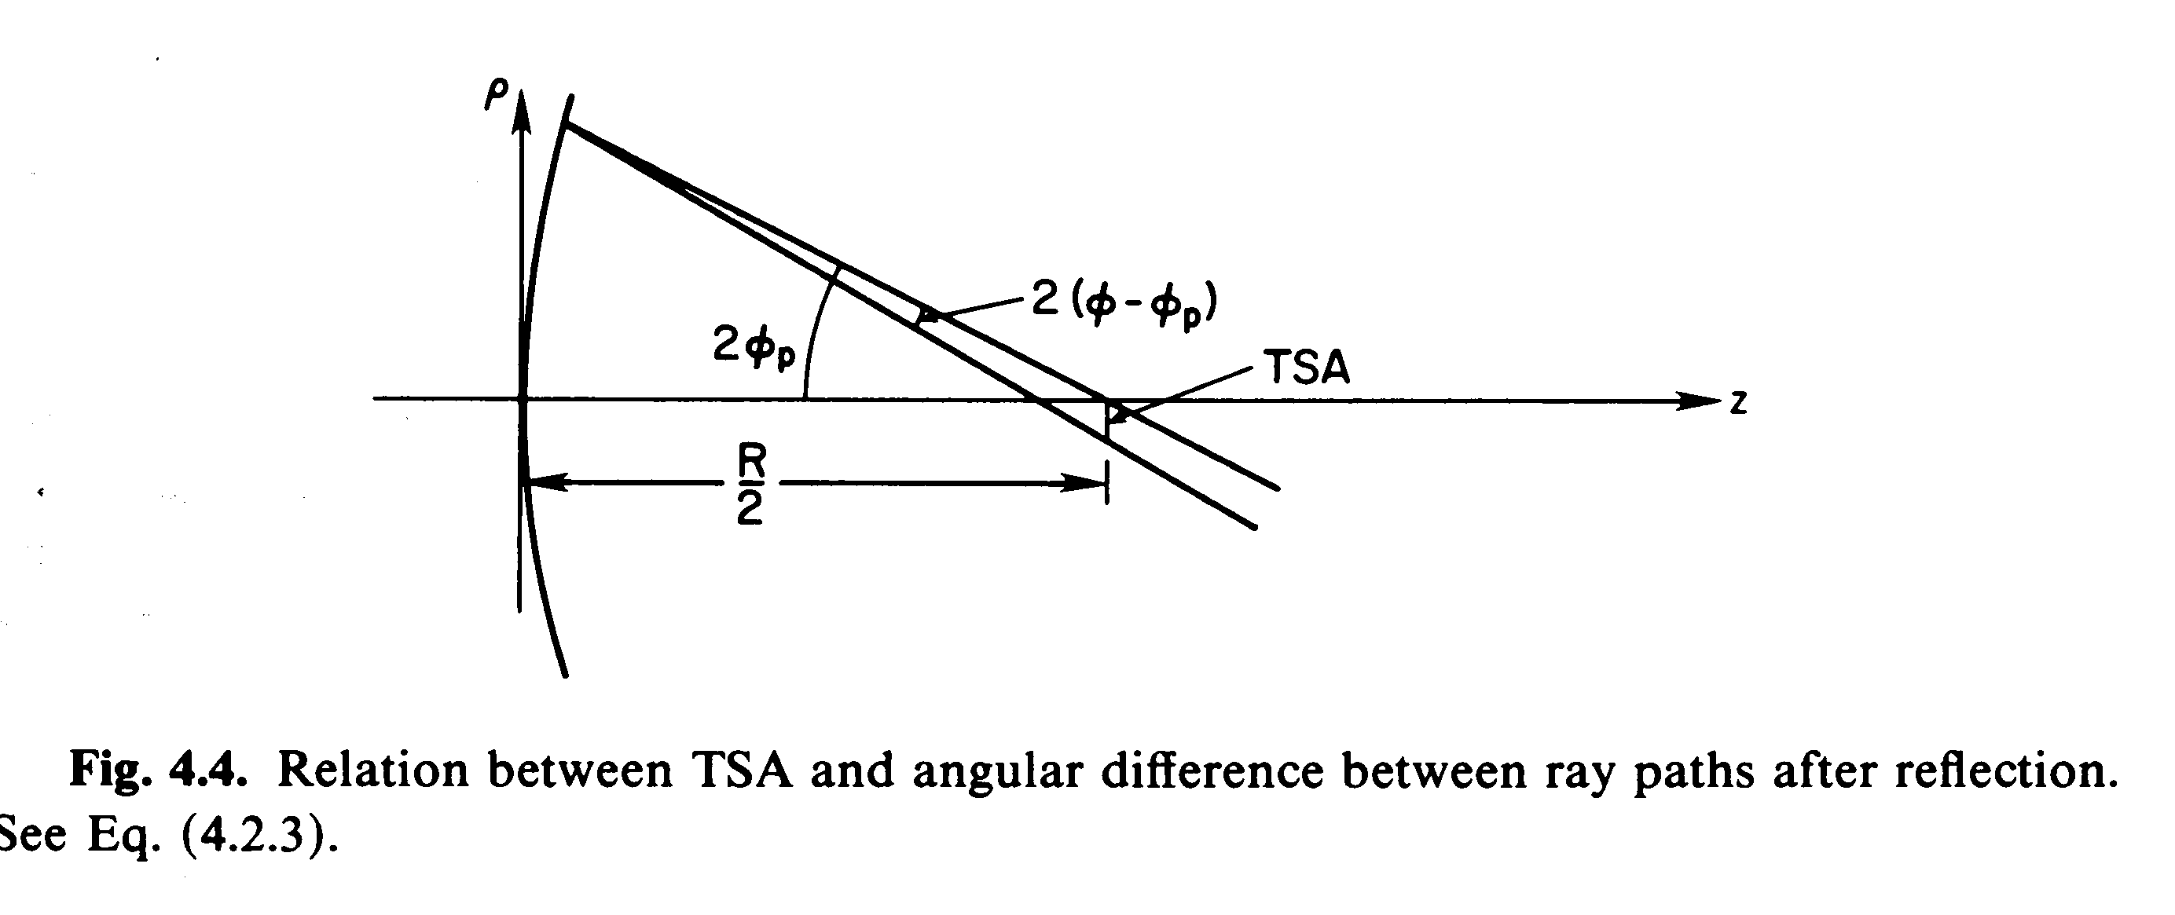
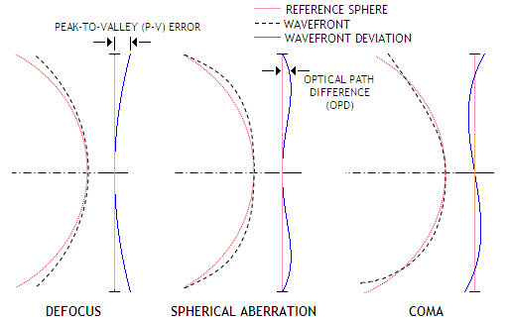
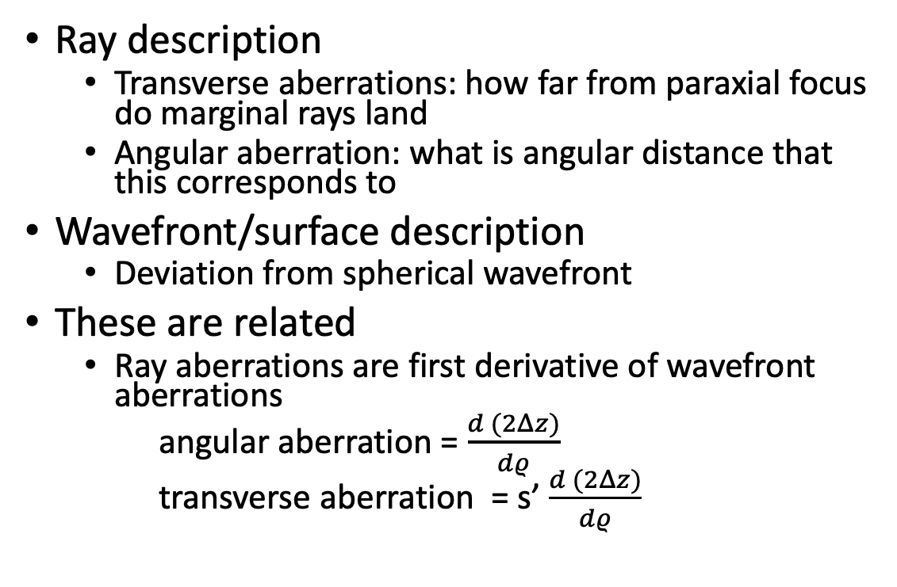
Characterizing aberrations
Ray description
  Transverse aberrations: how far from paraxial focus do marginal rays land
  Angular aberration: what is angular distance that this corresponds to
Wavefront/surface description
  Deviation from spherical wavefront
These are related
  Ray aberrations are first derivative of wavefront aberrations
  angular aberration = $\frac{d (2Δz)}{dρ}$
  transverse aberration = s’ $\frac{d (2Δz)}{dρ}$
Schroeder, Astronomical Optics

Slide 36
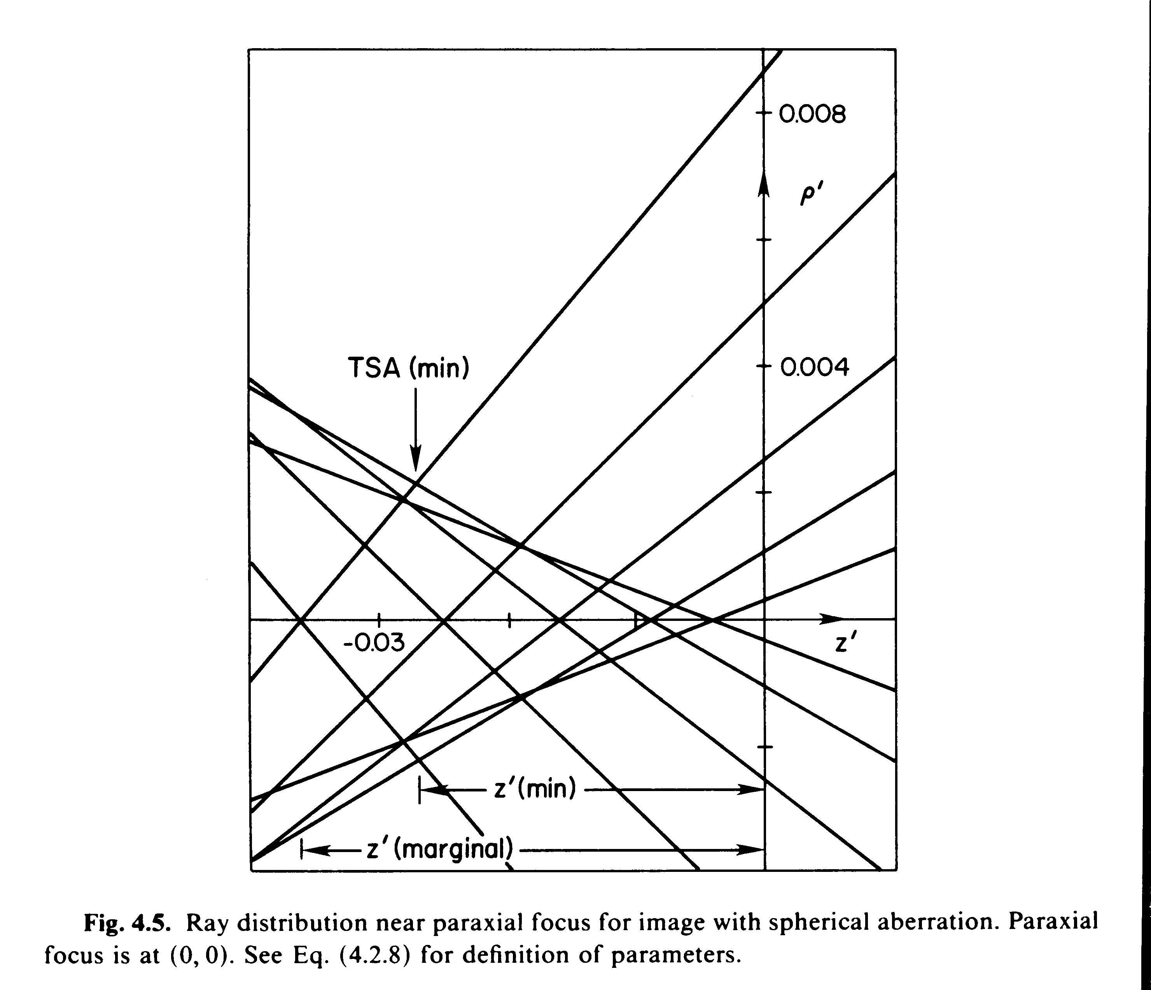
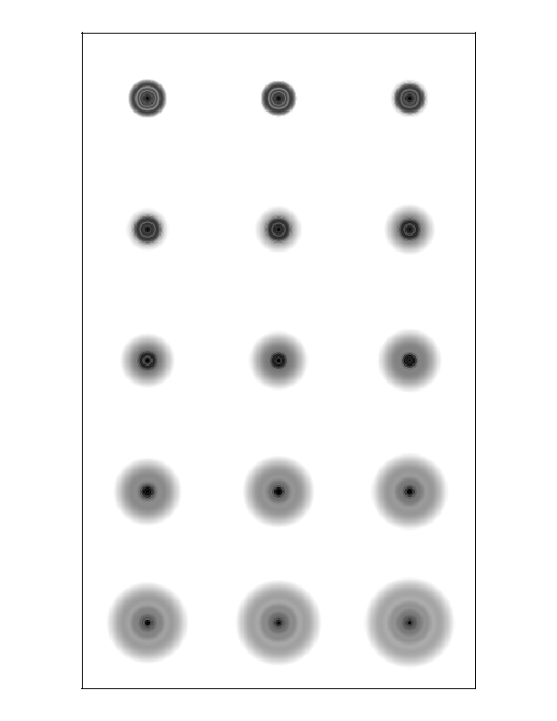
Spherical aberration
Present on-axis for non-ideal mirror shape
  Rays from different locations in aperture focus at different places
Terminology:
  transverse spherical (TSA), angular spherical (ASA)
  Paraxial, marginal, diffraction, circle of least confusion focal points
Schroeder, Astronomical Optics
Schroeder, Astronomical Optics

Slide 37
General third order aberrations
Can expand aberrations into a series expansion in distance from optical axis and field angle
  First order terms are paraxial approximation
  Next terms are third order: 𝜌^{m}𝜃^{n} , where n+m=3
Five third order aberrations
  Spherical aberration
  Astigmatism
  Coma
  Field curvature
  Distortion

Slide 38
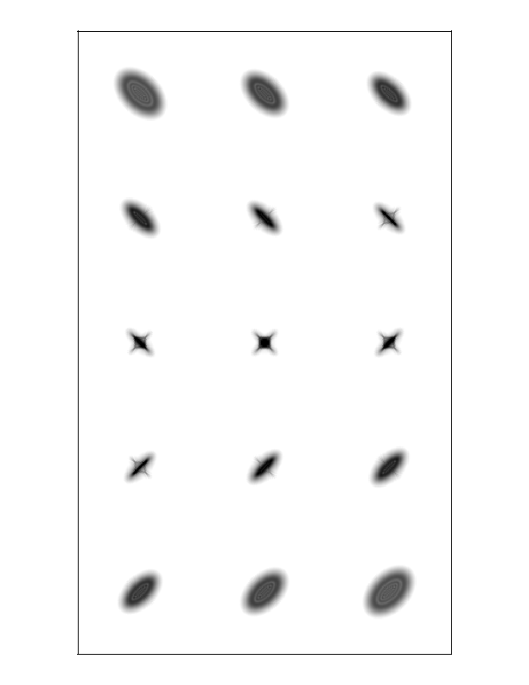
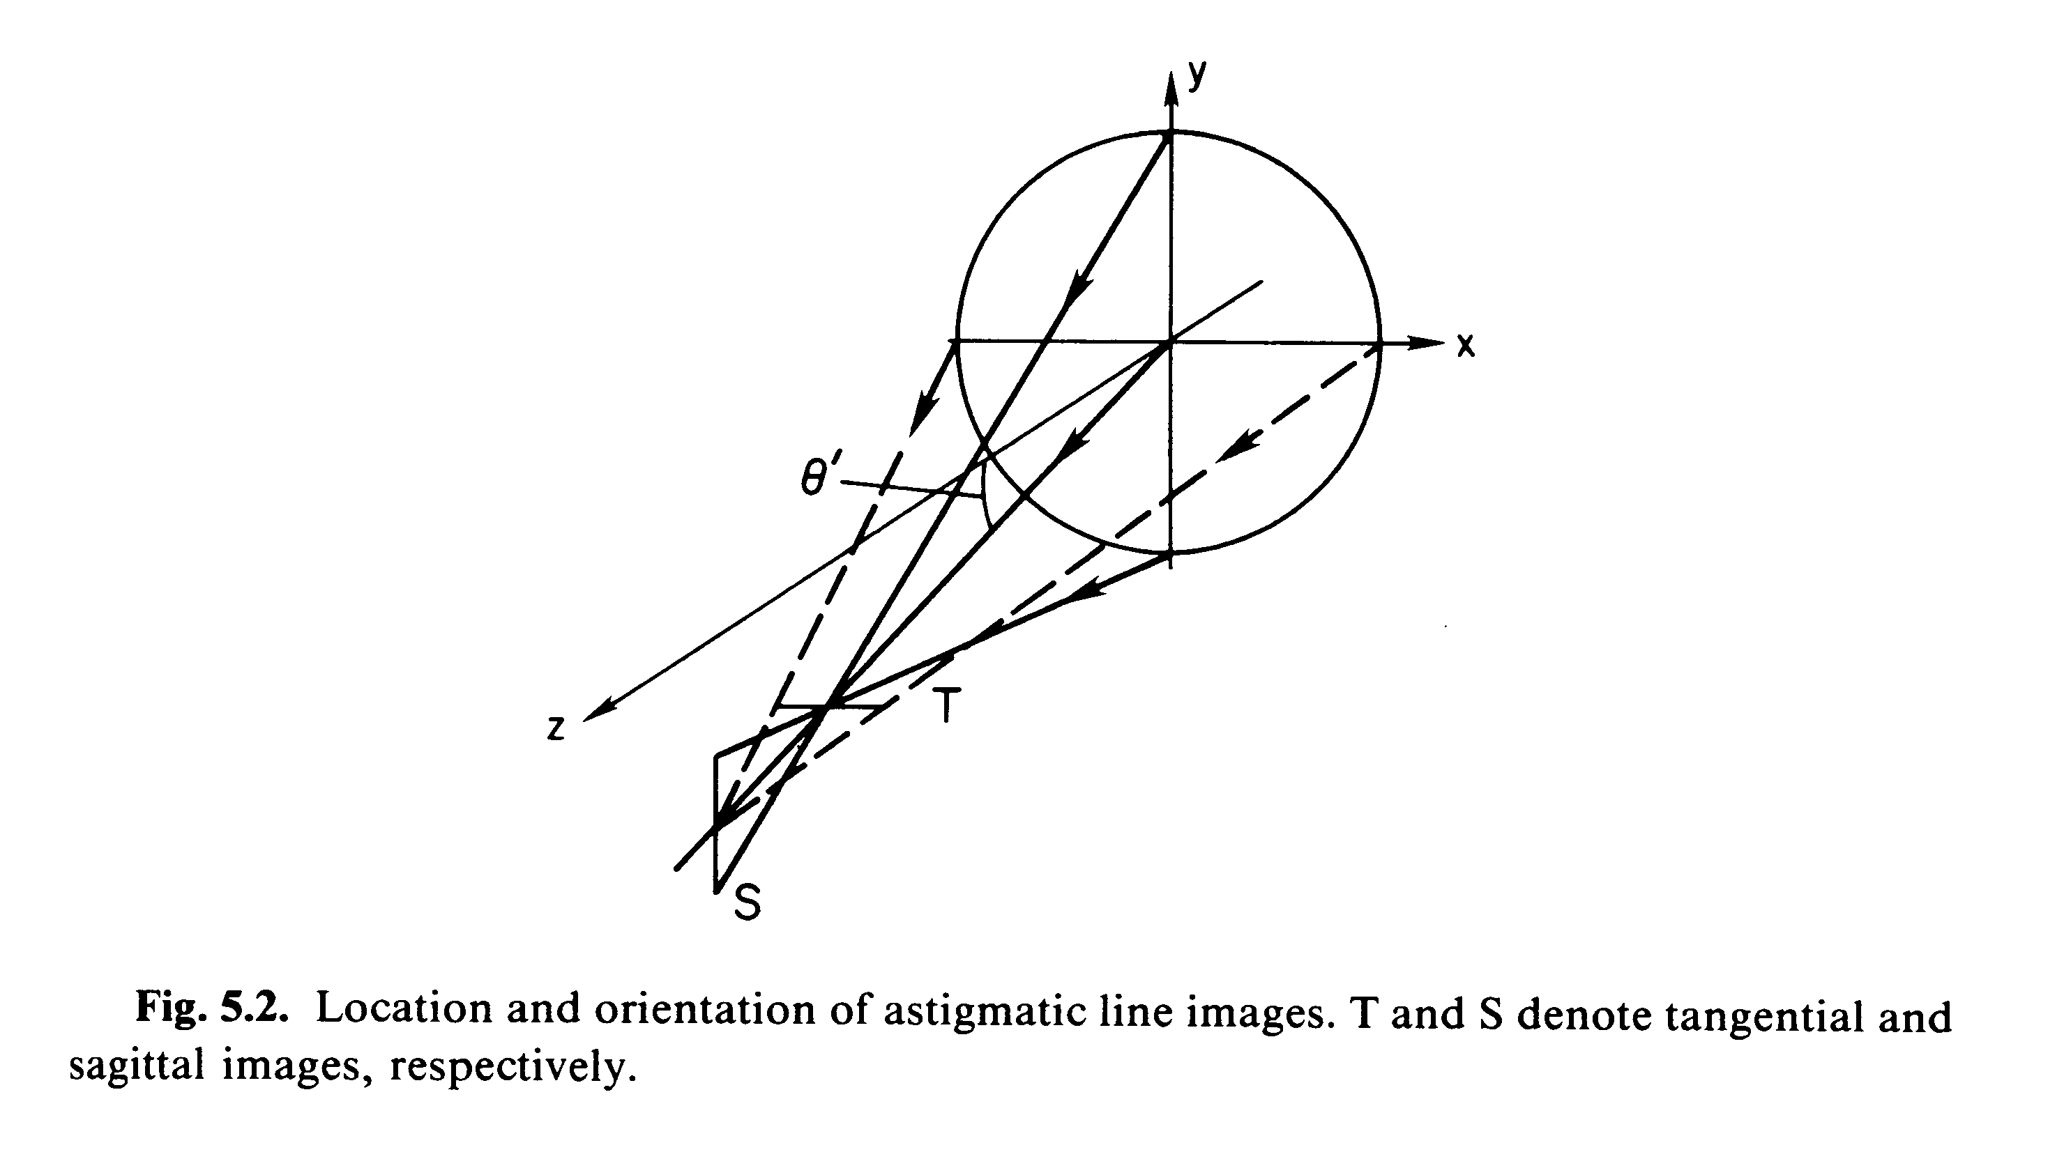
Astigmatism
Rays from different azimuth angles in aperture focus at different locations
Leads to characteristic elongated images that flip by 90 degrees as you go through focus
Schroeder, Astronomical Optics

Slide 39
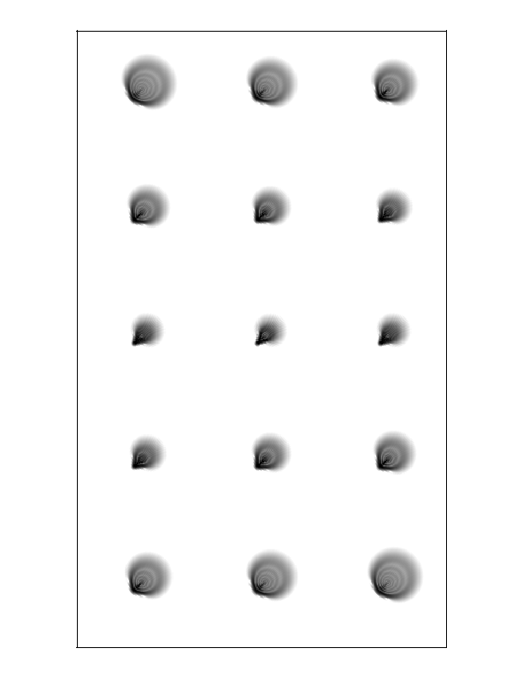
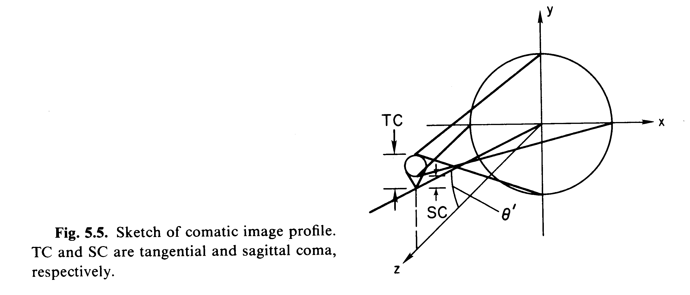
Coma
Rays from different azimuthal angles focus at same distance but offset from paraxial rays, and different for rays from different azimuth angles
Leads to characteristic “comet” shape, which is symmetric as one passes through focus
Schroeder, Astronomical Optics

Slide 40
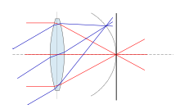
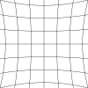
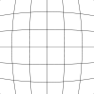
Field curvature and distortion
Field curvature
Field curvature and distortion affect image position, not (directly) image quality
Field curvature: curved focal plane. If flat detector is used, leads to focus variations across field of view
Distortion: leads to plate scale variations across field of view
Distortion

Slide 42
Topics 10/13
APO observing: housing reservations and vaccination cards
Questions : midterm/reading
Telescope technology
Aberrations
TMO observing procedures

Slide 43
ASTR 535
Observational Techniques
Optics / Telescopes
Aberration compensation and sources of aberration

Slide 44
Learning objectives
Understand how multi-surface systems can be used to reduce or remove aberrations.
Know the terminology: aplanatic telescope, Ritchey-Chretien telescope.
Understand some of things that can lead to aberrations

Slide 45
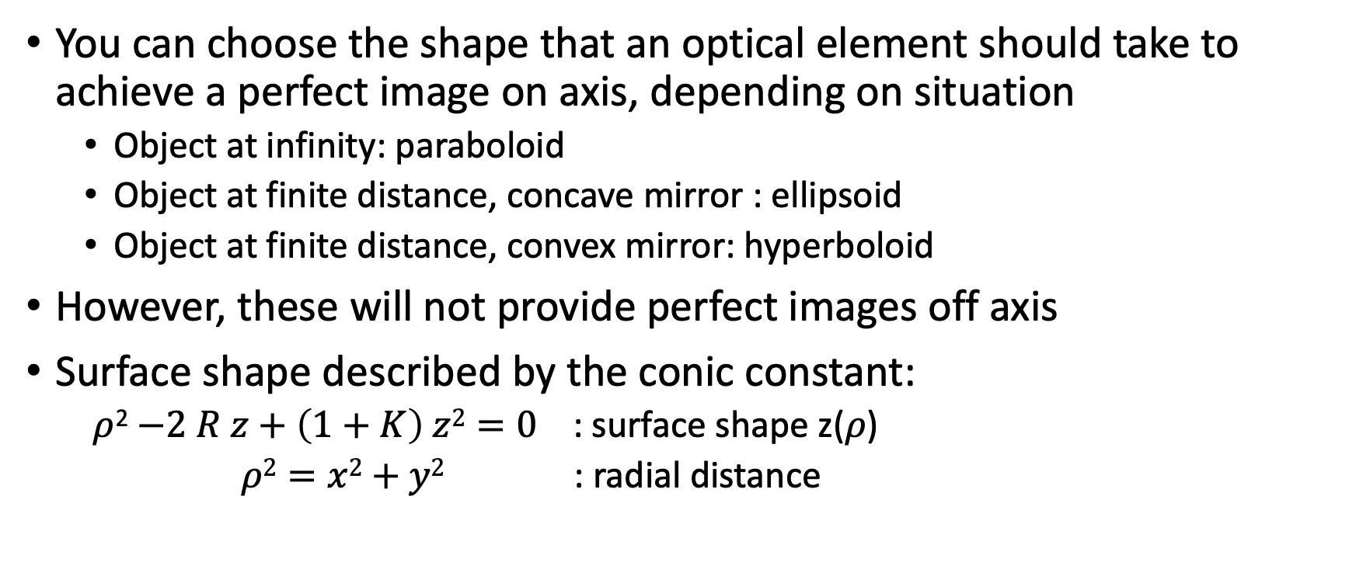
Aberration: quick review
You can choose the shape that an optical element should take to achieve a perfect image on axis, depending on situation
  Object at infinity: paraboloid
  Object at finite distance, concave mirror : ellipsoid
  Object at finite distance, convex mirror: hyperboloid
However, these will not provide perfect images off axis
Surface shape described by the conic constant:
  $ρ$²$−2 R z+\left(1+K\right) z2=0$ : surface shape z(𝜌)
  $ρ2=x2+y2$ : radial distance

Slide 46
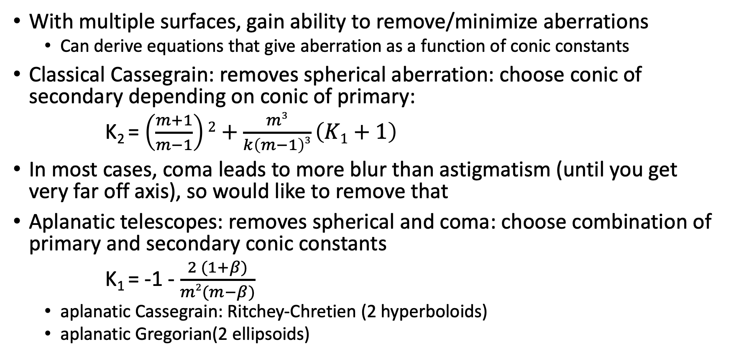
Aberration compensation
With multiple surfaces, gain ability to remove/minimize aberrations
  Can derive equations that give aberration as a function of conic constants
Classical Cassegrain: removes spherical aberration: choose conic of secondary depending on conic of primary:
K₂ = $\left(\frac{m+1}{m−1}\right)2+\frac{m3}{k\left(m−1\right)3}\left(K1+1\right)$
In most cases, coma leads to more blur than astigmatism (until you get very far off axis), so would like to remove that
Aplanatic telescopes: removes spherical and coma: choose combination of primary and secondary conic constants
K₁ = -1 - $\frac{2 (1+β)}{m2(m−β)}$
  aplanatic Cassegrain: Ritchey-Chretien (2 hyperboloids)
  aplanatic Gregorian(2 ellipsoids)

Slide 47
Characteristic of some sample two mirror telescopes
Classical Cassegrain
Classical gregorian
Ritchey Chretien
Aplanatic Gregorian
Parameter | CC | CG | RC | AG
m | 4.00 | -4.00 | 4.00 | -4.00
k | 0.25 | -0.417 | 0.25 | -0.417
1 - k | 0.75 | 1.417 | 0.75 | 1.417
mk | 1.000 | 1.667 | 1.000 | 1.667
ATC | 2.03 | 2.03 | 0.00 | 0.00
AAS | 0.92 | 0.92 | 1.03 | 0.80
ADI | 0.079 | 0.061 | 0.075 | 0.056
κ_{m}R₁ | 7.25 | -4.75 | 7.625 | -5.175
κ_{p}R₁ | 4.00 | -8.00 | 4.00 | -8.00
Angular tangential coma
Angular astigmatism
Schroeder, Astronomical Optics

Slide 48
Other sources of aberration
Design: higher order aberrations
  Optical design: ray tracing and optimization
Imperfect fabrication/polishing
Misalignments : field independent coma often most dominant
mechanical support
Chromatic aberration (lenses)
  Minimized with use of achromats
Seeing …

Slide 50
Topics 10/18
Questions
Aberration compensation
Diffraction
Case study: HST
TMO observing procedures

Slide 51
Questions
TMO is a Newtonian f/5 telescope with a parabolic primary mirror. What do you expect images to look like on and off axis?
The ARC 3.5m is a Ritchey Chretien f/10 telescope. What do you expect images to look like on and off axis?
Sketch the beams (a cone) coming into the focal plane for both TMO and the ARC 3.5m.
What are the relative plate scales of the two telescopes, without calculating the plate scale of either?

Slide 52
ASTR 535
Observational Techniques
Optics / Telescopes
Diffraction

Slide 53
Learning Objectives
Understand the basics of diffraction and the diffraction integral
Understand that the scale of diffraction is 𝜆/D
Know what the Airy pattern is
Understand how obscurations affect the diffraction PSF
Understand how aberrations are included in diffraction calculations, and what Zernike polynomials are

Slide 54
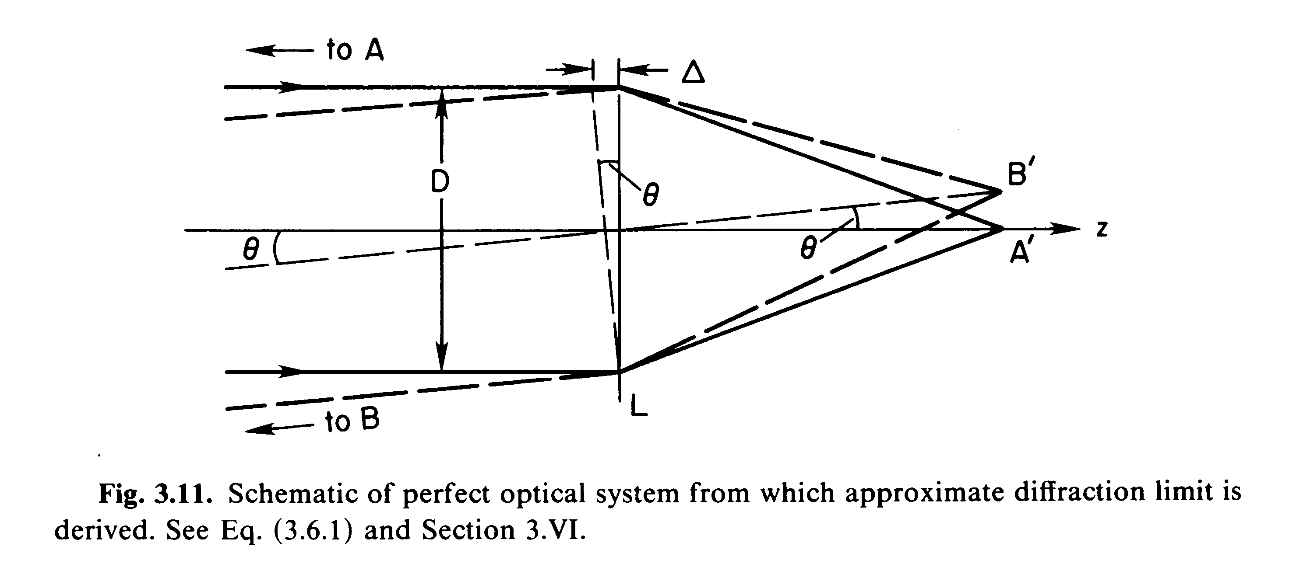
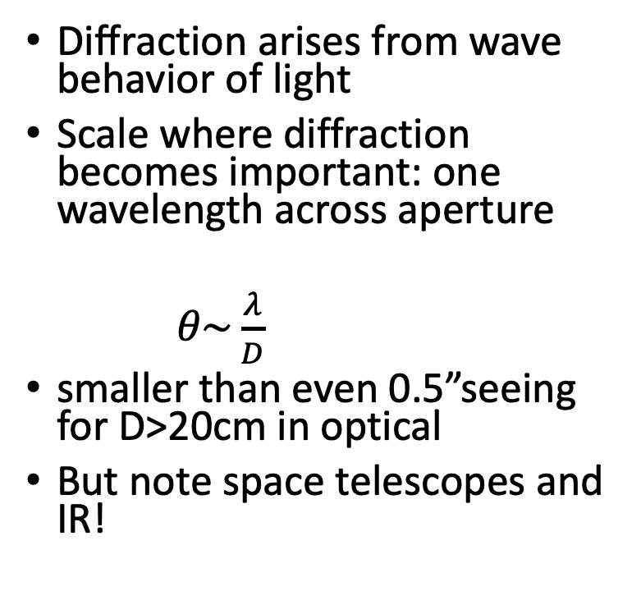
Physical (diffraction) optics
Diffraction arises from wave behavior of light
Scale where diffraction becomes important: one wavelength across aperture
𝜃$\sim \frac{λ}{D}$
smaller than even 0.5”seeing for D>20cm in optical
But note space telescopes and IR!
Schroeder, Astronomical Optics

Slide 55
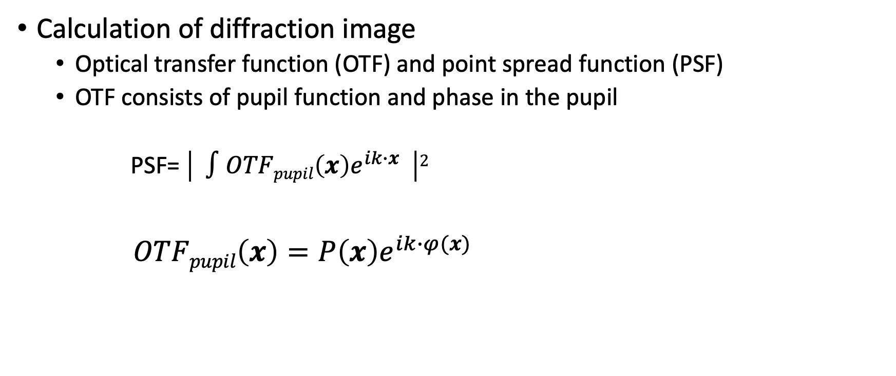
Diffraction integral
Calculation of diffraction image
  Optical transfer function (OTF) and point spread function (PSF)
  OTF consists of pupil function and phase in the pupil
  PSF= $\left| ∫OTFpupil\left(x\right)e^{ik∙x} \right|2$
$OTFpupil\left(x\right)=P\left(x\right)e^{ik∙φ(x)}$

Slide 56
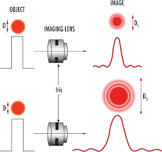
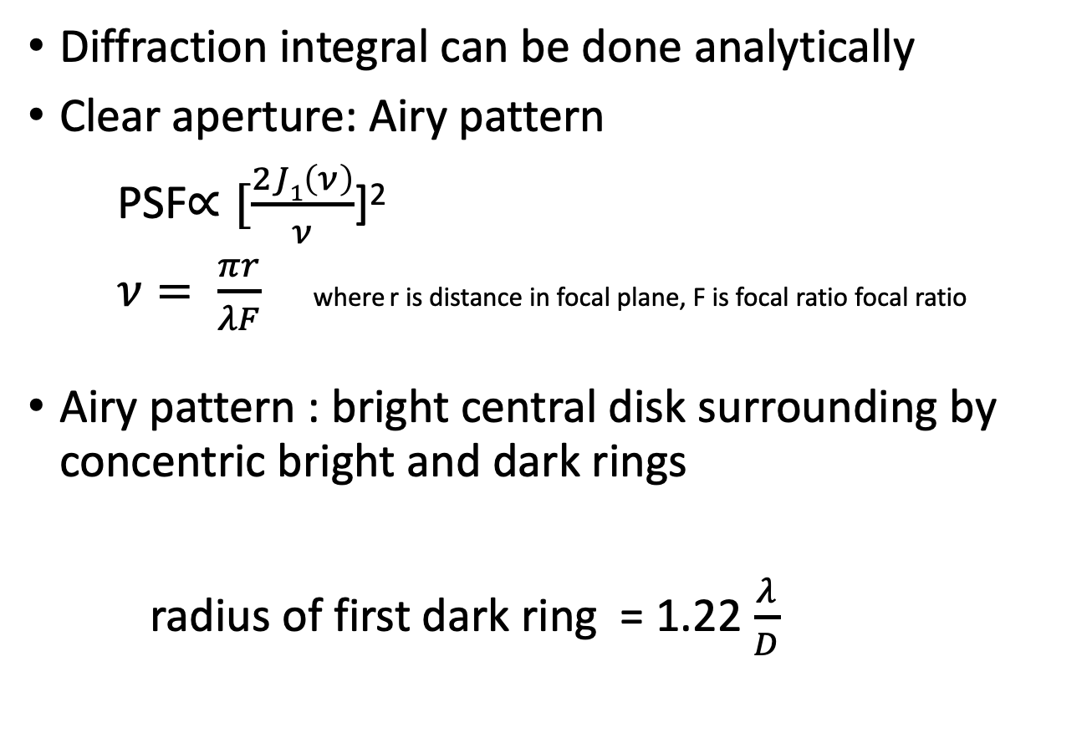
Circular aperture, no aberrations
Diffraction integral can be done analytically
Clear aperture: Airy pattern
PSF$∝[\frac{2J1\left(ν\right)}{ν}$]²
$ν= \frac{πr}{λF}$ where r is distance in focal plane, F is focal ratio focal ratio
Airy pattern : bright central disk surrounding by concentric bright and dark rings
radius of first dark ring = 1.22 $\frac{λ}{D}$

Slide 57
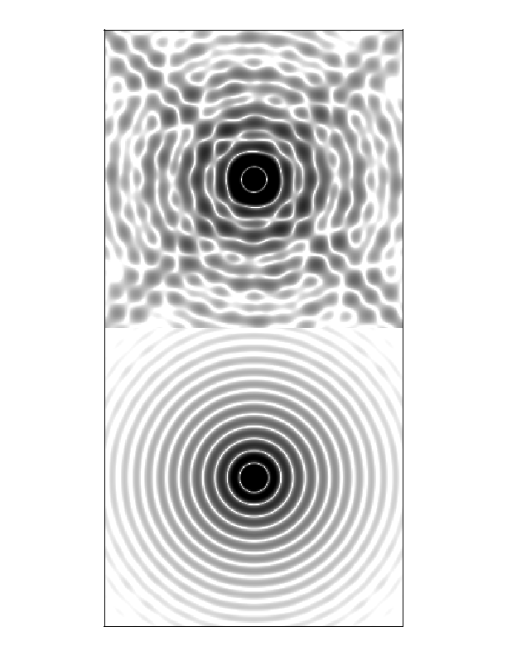
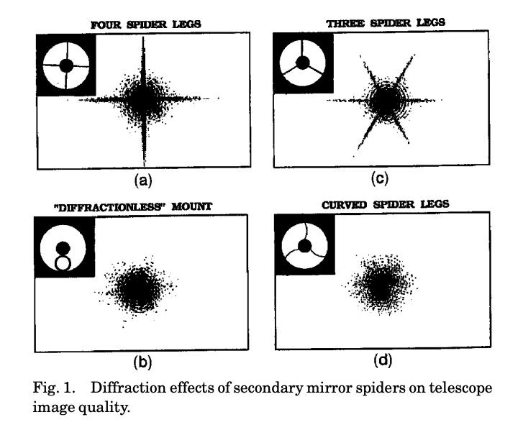


Circular aperture, no aberrations
With central obscuration
PSF$∝[\frac{2J1\left(ν\right)}{ν}− ε$²$\frac{J1(εν)}{εν}$]² 𝜖 is fractional obscuration
$ν= \frac{πr}{λF}$ where r is distance in focal plane, F is focal ratio focal ratio
Aperture with central obscuration+spiders
FromHarvey &Ftaclas,Applied Optics 1995

Slide 58

Circular aperture with aberrations
Aberration occurs when there are phase differences across the aperture or, equivalently, optical path differences across the aperture
For diffraction work, these are often characterized as a series expansion in Zernike polynomials, which are an orthogonal set of polynomials over a circular aperture
Lower order polynomials correspond to the lower order aberrations we have discussed

Slide 60
ASTR 535
Observational Techniques
Optics / Telescopes
Case study : Hubble Space Telescope

Slide 61


Application: HST optical aberrations
Observed PSFs through focus
First mages taken with the HST after 1990 launch did not look as expected!
Modelled PSFs through focus with ½ wave (at 547nm) spherical aberration
HST pupil function

Slide 62



Slide 63



Null correctors and the issue

Slide 64



Double checks and management

Slide 66
ASTR 535
Observational Techniques
Optics / Telescopes
Adaptive optics

Slide 67
Learning Objectives

Slide 68
Adaptive optics
What is it? Adaptive vs active optics
  timescales
Basic components
  Wavefront sensor
  control system
  Wavefront corrector
Wavefront sensor
  Shack-Hartmann sensor
Wavefront correctors
  Deformable mirrors / number of actuators

Slide 69

AO wavefront correction, limitations, and overcoming them
Correction as a function
of Zernike order
  Partial correction for large ratios of aperture diameter / $r_{0}$
Constraints on sources for wavefront measurement
  Need bright enough star, close enough
Laser guide stars
  Rayleigh and sodium beacons
  Focal anisoplanatism
Constraints on corrected field-of-view
  Field-dependent PSF
Wider field correction
  Ground layer adaptive optics
  Multi-conjugate AO
AO examples

