Slide 1
ASTR 535
Observational Techniques
Fall 2023
Sky / Earth’s atmosphere

Slide 2
Topic 9/28
TMO Status
Questions
Effects of the Earth’s atmosphere
Atmospheric (and other “background”) emission
Sky model calculator
Exposure time calculator
Image inspection II
  Light transfer curve

Slide 3
Canvas : sky emission and exposure time calculator
Canvas : image inspection II

Slide 4
Topic 10/3
Questions
TMO observing feedback?
APO trip /housing and plans
Midterm: Thursday 10/12, paper module summaries only
Atmospheric absorption/scattering
Atmospheric refraction

Slide 5
Topic 10/5
Questions
TMO observing feedback?
APO trip /housing and plans
Midterm: Thursday 10/12, paper module summaries only + calculators (no phones or computers?)
Image inspection and analysis software
APO observing software (TUI)
Differential refraction
Atmospheric seeing

Slide 6
Topic 10/10
Midterm review questions
Midterm: Thursday 10/12, paper module summaries only + calculators (no phones or computers)
APO planning
TMO data analysis

Slide 7
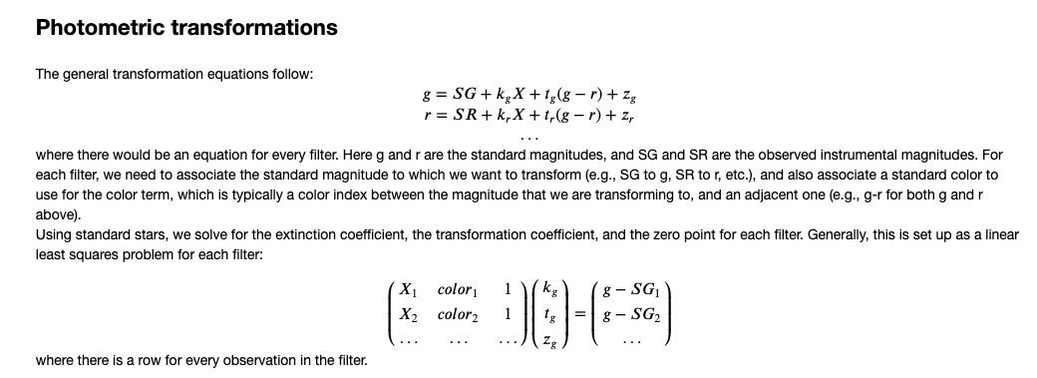
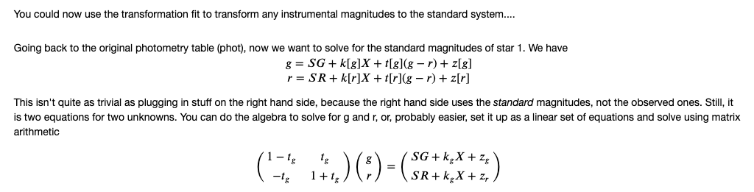
Once you have the extinction, transformation, and zeropoint

