Slide 1
ASTR 535 : Observational Techniques
Effects of the Earth’s atmosphere
Four atmospheric effects

Slide 2
Learning objectives
Understand the effects of the Earth’s atmosphere (+) that we will discuss: emission, absorption, refraction, and seeing

Slide 3
Four effects of Earth’s atmosphere
Emission : atmosphere emits light, with flux a function of wavelength
  Also will discuss other sources of “background” light
Absorption : atmosphere absorbs light, with fraction absorbed a function of wavelength and also a function of airmass
Refraction : atmosphere causes direction of light to be changed slightly, and this shift is a function of wavelength and also airmass
Seeing : atmosphere blurs images
  Also will discuss typical blurring function and how seeing is characterized

Slide 5
ASTR 535 : Observational Techniques
Effects of the Earth’s atmosphere
Atmospheric emission

Slide 6
Learning objectives
Understand the nature of sources that contribute to the sky “background”, including their origin, wavelength dependence, and dependence on location and time

Slide 7
Emission from Earth’s atmosphere
sources
  airglow : excitation of molecules in atmosphere
  thermal emission of atmosphere
  zodiacal light : scattered light from dust in solar system (not from atmosphere!)
  unresolved stars/galaxies
  moonlight
  sunlight
  aurorae
  light pollution
All are function of wavelength
Most are function of time
Most are function of position

Slide 8
Zodiacal light
Not from Earth’s atmosphere!
Dust in the plane of the solar system scatters sunlight
  Brighter near ecliptic
Continuous emission with solar-like spectrum
Surface brightness in optical (V band) ranges from 22-23.5 mag/square arcsec
Provides “base” background emission
  True even from orbit!

Slide 9
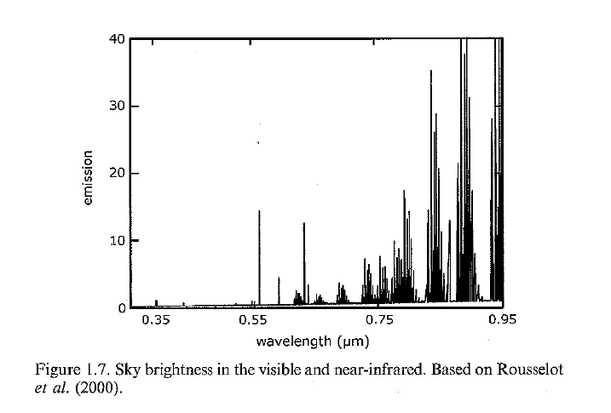
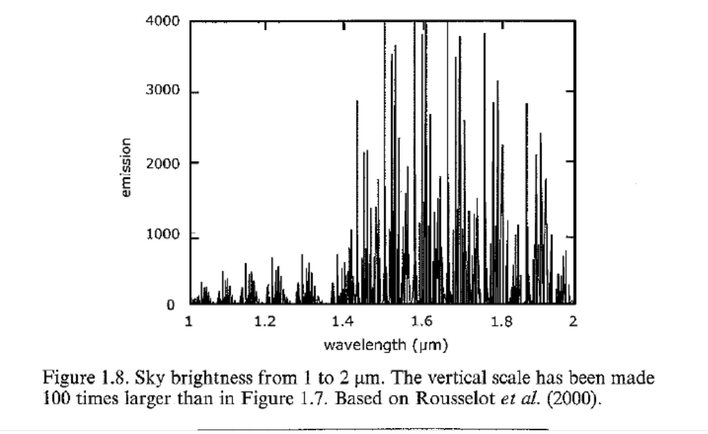
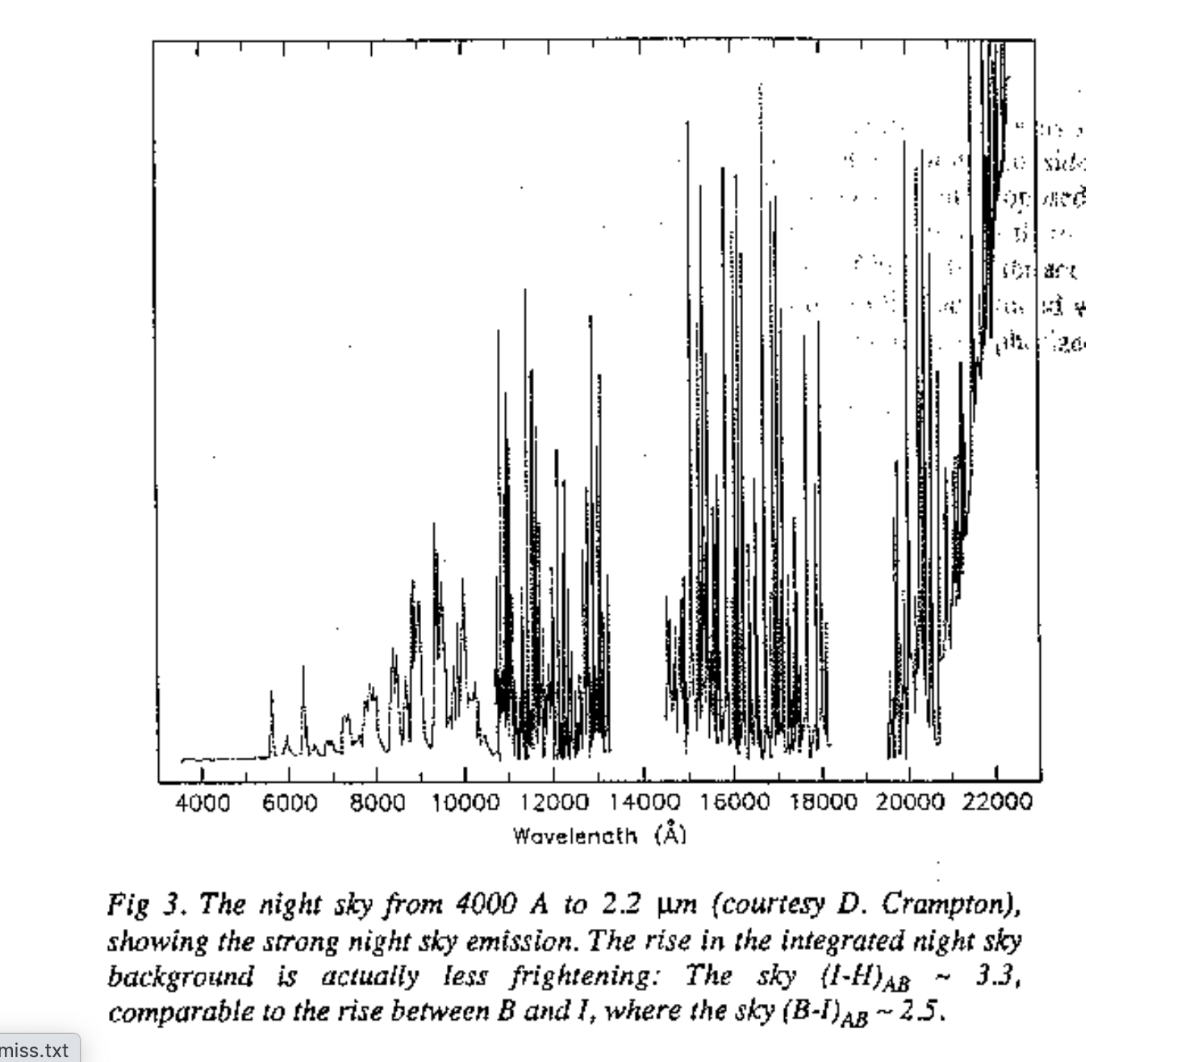
Emission spectrum
Baseline emission is from zodiacal light
Without moonlight, most atmospheric emission is in lines
Predominantly, emission is from airglow
  OH: the “OH forest”
  Others, e.g. [OI] 5577
Strong function of wavelength, increasing towards longer wavelengths

Slide 10
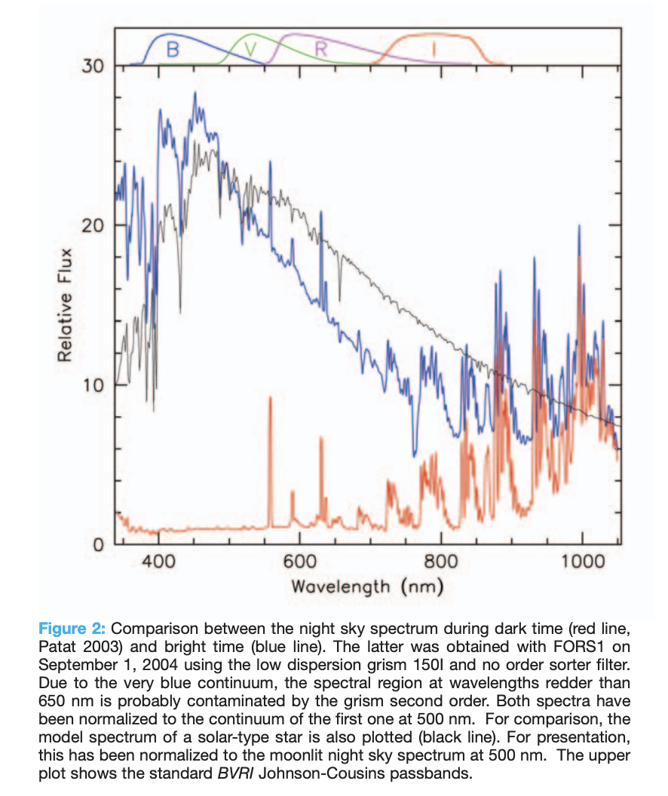
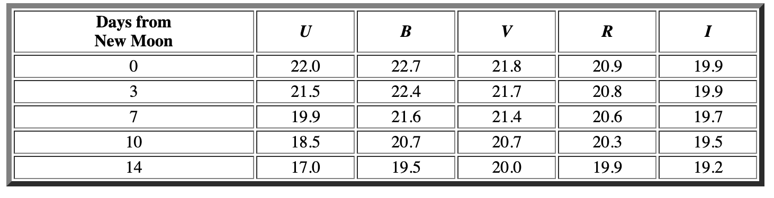
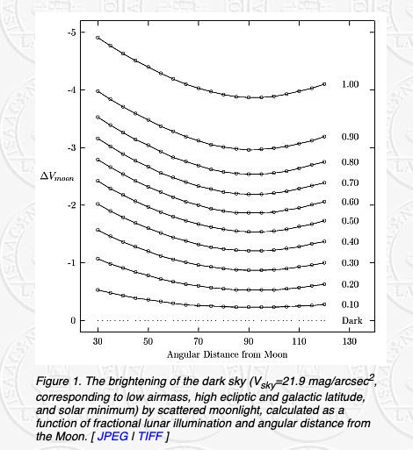
Lunar sky brightness
Lunar sky brightness is a function of wavelength (blue!), phase of the Moon, and distance from Moon in the sky
Because of significant effect of Moon, observing time usually split into:
  dark time: Moon below horizon
  grey time (various definitions) : above horizon, < 50% illuminated
  Bright time : above horizon, > 50% illuminated

Slide 11
Sunlight and twilight
Surface brightness from sunlight depends on distance of Sun below horizon
Note definitions:
  Sunset : sun goes below horizon
  Civil twilight: 6 degrees below
  Nautical twilight: 12 degrees below
  Astronomical twilight: 18 degrees below (fully dark)
Lots of useful stuff can be done before astronomical twilight!
  Twilight flat fields
  Brighter star calibration
  Brighter star observations
Observing: be prepared at sunset!

Slide 12
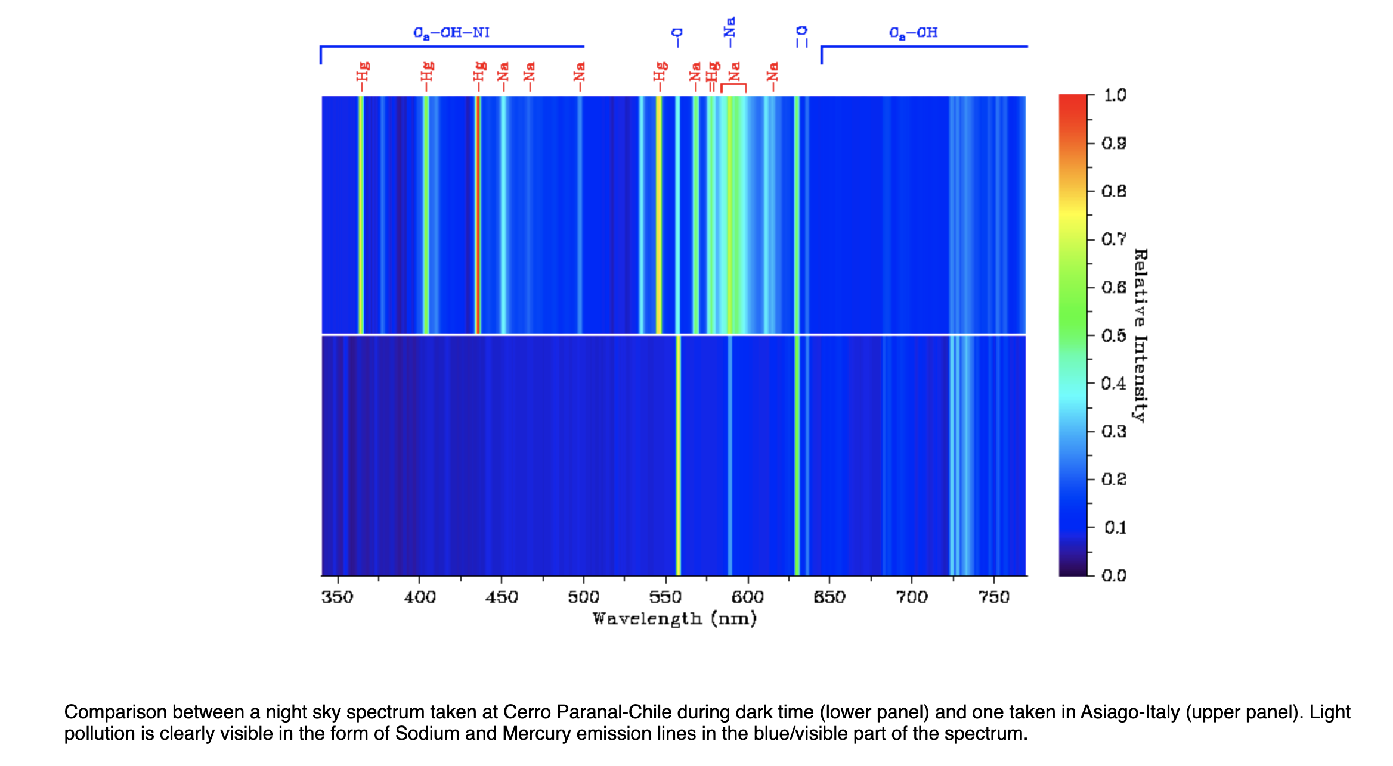
Light pollution

Slide 13

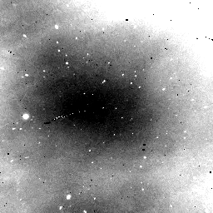
Variability of sky
Sky emission in variable!
Need to measure ~simultaneously to remove
Also can be spatially variable

Slide 14
Quantitative sky brightness
Sky simulators are now available:
  ESO Sky calculator
Sky contributes noise to observations!
  Amount of sky noise depends on sky brightness
  Amount of sky noise depends on image quality

Slide 15
Impact on observations
Optical broadband imaging
  Sky surface brightness between 17 and 22.5 mag / square arcsec, depending on moon
  “Fainter” objects achieve much better S/N in dark time
Optical spectroscopy
  Moon produces continuum emission
  “fainter” objects require dark time
Near-IR broadband imaging: brightness and time variation
  Sky is much brighter : between 12 and 13.5 mag / square arcsec. Background limited except for ”bright” objects
  Leads to different strategies for data collection and reduction
  Moon contributes relatively little
  Bright time!
Near-IR spectroscopy
  Sky significant in lines
  Again, moon contributes relatively little

Slide 17
ASTR 535 : Observational Techniques
Effects of the Earth’s atmosphere
Atmospheric absorption

Slide 18
Learning objectives
Understand the nature of sources that contribute to absorption in the Earth’s atmosphere, including their origin, wavelength dependence, and dependence on location and time
Understand the basic radiative transfer of absorption and the definition of airmass and extinction coefficients
Understand how atmospheric absorption is corrected for in imaging and spectroscopy

Slide 19
Atmospheric absorption
Sources
  Rsyleigh scattering, mostly off molecules in atmosphere
  Aerosols : particulates in the atmosphere, e.g. salt, dust, ash
  Molecular absorption : O₃, O₂, H₂O, CO₂, CH₄, etc.
All are functions of wavelength
All a functions of position
Some are functions of time

Slide 20
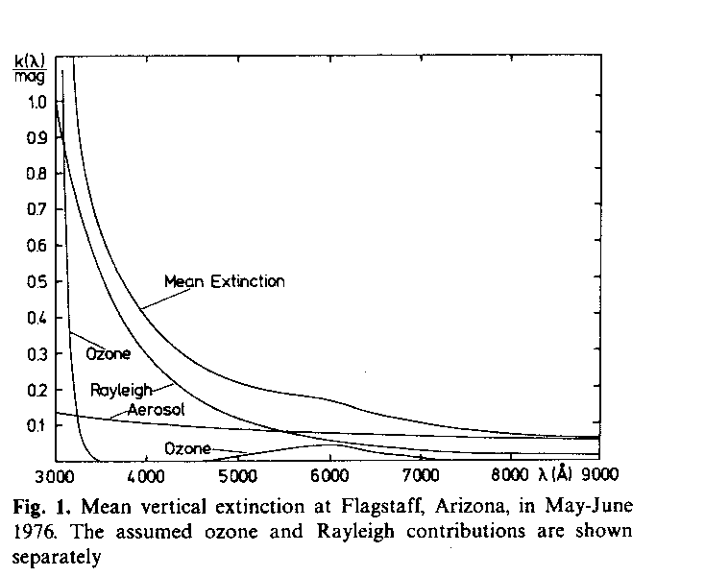
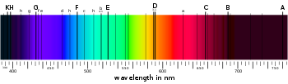
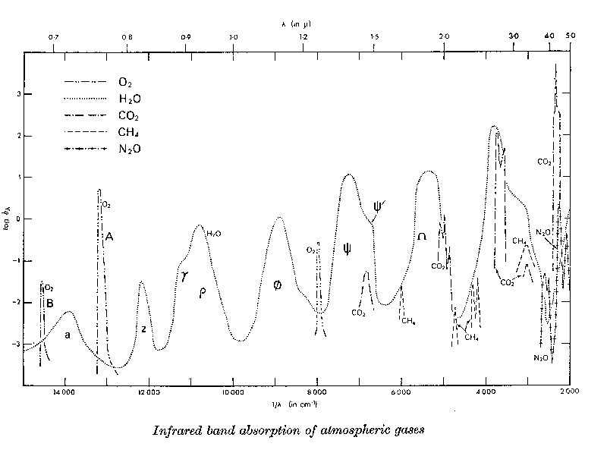
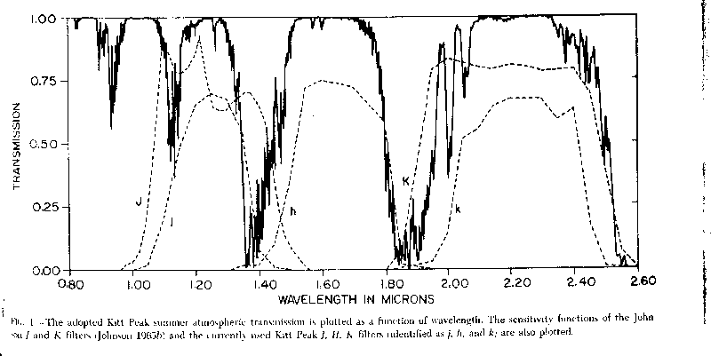
Absorption wavelength dependence
Optical:
Ozone provides short wavelength cutoff
largely continuous from scattering
Some molecular absorption, e.g. A and B bands
Near-IR
Molecular absorption, esp H2O, dominates
H2O absorption leads to atmospheric windows
I | 806 nm
Z | 900 nm^{[4]}
Y | 1020 nm
J | 1220 nm
H | 1630 nm
K | 2190 nm
L | 3450 nm
M | 4750 nm
N | 10500 nm
Q | 21000 nm^{[5]}
J
H
K

Slide 21
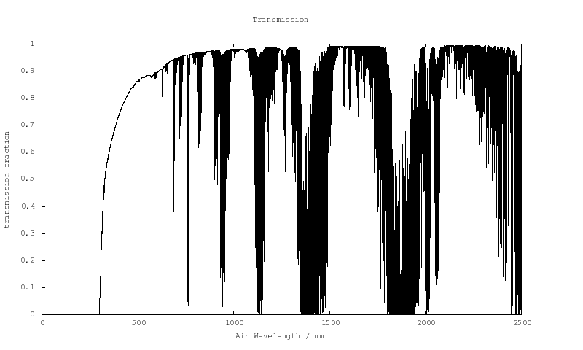
Modeling of absorption
Also in ESO Sky calculator

Slide 22
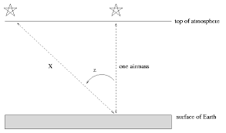
Quantitative light loss through atmosphere
Depends on how much air light passes through
  Parameterized by the airmass
X∼sec z
where z is the zenith distance, which can be calculated for an observation:
sec z = (sin φ sinδ + cosφcosδcos h)⁻¹
where φ is latitude, δ is declination, h is hour angle
Taking into account curvature (relevant only for higher airmass) :
X = sec z - 0.0018167(sec z - 1) - 0.002875(sec z - 1)² - 0.0008083(sec z - 1)³

Slide 23
Quantitative light loss through atmosphere
Consider a thin slab of atmosphere with incident flux F and absorber opacity
κ = N 𝜎
Simple radiative transfer equation :
dF = - κFdx
with solution
F = F_{top}e^{- 𝜅dx} ≡ F_{top}e^{-τ}
where 𝜏 is the optical depth. Scaling with airmass:
τ(X)∼τ₀X
we get
F = F_{top}e^{-τ}₀^{X}
Expressed in magnitudes
m = m₀ +1.086τ₀X
m₀ = m + k_{λ}X
Where the extinction coefficient, k, is defined as:
k_{λ}≡ -1.086τ₀
F
F + dF

Slide 24
Atmospheric absorption and photometry
All sky photometry
  Required conditions : photometric so that there is uniform dependence on airmass
  Solve for extinction only
    First and second order extinction coefficients
    m₀ = m + k_{λ}X + k_{2𝜆} (color )X
    Observe one (or more) stars at a range of airmasses, determine k
    Apply extinction correction to instrumental magnitudes
  Solve simultaneously for extinction plus transformation, observing a set of stars of known magnitude over a range of colors and a range of airmasses
  M_{i} = m_{i} + k_{i}X + t_{i}(M_{i} - M_{j}) + z_{i}
  solve for surface to determine k, t, z. Then for science targets, apply!
  In a single field (differential photometry), zeropoint accounts for extinction, but only to the extent to which the extinction is constant over the field

Slide 25
Atmospheric absorption and spectroscopy
Mean extinction coefficients
telluric absorption and spectroscopy
  “telluric standards”, usually hot stars

Slide 27
ASTR 535 : Observational Techniques
Effects of the Earth’s atmosphere
Atmospheric refraction

Slide 28
Learning objectives
Understand how refraction from the Earth’s atmosphere causes the direction of light from astronomical objects to be deflected
Understand the terms astronomical refraction and constant of refraction
Understand that refraction varies with wavelength, leading to differential refraction
Understand some of the implications of refraction and differential refraction

Slide 29
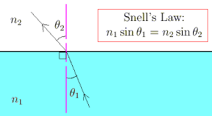
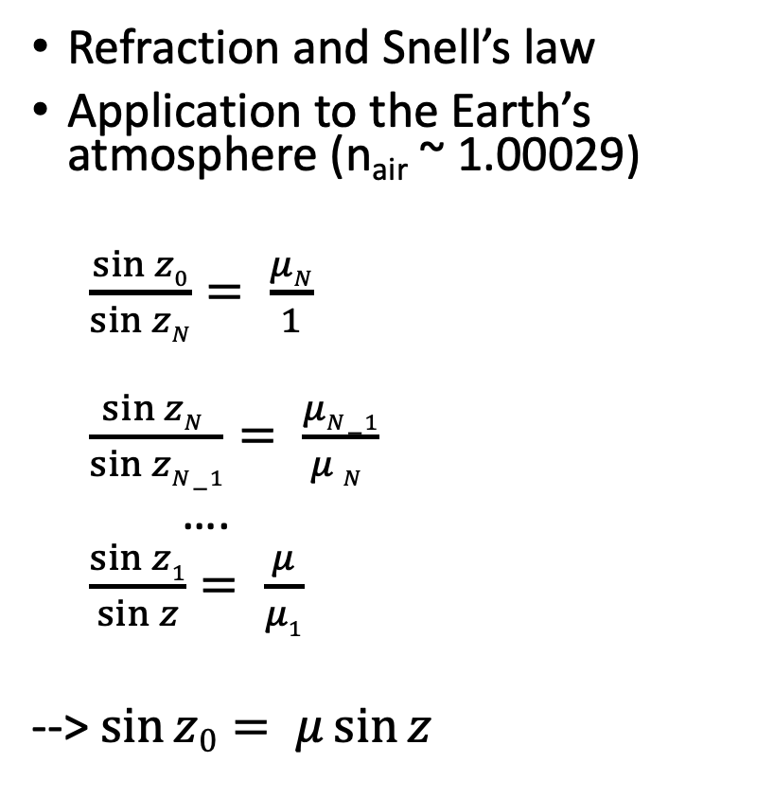
Atmospheric refraction
Refraction and Snell’s law
Application to the Earth’s atmosphere (n_{air} ~ 1.00029)
$\frac{\sin{z0}}{\sin{zN}}= \frac{μN}{1}$
$\frac{\sin{zN }}{\sin{zN−1}}= \frac{μN−1}{μ N }$
….
$\frac{\sin{z1}}{\sin{z}}= \frac{μ}{μ1}$
--> $\sin{z0= μ\sin{z}}$
N
1
https://britastro.org/node/17066

Slide 30
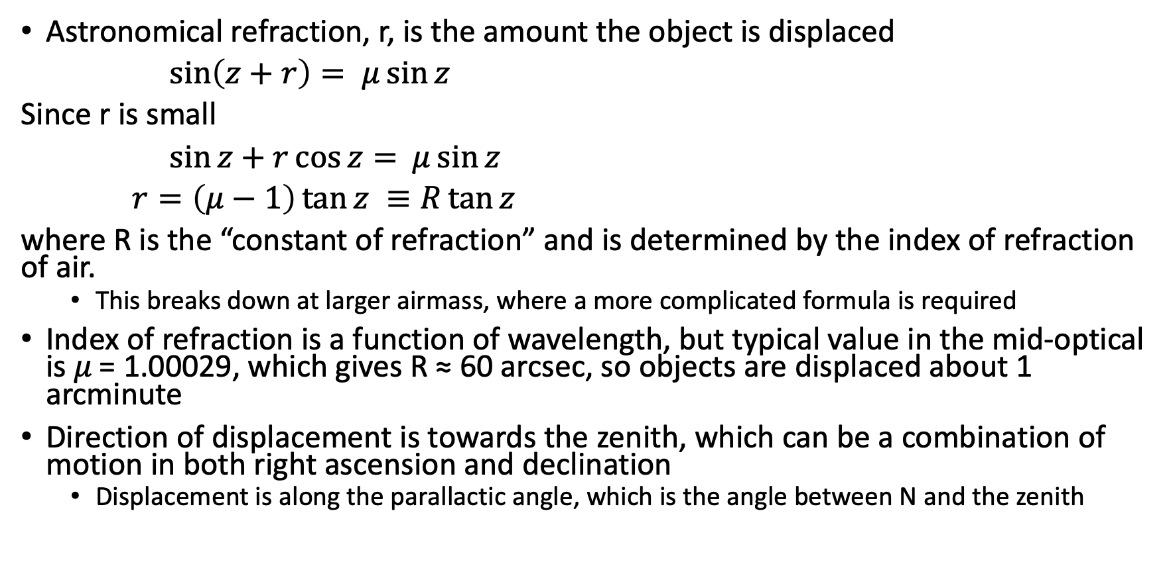
Atmospheric refraction
Astronomical refraction, r, is the amount the object is displaced
$\sin\left(z+r\right)= μ\sin{z}$
Since r is small
$\sin{z+r\cos{z= }}$ $μ\sin{z}$
$r=\left(μ−1\right)\tan{z ≡R\tan{z}}$
where R is the “constant of refraction” and is determined by the index of refraction of air.
  This breaks down at larger airmass, where a more complicated formula is required
Index of refraction is a function of wavelength, but typical value in the mid-optical is 𝜇 = 1.00029, which gives R ≈ 60 arcsec, so objects are displaced about 1 arcminute
Direction of displacement is towards the zenith, which can be a combination of motion in both right ascension and declination
  Displacement is along the parallactic angle, which is the angle between N and the zenith

Slide 31
Some impacts of refraction
Need to know to point telescopes
Need to know when determining actual positions of objects across the sky (all-sky astrometry)

Slide 32
Refraction and wide field spectroscopy
Across a ”wide” field, refraction varies, so if you need to precisely locate where the relative positions of objects are, you may need to do so for a particular position in the sky
Example: SDSS plug plates where multiple plates needed to be made for the same field, depending on hour angle of observation!

Slide 33
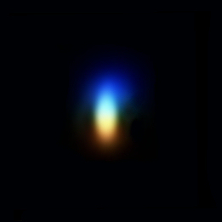
Differential refraction and spectroscopy
  Index of refraction of air is a function of wavelength
𝜆 (Å) | R (“ )
3000 | 63.4
4000 | 61.4
5000 | 60.6
6000 | 60.2
7000 | 59.9
10000 | 59.6
40000 | 59.3
Atmosphere acts as a prism : differential refraction
Implication for aperture or slit spectroscopy
  Will get different fraction of light depending on wavelength, leading to inability to accurately do relative flux calibration, i.e. get large scale shape of spectrum correct
  For slit spectroscopy, can be alleviated by positioning slit along the parallactic angle
  It is possible to build atmospheric dispersion (ADC) corrector to counteract the effect, but this must include a moving component, since amplitude changes with zenith distance
Figure 5. An image of Polaris at high magnification showing atmospheric dispersion. Image courtesy of Martin Lewis https://britastro.org/node/17066

Slide 35
ASTR 535 : Observational Techniques
Effects of the Earth’s atmosphere
Atmospheric seeing

Slide 36
Learning objectives
Understand the basic concept of scintillation and seeing. Know the terminology of the coherence length (r₀) and the isoplanatic patch, and know what typical values are.
Understand the multiple man-made sources of seeing.
Know the terminology for describing/characterizing image shape: FWHM, PSF, MTF, EE, and Strehl ratio.
Understand how the PSF extends to large distances and does not depend on the brightness of the star, although your ability to recognize it might.

Slide 37
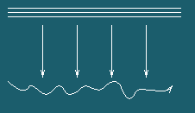
Atmospheric seeing
For an incoming plane wave of light, a perfect optical system will make a diffraction-limited image
Variations in the index of refraction over the scale of the cylinder of light coming into the telescope cause small deviations from a plane wave
Causes two effects:
  Scintillation : integrated intensity variations
  Seeing: positional and image quality variations

Slide 38
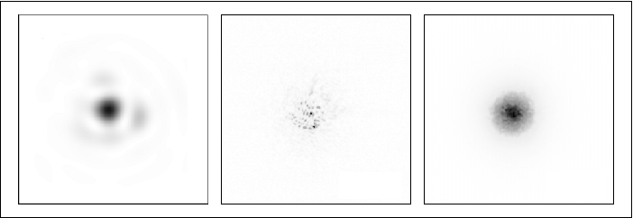
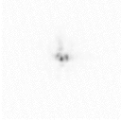
Atmospheric seeing: effects
Observation:
scintillation small for larger apertures
In small apertures (<~ 10cm), one sees diffraction limited images in short exposures (<10-100 msec), but they move around
In larger apertures, one sees “speckles” in short exposures, which move around
In longer exposures, both give similar images, typically around 1” FWHM
Implication:
Wavefront in ~flat on scales of 10-20 cm,
Instantaneous slopes vary by ~1 arcsec on scales of tens of millisec

Slide 39
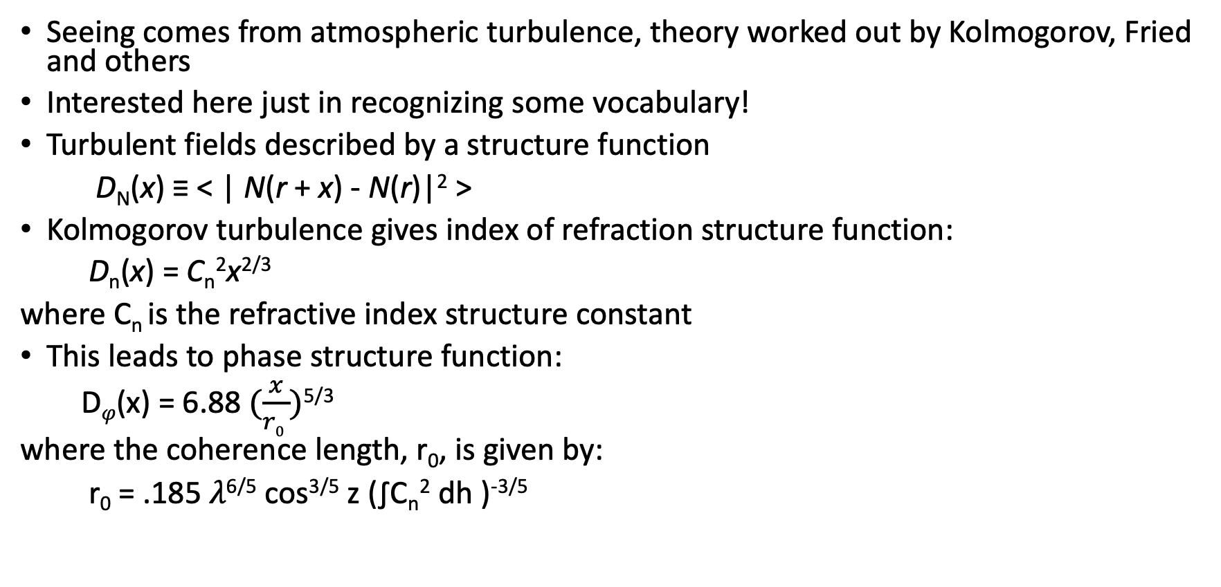
Atmospheric seeing: theory
Seeing comes from atmospheric turbulence, theory worked out by Kolmogorov, Fried and others
Interested here just in recognizing some vocabulary!
Turbulent fields described by a structure function
D_{N}(x) ≡ < | N(r + x) - N(r)|² >
Kolmogorov turbulence gives index of refraction structure function:
D_{n}(x) = C_{n}²x^{2/3}
where C_{n} is the refractive index structure constant
This leads to phase structure function:
D_{𝜑}(x) = 6.88$(\frac{x}{r0 })$^{5/3}
where the coherence length, r₀, is given by:
r₀ = .185 𝜆^{6/5} cos^{3/5} z (∫C_{n}² dh )^{-3/5}

Slide 40
Image size from seeing
Physically, r₀ is roughly inversely proportional to image size (d) from seeing
d ~ 𝜆 / r₀
bigger r₀ is better!
For diffraction, image size is given by
d ~ 𝜆 / D
Seeing dominates when r₀ < D; a larger r₀ means better seeing. Diffraction more important for smaller apertures.
Seeing is more important than diffraction at shorter wavelengths (and for larger apertures) since r₀ scales roughly with wavelength. Diffraction more important at longer wavelengths
effects of diffraction and seeing cross over in the IR for most astronomical-sized telescopes (∼5 microns for 4m); the crossover falls at a shorter wavelength for smaller telescope or better seeing.

Slide 41
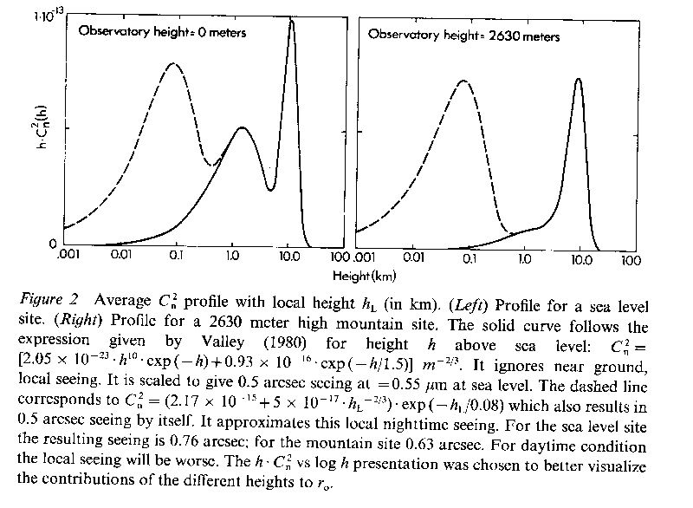
Where in atmosphere does seeing arise?
Amplitude of r₀ comes from (∫C_{n}² dh )^{-3/5}
as you might expect, this varies from site to site and also in time.
At most sites, there seems to be three regimes of ``surface layer" (wind-surface interactions and manmade seeing), ``planetary boundary layer" ( influenced by diurnal heating), and ``free atmosphere" (10 km is tropopause: high wind shears
typical astronomical site has r₀∼10-20 cm at 5000Å
  Roughly matches empirical data of when speckles are seen

Slide 42
Isoplanatic patch
Can also consider the coherence of the same turbulence pattern over the sky. This coherence angle is called the isoplanatic angle (solid angle over which wavefront is ~ the same). Theory gives
θ∼0.314r₀/H
where H is the typical distance to seeing layer
H = sec z (∫C_{n}² h^{5/3} dh / ∫ C_{n}² dh ) ^{3/5}
region over which the turbulence pattern is the same is called the isoplanatic patch.
relevant to adaptive optics, where we will try to correct for the differences across the telescope aperture; if we do a single correction, how large a field of view will be corrected?
For r₀ = 10 cm (e.g. in optical) H∼5000 m , θ∼1.3 arcsec. In the infrared r₀∼70 cm, H∼5000 m, θ∼9 arcsec, i.e. for free atmosphere.
  For boundary layer, however, isoplanatic patch is considerably larger (part of motivation for ground-layer AO).
Note that the ``isoplanatic patch for image motion" (not wavefront) is ∼0.3D/H.
  For D = 4 m, H∼5000 m, θ_{kin} = 50 arcsec.
  relevant for low-order atmospheric correction, i.e., tip-tilt, where one is doing partial correction of the effect of the atmosphere.

Slide 43
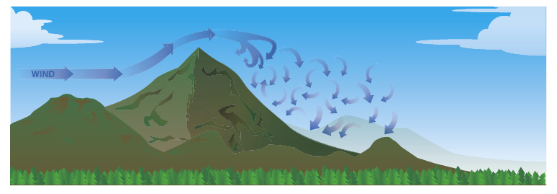
Seeing and site location
Seeing varies from night to night
Better seeing with less turbulence
Laminar air flow is less turbulent, so often observatories located along leading edge in direction of prevailing winds
atmospheric turbulence is not directly correlated with the presence of clouds. In fact, the seeing is often better with thin cirrus than when it is clear!

Slide 44
Other sources of image degradation
Man-made seeing
  Dome: turbulence at slit
  Mirror: turbulence at mirror
Telescope motion
  Wind
  Tracking
Optical design / fabrication

Slide 45
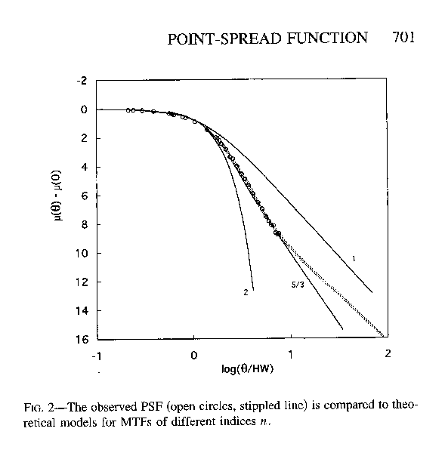
Characterizing image shape
Point spread function (PSF) : full 2D function
Under assumption of azimuthal symmetry
  Full width at half maximum (FWHM)
  Encircled energy (EE) : integral of PSF
Modulation Transfer Function (MTF) : Fourier transform of PSF
MTF(ν) = exp[-3.44(λν/r_{o})^{5/3}]
  Note that this is close to Gaussian
Strehl ratio
  Often used to describe AO performance
  Ratio of peak to peak of diffraction limited image

Slide 46
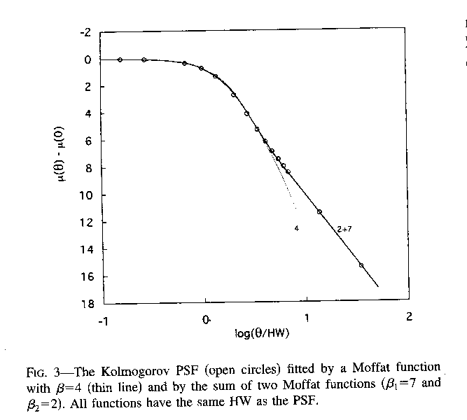
Empirical PSF
PSF has more extended wings than Gaussian
Well characterized by a Moffat function or, even better, by two
Note that PSF extends “forever”
Wings are “lost” in the background
Fainter star wings are lost at smaller radii, but the PSF of faint and bright stars are the same
Fainter stars are not “smaller” than brighter stars!

Slide 48
APO Observing programs
Observing information page: astronomy.nmsu.edu:8000/apo-wiki/wiki/NMSU/2019 (linked from Canvas page)
Spectrophotometric standards
In groups, read through material, present:
  Science context and goal
  Instrument and instrument configuration
  Targets : location, slit position?
    When are they observable? Use skycalc or some other observation planning tool
    TUI catalogs
  Required conditions
  Exposure times / criteria
  Calibrations
  Other?
  Outstanding questions

