Slide 1
ASTR 535 : Observational Techniques
Observing concepts and tools
Time

Slide 2
Learning objectives
Understand the different systems of time: solar time, atomic time, sidereal time
Understand calendars used in astronomy: Gregorian and Julian date

Slide 3
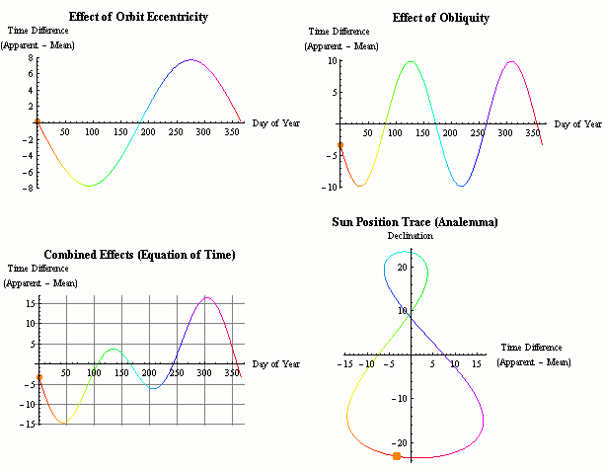
Time: solar time
Solar time : based on the position of the Sun
  Split into 24-hour intervals
  Local apparent solar time: position of the Sun
  But Sun doesn’t move at uniform speed across the sky throughout the year because of tilt of earth’s axis and eccentricity of orbit
  Mean solar time tracks a fictitious ”mean Sun” that moves at uniform rate
    ”equation of time” describes difference between mean and apparent solar time
  Local solar time depends on location on earth
    Local mean solar time = 0 when anti-Sun crosses meridian (N-S line)
  Solar time at Greenwich is called Universal Time
  Local solar time = UT + longitude
  “legal time” uses time zones
  Problem: Earth’s rotation is not perfectly uniform, esp., slowing with time

Slide 4
Time: atomic time and UTC
Atomic time: based on atomic transitions
  TAI : International Atomic Time
Coordinated Universal Time (UTC)
  Mean solar time occasionally adjusted to match atomic time, with the addition of “leap seconds”

Slide 5
Time : sidereal time
Sidereal time : also measured by Earth’s rotation, but now relative to the stars
  Since stars also move in space, sidereal time formally is measured by the position of the vernal equinox (location of mean Sun as it crossed the celestial equator)
  Sidereal time also split into 24 hours
  Sidereal day is slightly shorter (about 4 minutes, 23h 56m 4s) than solar day, because of Earth’s revolution around the Sun
  Over a year those extra minutes amount to one full rotation
  At 4 minutes per day, sidereal time drifts with respect to solar time by about 2 hours per month
  Stars cross the meridian (line between N and S) at the same sidereal time every day, so the solar time they cross the meridian every day drifts
Local sidereal time = 0 when vernal equinox crosses the meridian
  On ~March 21, LST=0 at noon: LST at midnight (standard time) = 12hr
  On ~June 21, LST at midnight (standard time) = 18 hr
  On ~Sep 21, LST at midnight (standard time) = 0 hr
  On ~Dec 21, LST at midnight (standard time) = 6 hr

Slide 6
Calendars and Julian date
Gregorian calendar:
  Splits years into months and days
  Since one year is not an even multiple of days (~365.25), periodically adds leap days, with complicated formula to account for the value of the fractional part of the length of the year in days
Julian date : just counts days
  Julian date (JD): number of days since UT noon, Monday, Jan 1, 4713 BC (note, starts at UT noon!) : 1/1/2021 → JD 2459216
  Modified Julian date (MJD) = JD – 2400000.5 (starts at UT midnight)
When giving precise times of astronomical events, may need to account for changing position of Earth with respect to object, and corresponding change in light travel time
  Heliocentric Julian Date : Julian date for light arriving at the Sun (not Earth)
  Difference from JD depends on location of object, can differ by up up ~8 minutes

Slide 8
ASTR 535 : Observational Techniques
Observing concepts and tools
Coordinate systems

Slide 9
Learning objectives
Understand the different celestial coordinate systems: equatorial, ecliptic, galactic
Understand the different local coordinate systems: alt-az, HA/Dec
Understand the effect of precession, and the meaning of the equinox of coordinates
Understand the effects of motions of astronomical objects: parallax and proper motions and the meaning of the epoch of coordinates

Slide 10
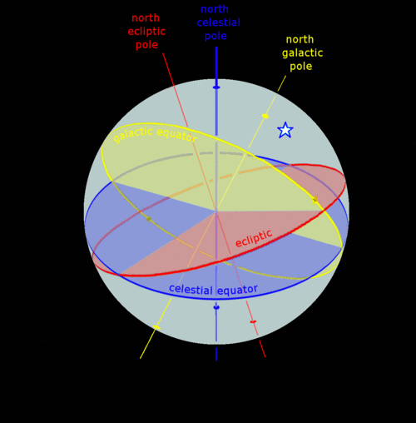
Celestial coordinate systems
Equatorial (RA/Dec) : aligned with Earth’s rotation axis
  Declination (== latitude) : 0 at celestial equator, 90 degrees at pole
  Right ascension: 0 at location of vernal equinox
  Conventionally, RA measured in units of hours (for good reason), but now sometimes measured in degrees (24h = 360 degrees, 1 hr = 15 degrees)
  Note when you look at the sky, if N is up, E is to the left!
Ecliptic (𝜆,𝛽): aligned with plane of Earth’s revolution, Sun at 0 ecliptic latitude
Galactic (l,b) : aligned with plane of the Milky Way (galactic latitude = 0), with galactic center at 0 galactic longitude
Can transform from one coordinate system to another using spherical trigonometry

Slide 11
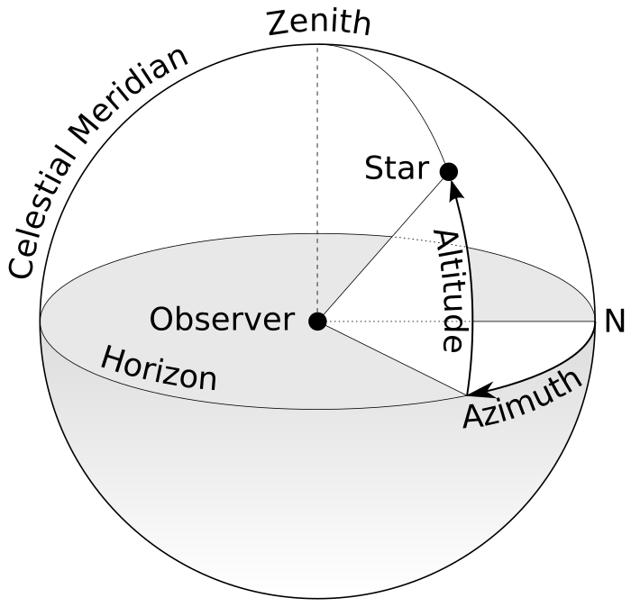
Local coordinate systems
Pole-to-zenith = 90-latitude
Horizon (alt/az) : relative to surface tangent
Equatorial: HA/Dec : relative to Earth’s rotation axis, but fixed in time: hour angle/HA replaces right ascension
  HA = 0 is the meridian
  HA usually measured in hms, for obvious reasons when one watches stars move across the sky!
Altitude related to declination on the meridian
  Declination that passes through zenith is given by the latitude

Slide 12
Precession
Issue with celestial coordinates: Earth’s rotation axis changes direction in time: precession and nutation
Coordinates change through time
Normally, this is “invisible” to the user because we use coordinates at some specified “equinox”, usually J2000.0
  Telescope pointing software has to know how to translate these coordinates to actual directions in the sky at any given time, including precession, etc.

Slide 13
Parallax
Stars also change their position because of changing position of Earth as it orbits the Sun: parallax
Generally, << 1 arcsec

Slide 14
Proper motion
Other issue: astronomical objects also physically move through space!
This is called proper motion
  Angular motion is larger for objects with larger space velocities and also for closer objects
For objects with measurable proper motion, need to also specify the epoch of the coordinates, i.e. the position (in some specified equinox, e.g. J2000) of the object.
  Combined with proper motion, can get the position at any given date of observation
With large automated precision surveys, these things can matter!
GAIA provides proper motions for billions of stars!

Slide 15
Other effects
There are other effects that need to be considered to go from a celestial position to a local position at a given time (i.e., pointing a telescope!)
  Aberration of starlight : arises from Earth’s motion
  Atmospheric refraction

Slide 16
Astronomical positions
Various catalogs of astronomical objects
  SIMBAD : astronomical object database
  VizieR : catalogs
  NED : extragalactic objects
  JPL Horizons : solar system objects (orbital motion very important)
  GAIA (!)

Slide 17
Describing orientations in the sky
Orientations of objects in the sky, e.g., the major axis of a galaxy or the orientation of a slit in a spectrograph, are described by the position angle, which is the angle of the object axis from a N-S line, measured counterclockwise (i.e.,going from N through E)
The position angle at any location in the sky of the line from zenith to horizon is called the parallactic angle

Slide 19
ASTR 535 : Observational Techniques
Observing concepts and tools
Observability of astronomical objects

Slide 20
Learning objectives
Understand the basic principles of optimizing observations of objects
Be aware of and familiar with some tools for observation planning

Slide 21
Observability of objects
To observe an astronomical object:
  Want it to be above the horizon!
  Prefer to observe through as little atmosphere as possible, since increasing atmospheric column increases light losses: stronger effect at shorter wavelengths
Airmass quantifies thickness of atmosphere at a given direction in the sky
  Overhead is minimum column: defined as 1 airmass
    Note this is a “local” quantity, i.e. airmass at zenith is always 1, even from observatories at different elevations!
  As one moves from zenith, airmass ~ 1/cos(Z), where Z is the zenith distance = 90 - altitude

Slide 22
Observability of objects
As objects move across the sky, airmass is minimized when it crosses the meridian, i.e. at HA=0
Relation between HA, RA, and LST:
  HA = LST – RA
So, object at a given RA crosses the meridian when LST = RA

Slide 23
When can you best observe objects
Airmass changes with hour angle depending on declination
At the celestial equator, an HA of +/- 3 hours is an airmass of about 2 from mid-latitude observatories
Generally, observers try to observe below an airmass of two
  Sometimes, you can’t, e.g. solar system observers of inner planets or comets!
So, from the northern hemisphere, observing window is ~6 hours on the celestial equator, longer at higher declinations, shorter at lower declination

Slide 24
Observation planning
Given list of objects to observe, want to maximize efficiency and data quality
Try to observe all objects as they are crossing meridian, so start by sorting by right ascension and knowing the local sidereal time on the night you are observing
  Don’t forget scientific priority!
  Objects at higher declination are more forgiving of being observed off of the meridian than those at lower declination
  Caveat: alt-az telescopes have a challenge tracking objects near the zenith, so there is often a “dead zone”, e.g. +/- 10 degrees from zenith, so for objects with declination near the latitude of the observatory, may need to avoid the meridian!
Also may want to consider efficiency in terms of slew times: prefer to move shorter distances in the sky
  Working by right ascension usually satisfies this
  But beware of alt-az telescopes if you have objects with declinations both less than and greater than the latitude, as these can require long azimuth slews!

Slide 25
Observability tools
skycalc/skycalendar : simple text based programs
JSkyCalc :graphical Java program
Python
  astropy.coordinates : tools for working with coordinates and transforming between different systems
  Astroplan : astropy affiliated package for observation planning
WCSTools : various tools for transformations between coordinate systems, tools for working with coordinates in image files

Slide 27
ASTR 535 : Observational Techniques
Observing concepts and tools
Telescope use and planning

Slide 28
Learning objectives
Understand some of the key things to prepare for before going observing

Slide 29
Overall consideration
At larger research telescopes, telescope time is valuable
  Thousands of dollars per night
  Often, oversubscription factors of several
Make full, efficient use of the resource
  Prepare in advance
  Have plan for productive use of all of the time

Slide 30
Telescope and pointing
Learn how telescope is commanded
Object catalogs
  Can save time and minimize chances of error, especially late at night
Observation scripts
  Critical for some types of observing, e.g., in the infrared
Pointing accuracy and finding charts
  How accurately does telescope point
  How easy will it be to identify your objects?
  Prepare finding charts in advance; understand orientation of images
  Tools: SIMBAD, SkyView
Tracking performance and guiding
  Sharper images maximize S/N, don’t want them to be degraded by telescope tracking
  When guiding is needed, understand how it is done
  In some cases, identifying guide stars in advance may be useful, e.g., to adjust pointing

Slide 31
Focus /data inspection
You need to inspect data as it comes in, to ensure you are getting what you expect, and that there are no issues
  Can impact observing efficiency: two people help
Tools for inspecting/analyzing images
  Are data as expected?
  Saturation issues?
  Image quality
Focusing a telescope/instrument
  Can be achieved by moving instrument, but more common, by moving secondary mirror
  Focus run goes through several positions, chooses best (or fits a curve to find the minimum)
  Focus provides you a measurement of the seeing, which may affect your plans
  Focus can change throughout the night, so continue to monitor image quality

Slide 32
Observation planning and logs
Observation planning
  HA = LST – RA
  Consider slew times
  Consider scientific priorities
  Tools: skycalc, astropy-affiliated astroplan
Observing logs
  Although you may think you won’t forget details, you probably will
  Take notes on everything, especially anything odd/unusual
  Note conditions of the sky, including transparency and seeing
  While a log spreadsheet giving details of each exposure is nice, often, much of this information is in the image files: it’s the less standard stuff that it’s REALLY important to log!
  Set up observing log in advance, e.g. Google Doc

Slide 34
ASTR 535 : Observational Techniques
Observing concepts and tools
Digital imaging and image display

Slide 35
Learning objectives
Understand what digital imaging is, and some of the challenges involved with looking at digital images
Learn about intensity scaling
Learn about some standard image display software

Slide 36
Digital imaging
Quantitative detection of light
Linear detector: number of photons recorded is proportional to number of incident photons
Output of a detector is an array of numbers, often referred to as counts or DN (data numbers)
Individual picture elements: pixels
Potential issues in data visualization / inspection
  Larger number of pixels than available on display
  Larger dynamic range (intensities) than available on display

Slide 37
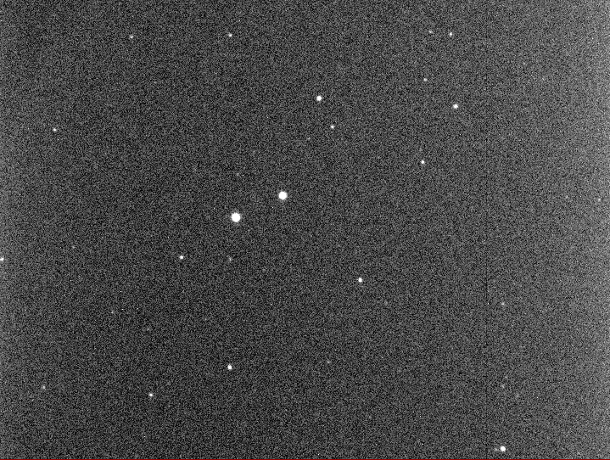
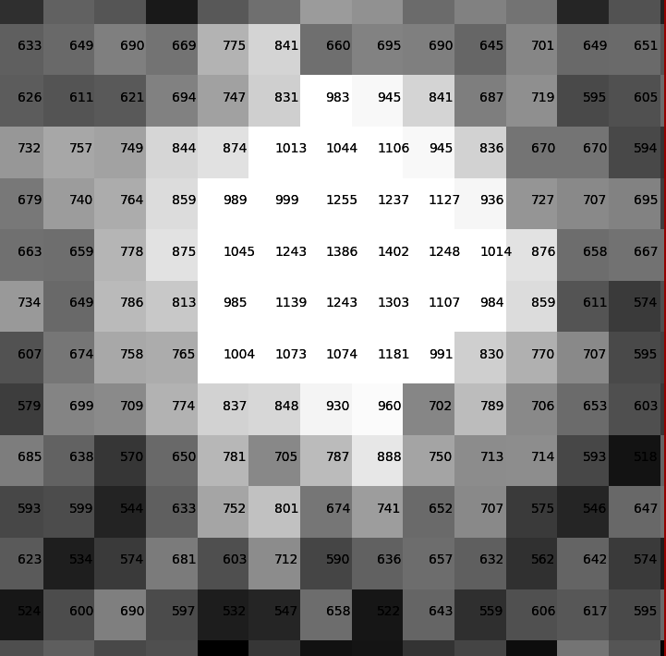
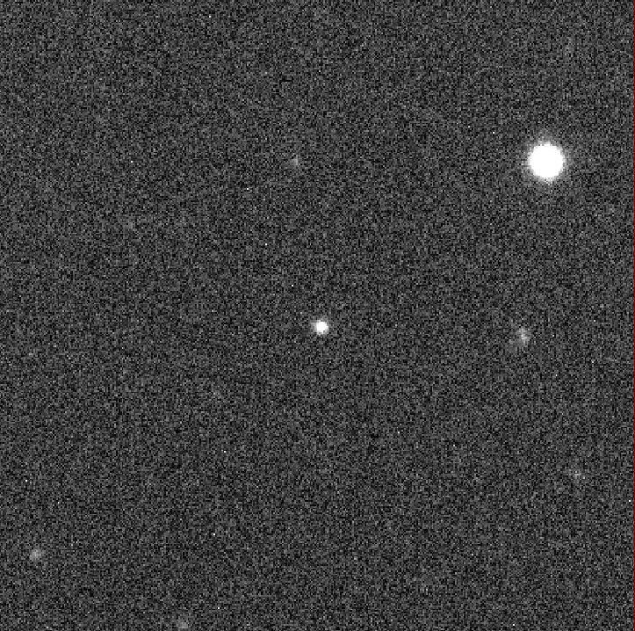
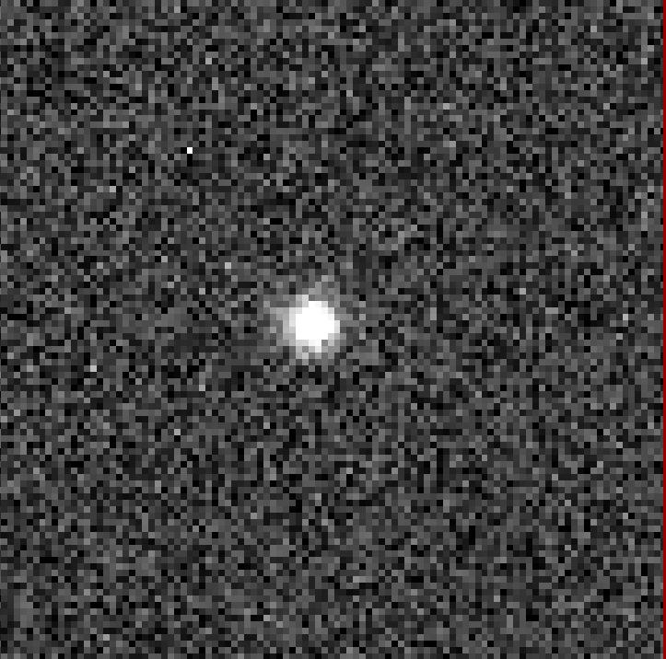

Slide 38
Digital imaging: spatial resolution
Computer display, e.g., laptop 2560x1600, external monitor 1920x1200
Digital cameras
  High quality 2048x2048 detectors are widespread
  TMO camera: 9600x6422 unbinned, 4800x3211 binned 2x2
Not possible to see every pixel at the same time!
Options:
  Zoom
  Every Nth pixel
  Average NxN pixels
  Beware of Moire patterns
Be aware!

Slide 39
Demo

Slide 40
Digital imaging: image display
Dynamic range : ratio of brightest to faintest objects
Typical astronomical signal chains provide 16-bit data, i.e. DN from 0 to 65535
  ARC/KOSMOS will have an 18-bit signal chain
Typical graphics card and image display provide 8-bits of intensities, i.e. from 0 to 255, for each of 3 colors (eye may not be able to distinguish any more)
→ Not possible to see all intensity information at the same time

Slide 41
Brightness and contrast
…. 65535
Given limits of display:
  Show small range at full intensity resolution, but nothing outside of range (high contrast) (blue lines)
  Show large range, but at reduced intensity resolution (low contrast) (red lines)
  Some combination (green lines)
If displaying at lower contrast, also choose which part of range to show (brightness)
Brightness (level) and contrast (range)
  Contrast: separation between lines
  Brightness: location of lines
  Alternatively, low and high levels
255
0
0…..

Slide 42
Display parameters
Many software display routines will choose a default intensity scaling, or give you a choice of some algorithms:
  Min-max (100%)
  Various other percentiles (99% → 50%)
  Histogram equalization
  Nonlinear display scalings
In many cases, the full dynamic range is not populated
  Reasonable scaling: few sigma below sky to more sigma above
Changing scaling requires recalculation and display

Slide 43
Demo

Slide 44
Color maps and pseudo color
Given a scaling to 8-bits, can also associate a color with each one of the intensity levels
  Black-and white (greys)
  Inverted
  Pseudo color: assign various colors to different intensity levels
Quick brightness/contrast adjustment can be done by adjusting the color map, but at some loss of information

Slide 45
Demo

Slide 46
“True” color images
True color images are made by combining images taken at multiple (usually 3) wavelength ranges
  Standard color images: red, green, blue
  Can encode other bandpasses into a “true” color:
    UV, visual, IR
    Broadband + narrowband

Slide 47
Other display functions
Blinking images
Annotating images
Interactive display: marking objects
Calculating quantities based on interactively marked objects

Slide 48
Some display tools
SAOimage ds9 : https://sites.google.com/cfa.harvard.edu/saoimageds9
ximtool : https://github.com/iraf-community/x11iraf
gaia : http://star-www.dur.ac.uk/~pdraper/gaia/gaia.html
Python image display
  Basic display with matplotlib imshow
  More advanced possibilities

Slide 50
ASTR 535 : Observational Techniques
Observing concepts and tools
Digital imaging: file formats

Slide 51
Learning objectives
Understand some basic concepts of how data are stored in files
Understand how FITS files are structured

Slide 52
Storing image data
Image data is just a grid of numbers
In simplest format, one could just provide those numbers
  For more compact files, store in binary representation
Need some minimal basic information in addition to a string of bits
  How many bits for each pixel
  How many pixels per row
For astronomical images, there is a lot of other potentially interesting ancillary information
  telescope, coordinates, time, exposure time, etc.
  what is on the axes
  Instrument information

Slide 53
Flexible Image Transport System (FITS)
Basic FITS image files: contain two pieces: header and image
Header
  Set of rows of 80 characters each
    ”card” name (limited to 8 characters)
    “card” value
    “card” comment
  Must come in multiples of 36 card (2880 bytes); pad with blanks
Image
  Binary sequence of data

Slide 54
FITS tables
FITS has been generalized to also allow the storage of “tables”
ASCII and binary tables
Table column names not limited to 8 characters
Mixed data types supported
Some “data” files may be saved as FITS tables rather than FITS images
  E.g., spectroscopic data

Slide 55
FITS multi-extension files
Some data may not be limited to a single “image” or a single “table”
Can have multiple “extensions” in a single FITS file
  E.g., data, uncertainty, and mask
Each extension is an “HDU” (header-data unit)

Slide 56
Tools for working with FITS files
astropy.io.fits provides a comprehensive set of tools
For tabular data astropy.table provides good tools
Quick demo

Slide 57
Other file formats
ascii (text) files : note astropy.io.ascii
HDF format

Slide 59
ASTR 535 : Observational Techniques
Observing concepts and tools
Digital imaging: gain and readout noise

Slide 60
Learning objectives
Understand the concept of gain and why it is critical for characterizing the noise in your data
Understand how you can measure the gain and readout noise

Slide 61
Gain
Digital detector signal chains usually introduce an electronic “gain”: a multiplicative constant that modifies the signal coming from the detector before the signal is digitized
Because of this, the data numbers do not directly give the number of detected photons (each of which generates an electron)
Instead
N(electrons) = GC
where C is the number of counts (DN) and G is the “gain” in “units” of electrons/DN (all dimensionless), even though an electronics person would call this the ”inverse gain”
Knowing the gain is critically important, because the Poisson statistics is on the number of detected photons, not the DN value

Slide 62
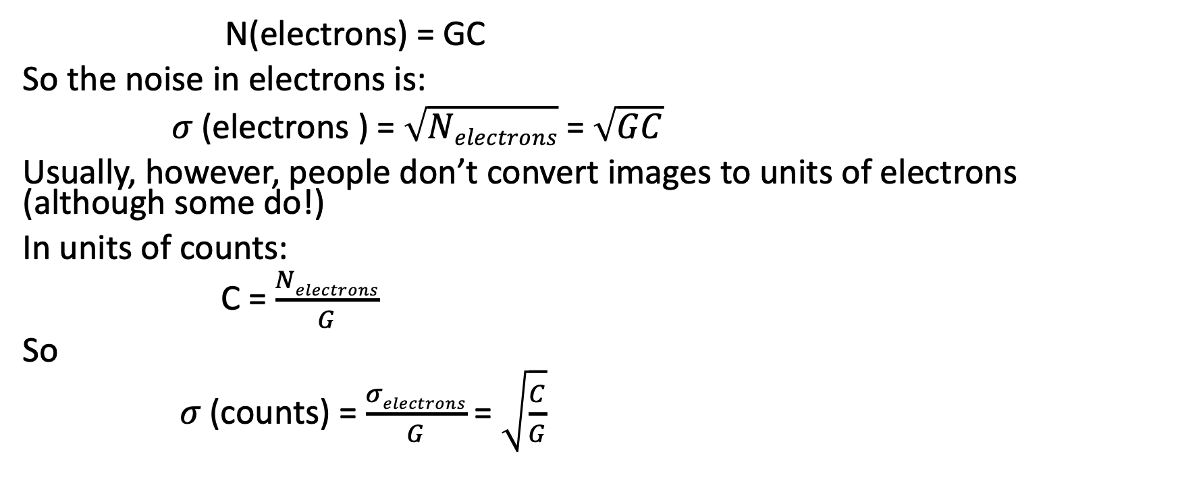
Gain and Poisson noise
N(electrons) = GC
So the noise in electrons is:
𝜎 (electrons ) = $\sqrt{Nelectrons}$ = $\sqrt{GC}$
Usually, however, people don’t convert images to units of electrons (although some do!)
In units of counts:
C = $\frac{Nelectrons}{G}$
So
𝜎 (counts) = $\frac{σelectrons}{G}$ = $\sqrt{\frac{C}{G}}$

Slide 63
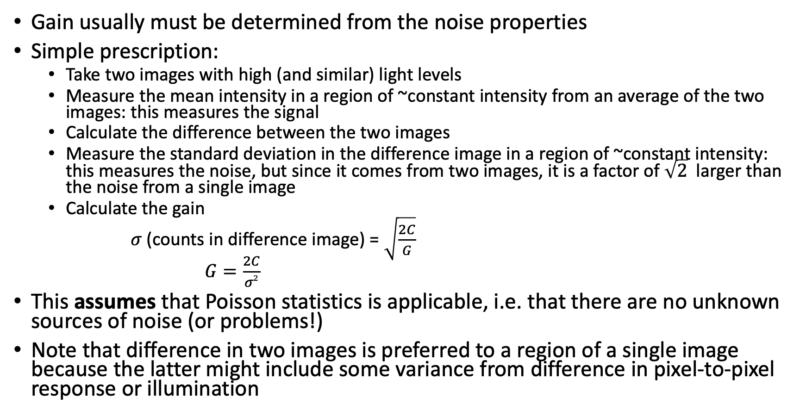
Determining the gain
Gain usually must be determined from the noise properties
Simple prescription:
  Take two images with high (and similar) light levels
  Measure the mean intensity in a region of ~constant intensity from an average of the two images: this measures the signal
  Calculate the difference between the two images
  Measure the standard deviation in the difference image in a region of ~constant intensity: this measures the noise, but since it comes from two images, it is a factor of $\sqrt{2}$ larger than the noise from a single image
  Calculate the gain
  𝜎 (counts in difference image) = $\sqrt{\frac{2C}{G}}$
  $G=\frac{2C}{σ2}$
This assumes that Poisson statistics is applicable, i.e. that there are no unknown sources of noise (or problems!)
Note that difference in two images is preferred to a region of a single image because the latter might include some variance from difference in pixel-to-pixel response or illumination

Slide 64

Gain: more comprehensive test
  𝜎 (counts in difference image) = $\sqrt{\frac{2C}{G}}$
  $G=\frac{2C}{σ2}$
For a more comprehensive test, do this at multiple light levels and plot 𝜎² vs C: this should be a straight line with slope given by 2/G

Slide 65
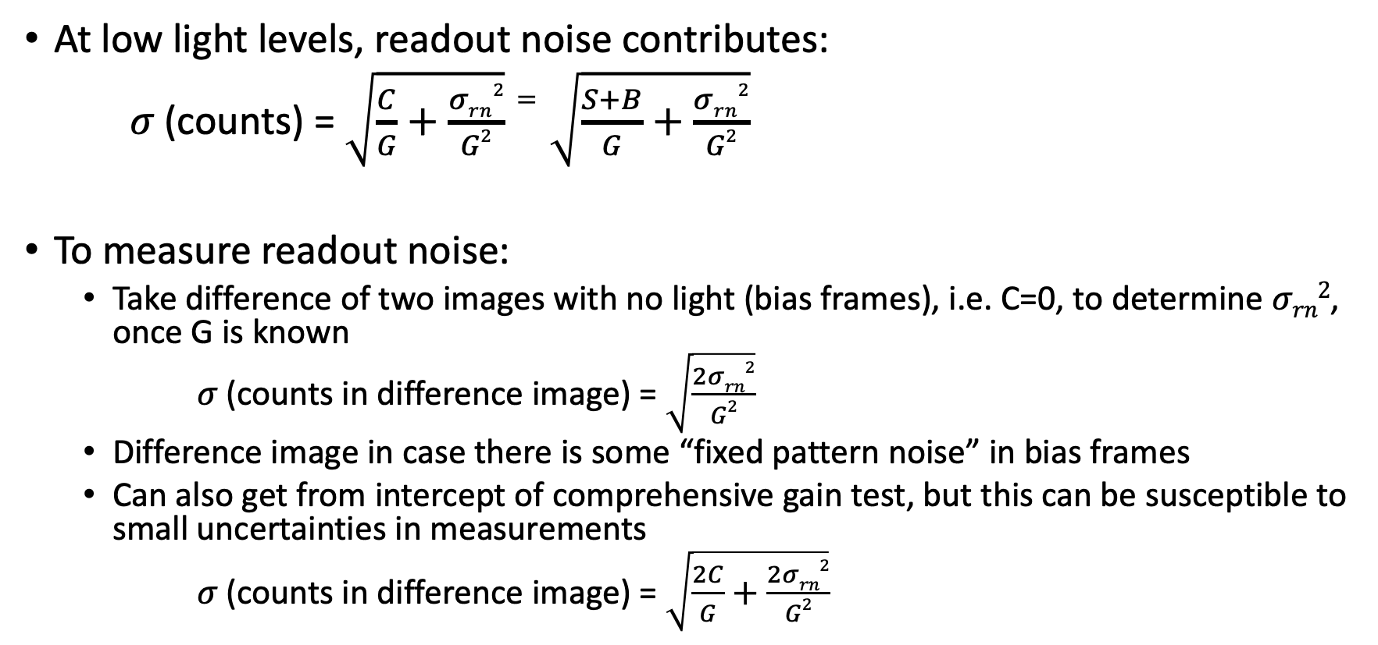
Readout noise
At low light levels, readout noise contributes:
𝜎 (counts) = $\sqrt{\frac{C}{G}+\frac{σrn2}{G2}}=\sqrt{\frac{S+B}{G}+\frac{σrn2}{G2}}$
To measure readout noise:
  Take difference of two images with no light (bias frames), i.e. C=0, to determine $σrn2$, once G is known
  𝜎 (counts in difference image) = $\sqrt{\frac{2σrn2}{G2}}$
  Difference image in case there is some “fixed pattern noise” in bias frames
  Can also get from intercept of comprehensive gain test, but this can be susceptible to small uncertainties in measurements
  𝜎 (counts in difference image) = $\sqrt{\frac{2C}{G}+\frac{2σrn2}{G2}}$

Slide 67
ASTR 535 : Observational Techniques
Observing concepts and tools
Digital imaging: basic data reduction

Slide 68
Learning objectives
Understand the most basic data reduction steps of bias level subtraction and flat fielding

Slide 69
Basic data reduction
While data reduction may need to include correction for multiple effects, the most basic data reduction of digital images is simple and consists of two steps:
  Bias level (overscan) subtraction
  Flat fielding
Other things that we will address later:
  Bias pattern subtraction
  Dark current subtraction
  Linearity correction
  Shutter shading correction
  Fringing subtraction
  Spectroscopic data reduction (wavelength and flux calibration)

Slide 70
Bias level (overscan) subtraction
Before digitizing the signal from a detector, the signal electronics will add some level so that, in the presence of noise, there will be no ”negative” signal
This bias level does NOT contribute Poisson noise, so must be subtracted before the correct Poisson uncertainties can be determined
This level, usually called the bias level, may not be perfectly stable in time, so, when possible, should be determined from each image independently
This is usually achieved by adding a “overscan” region to each image, which adds ”virtual” pixels to an image, i.e. data values that are read through the signal chain but without any real pixel input
  In CCDs, this generally adds columns to the “real” image
  At TMO (CMOS detector), extra rows are added

Slide 71
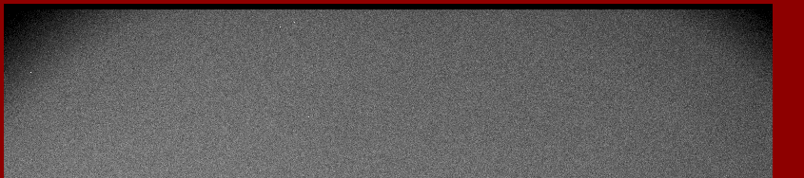
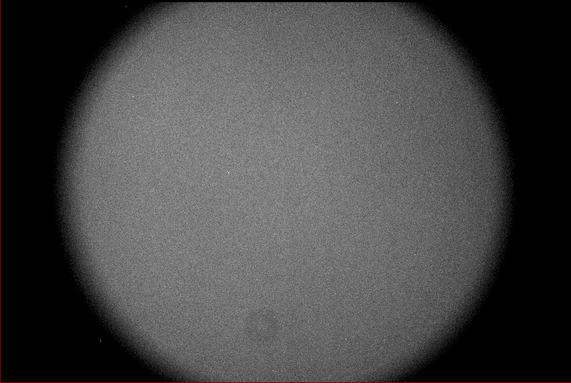

Overscan
TMO
ARCTIC

Slide 72
Bias level (overscan) subtraction
In simplest form, one determines the mean value in the overscan, and subtracts this from the rest of the image
In more complex cases, the bias level may drift over the course of the readout, so it may be necessary to do a row-by-row subtraction of bias level (or some smoothed version of it)

Slide 73
Flat fielding
Flat fielding corrects for non-uniform throughput across the field-of-view, i.e. at different locations within an image
  Variations in throughput can arise from optics (vignetting, non-uniformity of filter, dust, etc.) and/or from variations in sensitivity of the detector in different locations
  Flat fielding is critical for comparing intensity at one location to intensity at another
    If one compares intensity in one image to another at the same location, then the need for flat fielding is minimized

Slide 74
TMO flat field

Slide 75
Flat fielding
Flat fields are created by observing an object that produces spatially uniform illumination, so that observed variations can be attributed to variations in throughput
Typical sources:
  “white spot” on side of dome
  Illuminated mirror covers
  Twilight sky
No source is perfectly uniform, so deviations from uniformity will be propagated systematically into your images, at whatever level the non-uniformity is
Any noise in your flat field will be propagated systematically into your images, so you generally want to achieve very high S/N in the flat fields
  Usually combine multiple images, each one at high S/N

