Slide 1
ASTR 535
Observational Techniques
Fall 2023
Uncertainties and Error Propagation

Slide 2
Topics 8/31
APO trip : 10/29-10/31, rough schedule
Questions
Probability distribution functions
Application to observational uncertainties
Exposure time calculator: signal equation

Slide 3
Questions

Slide 4
Probability distribution functions
What is a PDF, esp in the context of observational techniques?
  What are some statistics that are often used to characterize a PDF?
Population statistic vs sample statistics
  Robustness and efficiency

Slide 5
Poisson distribution
What is it a function of? What is the analytical form?
What does it look like?
What is the mean?
Standard deviation?
What is the application in observational techniques?

Slide 6
Poisson statistics
You collect 10000 photons with an instrument on the 3.5m. What’s the uncertainty (standard deviation)?
You collect 10000 photons with an instrument on the 0.6m. What’s the uncertainty (standard deviation)?
You collect 100000 photons with an instrument. What’s the uncertainty? Is the better or worse than the 10000 photon case?
What fractional uncertainties (uncertainty / signal) do these correspond to?
You collect 100 photons/second with some instrument. How long to you have to expose to reach the same fractional uncertainty as the first two above?

Slide 7
Gaussian (normal) distribution
What does it look like?
What is the mean?
What is the standard deviation?
What is the application in observational techniques?

Slide 8
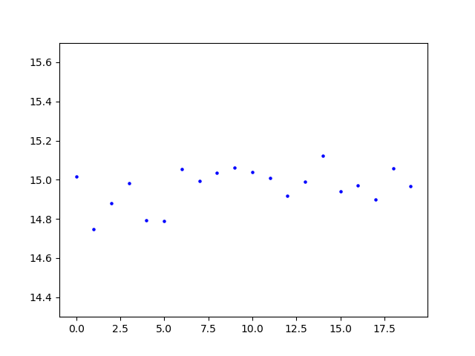
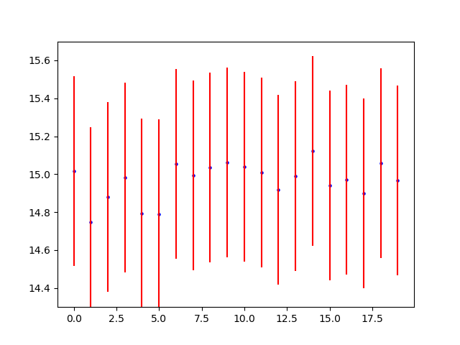
Importance of uncertainties: applications
Exposure time calculation
Probability of single measurements
  Gaussian: error function and typical values
Probability of a series of measurements
  Chi^2 and reduced chi^2

Slide 9
Exposure time calculator
Given information about source (magnitude and SED) and observational setup (telescope, instrument, etc.), how long do you have to observe to achieve a desired fractional uncertainty?
  What photon flux does the source produce?
  How long to achieve desired fractional uncertainty? Depends not only on source photon flux, but also on:
    Sky flux
    Instrumental noise
Start with first piece: what photon flux does the source produce?
  Spectroscopic and photometric applications

Slide 10
Examples
Class problem notebook
https://github.com/APOExposureTimeCalculator/APOExptime) (compiles many data files relevant for APO)

Slide 11
Topics 9/5
Questions
Noise equation
Propagation of uncertainties

Slide 12
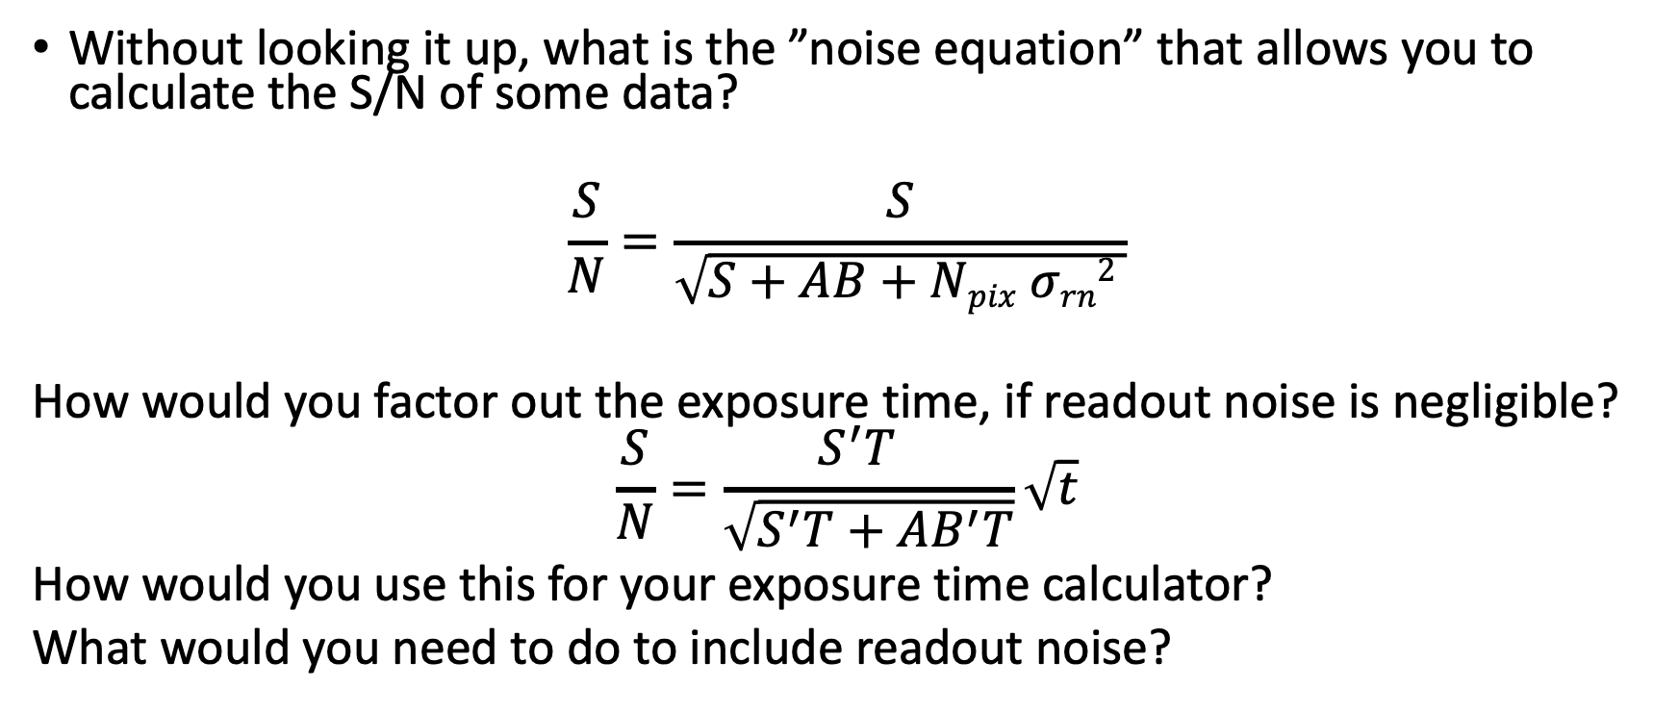
Noise equation
Without looking it up, what is the ”noise equation” that allows you to calculate the S/N of some data?
$$\frac{S}{N}=\frac{S}{\sqrt{S+AB+Npix σrn2 }}$$
How would you factor out the exposure time, if readout noise is negligible?
$$\frac{S}{N}=\frac{S^{′}T }{\sqrt{S^{′}T+AB^{′}T}}\sqrt{t}$$
How would you use this for your exposure time calculator?
What would you need to do to include readout noise?

Slide 13
Astronomical measurements
Uncertainty, noise, fractional uncertainty, and S/N
Standard noise sources
  Source
  Background : note area term, and importance of dark skies AND good image quality
  Readout noise
Noise equation, assuming perfect background subtraction
What is typical area over which we need to integrate source (and background)?
Where do we encounter different limiting cases?
  Broad band imaging (optical and near-IR), narrow-band imaging, spectroscopy
Limiting cases
  Signal-limited, background-limited, readout noise-limited
  Behavior with signal, exposure time and telescope aperture

Slide 14
Error propagation
Without looking it up, what is the general equation for error propagation?

Slide 15
Problems: noise equation
  See Canvas assignment

Slide 16
Problems: error propagation
See Canvas assignment

Slide 18
Topics 9/7
Questions
Averaging and splitting
Random and systematic uncertainties
Digital photometry
Exposure time calculator

Slide 19
Exposure time calculator
Code comments
Code organization
  Group subdirectories
  Code subdirectory
    using import
    Using PYTHONPATH
    Example:
      code in XXX/a535/holtz/exptime/
        Say your code is in expcalc.py
      setenv PYTHONPATH = XXX/a535/holtz (csh) or export PYTHONPATH=XXX/a535/holtz (bash)
      From exptime import expcalc
Code development
  Generalize to reading throughput files with named columns
  Add routine to calculate noise (or S/N) given exptime
  Add routine to calculate exptime given S/N
Code testing and validations

Slide 20
Splitting and averaging measurements
See canvas assignment

Slide 21
Exposure time calculator II
See Canvas assignment

