Slide 1
ASTR 535 : Observational Techniques
Uncertainties and Error Propagation
Probability distribution functions and their statistics

Slide 2
Learning objectives
Understand the concept of probability distribution functions and basic quantities used to describe them: mean, variance, standard deviation.
Understand the difference between population quantities and sample quantities.
Understand the impact of outliers and advantages and disadvantages of using robust estimators

Slide 3
Motivation
In most empirical science, where one is making measurements, it is critical to understand the uncertainty on the measurement
Being able to predict the expected uncertainty is critical to experimental design
In the case of measuring light, there are multiple sources of uncertainty
  Statistical uncertainty in counting photons, both from object and sky
  Instrumental uncertainties
Note that uncertainty analysis is often called error analysis, and uncertainties are often called errors
Distinction between random and systematic uncertainties: precision and accuracy

Slide 4
Light
For a given incident photon flux, the detected flux in a series of exposures will yield a range of measured photon fluxes
we describe this by a probability distribution function (PDF), which gives the relative frequency of getting different measurements for a given true value (which we are trying to discern)

Slide 5
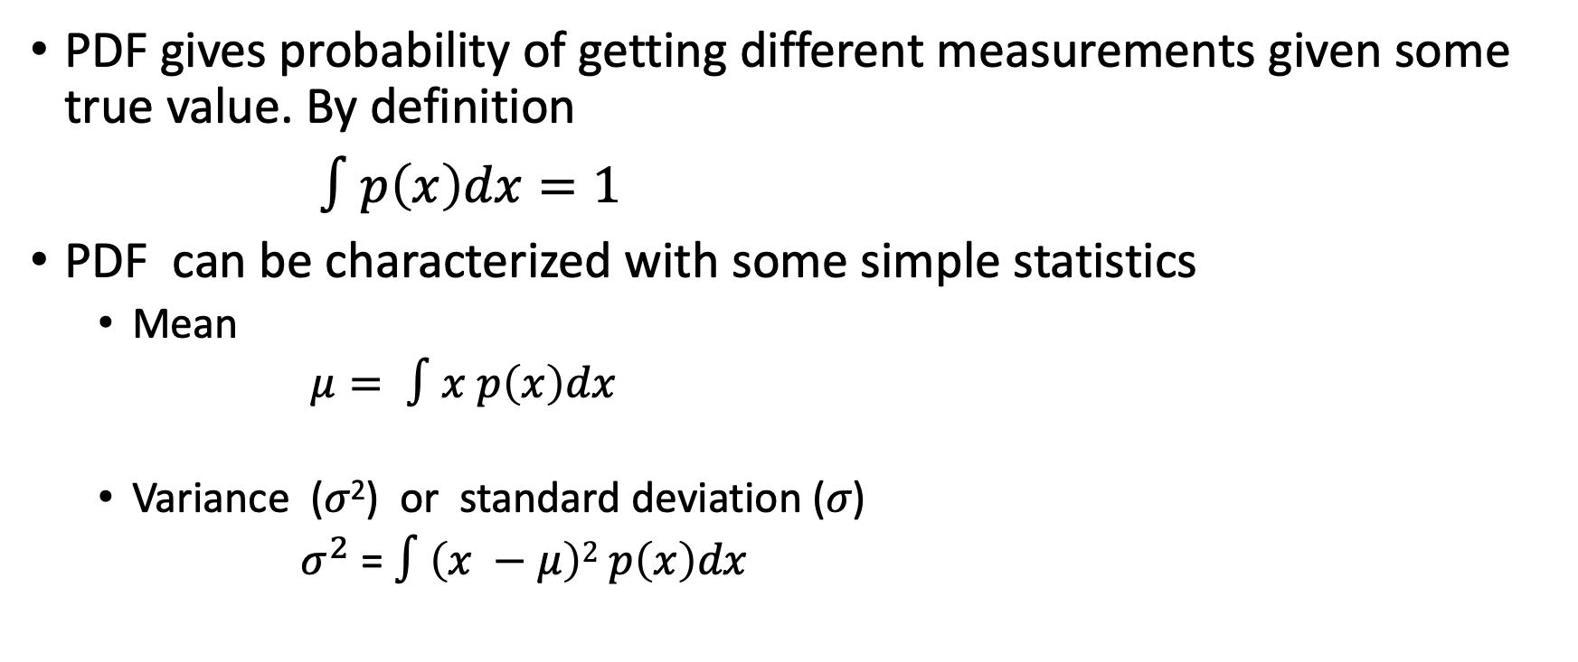
Probability distribution functions
PDF gives probability of getting different measurements given some true value. By definition
$∫p\left(x\right)dx=1$
PDF can be characterized with some simple statistics
  Mean
  $μ= ∫x p\left(x\right)dx$
  Variance (𝜎²) or standard deviation (𝜎)
  $σ^{2}$ = $∫\left(x −μ\right)2 p\left(x\right)dx$

Slide 6
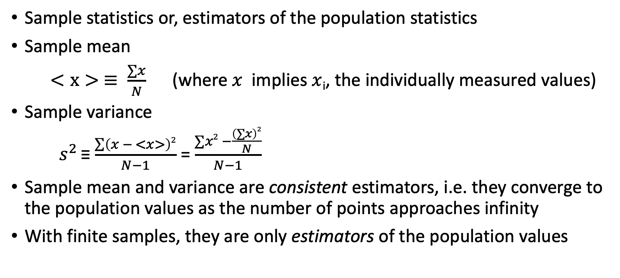
Population vs sample statistics
Sample statistics or, estimators of the population statistics
Sample mean
$<x> ≡ \frac{∑x}{N}$ (where $x$ implies $x$_{i}, the individually measured values)
Sample variance
$s^{2 }$≡ $\frac{\sum{\left(x − <x>\right)2}}{N−1}$ = $\frac{∑x2 −\frac{\left(∑x\right)2}{N}}{N−1}$
Sample mean and variance are consistent estimators, i.e. they converge to the population values as the number of points approaches infinity
With finite samples, they are only estimators of the population values

Slide 7
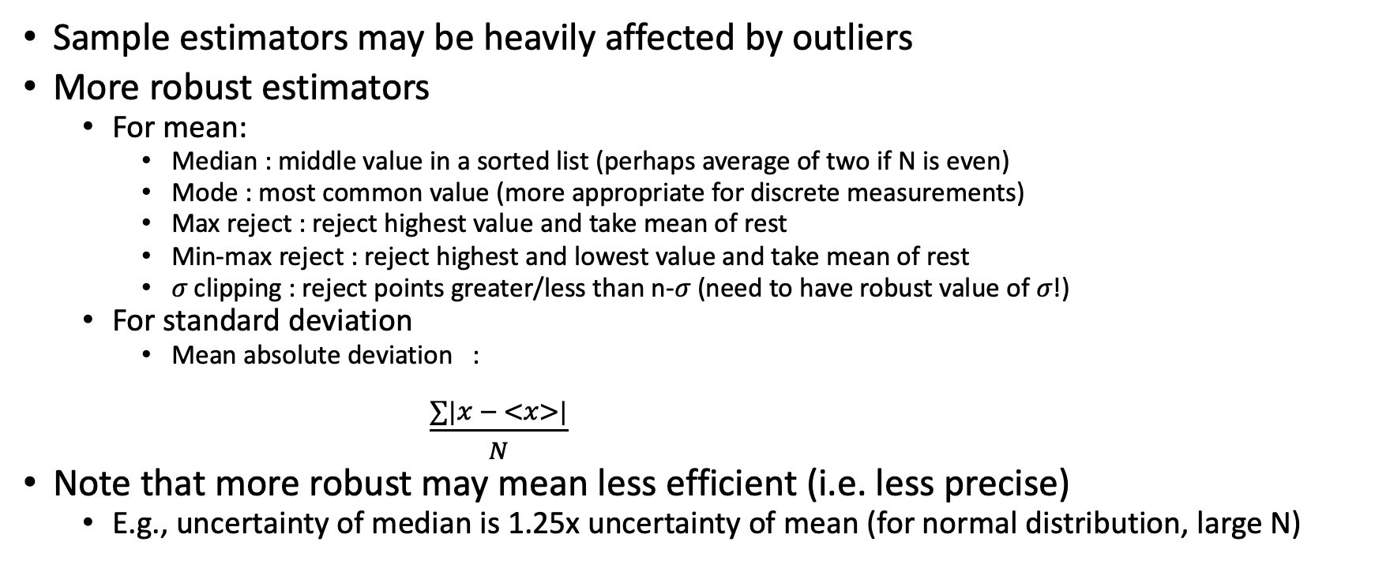
Outliers and their effects
Sample estimators may be heavily affected by outliers
More robust estimators
  For mean:
    Median : middle value in a sorted list (perhaps average of two if N is even)
    Mode : most common value (more appropriate for discrete measurements)
    Max reject : reject highest value and take mean of rest
    Min-max reject : reject highest and lowest value and take mean of rest
    𝜎 clipping : reject points greater/less than n-𝜎 (need to have robust value of 𝜎!)
  For standard deviation
    Mean absolute deviation :
    $\frac{∑|x − <x>|}{N}$
Note that more robust may mean less efficient (i.e. less precise)
  E.g., uncertainty of median is 1.25x uncertainty of mean (for normal distribution, large N)

Slide 9
ASTR 535 : Observational Techniques
Uncertainties and Error Propagation
Some standard probability distribution functions

Slide 10
Learning objectives
Understand the Poisson distribution and when it applies.
Know how the variance/standard deviation of the Poisson distribution is related to the mean of the distribution.
Know what a Gaussian (normal) distribution is, including the full functional form of it.
Understand under what circumstances the Poisson distribution is similar to a normal distribution.

Slide 11
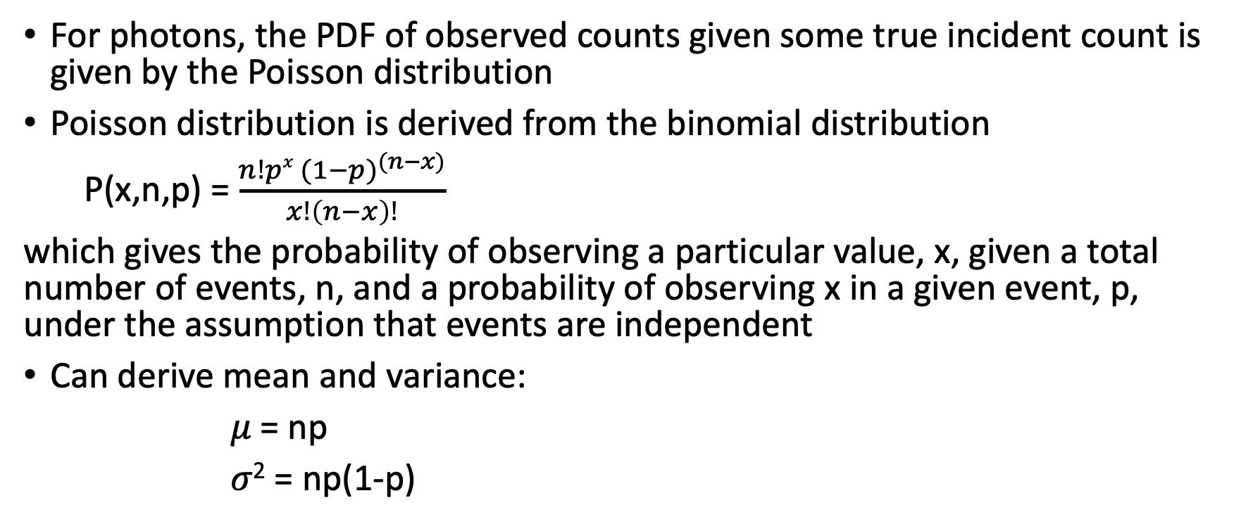
Probability distribution function for counting photons
For photons, the PDF of observed counts given some true incident count is given by the Poisson distribution
Poisson distribution is derived from the binomial distribution
P(x,n,p) = $\frac{n!px {(1−p)}^{(n−x)}}{x!\left(n−x\right)!}$
which gives the probability of observing a particular value, x, given a total number of events, n, and a probability of observing x in a given event, p, under the assumption that events are independent
Can derive mean and variance:
𝜇 = np
𝜎² = np(1-p)

Slide 12
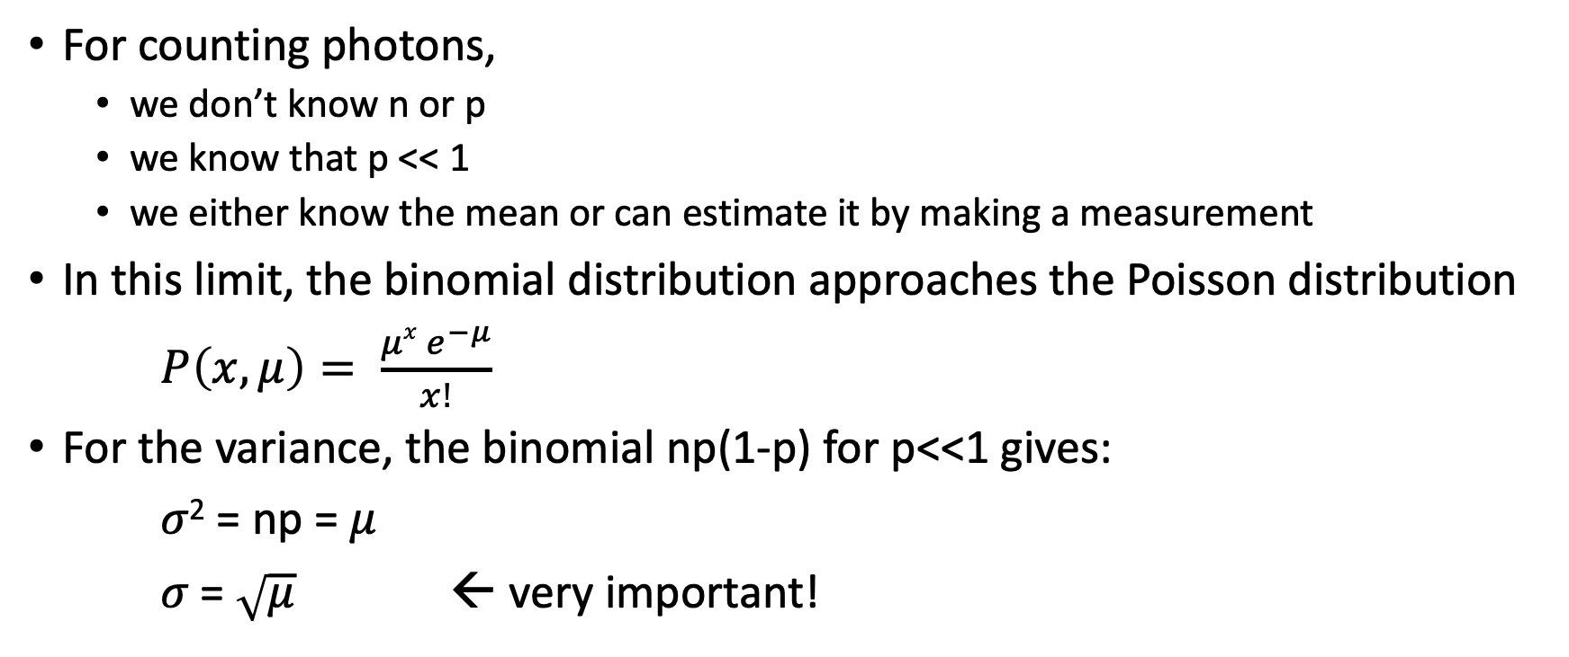
Poisson distribution
For counting photons,
  we don’t know n or p
  we know that p << 1
  we either know the mean or can estimate it by making a measurement
In this limit, the binomial distribution approaches the Poisson distribution
$P\left(x,μ\right)= \frac{μx e^{−μ}}{x!}$
For the variance, the binomial np(1-p) for p<<1 gives:
𝜎² = np = 𝜇
𝜎 = $\sqrt{μ}$ ← very important!

Slide 13
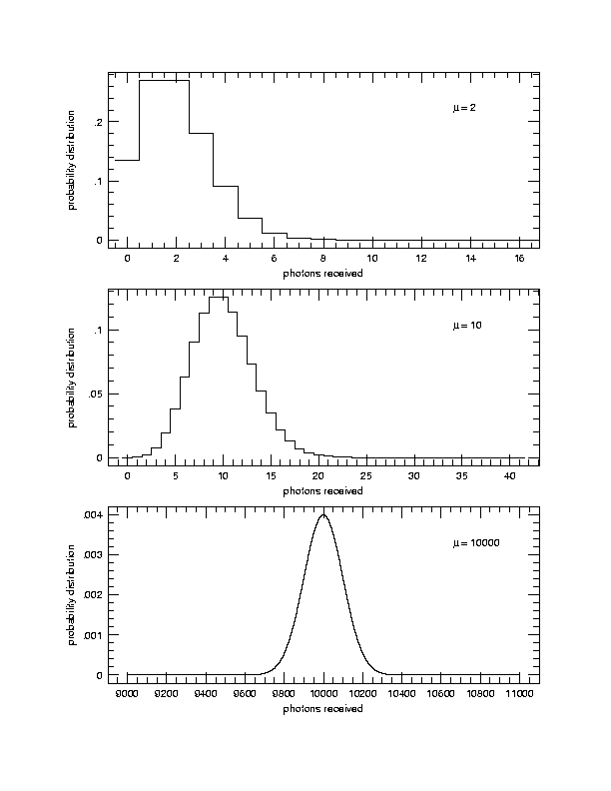
Poisson distribution
Applies for discrete quantities
Can’t count less than zero!
Distribution is not symmetric, esp. for low means
At high means, approaches a Gaussian (normal) distribution
Poisson distribution is applicable to any counting experiment, and is sometimes called counting statistics

Slide 14
Gaussian (normal) distribution
Gaussian distribution is important for several reasons
  Poisson approaches Gaussian for large mean
  Gaussian describes some other noise sources in observing, in particular, the instrumental noise known as readout noise
  Many quantities in nature appear to be distributed according to a normal distribution, perhaps due to the central limit theorem
But certainly, not all PDFs are Gaussian!

Slide 15

Gaussian (normal) distribution
$$P\left(x,μ,σ\right)= \frac{1}{σ\sqrt{2π}}e^{\frac{−\left(x−μ\right)2}{2σ^{2} }}$$

Slide 17
ASTR 535 : Observational Techniques
Uncertainties and Error Propagation
Using uncertainties and confidence limits

Slide 18
Learning objectives
Understand different circumstances under which you need to understand uncertainties and their importance
Know how uncertainties are represented and how confidence intervals are used
Understand how to assess whether a data series is consistent with a hypothesis and the stated uncertainties

Slide 19
Importance of uncertainties: applications
Exposure time calculation : how much time is needed to bring uncertainties to required level
Is observed scatter consistent with expectation?
  If not, need to revise expectation or investigate uncertainties
Distinguish scientific hypotheses

Slide 20
Uncertainties
Distribution of uncertainties is given by the probability distribution function of experimental outcomes
Often simply characterized by the standard deviation→ the error bar
Interpretation of the error bar does depend on the nature of the PDF, but often is interpreted under the assumption of normally distributed uncertainties

Slide 21
Confidence levels
Say you observe some value well off of the mean value
Calculate the probability of getting a value as far or farther from the mean as a particular measured value
Integrate under the Gaussian: the error function (erf)
1𝜎, 2𝜎, 3𝜎 results, etc.

Slide 22
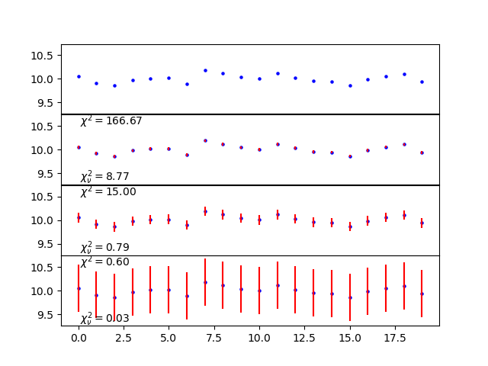
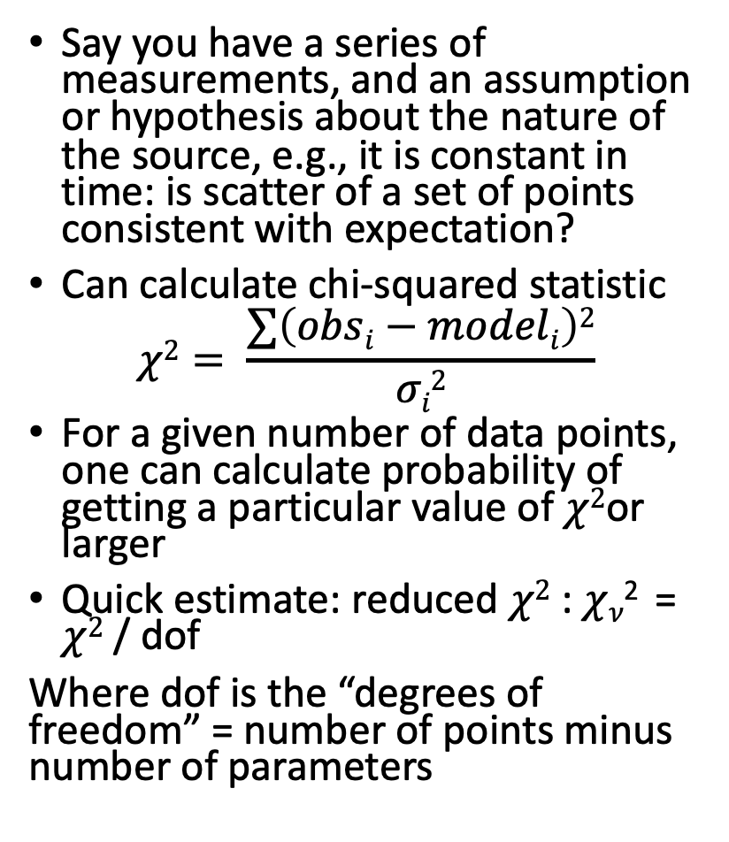

$$χ2$$
Say you have a series of measurements, and an assumption or hypothesis about the nature of the source, e.g., it is constant in time: is scatter of a set of points consistent with expectation?
Can calculate chi-squared statistic
$$χ2= \frac{∑\left(obsi−modeli\right)2}{σi2}$$
For a given number of data points, one can calculate probability of getting a particular value of$χ2$or larger
Quick estimate: reduced $χ2$ : $χ$_{𝜈}² = $χ2$ / dof
Where dof is the “degrees of freedom” = number of points minus number of parameters

Slide 24
ASTR 535 : Observational Techniques
Uncertainties and Error Propagation
Noise equation

Slide 25
Learning objectives
Understand the concept of S/N and fractional error.
Know how S/N depends on the signal for the Poisson-limited case.
Understand how Poisson uncertainties in the background contributes to the S/N of an object, and how the background contribution depends on both the brightness of the background but also on the image quality because the amount of background included in the measurement
Understand readout noise and how it represented by a normal distribution with zero mean. Know under what circumstances readout noise is an important contributor to the total noise.

Slide 26
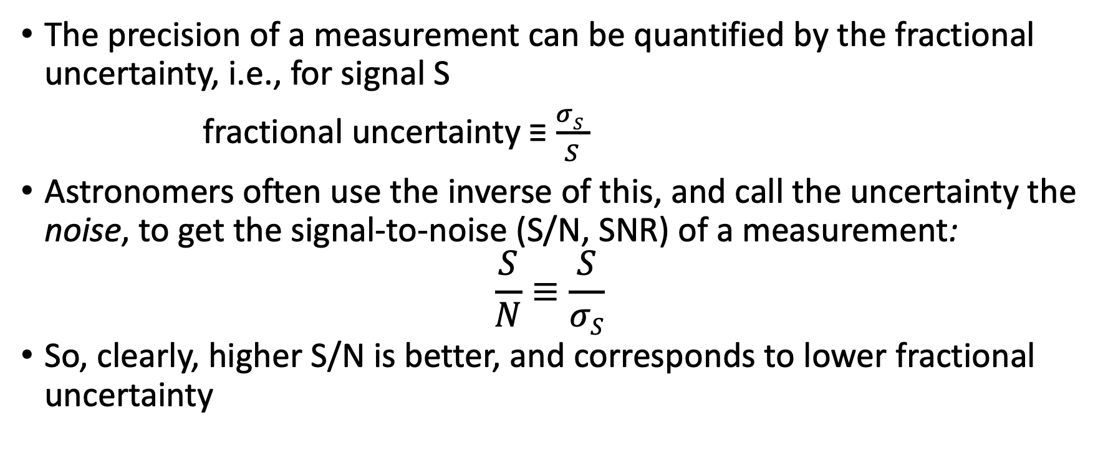
Signal-to-noise
The precision of a measurement can be quantified by the fractional uncertainty, i.e., for signal S
fractional uncertainty ≡ $\frac{σS }{S}$
Astronomers often use the inverse of this, and call the uncertainty the noise, to get the signal-to-noise (S/N, SNR) of a measurement:
$$\frac{S}{N}≡\frac{S}{σS}$$
So, clearly, higher S/N is better, and corresponds to lower fractional uncertainty

Slide 27
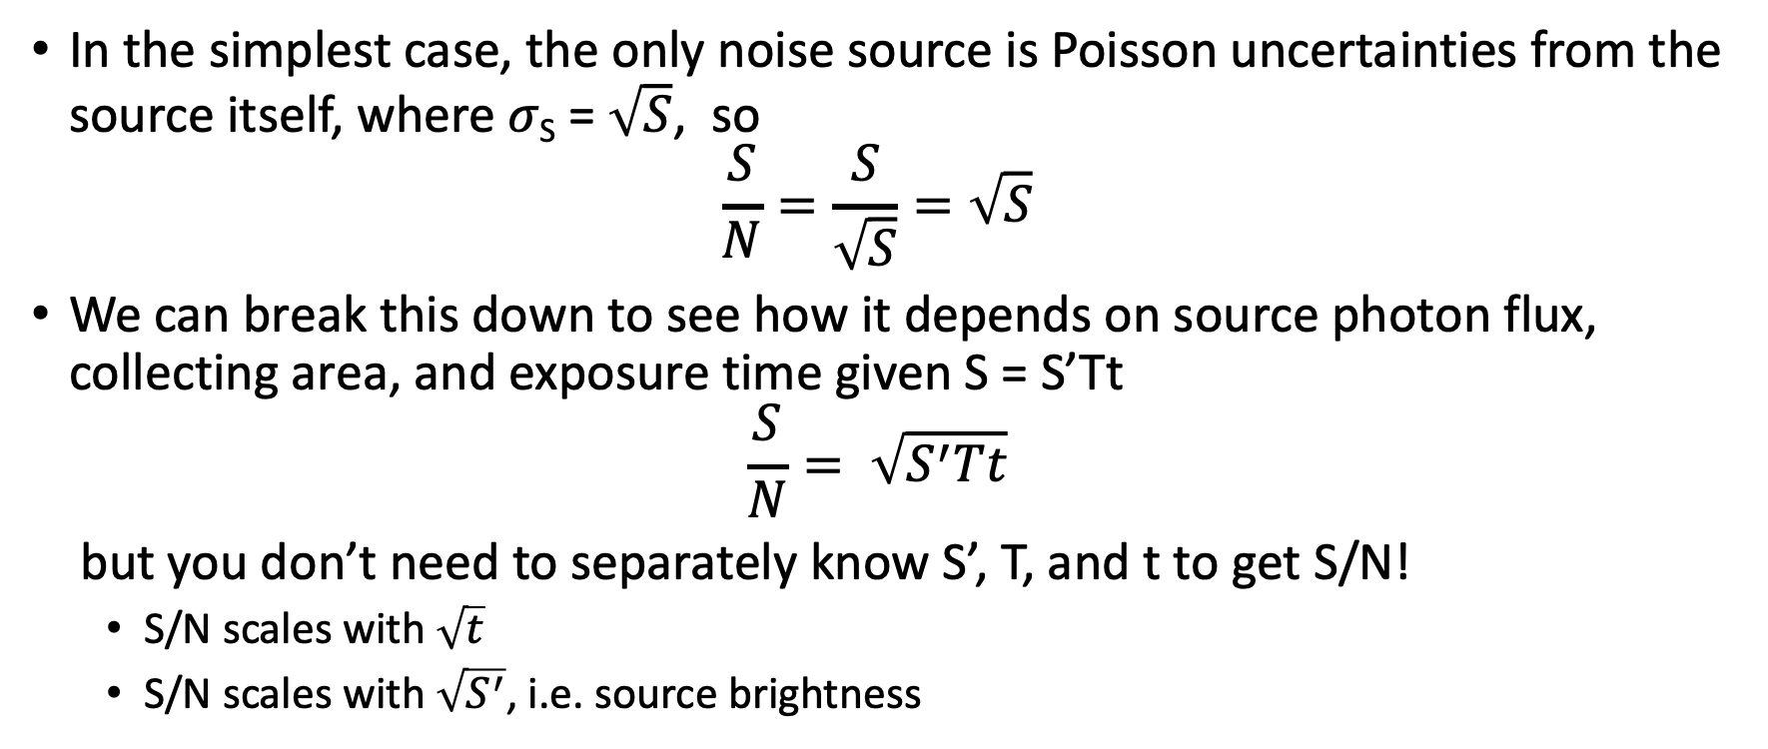
Noise source: signal
In the simplest case, the only noise source is Poisson uncertainties from the source itself, where 𝜎_{S} = $\sqrt{S}$, so
$$\frac{S}{N}=\frac{S}{\sqrt{S}}=\sqrt{S}$$
We can break this down to see how it depends on source photon flux, collecting area, and exposure time given S = S’Tt
$$\frac{S}{N}= \sqrt{S^{′}Tt}$$
but you don’t need to separately know S’, T, and t to get S/N!
  S/N scales with $\sqrt{t}$
  S/N scales with $\sqrt{S^{′}}$, i.e. source brightness

Slide 28
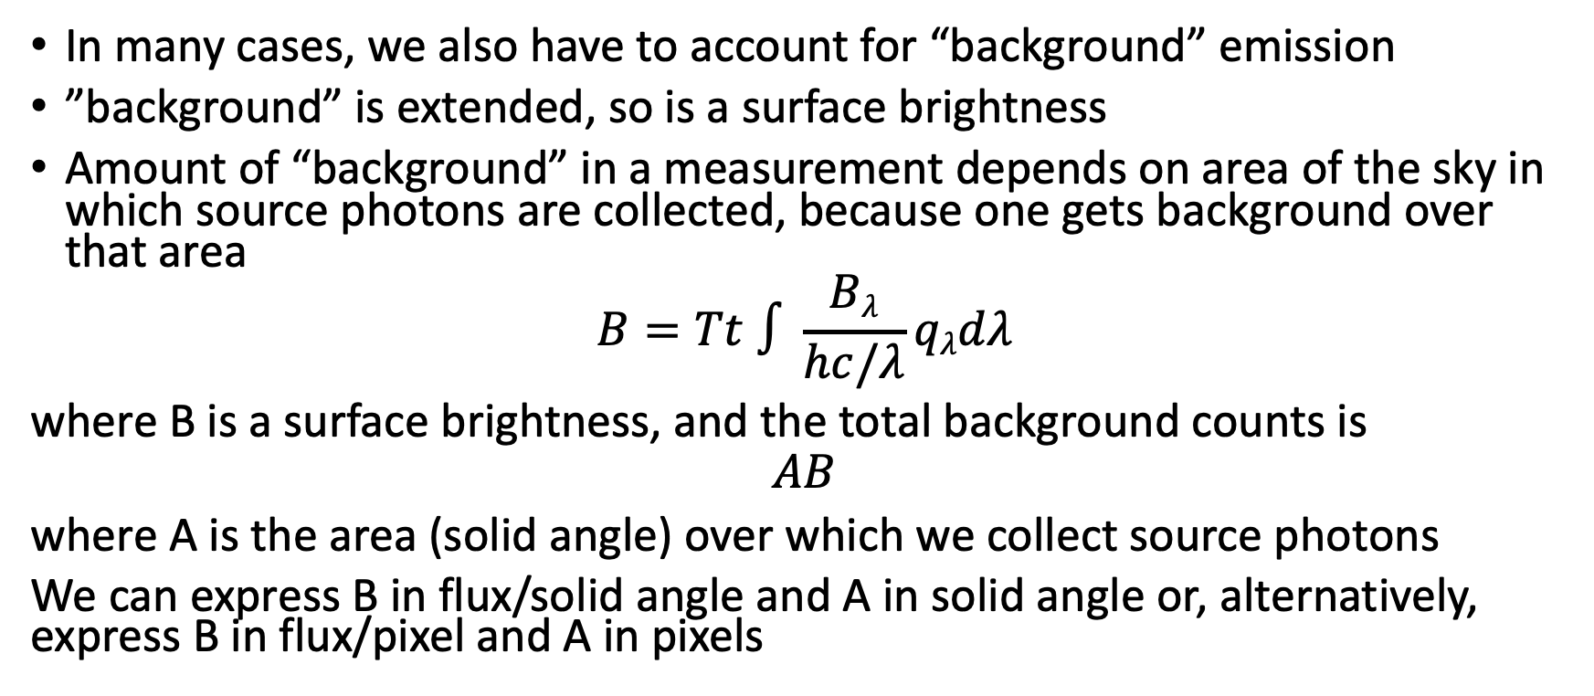
Noise source: background
In many cases, we also have to account for “background” emission
”background” is extended, so is a surface brightness
Amount of “background” in a measurement depends on area of the sky in which source photons are collected, because one gets background over that area
$$B=Tt ∫\frac{Bλ}{hc/λ}qλdλ$$
where B is a surface brightness, and the total background counts is
$$AB$$
where A is the area (solid angle) over which we collect source photons
We can express B in flux/solid angle and A in solid angle or, alternatively, express B in flux/pixel and A in pixels

Slide 29
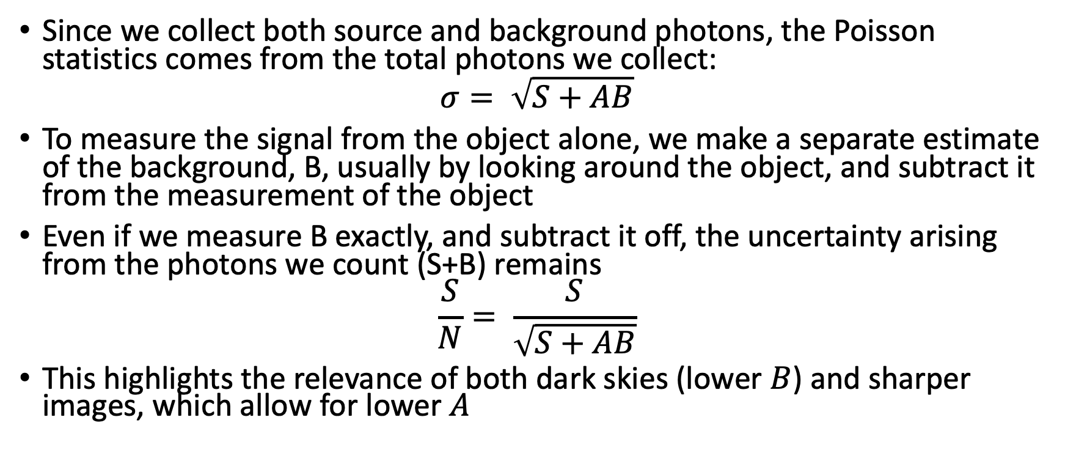
Noise source: background
Since we collect both source and background photons, the Poisson statistics comes from the total photons we collect:
$$σ= \sqrt{S+AB}$$
To measure the signal from the object alone, we make a separate estimate of the background, B, usually by looking around the object, and subtract it from the measurement of the object
Even if we measure B exactly, and subtract it off, the uncertainty arising from the photons we count (S+B) remains
$$\frac{S}{N}= \frac{S}{\sqrt{S+AB}}$$
This highlights the relevance of both dark skies (lower $B$) and sharper images, which allow for lower $A$

Slide 30
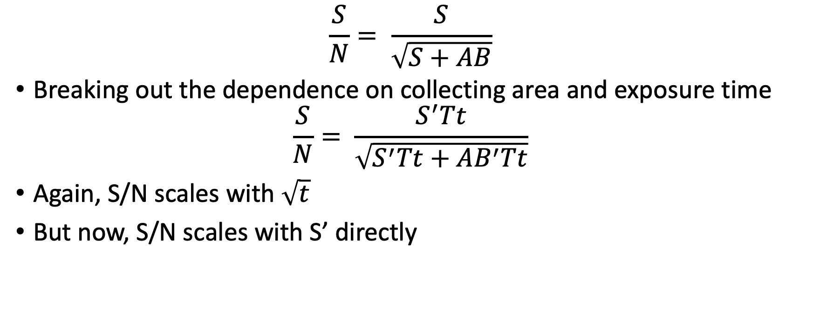
Noise source: background
$$\frac{S}{N}= \frac{S}{\sqrt{S+AB}}$$
Breaking out the dependence on collecting area and exposure time
$$\frac{S}{N}= \frac{S^{′}Tt}{\sqrt{S^{′}Tt+AB^{′}Tt}}$$
Again, S/N scales with $\sqrt{t}$
But now, S/N scales with S’ directly

Slide 31
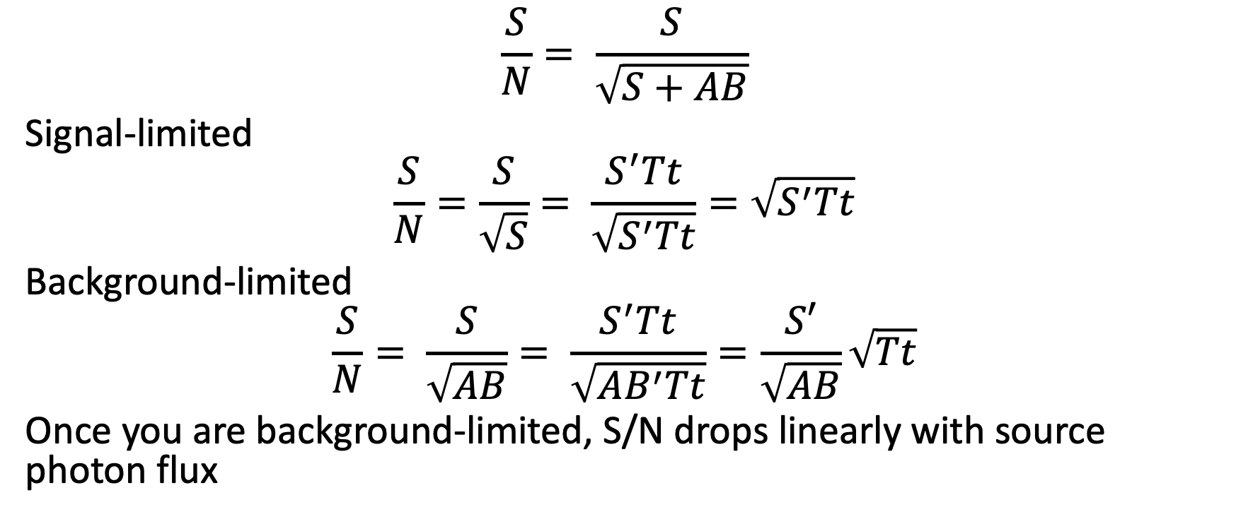
Noise source: signal and background limited
$$\frac{S}{N}= \frac{S}{\sqrt{S+AB}}$$
Signal-limited
$$\frac{S}{N}=\frac{S}{\sqrt{S}}= \frac{S^{′}Tt}{\sqrt{S^{′}Tt}}=\sqrt{S^{′}Tt}$$
Background-limited
$$\frac{S}{N}= \frac{S}{\sqrt{AB}}= \frac{S^{′}Tt}{\sqrt{AB^{′}Tt}}=\frac{S′}{\sqrt{AB}}\sqrt{Tt}$$
Once you are background-limited, S/N drops linearly with source photon flux

Slide 32
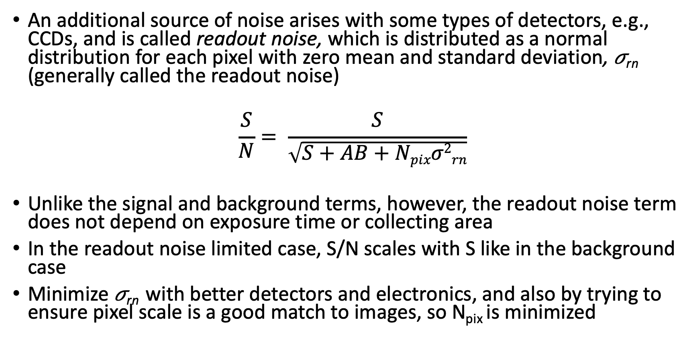
Noise source: readout noise
An additional source of noise arises with some types of detectors, e.g., CCDs, and is called readout noise, which is distributed as a normal distribution for each pixel with zero mean and standard deviation, 𝜎_{rn} (generally called the readout noise)
$$\frac{S}{N}= \frac{S}{\sqrt{S+AB+Npixσ2rn}}$$
Unlike the signal and background terms, however, the readout noise term does not depend on exposure time or collecting area
In the readout noise limited case, S/N scales with S like in the background case
Minimize 𝜎_{rn} with better detectors and electronics, and also by trying to ensure pixel scale is a good match to images, so N_{pix} is minimized

Slide 33
What regime are different types of observations?
Imaging
  Bright objects (much brighter than sky) : signal-limited
  Fainter objects : background-limited
  In optical, typical sky surface brightness ranges from 18-22 mag/square arcsec
  In near-IR, typical sky surface brightness ranges from 12-15 mag/square arcsec
  Image quality also matter
Spectroscopy
  Both object and background light is dispersed (in most applications)
  Readout noise can become important, especially for short exposures

Slide 35
ASTR 535 : Observational Techniques
Uncertainties and Error Propagation
Error propagation

Slide 36
Learning objectives
Know the uncertainty (error) propagation formula and be able to apply it in a general case

Slide 37
Motivation
say we want to make some calculations (e.g., calibration, unit conversion, averaging, conversion to magnitudes, calculation of colors, etc.) using these observations: we need to be able to estimate the uncertainties in the calculated quantities that depend on our measured quantities.
Specific example: when we added in readout noise in the noise equation, why did we add the uncertainty in quadrature?

Slide 38
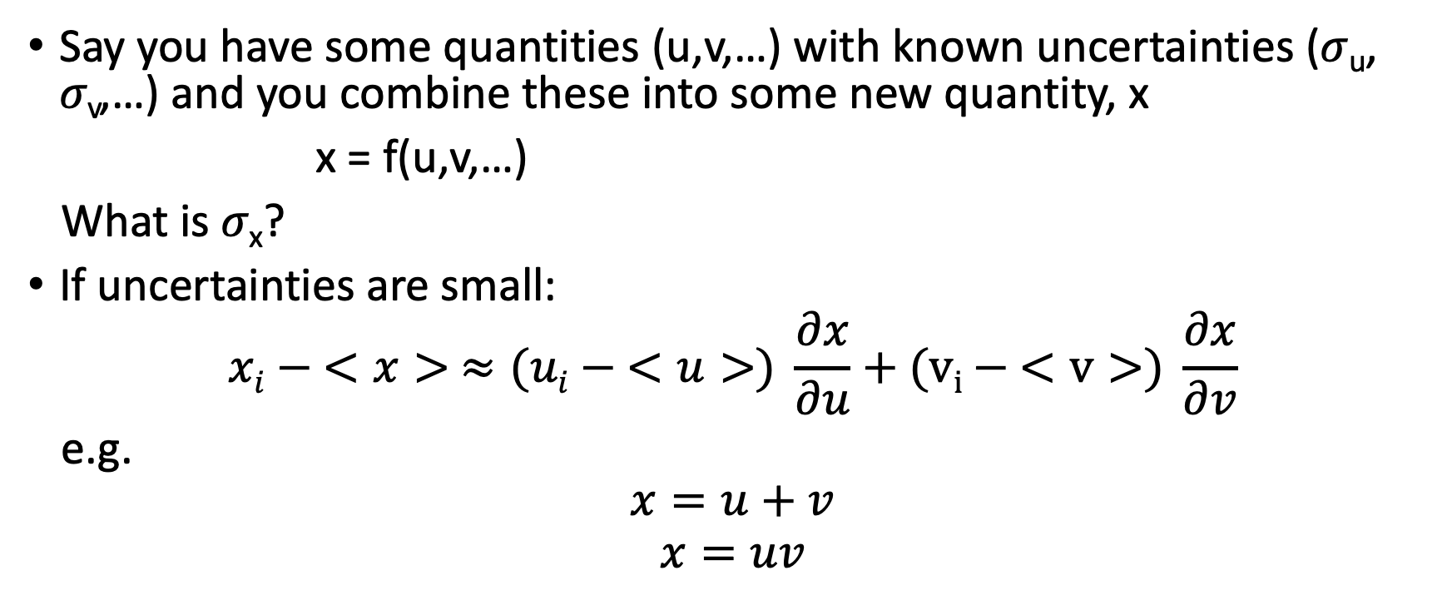
Propagation of uncertainties
Say you have some quantities (u,v,…) with known uncertainties (𝜎_{u}, 𝜎_{v},…) and you combine these into some new quantity, x
x = f(u,v,…)
What is 𝜎_{x}?
If uncertainties are small:
$$xi − <x> ≈(ui − <u>) \frac{∂x}{∂u}+(vi − <v>) \frac{∂x}{∂v}$$
e.g.
$$x=u+v$$
$$x=uv$$

Slide 39
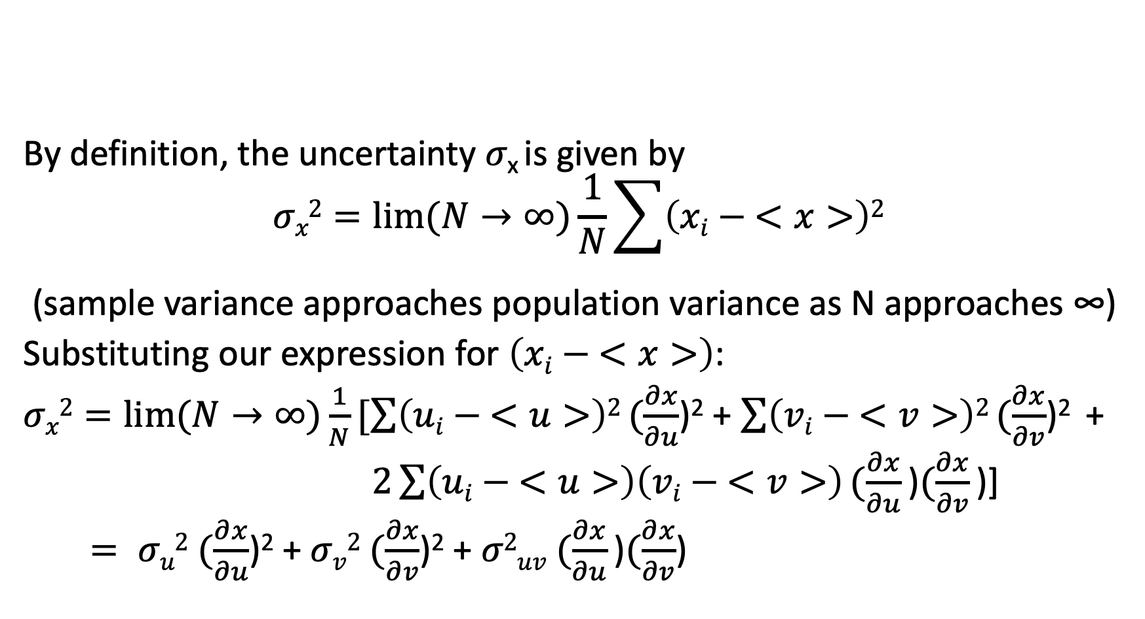
Propagation of uncertainties
By definition, the uncertainty 𝜎_{x} is given by
$$σx2=lim⁡(N→∞)\frac{1}{N}\sum{\left(xi − <x>\right)2}$$
(sample variance approaches population variance as N approaches ∞)
Substituting our expression for $\left(xi − <x>\right)$:
$σx2=lim⁡(N→∞)\frac{1}{N}[\sum{\left(ui − <u>\right)2}(\frac{∂x}{∂u}$)² + $\sum{\left(vi − <v>\right)2}(\frac{∂x}{∂v}$)² +
$2\sum{\left(ui − <u>\right)\left(vi − <v>\right)}(\frac{∂x}{∂u}\text{)}(\frac{∂x}{∂v}\text{)]}$
$= σu2$ $(\frac{∂x}{∂u}$)² + $σv2$ $(\frac{∂x}{∂v}$)² + $σ2uv$ $(\frac{∂x}{∂u}\text{)}(\frac{∂x}{∂v}$)

Slide 40
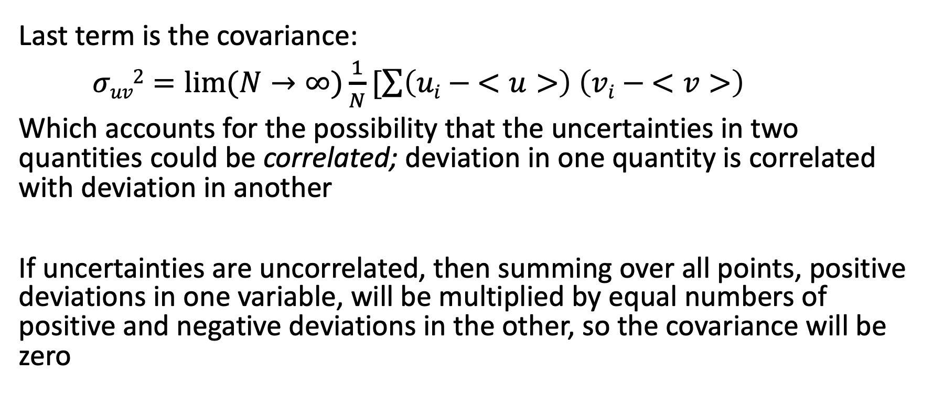
Covariance
Last term is the covariance:
$σuv2=lim⁡(N→∞)\frac{1}{N}[\sum{\left(ui − <u>\right)}$ $\left(vi − <v>\right)$
Which accounts for the possibility that the uncertainties in two quantities could be correlated; deviation in one quantity is correlated with deviation in another
If uncertainties are uncorrelated, then summing over all points, positive deviations in one variable, will be multiplied by equal numbers of positive and negative deviations in the other, so the covariance will be zero

Slide 41
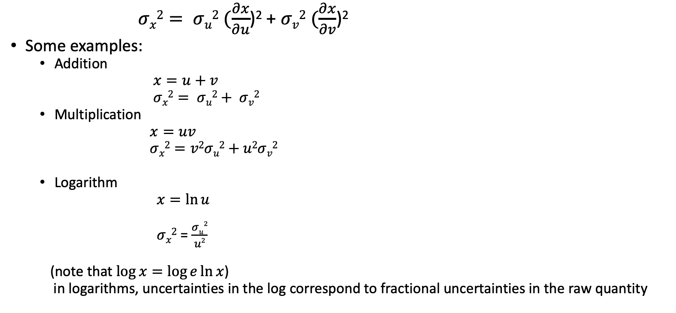
Uncorrelated uncertainties
$σx2= σu2$ $(\frac{∂x}{∂u}$)² + $σv2$ $(\frac{∂x}{∂v}$)²
Some examples:
  Addition
  $x=u+v$
  $σx2= σu2+ σv2$
  Multiplication
  $x=uv$
  $σx2=v2σu2+u2σv2$
  Logarithm
  $x=\ln{u}$
  $σx2$ = $\frac{σu2}{u2}$
  (note that $\log{x=\log{e\ln{x}}}$)
  in logarithms, uncertainties in the log correspond to fractional uncertainties in the raw quantity

Slide 42
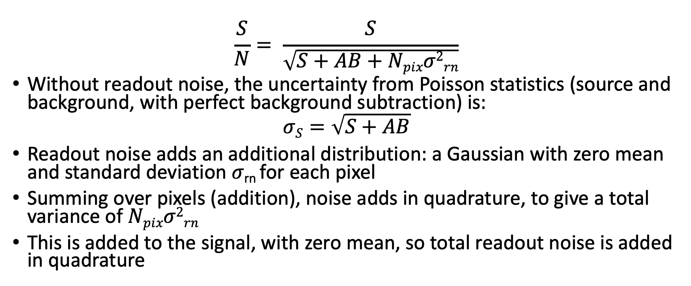
Example: readout noise
$$\frac{S}{N}= \frac{S}{\sqrt{S+AB+Npixσ2rn}}$$
Without readout noise, the uncertainty from Poisson statistics (source and background, with perfect background subtraction) is:
$$σS=\sqrt{S+AB}$$
Readout noise adds an additional distribution: a Gaussian with zero mean and standard deviation 𝜎_{rn} for each pixel
Summing over pixels (addition), noise adds in quadrature, to give a total variance of $Npixσ2rn$
This is added to the signal, with zero mean, so total readout noise is added in quadrature

Slide 43
Distribution of resultant uncertainties
We have characterized the uncertainty PDF with the standard deviation, but a given standard deviation could arise with different PDFs
In general, the shape of the PDF of the derived quantity is not necessarily the shape of the PDF of any of the input quantities
If two normally distributed variables are combined by addition – i.e. the uncertainties add in quadrature – then the resulting PDF is also normally distributed

Slide 45
ASTR 535 : Observational Techniques
Uncertainties and Error Propagation
Summing and averaging measurements

Slide 46
Learning objectives
Understand under what circumstances you can split exposures without a noise penalty, and under what circumstances you cannot. Understand some of the reasons why you might want to split an exposure into shorter pieces
Understand how to properly average measurements and estimate the uncertainty on the sample mean
Understand how the distinction between sample variance and true variance can lead to biases when calculating a weighted mean, and how to overcome this.

Slide 47

Summing exposures
Say you take multiple exposures of an object and want to sum the counts, C_{i,} given an uncertainty 𝜎 on each
Uncertainty on the sum is 𝜎$\sqrt{N},$ from error propagation

Slide 48
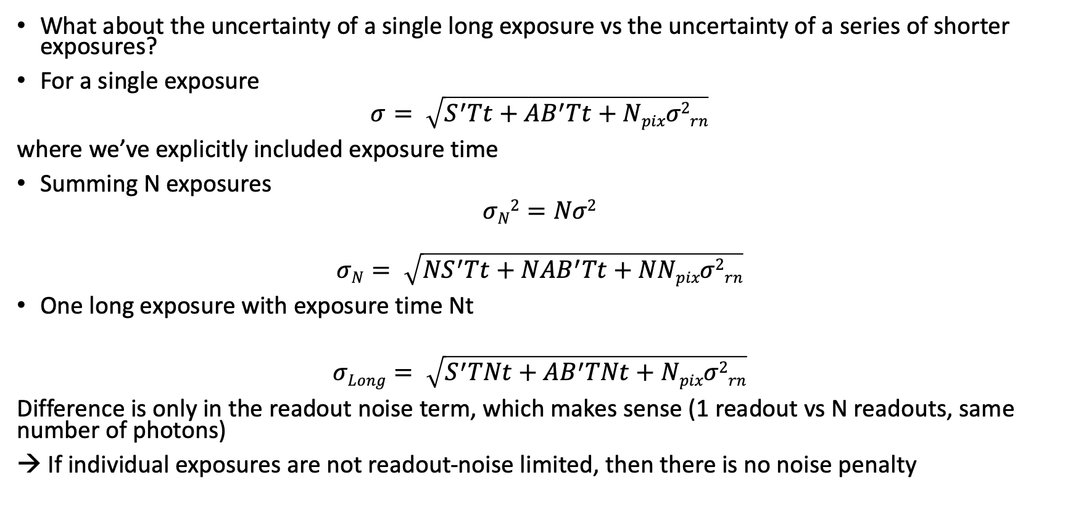
Summing / splitting exposures
What about the uncertainty of a single long exposure vs the uncertainty of a series of shorter exposures?
For a single exposure
$$σ= \sqrt{S^{′}Tt+AB^{′}Tt+Npixσ2rn}$$
where we’ve explicitly included exposure time
Summing N exposures
$$σN2=Nσ2$$
$$σN= \sqrt{{NS}^{′}Tt+NAB^{′}Tt+NNpixσ2rn}$$
One long exposure with exposure time Nt
$$σLong= \sqrt{S^{′}TNt+AB^{′}TNt+Npixσ2rn}$$
Difference is only in the readout noise term, which makes sense (1 readout vs N readouts, same number of photons)
→ If individual exposures are not readout-noise limited, then there is no noise penalty

Slide 49
Splitting exposures
For long exposures, there are benefits to splitting exposures, but make sure that individual exposure have sufficient signal to dominate readout noise
  Tracking
  Monitoring of conditions
  Cosmic ray rejection
  Increasing dynamic range by avoiding saturation
There are also some potential disadvantages
  Increased readout time
  Increased data volume

Slide 50
Averaging measurements
In some circumstances, we might be in the position of wanting to average measurements, e.g., from a set of measurements taken with different exposure times, on different nights, or from different telescopes

Slide 51
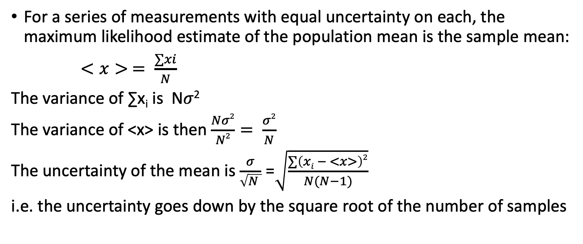
Averaging measurements : equal uncertainties
For a series of measurements with equal uncertainty on each, the maximum likelihood estimate of the population mean is the sample mean:
$<x> = \frac{∑xi}{N}$
The variance of ∑x_{i} is N𝜎²
The variance of <x> is then $\frac{Nσ2}{N2}= \frac{σ2}{N}$
The uncertainty of the mean is $\frac{σ}{\sqrt{N }}$ =$\sqrt{\frac{∑\left(xi − <x>\right)2}{N(N−1)}}$
i.e. the uncertainty goes down by the square root of the number of samples

Slide 52
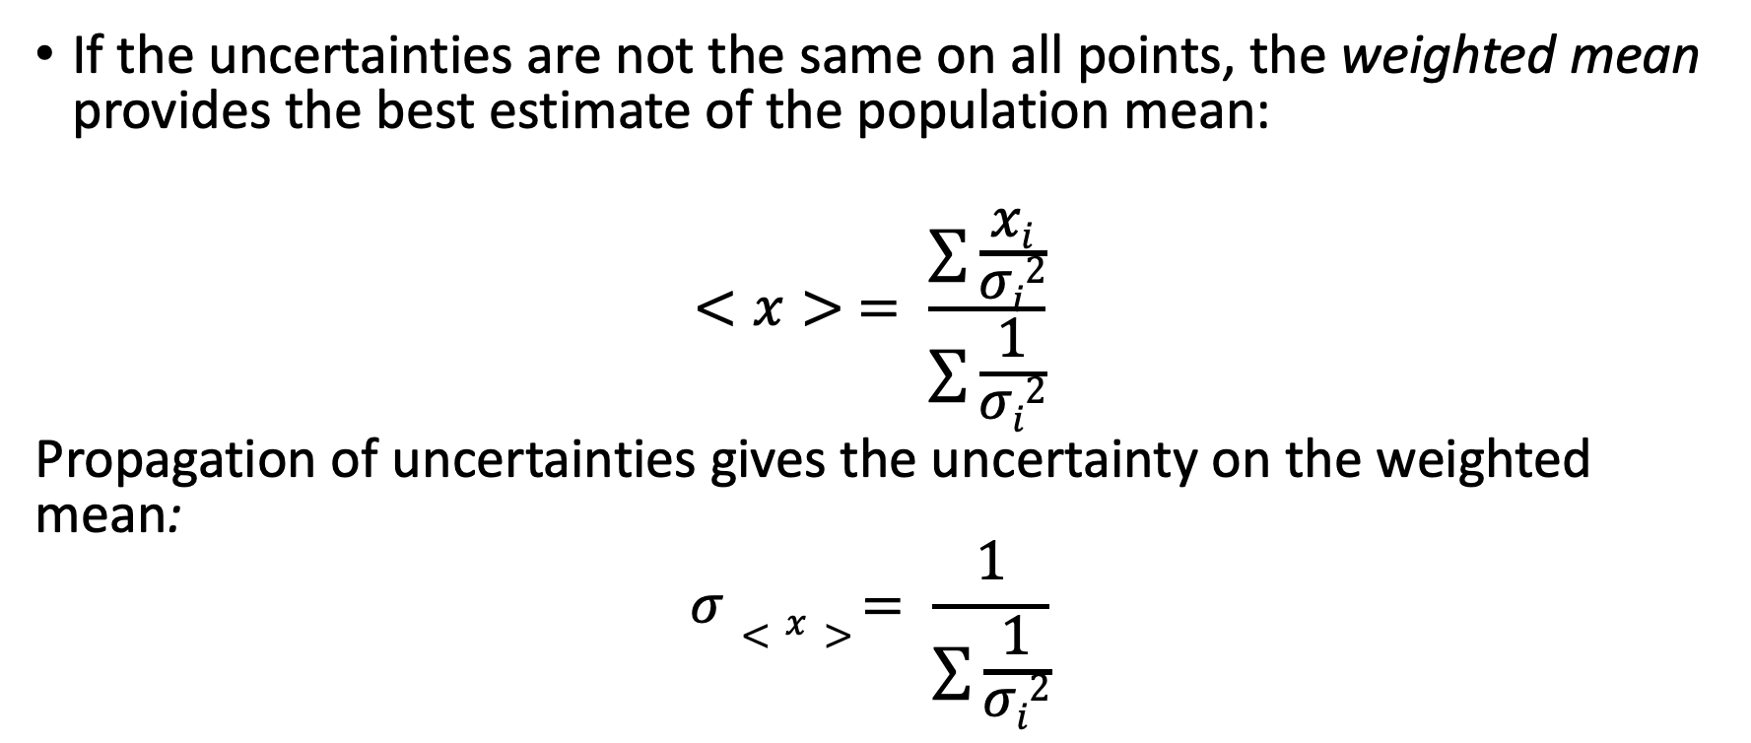
Averaging with unequal uncertainties
If the uncertainties are not the same on all points, the weighted mean provides the best estimate of the population mean:
$$<x> = \frac{∑\frac{xi}{σi2}}{∑\frac{1}{σi2}}$$
Propagation of uncertainties gives the uncertainty on the weighted mean:
$$σ<x> = \frac{1}{∑\frac{1}{σi2}}$$

Slide 53
Weighted mean: a subtlety
For the weighted mean, the weights, 1/𝜎_{i}² use the population variances
But we generally only have the sample variances, which are estimates of the population variances!
This can lead to biases if the estimates are not determined self consistently
Example:
  three measurements give photon counts of 40, 50, and 60 photons
  Considered independently, one might adopt variances of 40, 50, and 60 photons, respectively
  Using a weighted mean would then give a biased result, since the 40 measurement will be weighted more
  For three identical measurements of the same thing, you might recognize the fallacy, but there are certainly cases in which you would want to use a weighted mean
  Remedy: weight the measurements self-consistently!

Slide 55
ASTR 535 : Observational Techniques
Uncertainties and Error Propagation
Random vs systematic uncertainties

Slide 56
Learning objectives
Understand the distinction between random and systematic errors
Understand how comparing observed scatter with expected scatter may be critical to discovering systematic errors

Slide 57
Random and systematic errors
Random uncertainties describe scatter around the true value
Systematic uncertainties describe the possibility that observed values are offset from the true value
Sometimes described as precision (random scatter) and accuracy (offset from true value)
Systematic uncertainties are often the most problematic as they often arise from unknown things
  If a source of systematics is known, one can attempt to mitigate it and/or to estimate its amplitude

Slide 58
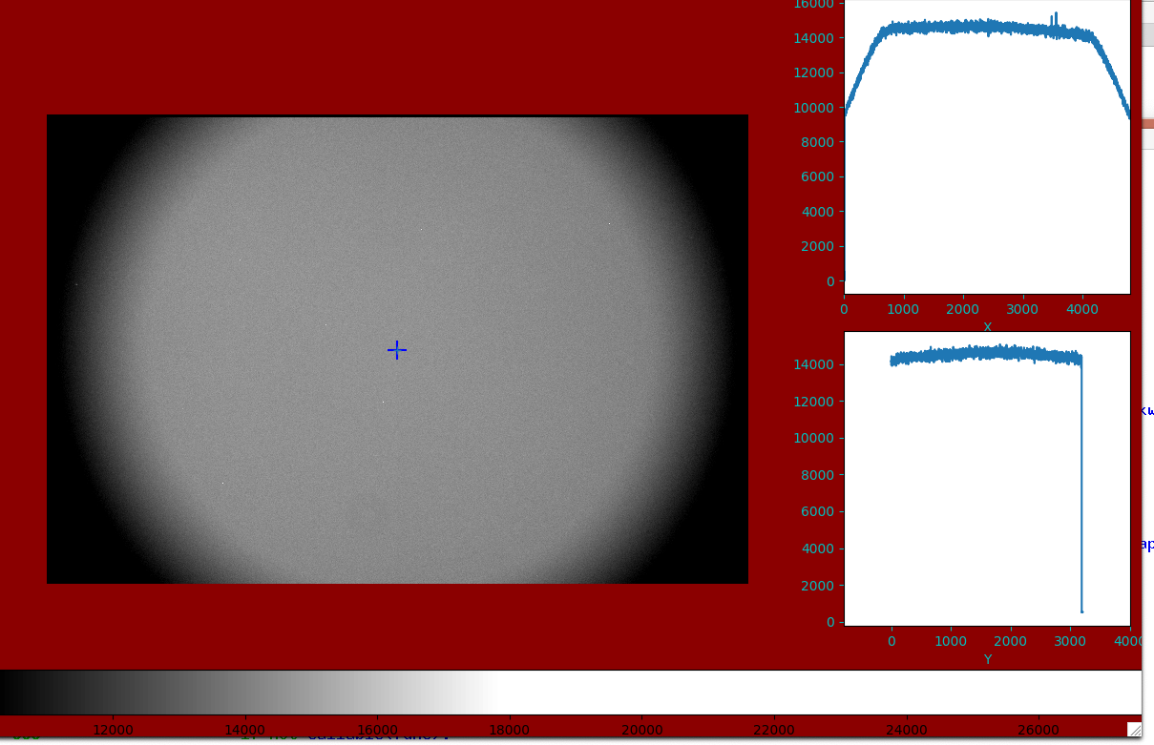
Example: flat fielding
Typically, imaging systems don’t have a uniform response across the field of view
  Non-uniformities can arise from vignetting in the system, non-uniform filter response, non-uniform detector response, etc.
If this was ignored, it would lead to systematics as a function of position: objects in areas with lower sensitivity would be measured fainter
Of course, it is not ignored: one uses a “flat field”, an observation of a (supposedly) uniformly illuminated field to calibrate out the non-uniform response
But what is a “uniformly illuminate field” and how uniform is it?
  Any deviations from “uniformity” lead to systematic errors
How can you test for this?
  One possibility: take images of the same object at multiple locations

Slide 59
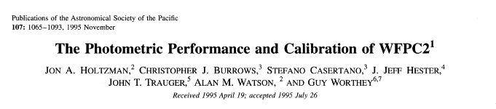
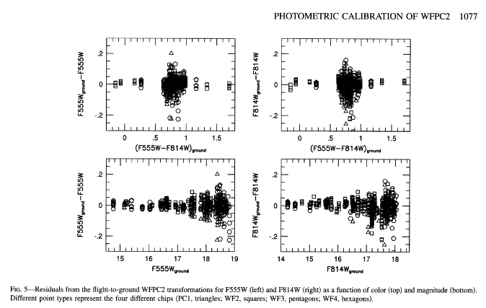
Example: HST/WFPC2 CTE
For the HST/WFPC2, calibration was done by observing stars that had calibrated magnitudes from ground-base observations
In the resulting analysis, the scatter for brighter stars was larger than expected given the noise model (signal + background + readout noise)
Looking at scatter:
  Not correlated with color (transformation term)
  Correlated with row position on detector!
Discovery of an (unfortunate) unforeseen effect: charge transfer losses!
Discovered by comparing observed scatter to expected scatter!

Slide 60
Finding unknown systematics
Check to see if observed scatter is consistent with known sources of uncertainty.
  If not, there’s something you need to understand!
  Look for correlations of deviations with other quantities
  Don’t overestimate random uncertainties!

Slide 62
ASTR 535 : Observational Techniques
Uncertainties and Error Propagation
Digital photometry

Slide 63
Learning objectives
Understand the basic principles of doing aperture photometry on images
Understand the S/N tradeoffs with aperture size depending on source and background brightness
Understand the basic principles of doing crowded field photometry

Slide 64
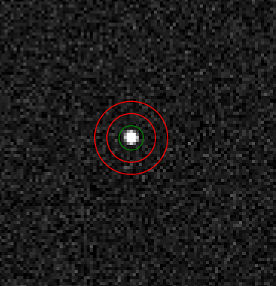
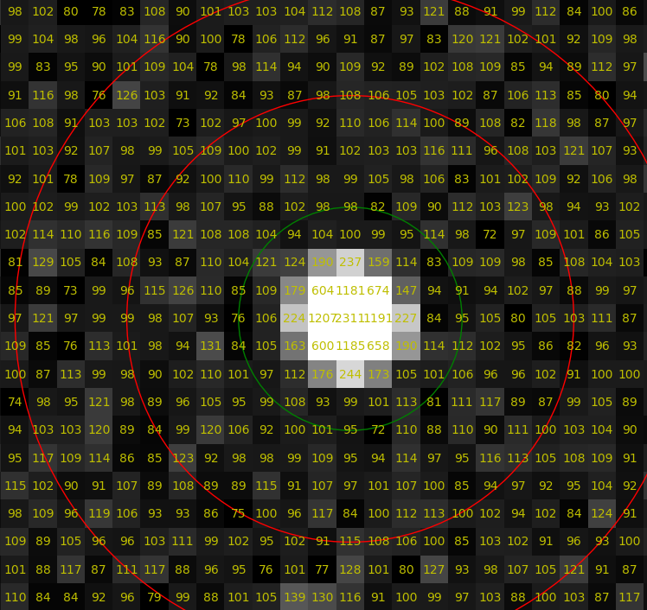
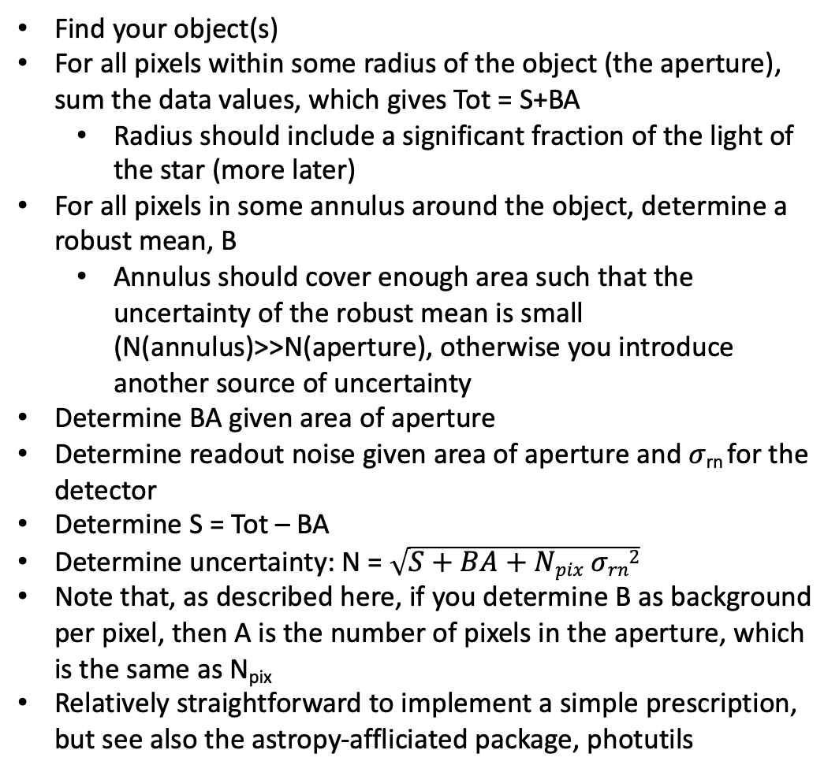
Digital aperture photometry
Find your object(s)
For all pixels within some radius of the object (the aperture), sum the data values, which gives Tot = S+BA
  Radius should include a significant fraction of the light of the star (more later)
For all pixels in some annulus around the object, determine a robust mean, B
  Annulus should cover enough area such that the uncertainty of the robust mean is small (N(annulus)>>N(aperture), otherwise you introduce another source of uncertainty
Determine BA given area of aperture
Determine readout noise given area of aperture and 𝜎_{rn} for the detector
Determine S = Tot – BA
Determine uncertainty: N = $\sqrt{S+BA+Npix σrn2}$
Note that, as described here, if you determine B as background per pixel, then A is the number of pixels in the aperture, which is the same as N_{pix}
Relatively straightforward to implement a simple prescription, but see also the astropy-affliciated package, photutils

Slide 65
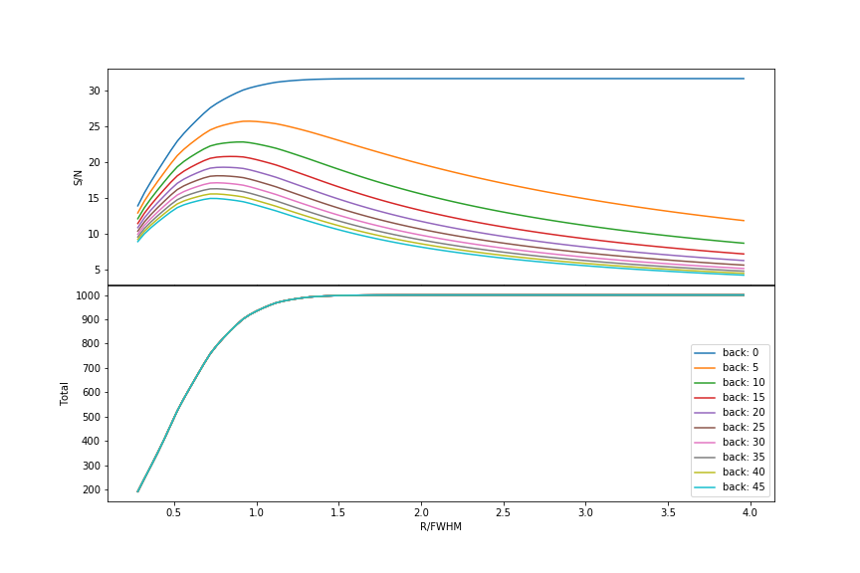
Photometry
Choice of aperture radius
  Larger gets more light
  Larger includes more background
  Tradeoff depends on source and background brightness
Differential photometry
  If comparing to other object(s) in field, need aperture radius to provide consistent fraction of light across frame

Slide 66
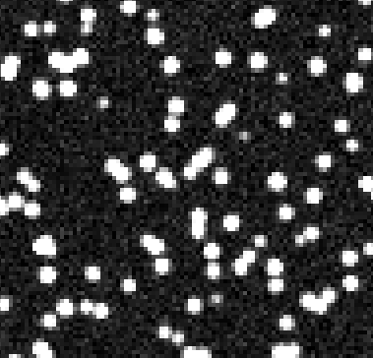
Crowded field photometry
If there are many objects, such that they are “overlapping”, then digital aperture photometry clearly won’t work!
Here, things become more complicated
Find stars
Determine shape of a star (PSF) from some isolated star(s)
Simultaneously fit groups of stars, solving for brightnesses and also centers (since your initial estimates may have been biased by neighbors
Include pixel uncertainties when doing the fit
Adopt derived parameter uncertainties
Implementations: DAOPHOT, DoPHOT, DolPhot, implementations in astropy-affiliate photutils

