Slide 1
ASTR 535 : Observational Techniques
Fall 2023 : class sessions
Light and magnitudes

Slide 2
Logistics
Syllabus
Policies: attendance and ethics
APO trip
Groups
A: April, Kevin, Victoria
B: Tim, Anna
C: Bill, Jessica, Julio
D: Maya, Asif, Anokh

Slide 3
Topics 8/22
Quick student discussion to identify questions
Questions
Errata: wavelength in vacuum relative to wavelength in air
properties of light and quantities astronomers measure
Basic quantities
Electromagnetic spectrum
magnitudes

Slide 4
Discussion: flux, surface brightness, and luminosity
Describe these qualitatively
What are the dimensions?
Which quantities are relevant for what astronomical objects?
How do they depend on distance?

Slide 5
Light and the electromagnetic spectrum
What are different types of light?
By what quantities are they characterized?
How are these quantities related?

Slide 6
Discussion: magnitudes
Why use magnitudes?
How are magnitudes defined?
How does this apply to the relative brightnesses of two objects?
What is the relative brightness of two objects, m1=2,m2=9.5?
What is the relative brightness of two objects,m1=12, m2=19.5?
What is the magnitude difference between two objects that differ in brightness by a factor of a million?
What does the ratio of two magnitudes indicate?
What mathematical operations might you expect to use with magnitudes and which ones not)?
What quantities do apparent and absolute magnitude correspond do (flux, surface brightness, or luminosity?)

Slide 7
Problem : solar flux and surface brightness
The solar constant is a flux measuring the mean solar radiation at the Earth.
What are the dimensions (i.e., in terms of length, mass, time, energy, etc?
In MKS/SI, what are the units?
In cgs, what are the units?
Calculate its value, given the luminosity of the sun is about $3.83×{10}^{33}$ ergs/s and the distance to the sun is $\left(on average\right)1.496×{10}^{13}$cm?
What is the surface brightness of the sun as seen from Earth (note that the Sun has an angular diameter of about 0.5 degrees)?
Give your results per sterradian and per square arcsecond.
What is the solar constant at Jupiter? How is it related to the solar constant at Earth?
What is the surface brightness of the Sun as seen from Jupiter? How is it related to the surface brightness of the Sun as seen from Earth?

Slide 8
Problem : monochromatic flux
The monochromatic flux of Vega at 5500 A is $F_{λ}$=3.63x${10}^{−9 }$ergs/cm^2/s/A
Calculate the monochromatic flux $F_{ν}$ in units of ergs/cm^2/s/Hz?

Slide 9
Problem : binary stars
A binary star system consists of two stars of equal brightness. If the magnitude of one star is m, what is the combined magnitude of the two stars, i.e., if they were observed as an unresolved system?
Imagine you are observing a binary star system, but where the stars are so close together that you see them as a single object. If the two stars have magnitudes of 17 and 18 individually, what is the combined observed magnitude?
Write a (short!) software function that takes as input the apparent magnitude of each of two stars, and computes and returns the apparent magnitude of the two stars combined. Make sure to document the function properly!
Roughly half of the stars in our Galaxy are in binary systems, and most of these are unresolved. What effect do you think this has on a HR diagram of a star cluster?

Slide 10
Problem: flux and distance
How does the flux of an object depend on distance? Consider an object at distances $d_{1 }$and $d_{2}$, what is the ratio of the fluxes?
What does this relation look like using magnitudes?
What does the relation look like if one of the distances is 10 pc?
What is special about the magnitude at 10 pc?

Slide 11
Topics 8/24
Questions on problems and/or lecture videos
Docstrings
Binaries and the HR diagram
Github accounts
Quiz
Errata:
Magnitude systems
Magnitude-flux conversion
colors

Slide 12
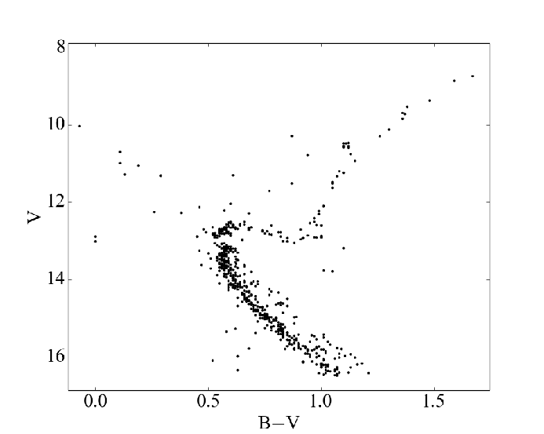
Binaries and the HR diagram
M67
GAIA with APOGEE SB2s
Geller et al 2015
Kounkel et al 2021

Slide 13
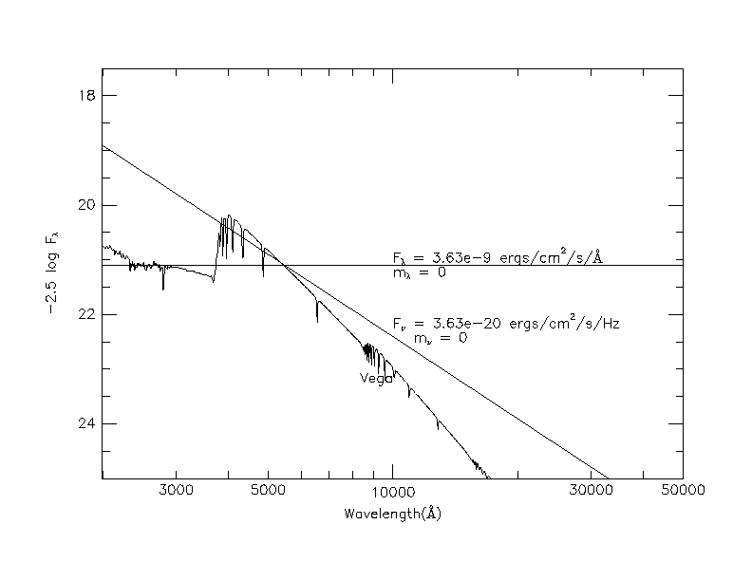
Discussion: magnitude systems
What does it mean to talk about a photometric system?
What are 3 such systems that are discussed in the notes? How are they different?
What system does the UBVRI photometric system use (approximately)?
What system does the SDSS $ugriz$ photometric system use (approximately)?
Do you need to know what the magnitude system is to interpret the difference in magnitudes of two objects?

Slide 14
STMAG : relative to constant F_{𝜆}
Used by Space Telescope Science Institute
F₀ = 3.63x10⁻⁹ ergs / cm² / s/ Å
This is roughly the flux of Vega at 5500 A
$mλ=−2.5\log{\frac{Fλ}{F0}}$ = -2.5 log F_{𝜆} - 21.1
(where F_{𝜆} is in units of ergs/cm²/s/Å)
$Fλ = {F010}^{−0.4 mλ }$
So, Vega will have a magnitude of 0 at 5500 Å, but will deviate from zero at different wavelengths/bandpasses to the extent to which its spectrum deviates from a flat F_{𝜆} spectrum

Slide 15
ABNU: relative to a constant F_{𝜈}
Used by many surveys, e.g. SDSS (ugriz), panStarrs, …
F₀ = 3.63x10⁻²⁰ ergs / cm² / s/ Hz
This is roughly the flux of Vega at 5500 Å
$mν=−2.5\log{\frac{F}{F0}}$ = -2.5 log F_{𝜈} – 48.6
(where F_{𝜈} is in units of ergs/cm²/s/Hz)
$Fν = {F010}^{−0.4 mν }$
So, Vega will have a magnitude of 0 at 5500 Å, but will deviate from zero at different wavelengths/bandpasses to the extent to which its spectrum deviates from a flat F_{𝜈} spectrum

Slide 16
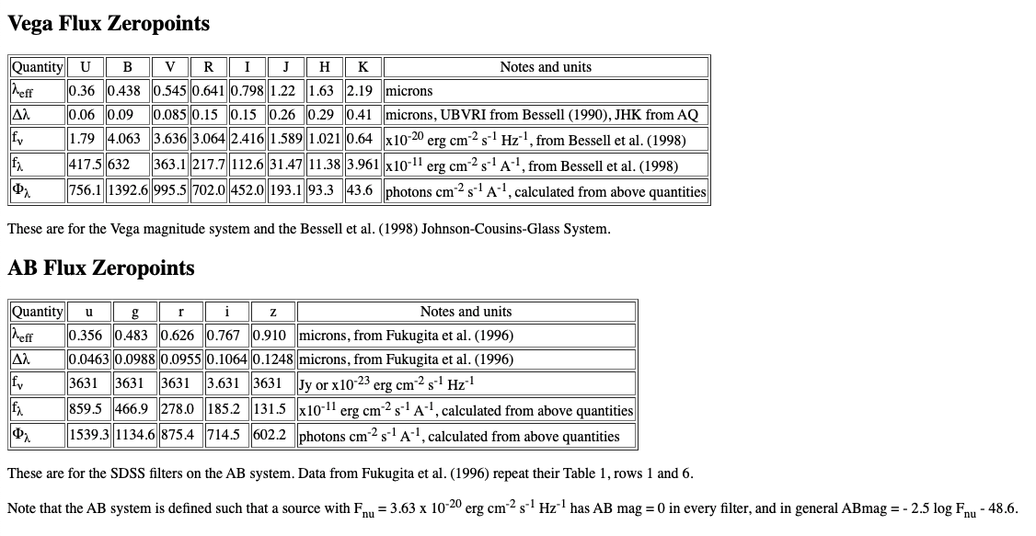
From magnitudes to fluxes
Astrophysics computes fluxes, so to compare to observed magnitudes, need to convert one way or another
If astrophysics computes a spectrum, straightforward to derive magnitude
Going from magnitude to flux can be done, but note subtlety depending on SED
Table with fluxes corresponding to 0 magnitude
Note subtlety depending on spectral energy distribution (SED), e.g. WISE
How would you calculate the apparent V magnitude of the Sun? The absolute magnitude?

Slide 17
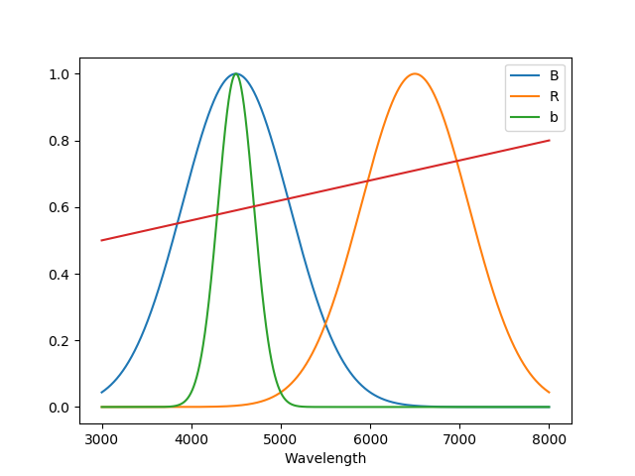
Discussion: colors
Colors expressed in magnitudes: what do B-V=0, g-r = 0 imply?
Do we need to know what the photometric system is to interpret colors, i.e., differences of magnitudes at two wavelengths?
Narrowband vs broadband:
For the adjacent figure, let’s say you do photometry of the star with the red SED through the B(shown in blue) and R (shown in orange) filters, and you find that star has a B-R=1.0
You also make a measurement using the b (shown in green) filter, which uses the same photometric system zeropoint. What approximate value do you expect for b-R?

Slide 18
Questions: STMAG and ABNU systems
See Canvas assignment

Slide 19
Questions: magnitude –flux conversion
See Canvas assignment

Slide 21
Topics 8/29
How are things going? Videos, level, time, groups?
Questions on problems and/or lecture videos
End of module on light! Assignments:
Problems from today
Module summary by next Tuesday
Exposure time calculator : github accounts
Signal (count) equation
Photometry: zeropoints and transformation coefficients

Slide 22
Observed fluxes and the signal (count) equation
How is what we observe related to what objects emit?
The “signal (count) equation”
What are the terms?
How well do we know them?
Can we use the signal equation to measure accurate fluxes?
What can we use it for?

Slide 23
Signal equation
$S= Tt ∫Fλ\frac{λ}{hc}aλmλiλfλdλ dλ$
We can define the observed photon flux, S’:
S’ = $∫Fλ\frac{λ}{hc}aλmλiλfλdλ dλ$
S = S’ T t
What are the units of S? S’? S’T?

Slide 24
Calibrating observations of brightness
Photometry: measurement of brightnesses
Images to counts
Counts to magnitudes: “instrumental” magnitudes
$$m_{inst}=−2.5\log{counts/s}$$
Differential photometry: compare to other stars in field
All terms cancel out (to some “reasonable” level), even in poor conditions!
Even if no stars of known brightness, still useful for variability study
Calibrating photometry
If stars of known brightness in field, can determine the zeropoint:
$${ m}_{apparent}=m_{inst}+z$$
Subtlety: zeropoint as a function of SED (transformation): observe stars with range of SED / color
All sky photometry
If no stars of known brightness in field, need to observe stars of known brightness in another field!
In this case, transmission of Earth’s atmosphere needs to be considered and characterized: observe stars at range of airmass
Extinction, transformation, and zeropoint usually considered simultaneously: observe stars of known brightness at range of airmass and SED/color

Slide 25
Zeropoint
Two telescope systems have zeropoints of 22 and 24, respectively. Which one would you prefer to use?

Slide 26
Transformation coefficients
Why?
How?

Slide 27
Photon flux and signal equation
See Canvas assignment

Slide 28
Photometric transformations
See Canvas assignment

Slide 29
Topics 8/31
Questions?
End of module on light and the signal equation!
Problem solutions
Module summary
Uncertainties
Distributions
Poisson and Gaussian (normal) distribution
confidence levels

Slide 30
Poisson distribution
What does it look like?
What is its key characteristic (in terms of mean and standard deviation)?
What is uncertainty for a mean count of:
100 photons
10000 photons
1000000 photons
Which is the most accurate measurement?
Does it matter how long it took to obtain that number of photons?
The noise equation….

Slide 31
Exposure time calculator: part one
Let’s design a modular program to apply the count equation
Given a magnitude and unnormalized SED, or input spectrum and a telescope/instrument, return estimate of observed photons, either as a function of wavelength (spectrograph) or number(s) for given filter(s) (imager)
What functions do we need?
Function to return f(lambda) given input mag, spectrum
Function to return collecting area given observatory/telescope
function to return telescope transmission: tel(lambda), combine with previous?
Function to return atmos(lambda) given observatory
Function to return inst(lambda) given instrument
Function to return filt(lambda) given instrument/filter(s)
Function to return det(lambda) given instrument
Function to integrate
How would we test this?
An alternative: object oriented programming

Slide 32
Implementation
Function vs object oriented
Using git for version control
You should have received invitation to be collaborator on a535 project
git clone git@github.com:holtzmanjon/a535.git
Each group should create a branch
E.g., git branch groupA
Create a directory for your project
Create files in your directory
Commit them with comments to the local repository
git commit
Push them to the remote github repository
git push origin branch
When you have a working version, can merge into main and tag

