Slide 1
ASTR 535 : Observational Techniques
Light, magnitudes, and the signal equation
Light and its measured quantities

Slide 2
Learning objectives
Know the basic characteristics of light: energy, frequency and wavelength, and how they are related. Know the different regimes in the electromagnetic spectrum, the units used to characterize the different regimes, and characteristic wavelengths for each regime.
Have a complete understanding of the difference between surface brightness, flux, and luminosity and their units.
Recognize and understand that flux (or surface brightness or luminosity) is generally a function of wavelength/frequency and can be specified per unit wavelength or per unit frequency and how to convert between the two.

Slide 3
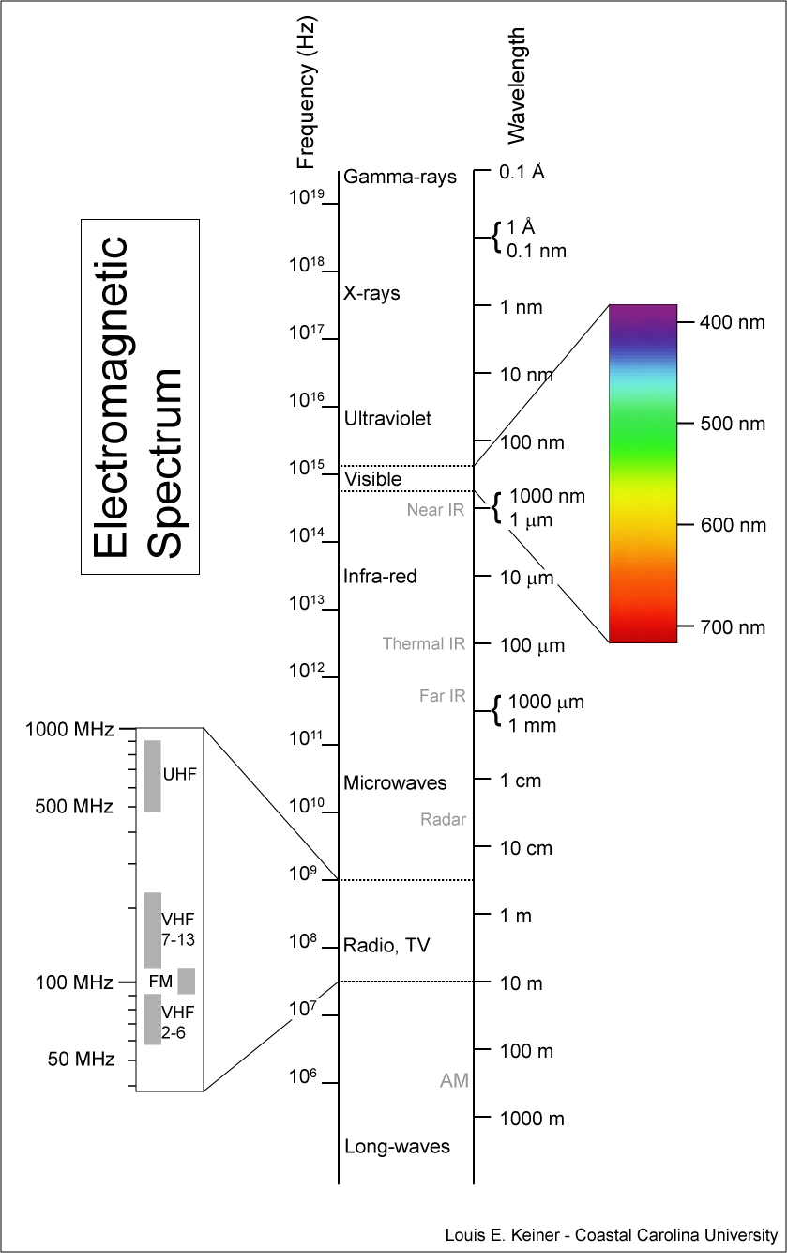
Light and the electromagnetic spectrum
Light is a type of energy: electromagnetic energy
Comes in packets called photons, which have characteristics of both particles and waves
Covers a wide range of energies, making up the electromagnetic spectrum
Different parts of the spectrum have different names: gamma rays, X rays, ultraviolet, optical (VIBGYOR), infrared, microwave, radio

Slide 4
Energy, frequency, wavelength, and speed
The energy of a photon is directly related to its frequency (cycles/s)
E = h 𝜈
As with any wave, the frequency, wavelength and speed are related by
v = 𝜆𝜈
Light in a vacuum travels at the same speed, c, regardless of energy, so
𝜆 = c / 𝜈
In a medium, light travels slower, so the wavelength changes
𝜆 = c / n𝜈
where n is the index of refraction.

Slide 5
Units
Light can be characterized by energy, frequency, or wavelength
At high energies, astronomers often use energy (MeV or keV)
At lower energies, astronomers often use wavelength, but with different units:
  Angstroms = 10⁻¹⁰ m
nanometer = 10⁻⁹ m
microns = 10⁻⁶ m
millimeters = 10⁻³ m
centimeters = 10⁻² m
  far-UV ( 0.01 - 0.1μ, 10-100 nm, 100-1000 Å)
  near-UV ( .1 - 0.35μ, 100-350 nm, 1000-3500 Å)
  optical ( 0.35 - 1μ, 350-1000 nm, 3500-10000 Å)
  near-IR (1000-10000 nm, 10000-100000 Å, 1 - 10μ)
  mid-IR ( 10 - 100μ)
  far-IR ( 100 - 1000μ)
In the radio, astronomers may use cm or m, or frequency (MHz)

Slide 6
Measuring light
Three fundamental quantities:
intensity or surface brightness (radiance)
flux (irradiance)
luminosity (radiant flux)

Slide 7
Surface brightness
the amount of energy received in a unit surface element per unit time from a unit solid angle in the direction ( θ, φ), where θ is the angle away from the normal to the detector surface element, and φ the azimuthal angle.
The solid angle is related to the physical size of an object and its distance: Ω = A/d². Note units often used for solid angle:
  sterradian : 4𝜋 in a sphere
  square degree : 4𝜋 (180/𝜋)² ≈41253 square degrees in a sphere
  square arcsec

Slide 8
Flux
The flux is the amount of energy passing through a unit surface element in all directions, defined by
F_{ν} = ∫ I_{ν}cosθdΩ
where dΩ is the solid angle element, and the integration is over the entire solid angle subtended by the object
In astronomical applications, we usually point our telescope in the direction of the object, so θ=0, and the area we integrate over is small, so cosθ is well approximated by unity

Slide 9
Luminosity
The luminosity is the intrinsic energy emitted by the source per second. For an isotropically emitting source:
L = 4πd²F
where d is the distance to the source
For a isotropic, constant source, this leads to the inverse square law:
F = L / 4πd²

Slide 10
What do we observe?
Many objects in astronomy are very far away, so they subtend relatively small areas on the sky
Resolved sources are those for which we can distinguish one location in the source from another.
  Our ability to distinguish depends on the tool we are using to observe
  For resolved source, we can observe the surface brightness
Unresolved sources are those for which we cannot distinguish one location in the source from another: the sources appear “point-like”
  For unresolved sources, we can only observe the flux
To determine the luminosity of a source, we must know the distance

Slide 11
Monochromatic flux
The amount of light emitted is generally a function of wavelength (or, alternatively, frequency), so we actually are often interested in estimates of the monochromatic flux/intensity/luminosity (sometimes referred to as flux/intensity/luminosity density) :
F_{𝜆} : flux / unit wavelength
or
F_{𝜈} : flux / unit frequency

Slide 12
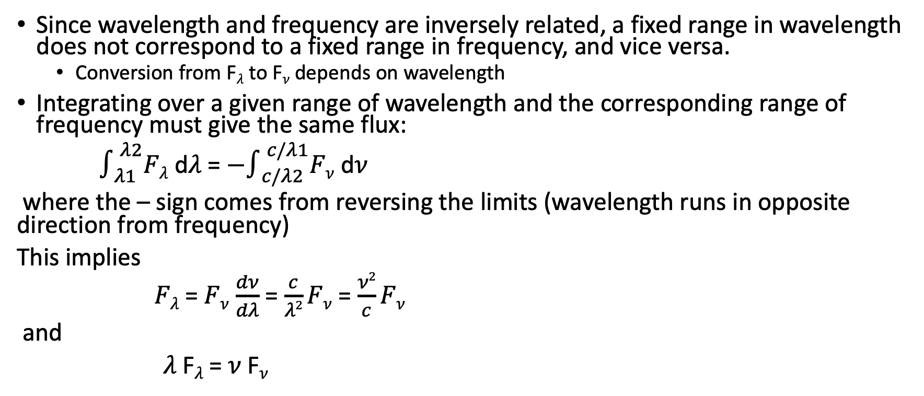
Monochromatic fluxes
Since wavelength and frequency are inversely related, a fixed range in wavelength does not correspond to a fixed range in frequency, and vice versa.
  Conversion from F_{𝜆} to F_{𝜈} depends on wavelength
Integrating over a given range of wavelength and the corresponding range of frequency must give the same flux:
$∫_{λ1}^{λ2}Fλ$ d𝜆 = ${−∫}_{c/λ2}^{c/λ1}Fν$ d𝜈
where the – sign comes from reversing the limits (wavelength runs in opposite direction from frequency)
This implies
$Fλ$ = $Fν$ $\frac{dν}{dλ}$ = $\frac{c}{λ2}Fν$ = $\frac{ν2}{c}Fν$
and
𝜆 F_{𝜆} = 𝜈 F_{𝜈}

Slide 13
Units
Most astronomers work in cgs units
Sometimes F_{𝜆,} sometimes F_{𝜈}
  Sometimes F_{𝜈} as a function of 𝜆
You may also run into the Jansky, which is a unit of monochromatic flux per unit frequency:
1 Jansky (Jy) = 10⁻²⁶W/m²/Hz

Slide 14
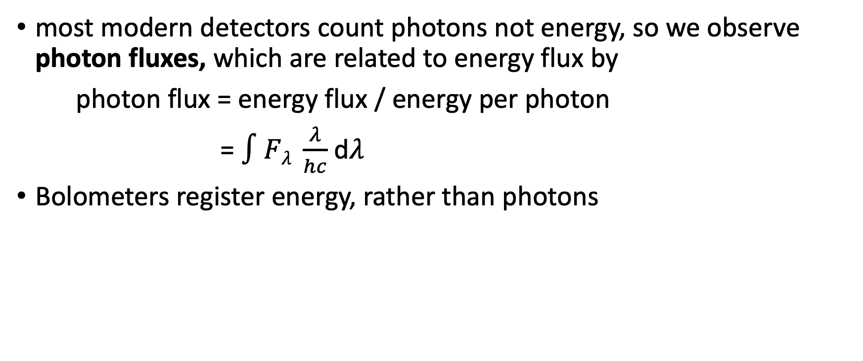
Photon flux
most modern detectors count photons not energy, so we observe photon fluxes, which are related to energy flux by
photon flux = energy flux / energy per photon
= $∫Fλ \frac{λ}{hc}$ d𝜆
Bolometers register energy, rather than photons

Slide 15
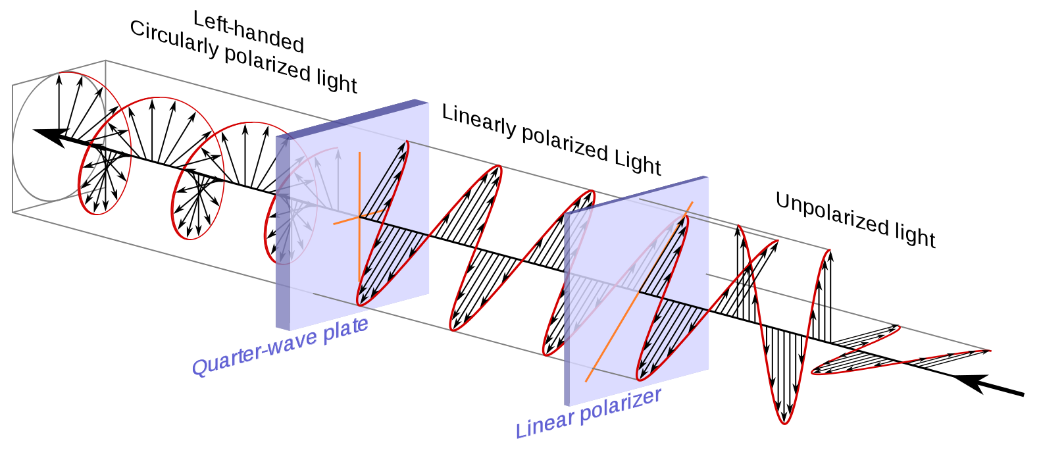
Polarization
There is an additional property of light at a given wavelength/frequency: the polarization
Light can be linearly and/or circularly polarized
Polarization is often characterized by the Stokes parameters: I, Q, U, V
which give the intensity, two components of linear polarization, and the circular polarization
The degree of polarization from astronomical sources is usually small, but polarization can arise from emission that is reflected or scattered light, and emission from regions where magnetic fields are significant

Slide 16
Terminology of astronomical measurements
Photometry : broad-band flux measurement
Spectroscopy: relative measurement of fluxes as a function of wavelength
Spectrophotometry : absolute measurement of flux as a function of wavelength
Spectropolarimetry : polarization as a function of wavelength
Astrometry : concerned with positions of observed flux
Morphology : intensity as a function of position; often, absolute measurements are unimportant

Slide 18
ASTR 535 : Observational Techniques
Light, magnitudes, and the signal equation
Magnitudes

Slide 19
Learning objectives
Know how magnitudes are defined, be able to work with them very comfortably, and recognize that relative fluxes can be represented as magnitudes independent of the magnitude system.

Slide 20
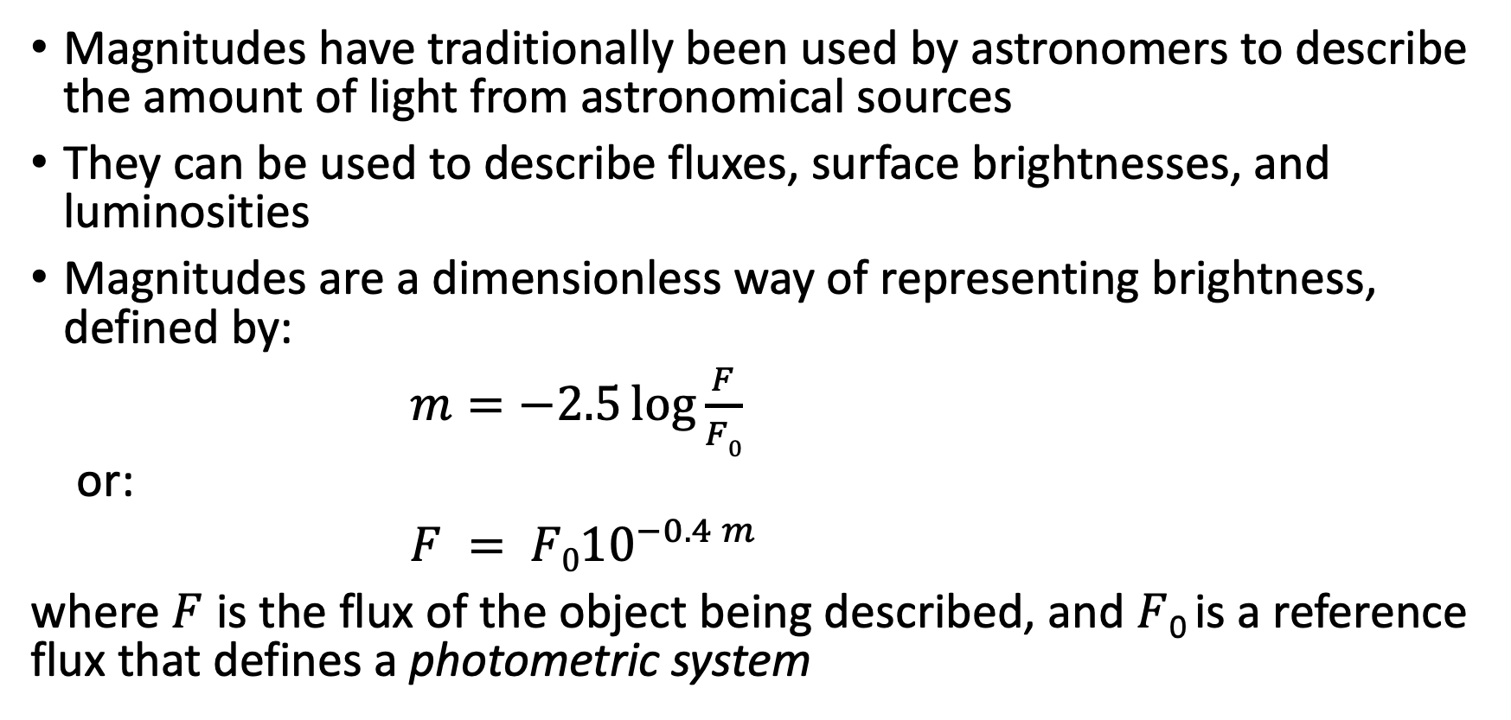
Magnitudes
Magnitudes have traditionally been used by astronomers to describe the amount of light from astronomical sources
They can be used to describe fluxes, surface brightnesses, and luminosities
Magnitudes are a dimensionless way of representing brightness, defined by:
$m=−2.5\log{\frac{F}{F0}}$
or:
$F = {F010}^{−0.4 m}$
where $F$ is the flux of the object being described, and $F$₀ is a reference flux that defines a photometric system

Slide 21
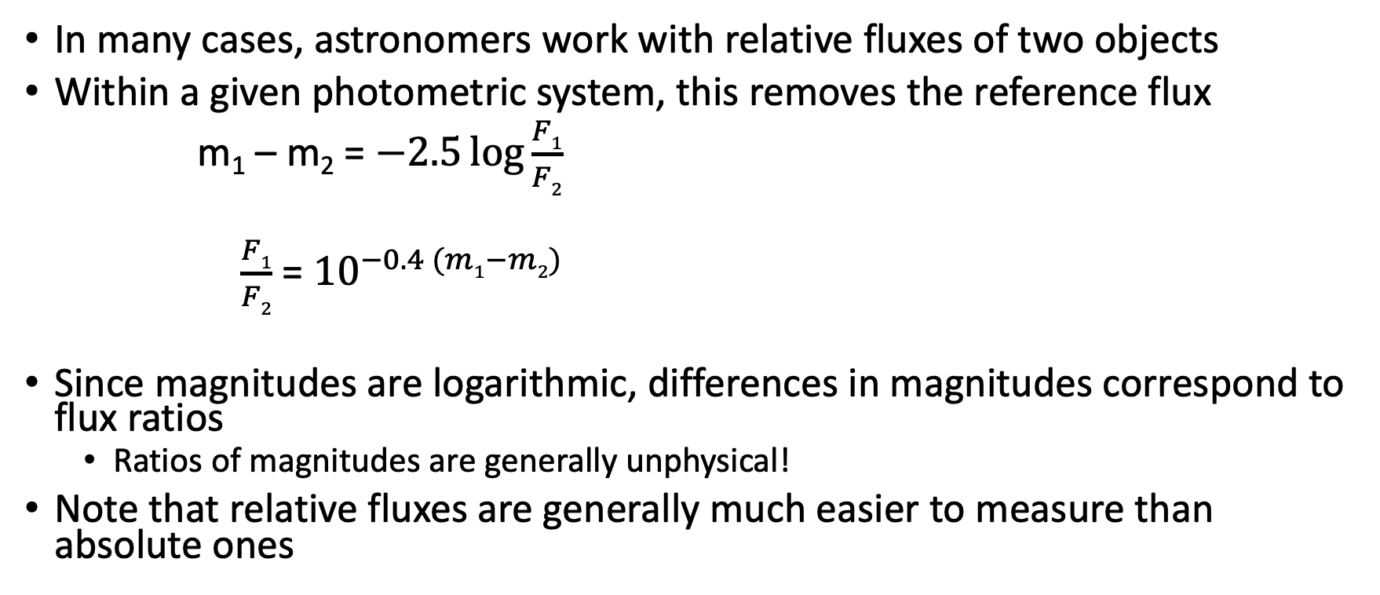
Magnitudes and relative fluxes
In many cases, astronomers work with relative fluxes of two objects
Within a given photometric system, this removes the reference flux
m₁ – m₂ = $−2.5\log{\frac{F1}{F2}}$
$\frac{F1}{F2}$ = ${10}^{−0.4 (m1−m2)}$
Since magnitudes are logarithmic, differences in magnitudes correspond to flux ratios
  Ratios of magnitudes are generally unphysical!
Note that relative fluxes are generally much easier to measure than absolute ones

Slide 22
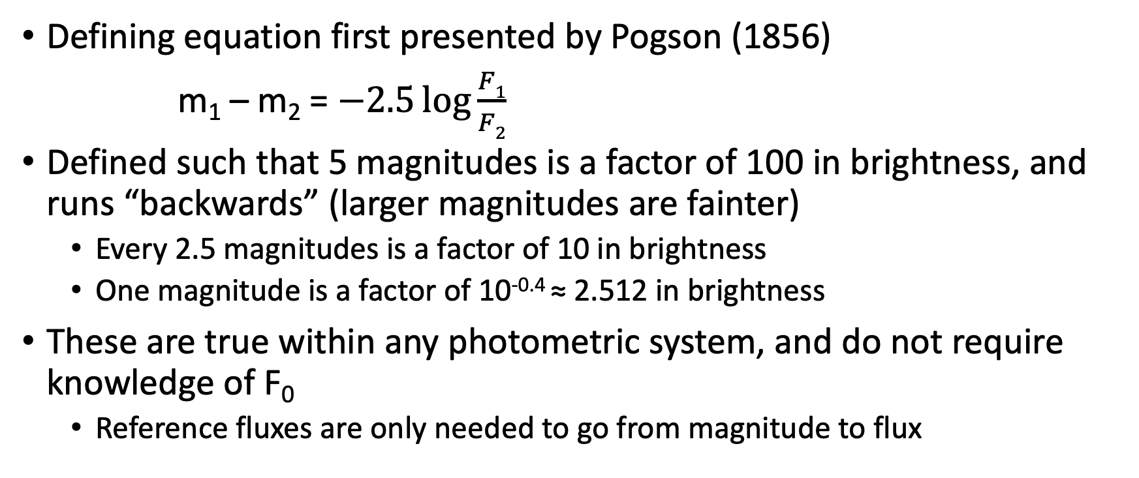
Magnitudes and relative fluxes
Defining equation first presented by Pogson (1856)
m₁ – m₂ = $−2.5\log{\frac{F1}{F2}}$
Defined such that 5 magnitudes is a factor of 100 in brightness, and runs “backwards” (larger magnitudes are fainter)
  Every 2.5 magnitudes is a factor of 10 in brightness
  One magnitude is a factor of 10^{-0.4} ≈ 2.512 in brightness
These are true within any photometric system, and do not require knowledge of F₀
  Reference fluxes are only needed to go from magnitude to flux

Slide 23
Luminosities and absolute magnitudes
Luminosities are represented by giving the magnitude that an object would have if it were located at a distance of 10 parsecs
Using the inverse square law, this leads to the distance modulus:
m₀ – M = 5 log d – 5
where d is the distance in parsecs and m₀ is the magnitude corrected for interstellar extinction
m₀ = m - A

Slide 24

Monochromatic magnitudes
Monochromatic fluxes can also be represented in magnitudes:
F_{λ} = F₀(λ)${10}^{−0.4mλ }$
Note that this explicitly shows that the reference flux, F₀(λ), may be a function of wavelength!

Slide 26
ASTR 535 : Observational Techniques
Light, magnitudes, and the signal equation
Photometric systems

Slide 27
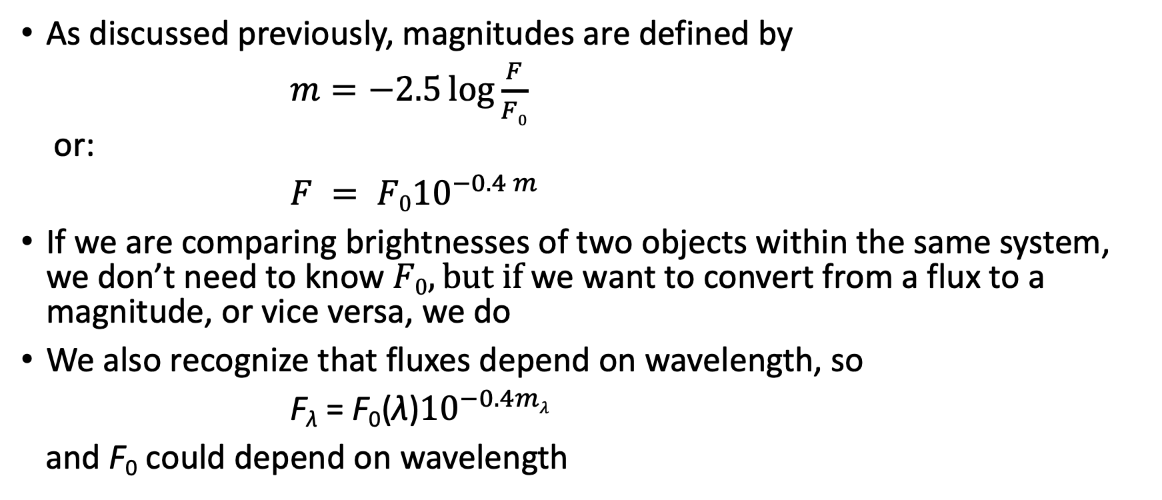
Photometric systems
As discussed previously, magnitudes are defined by
$m=−2.5\log{\frac{F}{F0}}$
or:
$F = {F010}^{−0.4 m}$
If we are comparing brightnesses of two objects within the same system, we don’t need to know $F0, but if$we want to convert from a flux to a magnitude, or vice versa, we do
We also recognize that fluxes depend on wavelength, so
F_{λ} = F₀(λ)${10}^{−0.4mλ }$
and F₀ could depend on wavelength

Slide 28
Photometric systems
You may come across three different types of photometric system zeropoints (choices of F₀)
  STMAG : F₀ is a constant F_{𝜆}
  ABNU : F₀ is a constant F_{𝜈}
  VEGAMAG : F₀ has the spectral shape of an A0V star

Slide 29
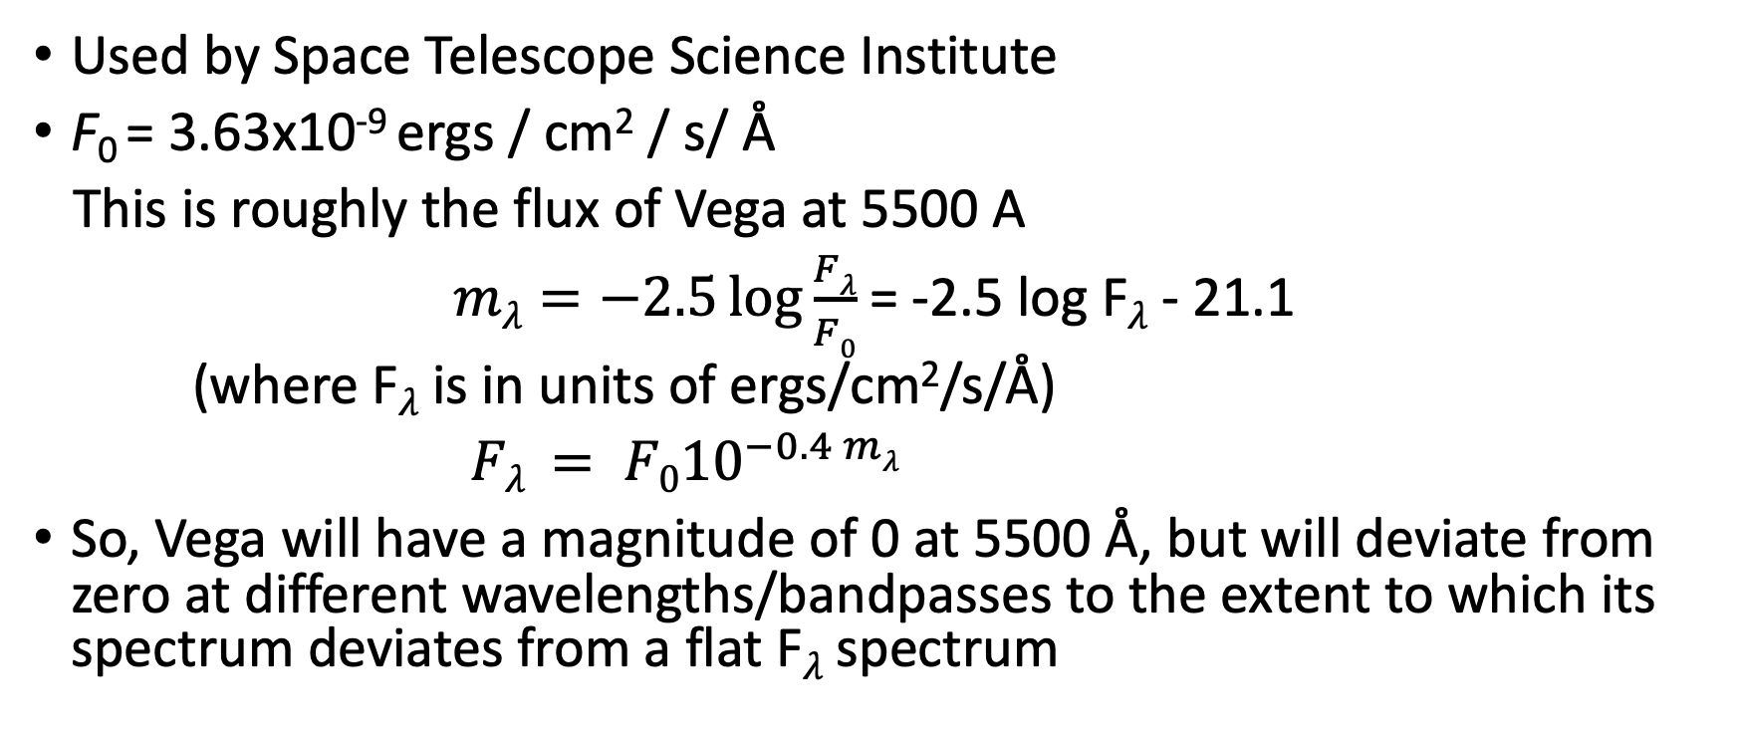
STMAG : relative to constant F_{𝜆}
Used by Space Telescope Science Institute
F₀ = 3.63x10⁻⁹ ergs / cm² / s/ Å
This is roughly the flux of Vega at 5500 A
$mλ=−2.5\log{\frac{Fλ}{F0}}$ = -2.5 log F_{𝜆} - 21.1
(where F_{𝜆} is in units of ergs/cm²/s/Å)
$Fλ = {F010}^{−0.4 mλ }$
So, Vega will have a magnitude of 0 at 5500 Å, but will deviate from zero at different wavelengths/bandpasses to the extent to which its spectrum deviates from a flat F_{𝜆} spectrum

Slide 30
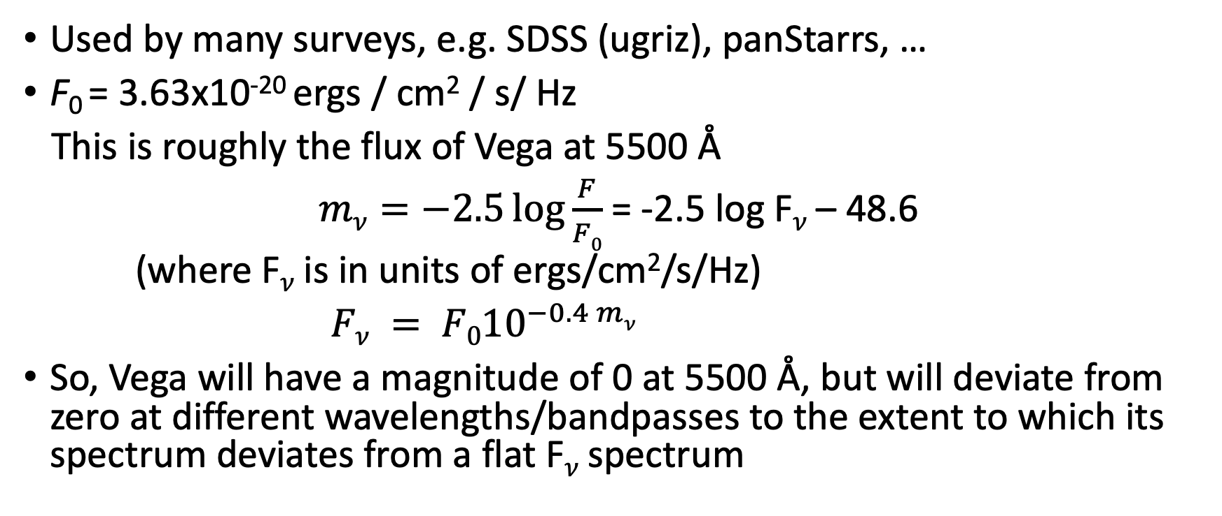
ABNU: relative to a constant F_{𝜈}
Used by many surveys, e.g. SDSS (ugriz), panStarrs, …
F₀ = 3.63x10⁻²⁰ ergs / cm² / s/ Hz
This is roughly the flux of Vega at 5500 Å
$mν=−2.5\log{\frac{F}{F0}}$ = -2.5 log F_{𝜈} – 48.6
(where F_{𝜈} is in units of ergs/cm²/s/Hz)
$Fν = {F010}^{−0.4 mν }$
So, Vega will have a magnitude of 0 at 5500 Å, but will deviate from zero at different wavelengths/bandpasses to the extent to which its spectrum deviates from a flat F_{𝜈} spectrum

Slide 31

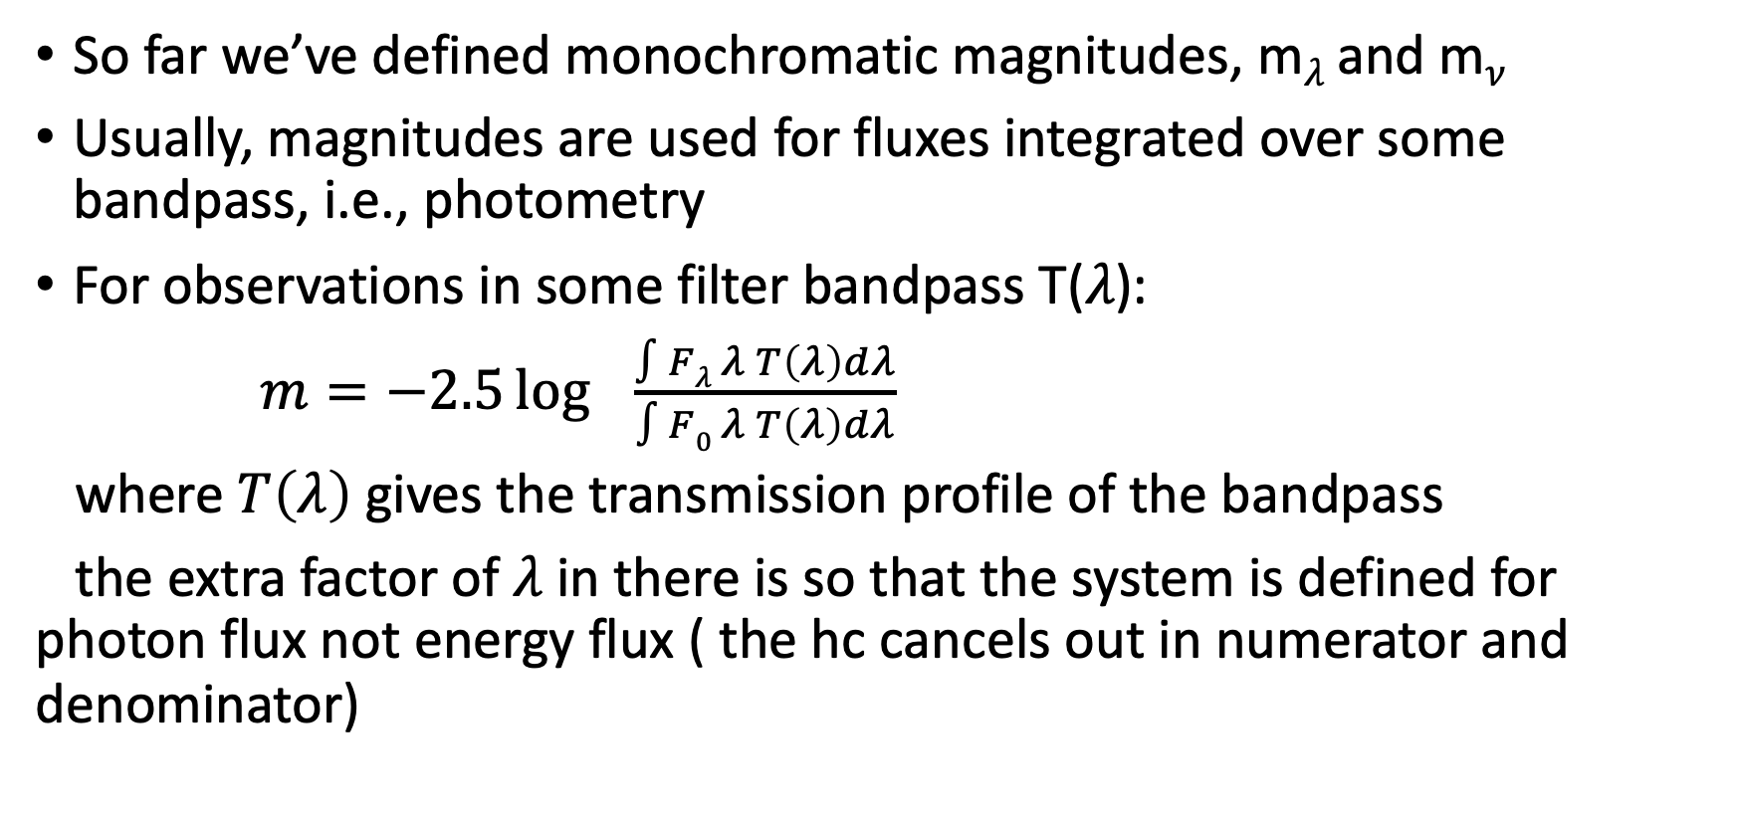
Bandpass magnitudes vs monochromatic magnitudes
So far we’ve defined monochromatic magnitudes, m_{𝜆} and m_{𝜈}
Usually, magnitudes are used for fluxes integrated over some bandpass, i.e., photometry
For observations in some filter bandpass T(𝜆):
$m=−2.5\log{ } \frac{∫Fλ λ T\left(λ\right)dλ}{∫F0 λ T\left(λ\right)dλ}$
where $T\left(λ\right)$ gives the transmission profile of the bandpass
the extra factor of 𝜆 in there is so that the system is defined for photon flux not energy flux ( the hc cancels out in numerator and denominator)

Slide 32
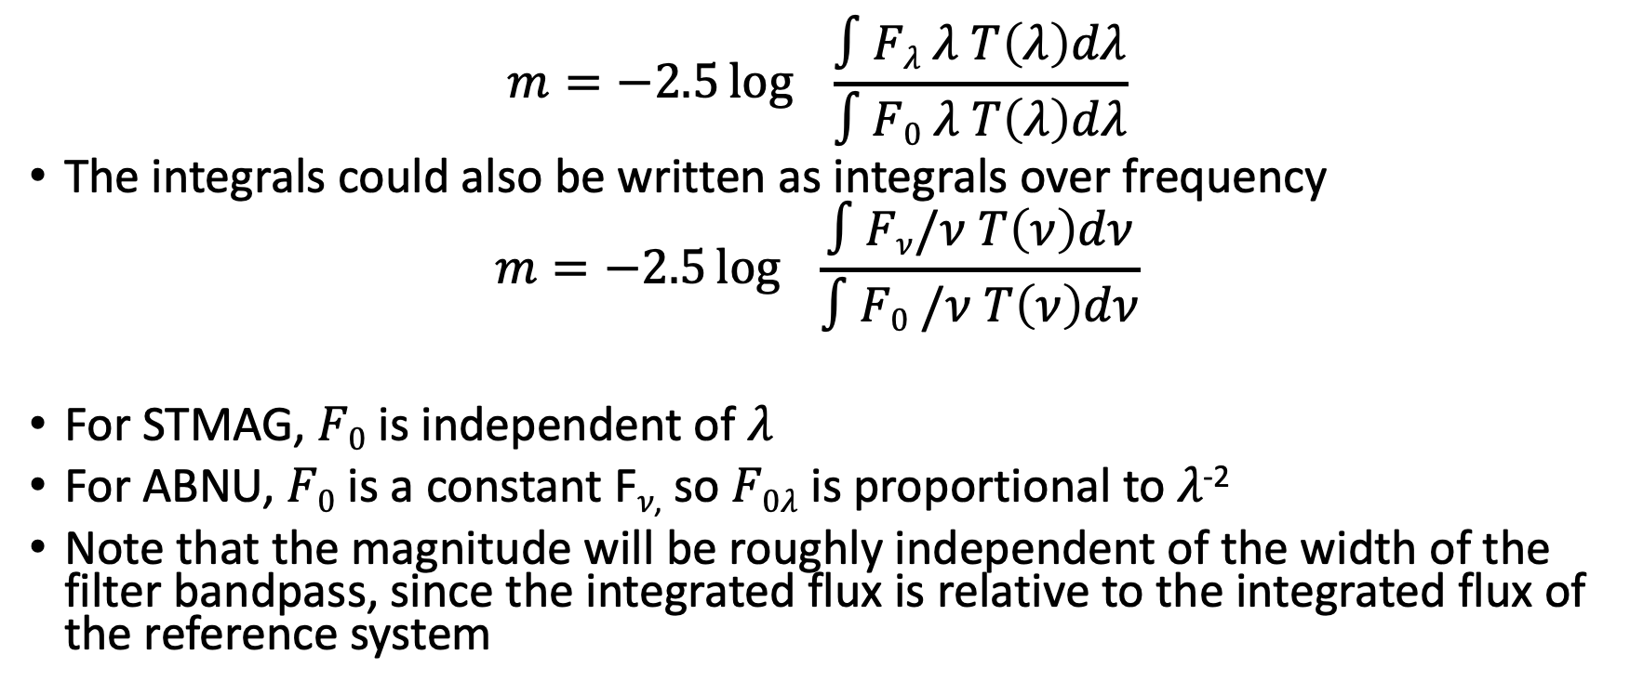
Bandpass magnitudes
$$m=−2.5\log{ } \frac{∫Fλ λ T\left(λ\right)dλ}{∫F0 λ T\left(λ\right)dλ}$$
The integrals could also be written as integrals over frequency
$$m=−2.5\log{ } \frac{∫Fν/ν T\left(ν\right)dν}{∫F0 /ν T\left(ν\right)dν}$$
For STMAG, $F0$ is independent of 𝜆
For ABNU, $F0$ is a constant F_{𝜈,} so $F0λ$is proportional to 𝜆⁻²
Note that the magnitude will be roughly independent of the width of the filter bandpass, since the integrated flux is relative to the integrated flux of the reference system

Slide 33
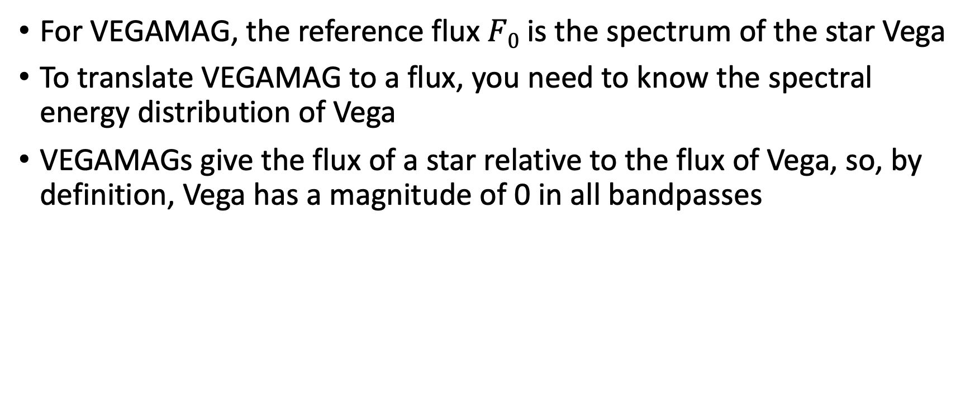
VEGAMAG
For VEGAMAG, the reference flux $F0$ is the spectrum of the star Vega
To translate VEGAMAG to a flux, you need to know the spectral energy distribution of Vega
VEGAMAGs give the flux of a star relative to the flux of Vega, so, by definition, Vega has a magnitude of 0 in all bandpasses

Slide 34
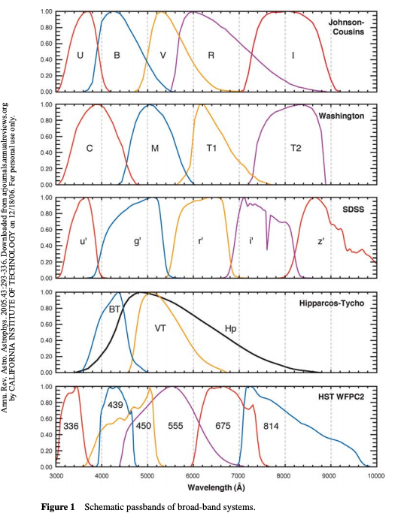
What photometric systems are used?
The UBVRIJHK system is a ~VEGAMAG system
The SDSS ugriz system is a ~ABNU system
The STScI STMAG system is a STMAG system
Even if the bandpasses were the same, the magnitude of a star in two different systems would be different!
All systems are normalized around 5500 A, so the difference grows as one moves away from this wavelength

Slide 35
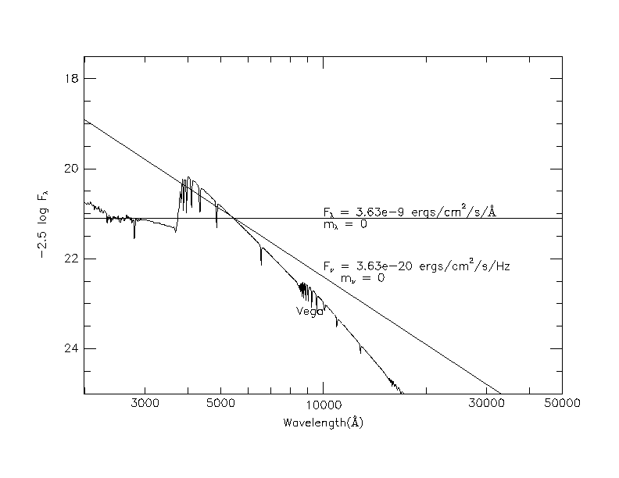
Differences between magnitude systems
If you had the spectrum of an object on this plot, the difference between the location of the spectrum and one of the reference spectra would give you the magnitude of the object
Again, usually, magnitudes are used for fluxes, i.e. integrals over a range in the spectrum

Slide 36
Why are there different systems?
STMAG and ABNU are conceptually much simpler
However, absolute fluxes are hard to measure, while relative fluxes are easier, e.g. the flux relative to Vega (or some set of stars that have been measured relative to Vega)
  No astrophysical or artificial source has a “flat” spectrum!
If you care about actual fluxes, you need to figure out how to do the absolute fluxes and, if you do this well, using STMAG or ABNU makes simpler physical sense

Slide 38
ASTR 535 : Observational Techniques
Light, magnitudes, and the signal equation
Magnitude – flux conversion

Slide 39
Converting magnitudes to fluxes
To convert from a magnitude in some bandpass to a flux in that bandpass:
  Roughly: look up the flux of the reference spectrum at the central wavelength of the bandpass, which gives the flux for an object with m=0, and scale by the observed magnitude, to get approximate flux density at the central wavelength; multiply by the filter width to get the fluxx
  More precisely: integrate the reference spectrum over the bandpass, and scale by the observed magnitude

Slide 40
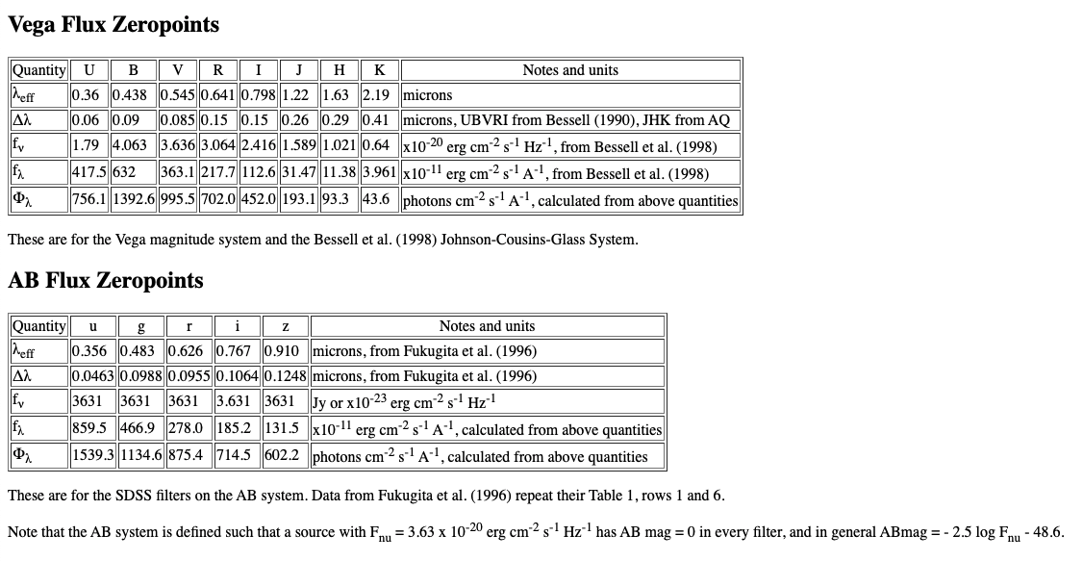
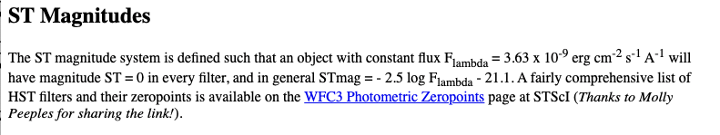
Photometric system data
mistake
From http://www.astronomy.ohio-state.edu/~martini/usefuldata.html

Slide 41
Estimating flux for objects
In some cases, e.g., for observation planning, we may want to estimate the flux we will receive in different bandpasses, or as a function of wavelength, for some object of a given magnitude in one band pass
  Done in many exposure time calculators
  For example, estimate the flux as a function of wavelength for an object with V=17
Clearly, we also need some information about the spectral energy distribution (SED), e.g., a blackbody temperature, spectral type, etc.
  Various libraries of spectra, e.g., of stars or galaxies, are available
To get an estimate of the flux as a function of wavelength for your object:
  Get the flux in the SED at the central wavelength of the desired bandpass
  Get the flux in the reference spectrum for the photometric system at this wavelength
  Scale the SED such that the flux divided by the reference flux is 10^{-0.4m}
  This gives you the desired flux as a function of wavelength
  If you want the flux is some other bandpass, read it off at the effective wavelength of the desired bandpass
To do this to higher precision, integrate over the bandpass rather that using the flux at the central wavelength

Slide 43
ASTR 535 : Observational Techniques
Light, magnitudes, and the signal equation
Colors

Slide 44
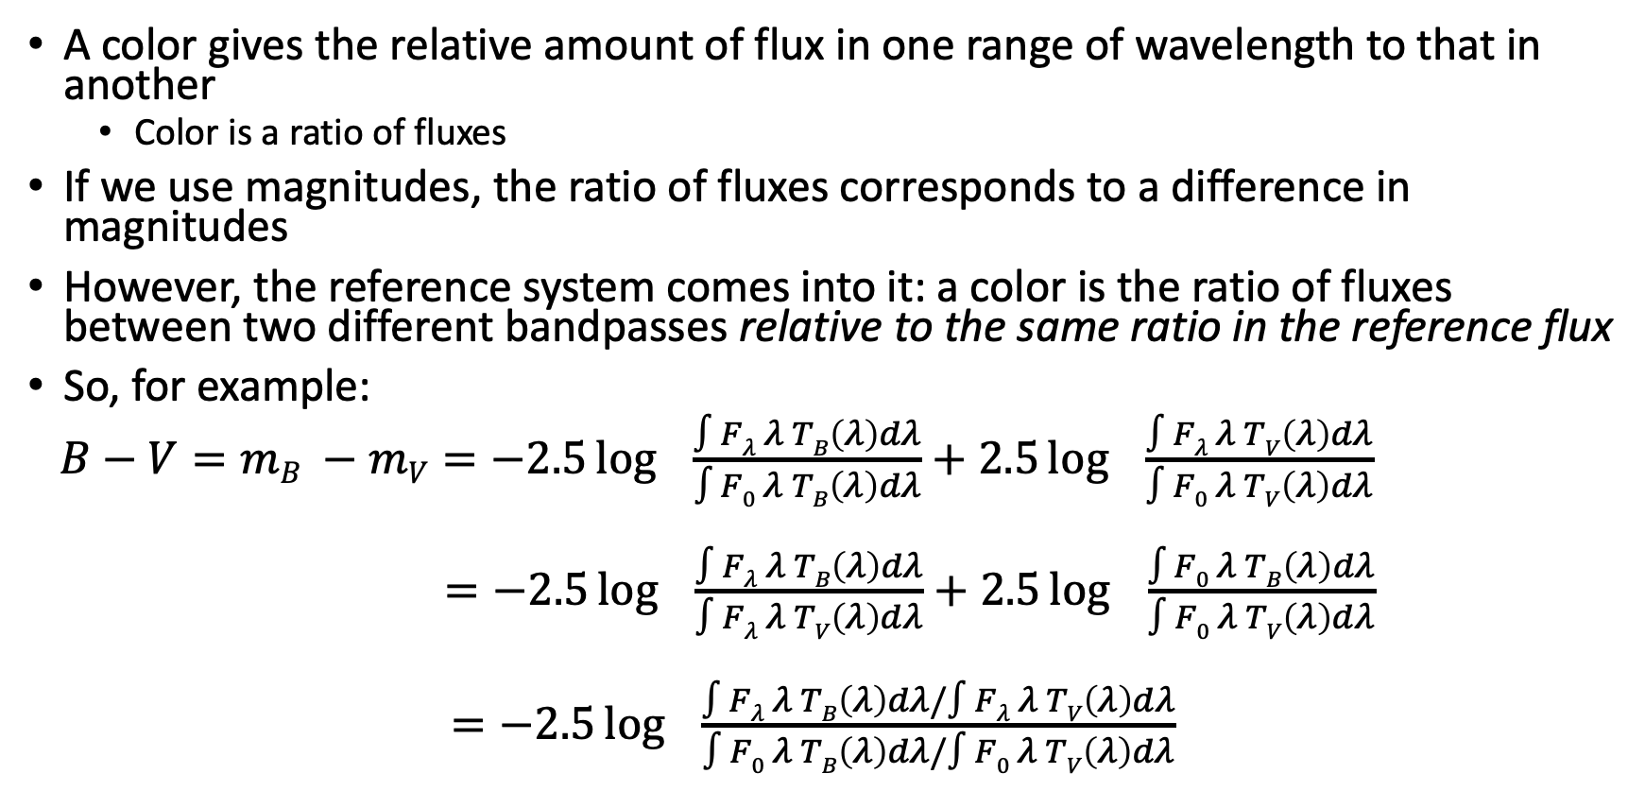
What is a color?
A color gives the relative amount of flux in one range of wavelength to that in another
  Color is a ratio of fluxes
If we use magnitudes, the ratio of fluxes corresponds to a difference in magnitudes
However, the reference system comes into it: a color is the ratio of fluxes between two different bandpasses relative to the same ratio in the reference flux
So, for example:
$B−V=mB −mV=−2.5\log{ } \frac{∫Fλ λ TB\left(λ\right)dλ}{∫F0 λ TB\left(λ\right)dλ}+2.5\log{ } \frac{∫Fλ λ TV\left(λ\right)dλ}{∫F0 λ TV\left(λ\right)dλ}$
$=−2.5\log{ } \frac{∫Fλ λ TB\left(λ\right)dλ}{∫Fλ λ TV\left(λ\right)dλ}+2.5\log{ } \frac{∫F0 λ TB\left(λ\right)dλ}{∫F0 λ TV\left(λ\right)dλ}$
$=−2.5\log{ } \frac{∫Fλ λ TB\left(λ\right)dλ/∫Fλ λ TV\left(λ\right)dλ}{∫F0 λ TB\left(λ\right)dλ/∫F0 λ TV\left(λ\right)dλ}$

Slide 45
Application
A color in the SDSS system, e.g. g-r gives the ratio in flux between the g and r bandpasses, relative to that ratio for an object with a flat F_{𝜈}
  g-r = 0 means the object has a spectral shape similar to that of a flat F_{𝜈} source
A color in the UBVRI system, e.g., B-V gives the ratio in flux between the B and V bandpasses, relative to that ratio for an object with an A0V spectrum
  B-V = 0 means the object has a spectral shape similar to that of an A0V star
  B-V = 2.5 means that the object has 10 times more flux in the V bandpass than the B bandpass relative to that flux ratio in an A0V star
Why “similar” and not the same?
  Different spectral energy distributions could give the same total flux in a bandpass

Slide 46
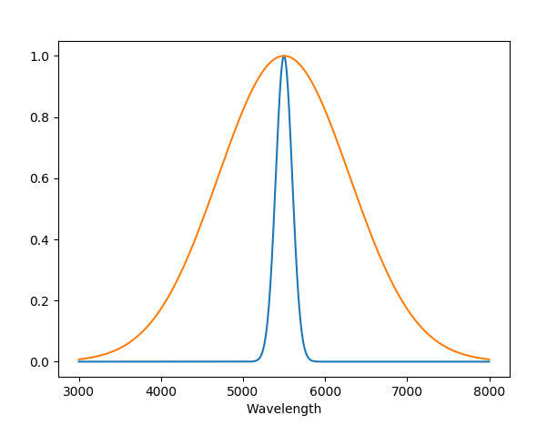
Colors
While it seems that one could define a color just as a ratio of fluxes without regard to a reference flux, consider the case where different bandpasses might have different widths
  You wouldn’t want a color to change if you were comparing a narrower bandpass at one wavelength to a broader one at another!

Slide 48
ASTR 535 : Observational Techniques
Light, magnitudes, and the signal equation
Signal equation

Slide 49
Learning objectives
Understand the signal equation and the terms in it.
Understand what the signal equation is and is not used for

Slide 50
What objects emit and what we observe
We’ve been discussing flux, surface brightness, luminosity and the quantities used to measure them
In an actual observation, the amount of signal we detect depends on the tools we use to collect it: e.g., the collecting area of our telescope and the amount of time we collect for
  Photon flux is the number of photons per unit area per unit time
  Signal is the number of photons from an object detected in an observation
When making actual observations, however, we generally don’t detect all of the flux that objects emit in our direction
  Some of it may be absorbed in the Earth’s atmosphere
  It may not be fully reflected by the mirrors of a telescope
  It may be attenuated by things we put in its path, like optics or a filter
  Our detectors may not be perfectly efficient in detecting it

Slide 51
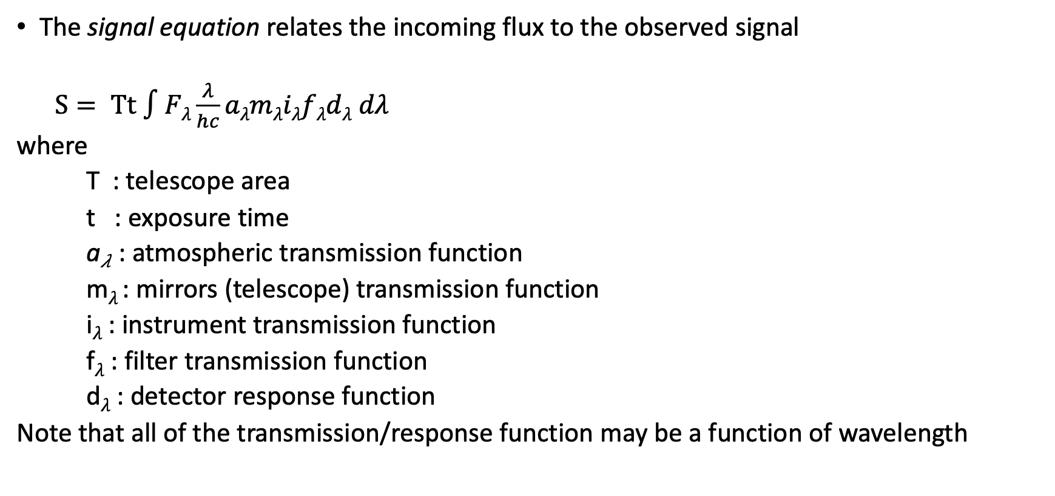
Signal equation
The signal equation relates the incoming flux to the observed signal
$S= Tt ∫Fλ\frac{λ}{hc}aλmλiλfλdλ dλ$
where
T : telescope area
t : exposure time
a_{𝜆} : atmospheric transmission function
m_{𝜆} : mirrors (telescope) transmission function
i_{𝜆} : instrument transmission function
f_{𝜆} : filter transmission function
d_{𝜆} : detector response function
Note that all of the transmission/response function may be a function of wavelength

Slide 52
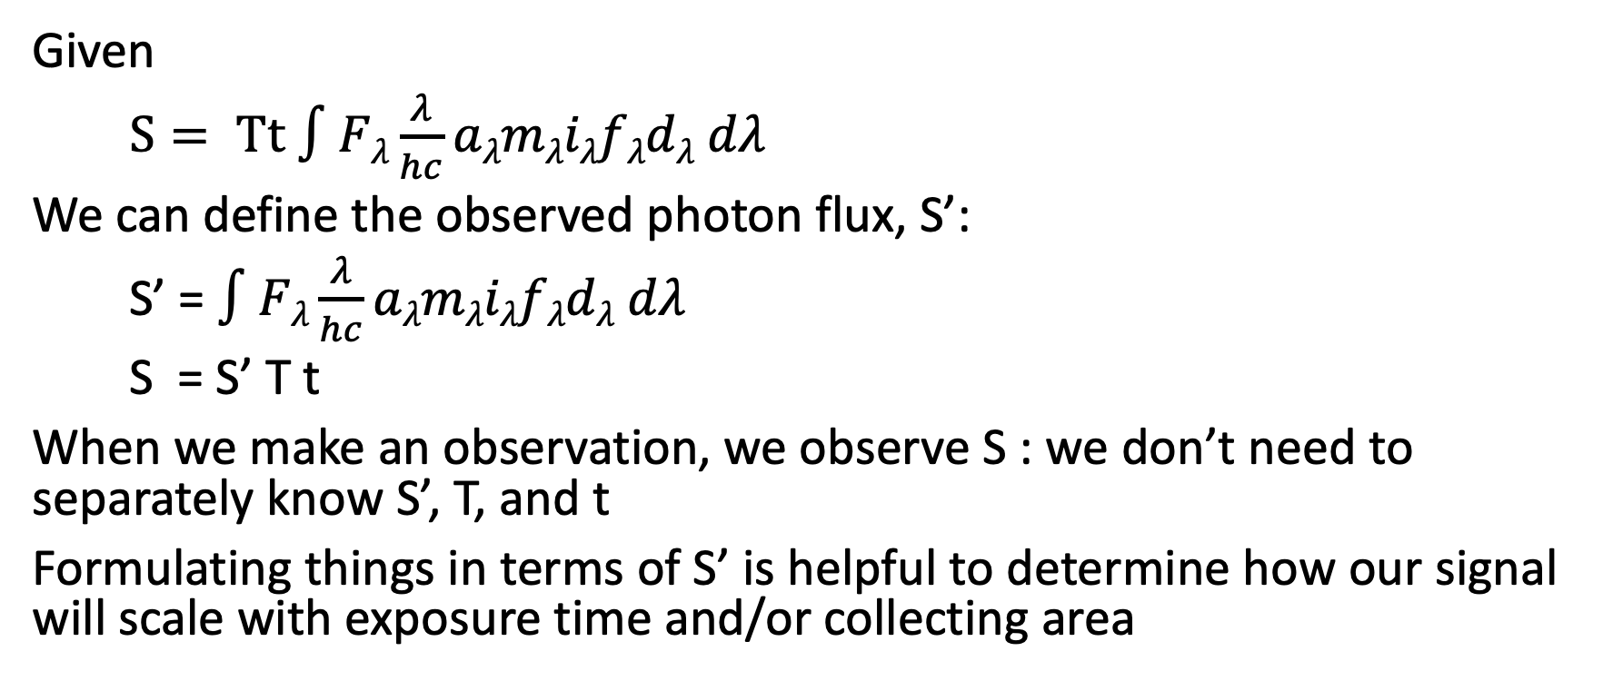
Observed photon flux, S’
Given
$S= Tt ∫Fλ\frac{λ}{hc}aλmλiλfλdλ dλ$
We can define the observed photon flux, S’:
S’ = $∫Fλ\frac{λ}{hc}aλmλiλfλdλ dλ$
S = S’ T t
When we make an observation, we observe S : we don’t need to separately know S’, T, and t
Formulating things in terms of S’ is helpful to determine how our signal will scale with exposure time and/or collecting area

Slide 53
Using the signal equation
We generally want to measure the flux/photon flux from the object
However, this is not usually done with the signal equation
  Many terms are hard to measure to high accuracy
  Some terms may vary with time
What is the signal equation used for?
  Terms are generally well enough approximated to predict observed photon flux for an object with an estimated brightness
  Exposure time calculator
  Given an estimate for the observed photon flux, one can determine how much time is required to collect a desired signal
  Accuracy of a measurement depends on the signal
  For a required accuracy (determined by scientific goal), determine minimum exposure time to achieve the associated required signal

Slide 54

Other uses of the signal equation
$$S= Tt ∫Fλ\frac{λ}{hc}aλmλiλfλdλ dλ$$
By observing object(s) of known brightness, use signal equation to estimate the throughput of your observing system
  Example: SDSS-V commissioning!
  Might also see effective area of an observing system (e.g., here)
We’ve mentioned that one generally doesn’t go backward from observed signal to intrinsic flux using the signal equation because it is hard to know all of the terms to sufficient accuracy
  Generally, if we want to know the intrinsic flux, we usually measure signal relative to some other object of known intrinsic flux
  At some point, you need to measure the intrinsic flux of some object! For this, you work hard to understand all of the terms in the signal equation, and use it!

Slide 56
ASTR 535 : Observational Techniques
Light, magnitudes, and the signal equation
Photometry

Slide 57
Learning objectives
Understand the distinction between estimating count rates from an understanding of all of the terms in the signal equation vs. measuring the overall throughput (zeropoint) by observing stars of known brightness.
Know what instrumental magnitudes and zeropoints are. Understand the ideas behind the use of transformation coefficient.

Slide 58
Measuring brightnesses of objects
If we don’t use the count equation to go from observed signal to intrinsic flux, how do we do it?
Measure brightnesses relative to some other source of known flux

Slide 59
Differential photometry
If there are stars of known brightness (reference stars) in the same field as the object for which you’re trying to measure the brightness, then the atmospheric term cancels out, under the approximation that the atmosphere doesn’t vary over the angular distance between the two objects
  Clearly, only true to some level of accuracy!
  Can work even if the weather is “non-photometric”, i.e., there are clouds
Determine ratio of program object signal to reference star signal and multiply reference star flux by that ratio to get program object flux
In magnitudes, get the magnitude difference corresponding to the signal ratio

Slide 60
Differential photometry in practice: simple case
Measure the signal of an object in the frame with known brightness/magnitude (reference star)
Determine instrumental magnitude
m = -2.5 log S/t
  sometimes people might not normalize by t
  Sometimes people might add some arbitrary constant, e.g. 25, to make instrumental magnitude positive
Given known magnitude of the reference star, determine instrumental zeropoint
  M = m + Z
Determine instrumental magnitude of target object
Add instrumental zeropoint to get calibrated magnitude!

Slide 61
Instrumental Zeropoint
M = m + Z
where lower case m is the instrumental magnitude and upper case M is the standard magnitude of the reference object (don’t confuse this with absolute magnitude!)
Instrumental zeropoint gives the sensitivity of the system
It is the magnitude of a star that would have an instrumental magnitude (-2.5 log S/t) of 0, i.e. a star that produces 1 photon per second
The larger the zeropoint, the more sensitive the system

Slide 62
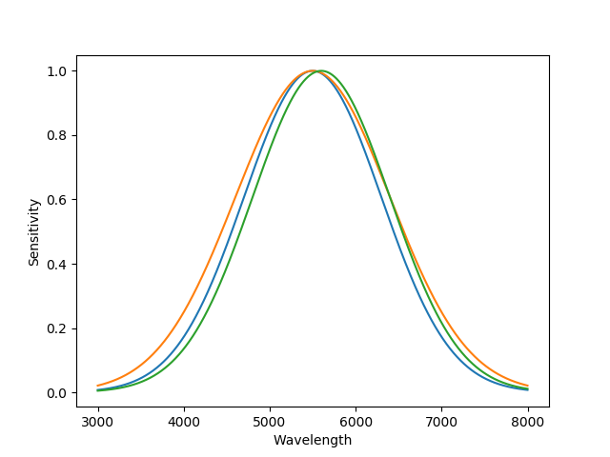
Real world issue: filter/sensitivity variation
The simple prescription works exactly only if the wavelength dependence of your observing sensitivity matches that of the system in which the reference star brightness was measured
In practice, there are small differences, e.g., from variations in filter profiles, detector sensitivities, etc.

Slide 63
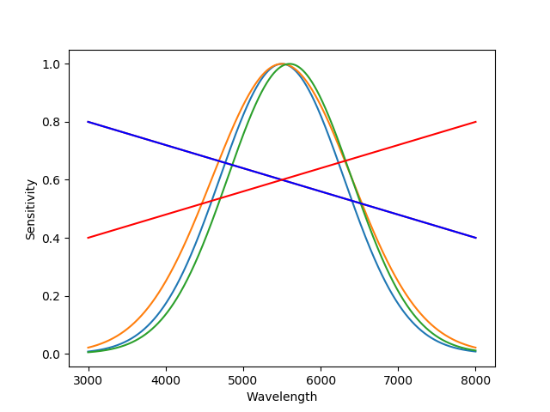
Accounting for sensitivity differences
To zeroth order, this doesn’t matter: you collect a little more or less light, at a slightly different range of wavelength
However, consider two different objects that measure, that might have different spectral energy distributions (SEDs), i.e., a bluer object and a redder object
If your sensitivity is a little bit ”redder”, you’ll get more extra signal in the red star than in the blue star
In practice, you’ll measure a different zeropoint, i.e., a different sensitivity, for the blue star and the red star

Slide 64
Transformation coefficients
Can calibrate this out to first order by using a transformation coefficient, parameterizing the difference in SED by the color of the object
M = m + t color + Z
As previously discussed, the color in magnitudes is given by a difference in magnitudes in two different bandpasses. Since we want to measure the color in the region of the spectrum where our desired filter is, usually the color is taken between the observed filter and one at an adjacent wavelength, e.g., if you’re working in the V bandpass, you might use B-V, or V-R as the color

Slide 65
Multi-bandpass photometry
If you’re observing in multiple bandpasses, e.g., if you want to be measuring colors of your object, there is a separate transformation equation for each filter, e.g.
B = b + t_{B} (B-V) + Z_{B}
V = v + t_{V} (B-V) + Z_{V}
R = r + t_{R} (V-R) + Z_{R}
with a separate transformation coefficient and zeropoint for each filter
These are derived by observing multiple reference stars, where the reference stars must span a range of color; generally, this is done using a least squares fit, e.g., m-M as a function of color

Slide 66
Multi-bandpass photometry
Once you’ve determined the transformation coefficients and zeropoints from the reference stars, you apply them to get the standard magnitudes for the target object(s)
B = b + t_{B} (B-V) + Z_{B}
V = v + t_{V} (B-V) + Z_{V}
Note that we’ve defined the transformation term using the standard magnitude, not the instrumental one
This is fine even if you don’t know that for your target object(s), so long as you have instrumental magnitudes in each filter, it’s just a matter of linear algebra to simultaneously solve for the two standard magnitudes (two equations with two unknowns).

Slide 67
Subtleties
Transformation coefficients parameterize spectral energy distributions as a function of colors
However, it is possible for two objects to have different SEDs but still have the same color
Transformation coefficients work to the extent that the SEDs of the program objects are similar to those of the reference (standard) objects
The larger the differences in program SED to standard SED, the larger the potential systematic errors
The more different the response function is from the standard response function, the larger the potential systematic errors

Slide 68
Simple differential photometry
Before we leave differential photometry, note that in some applications, you may not even care about zeropoints or transformation coefficients!
This is often the case when studying variability of objects, where the science comes from the change of flux, without necessarily needing to know what the flux is

Slide 69
All-sky photometry
What if you don’t have reference stars with known magnitude in the same field as observations of your program object?
Need to compare with reference stars in other observations
Now, atmospheric effects don’t cancel out! Need to account for different atmospheric absorption in different directions
  As we’ll discuss, this can be characterized as a function of airmass : how thick the column of atmosphere is in a given direction
  That only works if conditions are “photometric”

