Slide 1
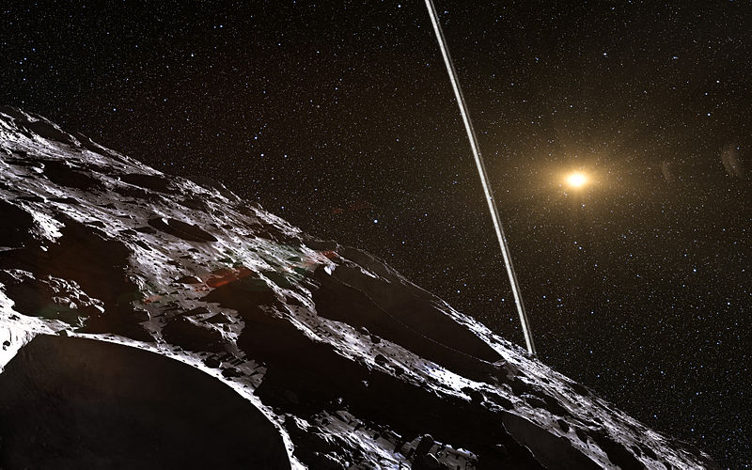
A ring system detected around the Centaur (10199) Chariklo
Emma Dahl
Seminar Spring 2017

Slide 2
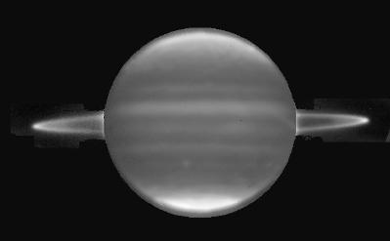
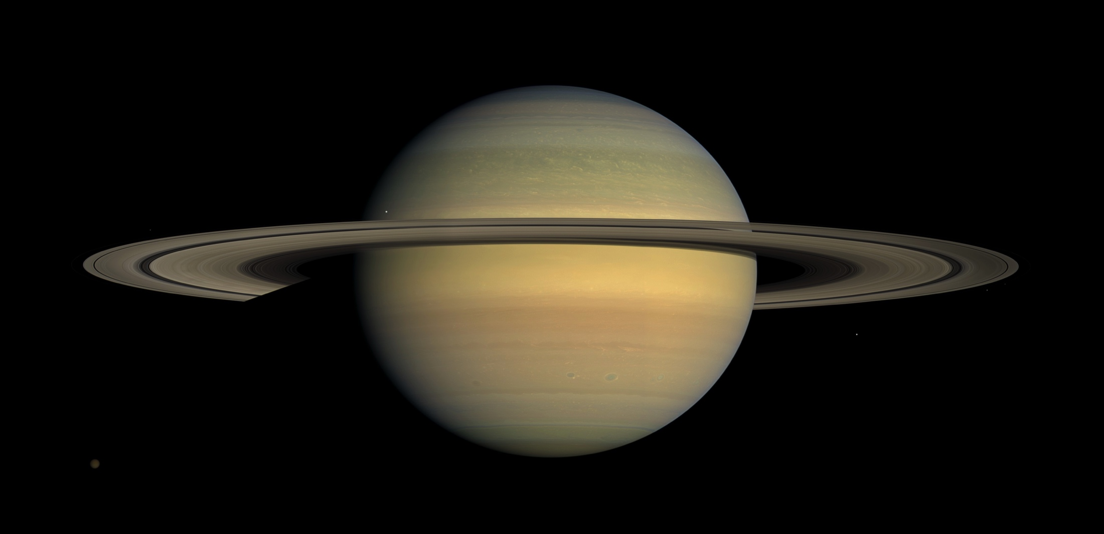
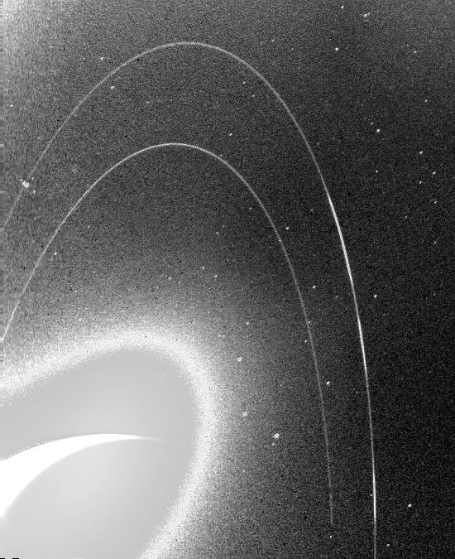
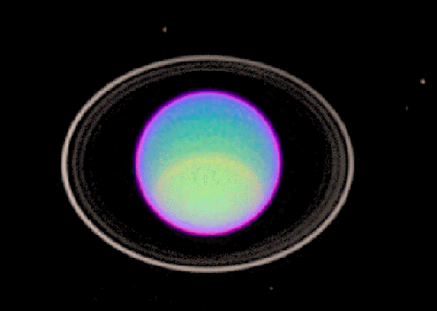
Mike Brown, Caltech
Erich Karkoschka, University of Arizona
Notes:
Ring systems in our Solar System
Jupiter rings at 2 microns (reflected sunlight). Image heavily enhanced.

Slide 3
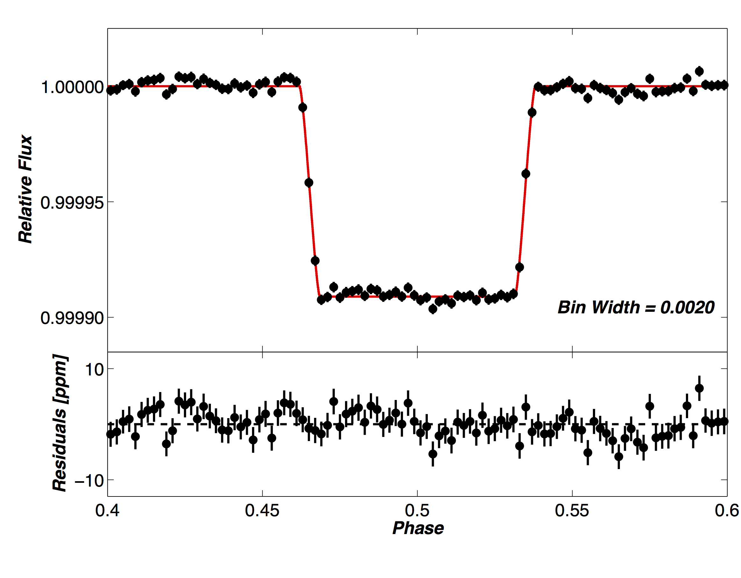
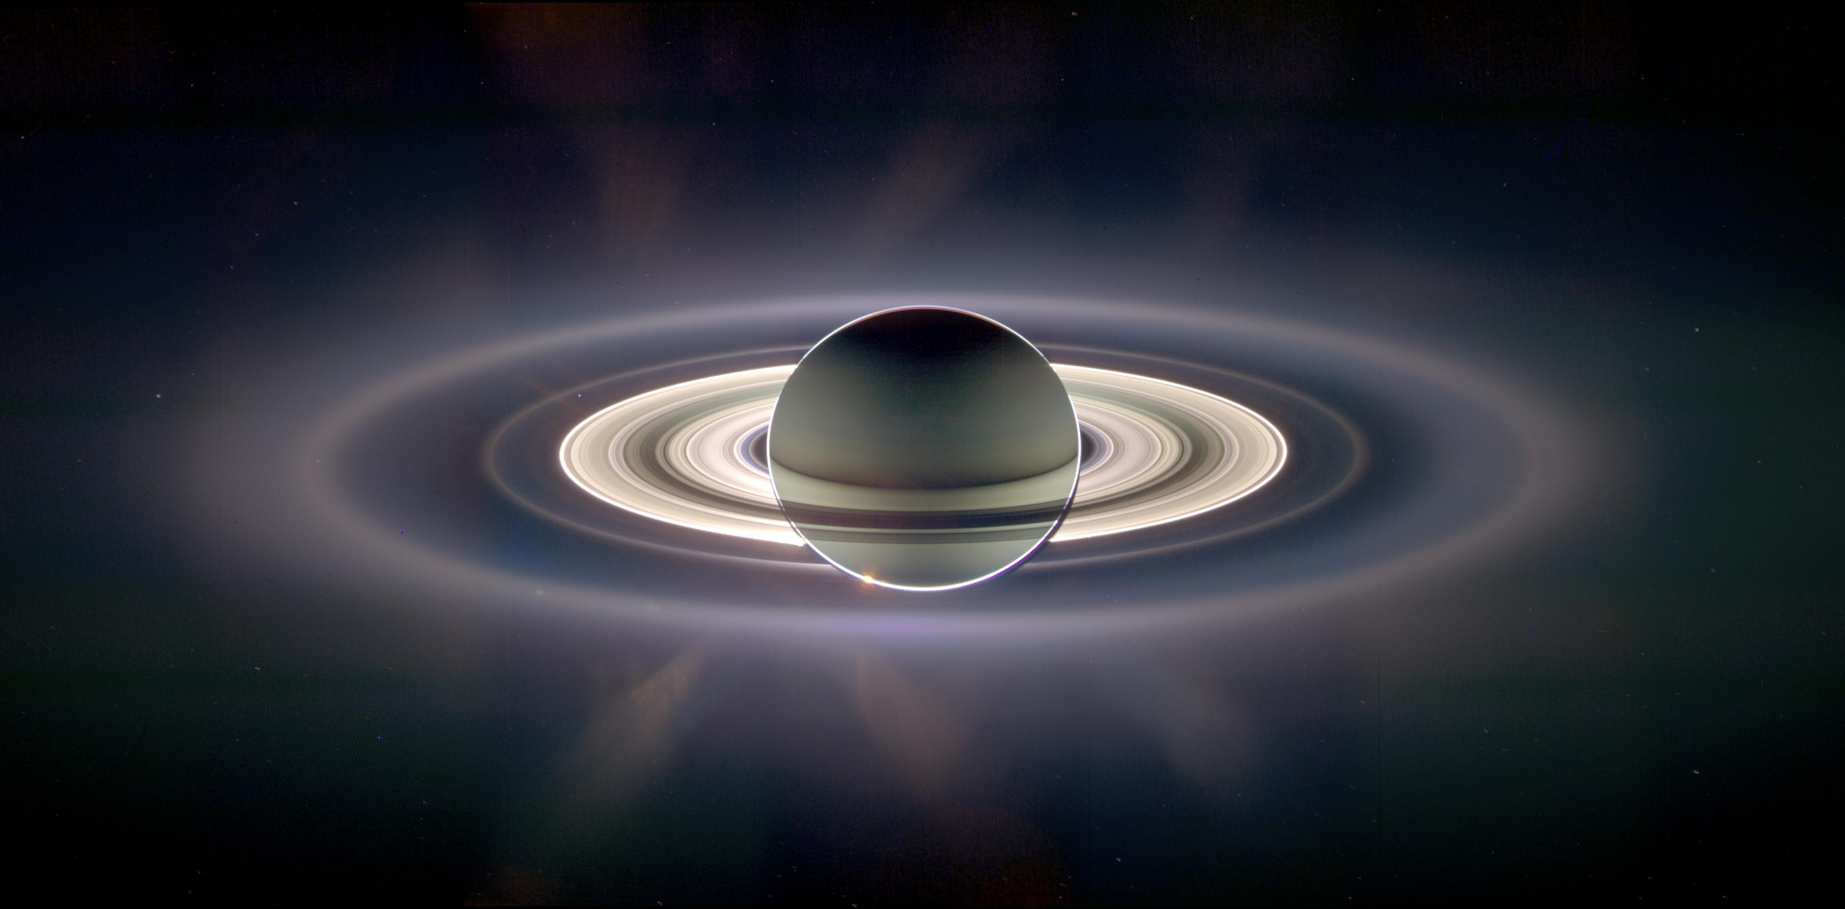
Detection methods
IR imaging
Occultations
Imaging from different
viewing geometries

Slide 4
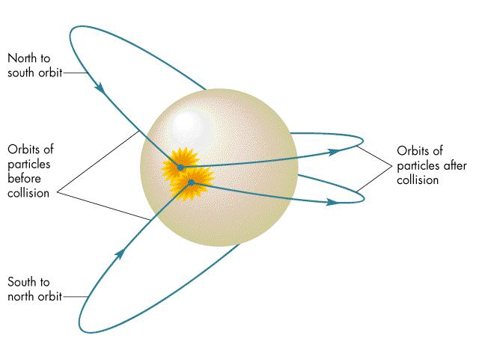
Ring Formation
Particles collide randomly, dissipate energy but conserve angular momentum
Particles even-
tually settle into
lowest energy
state (a disc)
University of North Carolina

Slide 5
What do rings tell us?
Test bed for planetary system dynamics

Slide 6
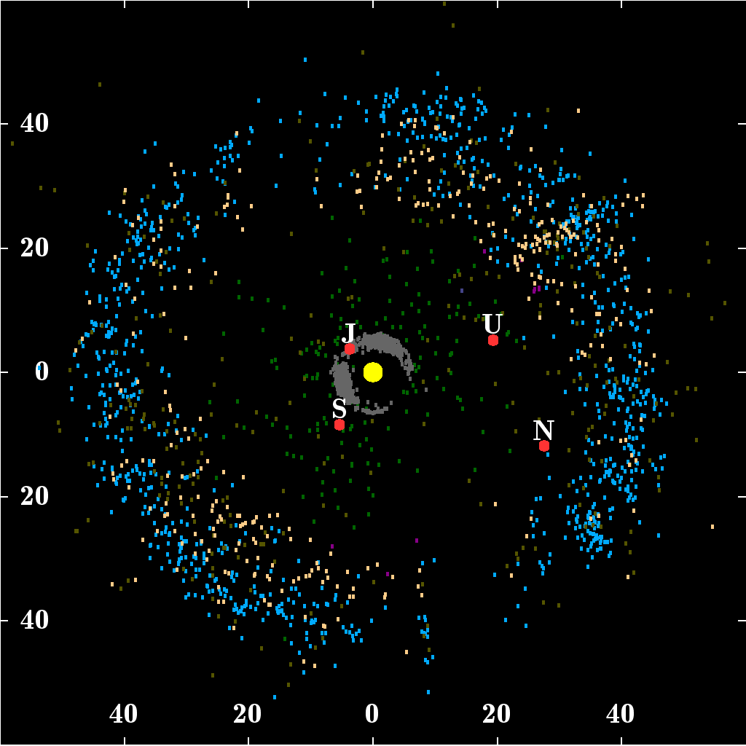
Centaurs
Notes:
FYI.
The green dots in that picture
Minor planets with semimajor axes between those of the giant planets. Possess qualities of both asteroids and comets

Slide 7
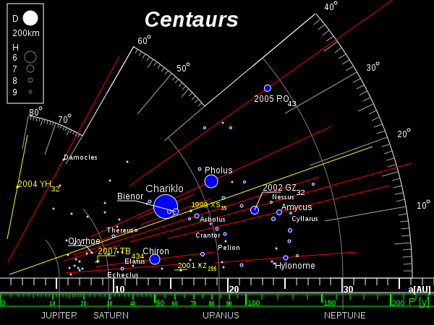
Notes:
Note Chariklo, the biggest known centaur

Slide 8
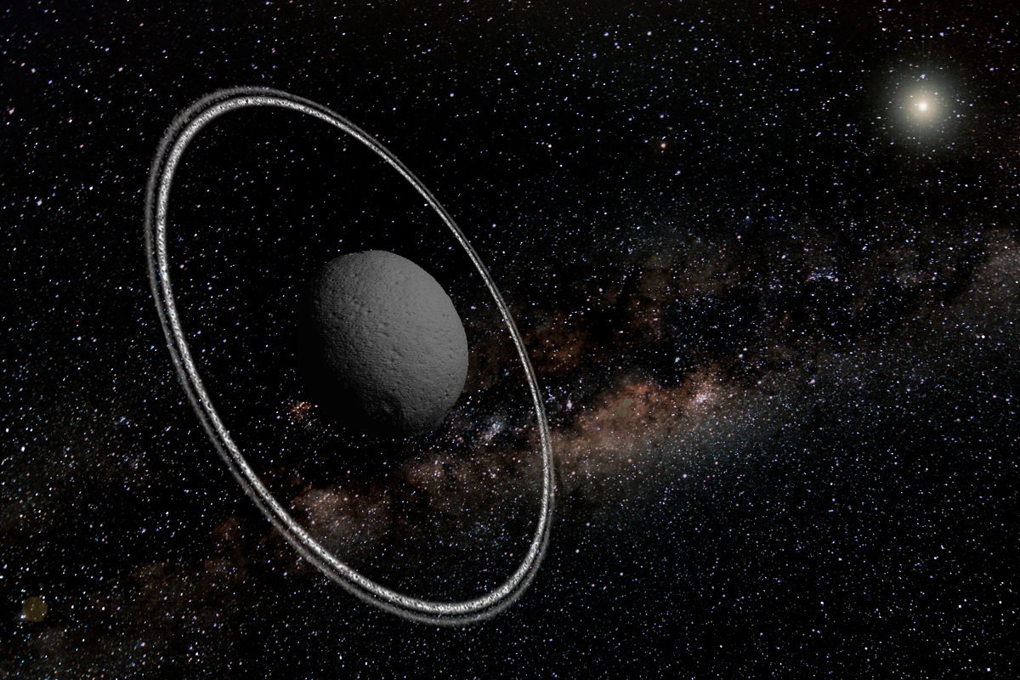
Notes:
Chariklo:
Radius of ~124 km, semimajor axis ~ 15.8 AU
Could have been a TNO that got pulled out of that orbit by Uranus.
Geometric albedo of 0.035 (It’s really dark).

Slide 9
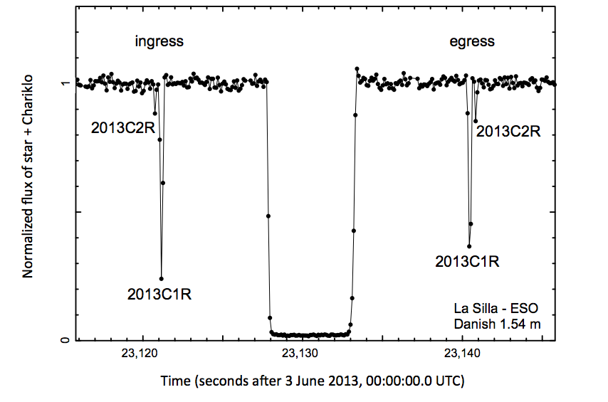
Notes:
Occulation happened over South America. Recorded by lots of telescopes, and a lot of them saw little events that indicated rings.
Secondary events could have been cometary jets or some kind of outgassing, but since they were all so consistent it makes that very unlikely.

Slide 10
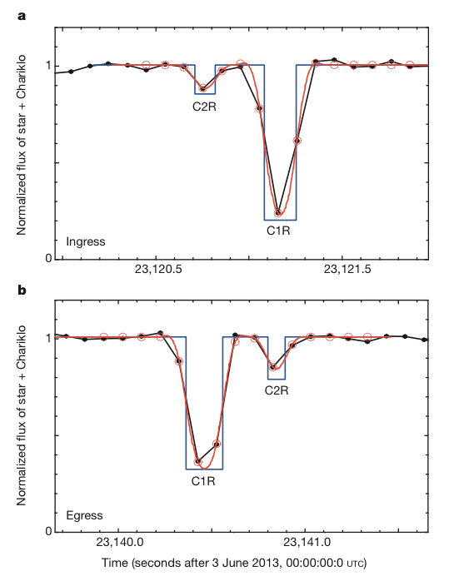
Notes:
Zoom-in of ring secondary events

Slide 11
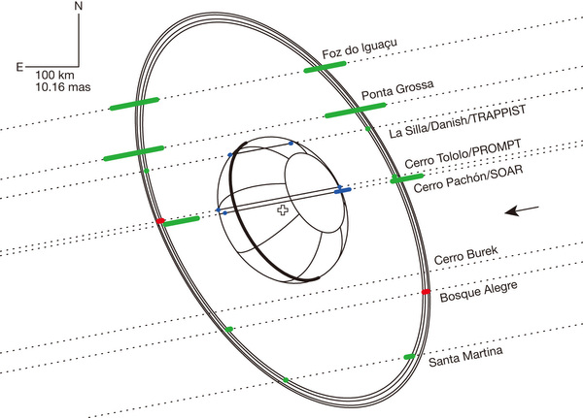
Notes:
All the secondary events can be explained by two narrow and azimuthally homogenous rings

Slide 12
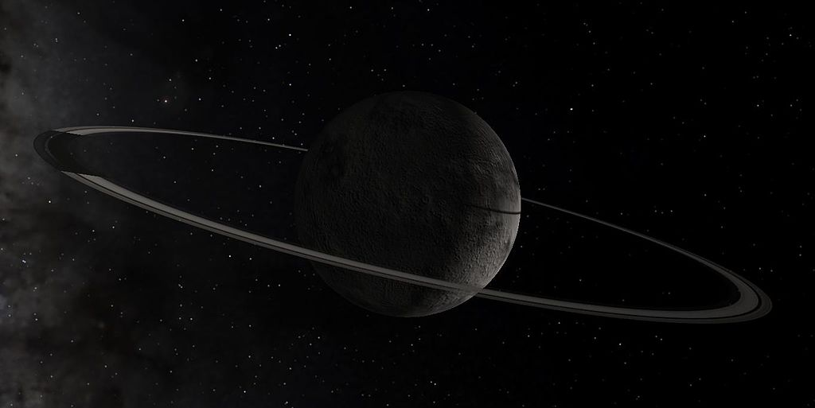
Chiron
Notes:
Since this paper came out: Another Centaur with rings, maybe. But not as confident as Chariklo. If it does, it says that Centaurs are actually a pretty active group of objects.

Slide 13
Take-away Points
Rings are a great testbed for a planetary system. They tell us how active the parent body is, what’s happened to it recently or long ago.
Chariklo is one of 5 (maybe 6?) known objects with a ring system
Implications for

