Slide 1
Gravity
The Real Reason You’re Heavy!

Slide 2
Recap
Midterm 11/1
Canvas homework delayed until FRIDAY this week
Lab this week: Kepler’s laws and orbits
Motion and gravity
Newton’s laws of motion
Forces in nature: Gravity, Electromagnetic, Strong, weak
Gravity
Attractive force
Depends on masses of objects AND distance between them
Force = G M m / d²

Slide 3
Gravity: example
Gravity is what pulls us down to the ground!
Even after we hit the ground, gravity keeps pulling us down: the ground pushes back with a different kind of force
This pull of gravity is the source of our weight. Weight is a measure of how strong gravity pulls us
Weight is different from, although related to, the quantity mass, which is a measure of how much stuff is in an object
Weight is what would be measured by a spring scale
Mass is what would be compared by a balance scale
Since weight is just the force of gravity exerted by the Earth, what does our weight depend on?
F = G M m / d²
Our weight (F) depends on our mass (m), the mass of Earth, (M) and the distance between us and the center of Earth (d)

Slide 4
Would you weigh the same amount if you carried a scale to the top of Mt. Everest and weighed yourself?
I would weigh a lot more
I would weigh a little more
I would weigh exactly the same
I would weigh a little less
I would weigh a lot less

Slide 5
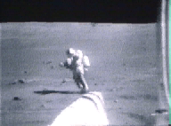
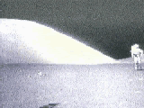
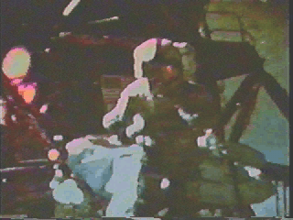
Weight on other planets
By experimentation: the Moon
http://www.theguardian.com/science/video/2009/jul/02/apollo-11-buzz-aldrin

Slide 6
Your weight on another planet depends on:
The atmosphere of the planet
The distance the planet is from the Sun
The mass of the planet
The mass AND size of the planet
The size of the planet

Slide 7
Weight on other planets
Since weight is a measure of how strong gravity is pulling us, it can change if we were to go to another planet
Force = G M m / d²
Our mass, m, doesn’t change when we go somewhere else (it measures how much stuff is in us), but the mass of the planet, M, and the distance between us and the center of the planet, d, will be different if we go to another planet!
Note that BOTH the mass AND the size of the other planet matter, because gravity depends on both the mass of the pulling object AND how far you are from the center of it

Slide 8
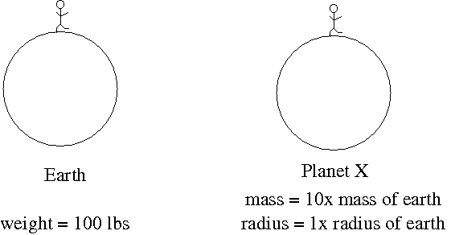
Imagine another planet, planet X, that has 10 times the mass of Earth, but the same size as Earth. If a 100 lb (on Earth) person went to visit, how much would they weigh?
force = G M m / d²
10 lbs
100 lbs
1000 lbs
10000 lbs
Can’t tell from information given

Slide 9
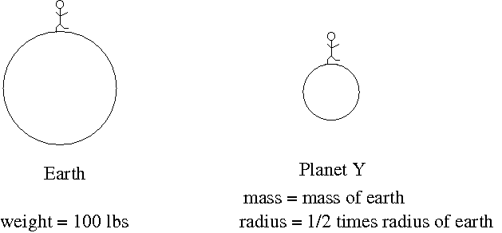
Imagine another planet, planet Y, that has the same mass as Earth, but has half the radius. If a 100 lb person went to visit, how much would they weigh?
force = G M m / d²
25 lbs
100 lbs
200 lbs
400 lbs
Can’t tell from information given

Slide 10
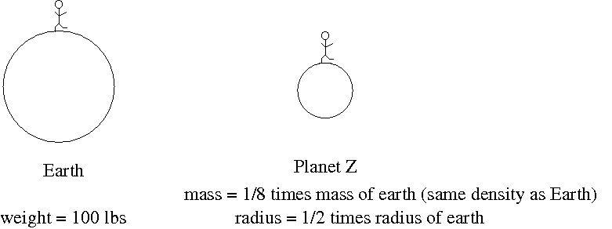
Imagine another planet, planet Z, that has 1/8th the mass of the Earth and has half the radius. If a 100 lb person went to visit, how much would they weigh?
force = G M m / d²
12.5 lbs
50 lbs
100 lbs
400 lbs
Can’t tell from information given

Slide 11
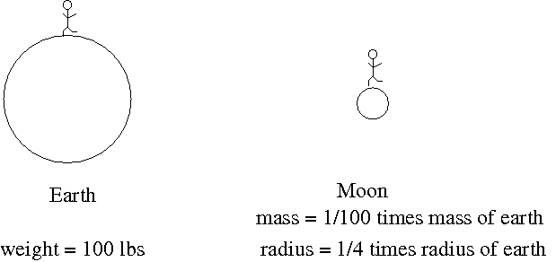
The Moon has about 1/100th the mass of Earth and about 1/4 the radius. If a 100 lb person went to visit, how much would they weigh?
force = G M m / d²
1 lbs
4 lbs
16 lbs
1600 lbs
Can’t tell from information given

Slide 12
Mars has about 1/10th the mass of Earth and about 1/2 the radius. If a 100 lb person went to visit, how much would they weigh?
force = G M m / d²
10 lbs
40 lbs
100 lbs
400 lbs
Can’t tell from information give

Slide 13
Imagine another planet, planet X, around some other star. Planet X has a mass that is 100 times the mass of Earth. If a 100lb person went to visit, how much would they weigh?
force = G M m / d²
10 lbs
10000 lbs
Can’t tell because we don’t know mass of the star
Can’t tell because we don’t know mass of the planet
Can’t tell because we don’t know the size of the planet

Slide 14
Weight on other planets
Other planets, weight calculator:
http://btc.montana.edu/ceres/html/Weight/weight.html

Slide 15
Gravity and orbits of planets in the Solar System
Sun has by far the most mass of all Solar System objects
When you consider the strength of gravity, the Sun dominates all other objects: pulls of one planet on another are almost negligible compared to the pull of the Sun

Slide 16
Orbits
If gravity is an attractive force between objects, how come the Earth and the other planets aren’t pulled into the Sun?
The key is Newton’s first law, the law of inertia, and the recognition that when objects are formed, they are not always formed standing still!

Slide 17
Orbits
What happens if an object has some initial velocity?
The law of inertia says an object will continue at the same velocity unless a force acts on it
Key issue is whether an object has sideways, or transverse, velocity, relative to the object that is pulling it
Consider some possibilities

Slide 18
Orbit simulator
See orbit simulator by PhET Interactive Solutions, University of Colorado
http://phet.colorado.edu/sims/my-solar-system/my-solar-system_en.html

Slide 19
Newton’s laws and Kepler’s laws
The mathematics of Newton’s laws can be used to quantitatively determine what motion will take place for an object with transverse velocity
When this is done, one finds that Newton’s laws GIVE Kepler’s laws:
Orbits are elliptical
Objects move faster in their elliptical orbits when they are closer to the Sun
Objects in larger orbits move slower and take longer to go around
Without any other forces, orbits are such that objects return back to where they started, with the same velocity they started it, so it just keeps going!
Good way to think about orbits: gravity causes objects to fall, but with sideways velocity, they fall around each other rather than towards each other!

Slide 20
Sideways motion of planets
Key to orbits is sideways motion
How did the planets get the sideways motion they need to keep them orbiting the Sun rather than falling into it?
Key is in understanding of how Solar System formed

Slide 21
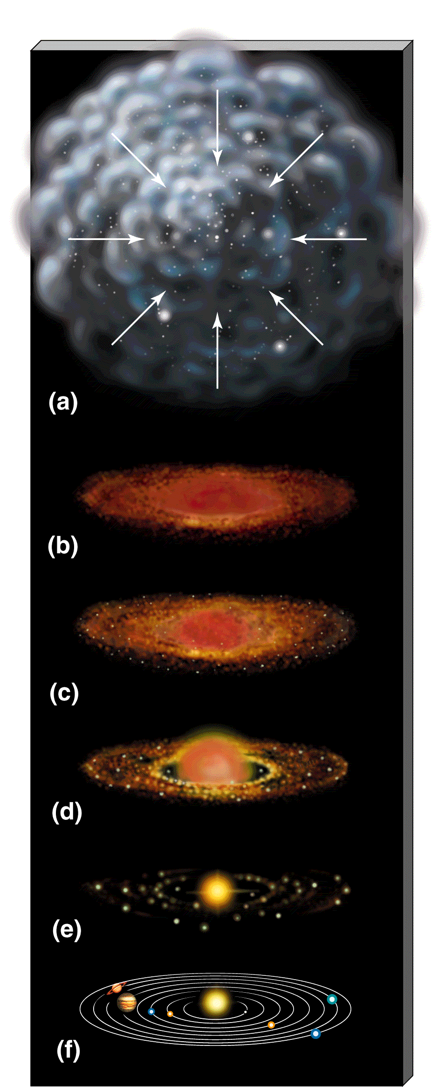
Model of Solar System Formation
Stars and planetary systems form from large, diffuse, interstellar gas clouds
Under certain conditions, these start to contract because of gravity
As objects contract (get smaller), any small amount of spin they might have can get greatly amplified
Conservation of angular momentum: mass times speed times distance from center stays the same
Another consequence is that collapsing cloud will flatten
If there’s lots of stuff, objects on non-circular orbits collide, and orbits get circularized
Result: things end up spinning in circular orbits!
Planets form out of material in spinning disk… in roughly circular orbits!

Slide 22
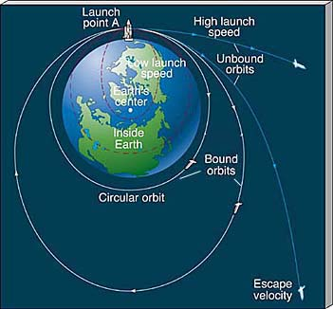
Putting objects into Earth orbit
The same principle is used to put objects in orbit around Earth
To put an object in orbit, just give it some sideways velocity!
Don’t need to keep running engines, just give it a sideways start and let the Earth do the rest of the pulling!
Do need to get above the Earth’s atmosphere so that friction isn’t a big effect

Slide 23
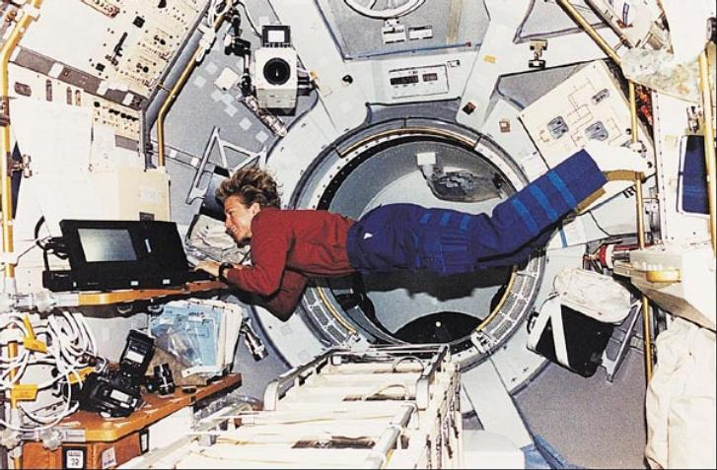
The shuttle orbits about 220 miles above the surface of the Earth. The Earth's radius is about 4000 miles. Given that the force of gravity between two objects (here, the Earth and the shuttle) is given by
force = G M_{earth} m_{shuttle} / d_{Earthcenter-to-shuttle}²
the force of gravity on the shuttle in orbit is
A. much greater than the force of gravity on the surface of the Earth
B. much less than the force of gravity on the surface of the Earth
C. only slightly less than the force of gravity on the surface of the Earth
D. can't tell from information given

Slide 24
Weightlessness and free fall
What is going on? The astronauts clearly experience the force of gravity, why do they appear to be weightless?
Key point is that they are in freefall, they are constantly falling, but because of their sideways motion, are falling around the Earth instead of falling towards it

